Slide 1





Quantum Simulation of
Frustrated Magnets
Ming-Shien Chang
Institute of Atomic and Molecular Sciences
Academia Sinica
www.iams.sinica.edu.tw

Slide 2


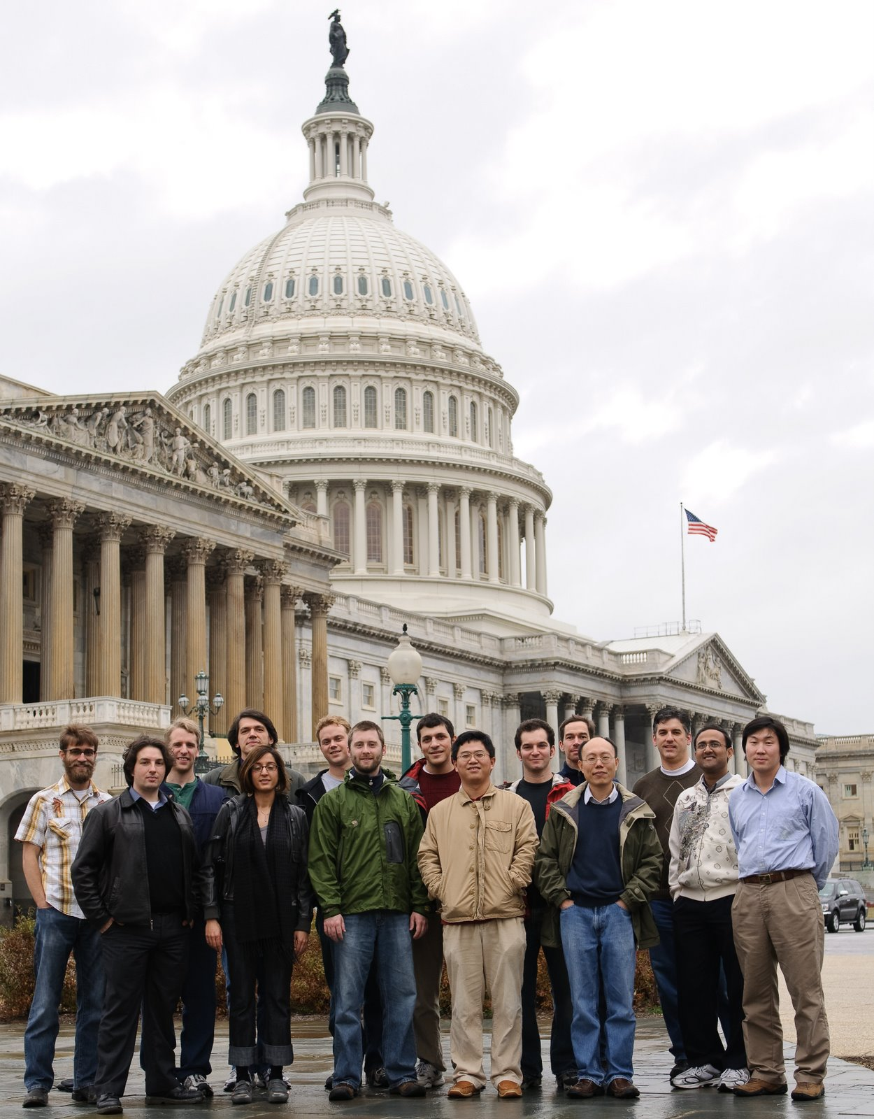





www.iontrap.umd.edu
Grad Students
Steven Olmschenk
Jon Sterk
Simcha Korenblit
Dave Hayes
Rajibul Islam
Andrew Manning
Jonathan Mizrahi
Dave Hucul
Crystal Senko
Res. Scientist
Peter Maunz
Postdocs
Ming-Shien Chang
Dzmitry Matsukevich
Kihwan Kim
Wes Campbell
Le Luo
Qudsia Quraishi
Emily Edwards
Undergrads
Andrew Chew
Brian Fields
Kenny Lee
pfc@jqi
Notes:
1

Slide 3
Recruiting now
Postdoctoral Fellows
PhD students
Master/Undergrad students
msc@gate.sinica.edu.tw

Slide 4
Outline
Motivation
  Preliminary, terminology, and intro to QS
  Why simulating quantum magnets
Trapped ion QS
  Coupling ions with transverse normal modes
  Tailoring spin-spin couplings for QS
Quantum simulation of a small spin network
  Phases diagram
  Magnetic frustration
Outlook
  Proposed scheme to scale to > 30 ions

Slide 5
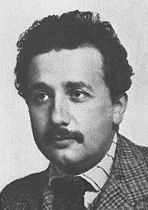
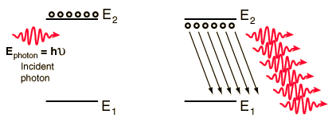
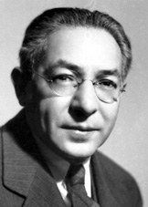
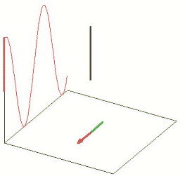
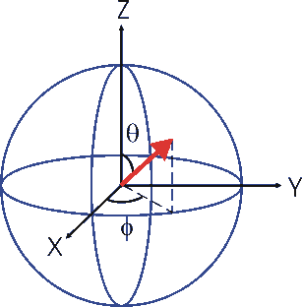
Brief review of two-level systems I
Physicists like two-level systems
Einstein: predicted stimulated emission which led to the invention of laser (population control)
A. Einstein
Rabi oscillation: coherent control of two-level atom
(state control, coherent control)
I. Rabi
Bloch vector picture

Slide 6
Brief review of two-level systems II
Physicists also like to approximate a three-level system to a two-level system.
E.g. Raman transition in a three-level atom (two-photon transition)
P_{1/2}
Spontaneous emission rate
due to off-resonance excitation
λ ~ 370 nm
|↑⟩
S_{1/2}
We want
ν =12.6 GHz
|↓⟩

Slide 7
Qubit/spin: building block for QC/QS
Qubit: a quantum two-level system, e.g., a spin-1/2 particle.
We mix-use the terms above.

Slide 8
What is special about qubits?
“superposition”
“entangled superposition”
qubit: a|0⟩ + b|1⟩
Two qubits: a|00⟩ + b|11⟩
or
or
measurement
This is only an analogue, not the real physics.
correlation
Fred Alan Wolf, “Taking the Quantum Leap.”

Slide 9
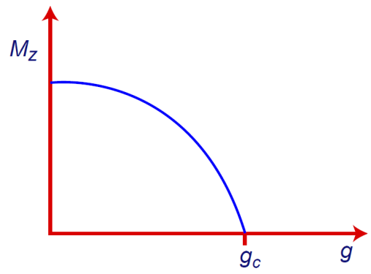
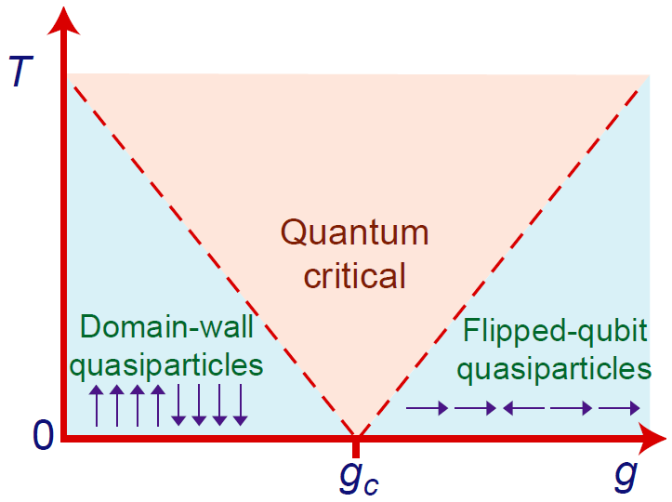
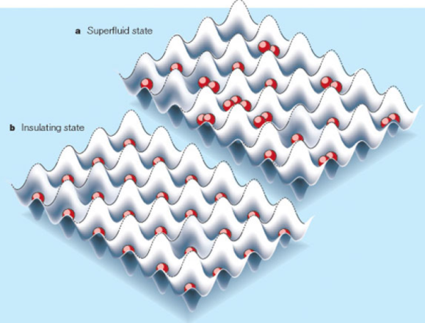
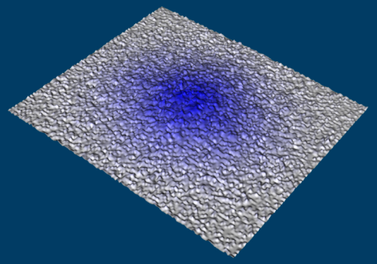
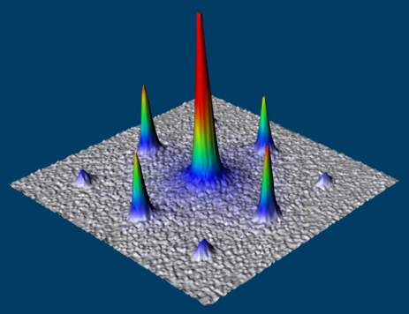

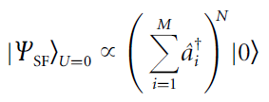
Quantum Phase Transition
Smooth variations in the non-thermal parameters, like pressure or magnetic field in the Hamiltonian result in sharp boundaries between different phases near T=0.
Uncertainty principle prevents atoms from staying statically at lattice sites at T=0.
Competition between non-commutable operators can lead to different quantum phases.
Quantum fluctuation induces transitions between quantum phases.
M. Greiner et al., Nature 415, 39 (2002)
S. Sachdev, Quantum Phase Transition (1999)

Slide 10
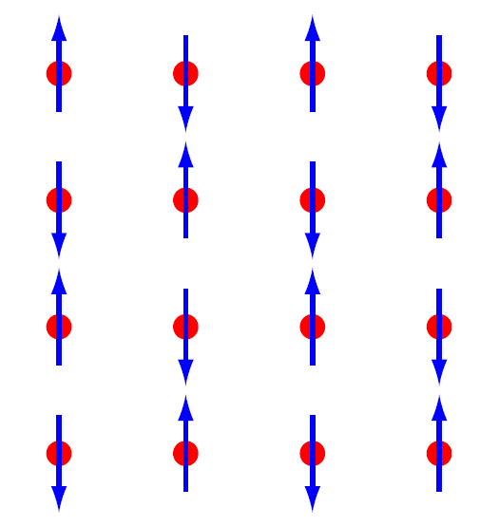
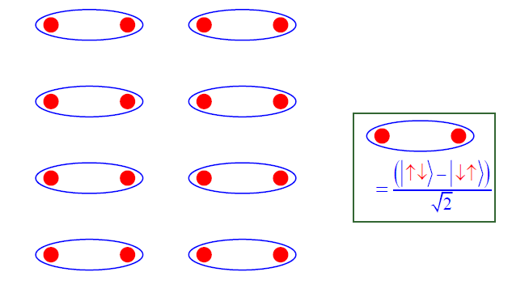
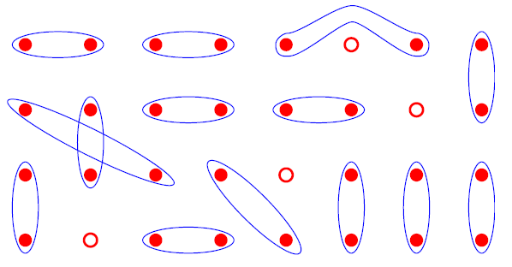
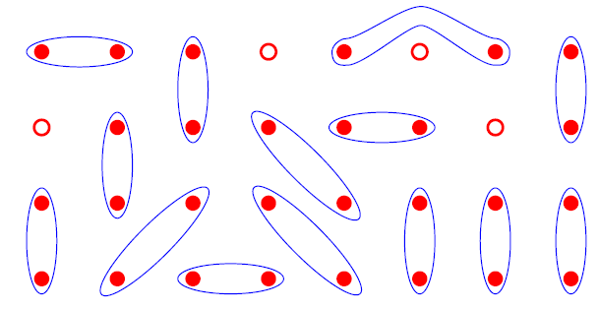
Anti-ferromagnets: ordered or disorder?
or
Allows max fluctuations and stable lowest energy state
Mechanism responsible for Hi-T_{c} Superconductivity?
Quantum Phase Transition, Subir Sachdev (2004)

Slide 11
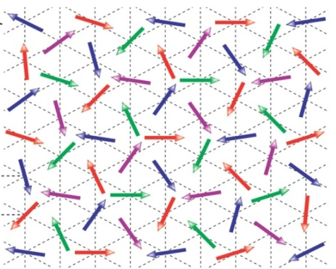
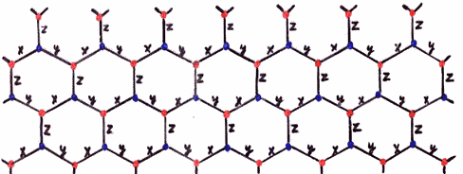
Exotic magnetic material
Magnetic Frustration – competing (antiferromagnetic) interactions that result in highly degenerate ground states with large degrees of entanglement.
Spin Liquids – a spin system with anti-ferromagnetic coupling, which has no long-range order, even at very low temperatures
Topological Order – where particle exchange can result in “anyonic” statistics that may have applications in fault-tolerant quantum computing.
AF
AF
?
AF
“Kitaev Lattice”

Slide 12
Generalized system
Modeling quantum magnets
Ising spins in transverse B field:
XY model:
XXZ model :
(~ Bose-Hubbard under Holstein-Primakoff transformation)
Possible Observations
Quantum phase transition
Spin frustration
Complex entangled states
Provided tunable spin-spin interactions:
Strength,
Sign (ferro or anti-ferro),
Range,
Coupling graph (geometry).
Detection- State tomography, Parity measurement
The detection efficiency is 95%, can be almost 100%, in principle.

Slide 13

Solving a complex quantum system is difficult
where
1 spin
2 spins
30 spins
a problem-specific quantum simulator or a universal quantum computer.

Slide 14
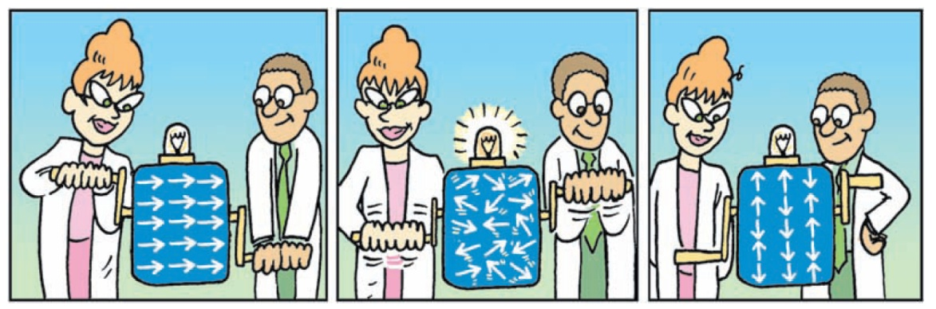
Quantum simulator ~ problem specific quantum computer
Ising spins – two-level atoms
Initialization -
Processing -
Answer – state conforms to
Illustration from Lloyd, Science v.319, 1209 (08)
Theory: D. Porras & J. I. Cirac, PRL 92, 207901(2004).
Two ion simulator: Friedenauer et al., Nature Physics, 4, 757 (2008).

Slide 15
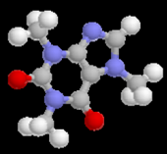
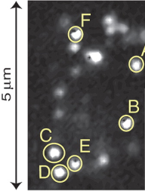
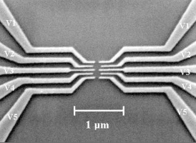
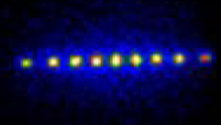
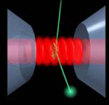
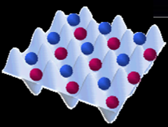
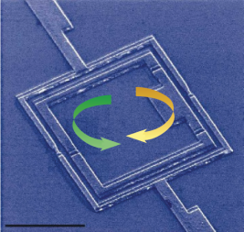
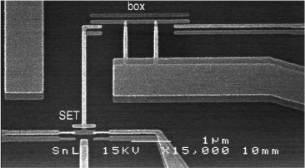
physical implementations of a QC/QS
coherent
Nuclear spin in QD
Diamond NVC
Trapped ions
Atoms in OL
Cavity QED
molecule NMR
scalable
controllable
measurable
Cooper pair box
SQUID
Notes:
Cooper pair box: charge qubit (Schoelkof group at Yale)
SQUID qubit: flux qubit (Mooij's group at Delft, Neiderland)
QD (Imamoglu, A. Chang, D. Steel, etc.)
NVC (Wrachtrup, Lukin, etc.)

Slide 16
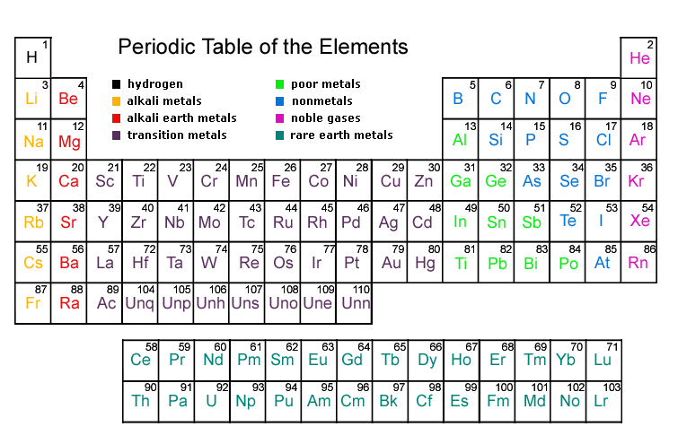
Which ion to trap?

Slide 17
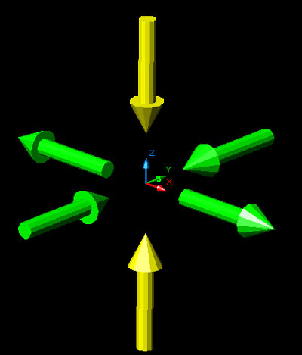
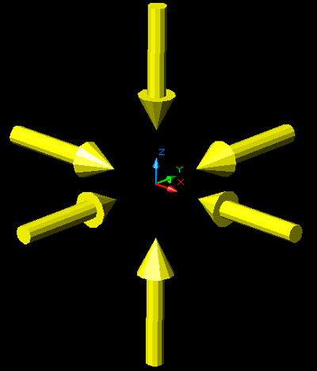
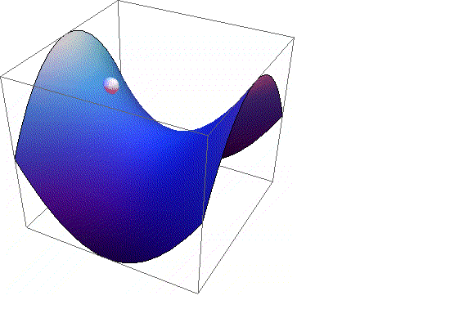
How to trap an ion?
Electric Field Vectors

Slide 18

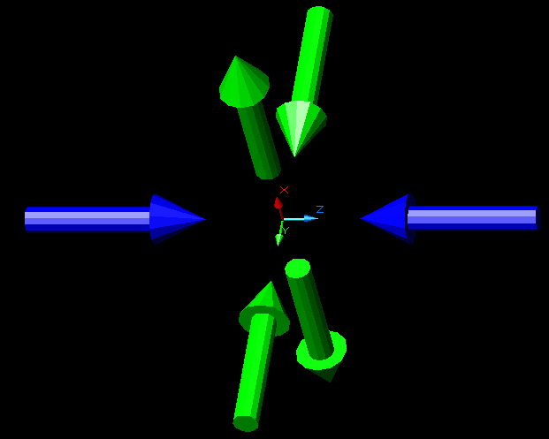
Linear Paul Trap
photo ionization lasers
cooling lasers
atomic beam
rf
ground
static

Slide 19
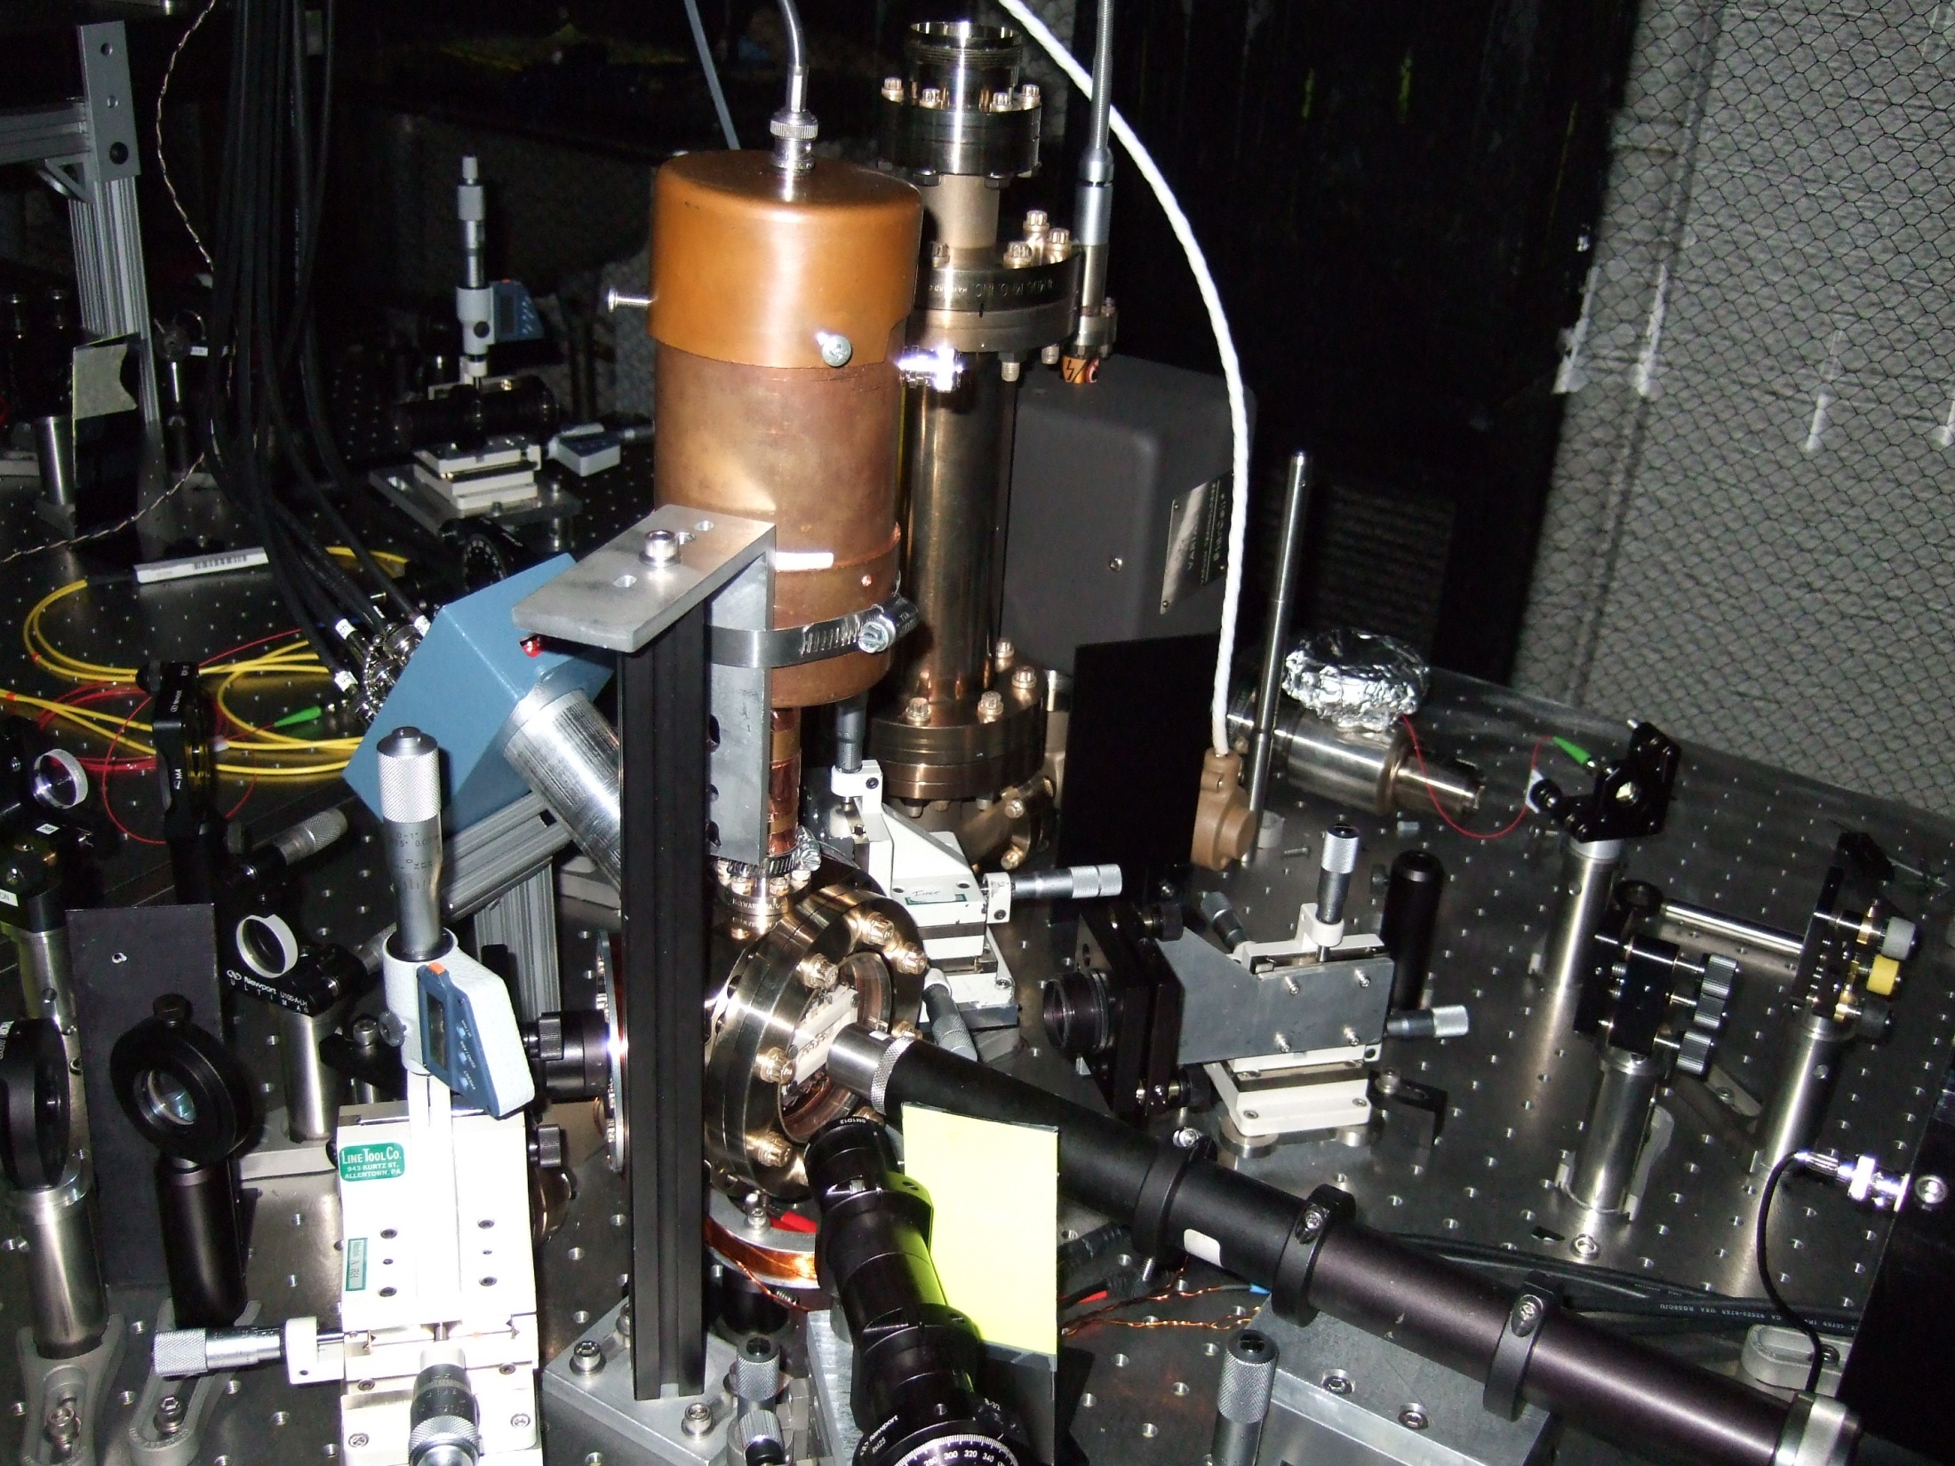
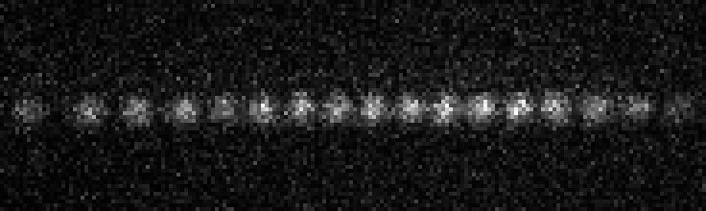
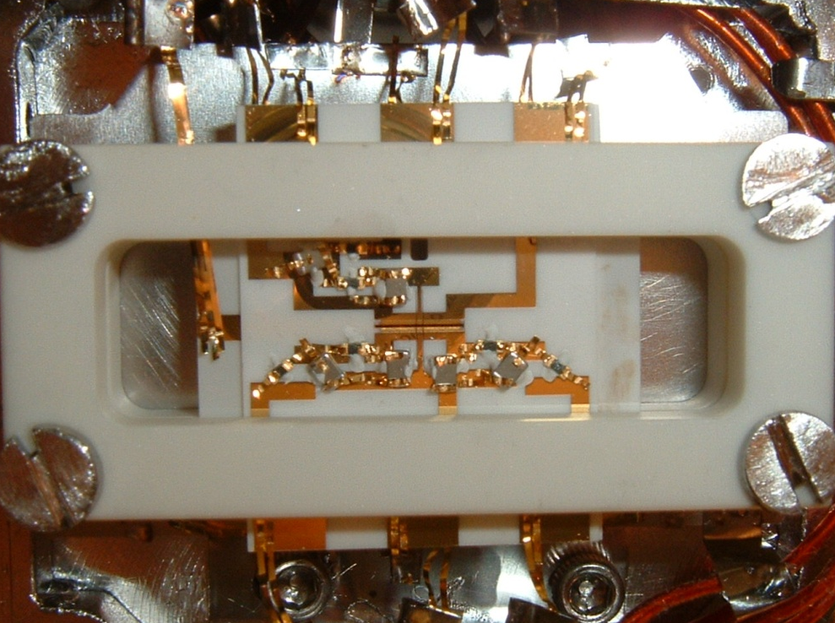
Trapped Ion QC / QS
²S_{1/2}
λ=370 nm
¹⁷¹Yb⁺
F=1
F=0
2 μm
12.64 GHz
•
•
•
2
1
ω ~ few MHz
0

Slide 20
Some Atomic Physics - State Detection
²P_{1/2}
²S_{1/2}
12.6 GHz
State detection fidelity ~ 97%
Notes:
19

Slide 21
Spin (qubit) Initialization
²P_{1/2}
²S_{1/2}
Notes:
20

Slide 22
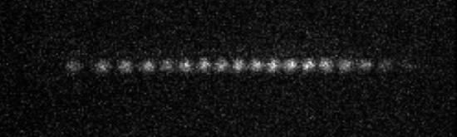
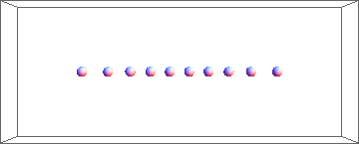
Motional normal modes
Axial Modes
Transverse Modes
y
N ions: 3N normal modes
-z
Amplitude ~ 5 nm @ 1 MHz
x
0
5
10
e.g.
Center of Mass
Stretch
Complicated
Longitudinal
Center of Mass
Tilt
Zig zag
Transverse
Zhu, Monroe, and Duan, PRL 97, 050505 (2006).

Slide 23
Coupling Spin to Motion
P_{1/2}
Δk
•
•
•
Transition rate
S_{1/2}
|↑⟩
2
1
•
•
•
0
ν =12.6 GHz
2
|↓⟩
1
ω ~ few MHz
0
carrier
Requires
blue sideband
Lamb-Dicke Parameter
red sideband
Notes:
2Delta , delete the formula

Slide 24
Ion normal mode spectrum
Δk
Two ion, transverse modes
Red Motional Sideband
CM x, CM y, Tilt x, Tilt y
Blue Motional Sideband
Tilt y, Tilt x, CM y, CM x
Carrier
2.0
1.5
Brightness
1.0
0.5
0.0
-5
-3
-1
1
3
5
Motional detuning (MHz)

Slide 25
excitation on 1st lower (“red”) motional sideband (n=0)
•
•
•
•
•
•
|↑⟩
2
2
1
|↑⟩
1
0
0
S_{1/2}
•
•
•
S_{1/2}
•
•
•
|↓⟩
2
2
1
|↓⟩
1
0
0
State mapping: (α|↓⟩ + β|↑⟩) |0⟩_{m}
→ |↓⟩ (α|0⟩_{m} + β|1⟩_{m})
Cirac and Zoller, Phys. Rev. Lett. 74, 4091 (1995)
Notes:
Hard to cool down to the ground state of motions
Applications: quantum logic spectroscopy

Slide 26
Molmer-Sorensen ( σ_{x} σ_{x}) Gate with Two Ions
Δk
|↑↑⟩
n
n+1
|↓↑⟩
n
|↑↓⟩
n-1
+
n
|↓↓⟩
Independent of n, requires harmonic
Molmer & Sorensen, PRL 82, 1971 (1999) & PRL 82, 1835 (1999)
Molmer-Sorensen PRL 82,1835, (1999)
Sackett, et. al. Nature 404, 256 (2000)
P. C. Haljan et al. PRA 72 (2005)
P. J. Lee et al. J. Opt. B 7 S371 (2005)

Slide 27
Entangling Ions via Spin-Dependent Force
Spin-dependent forces: e.g., |↑⟩ move up, and |↓⟩ move down.
Entangled state!
Magnus expansion

Slide 28
Molmer-Sorensen coupling with two modes
Single-mode coupling
Δk_{b} +Δk_{r}
Multi-mode coupling
Δk_{b}+ Δk_{r}
e.g.

Slide 29
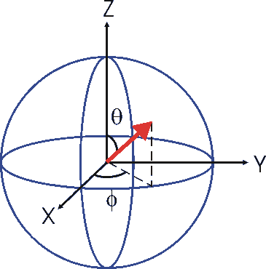
Simulating a B field (single qubit rotation)
Rabi oscillations
Ramsey oscillations
P(↑)
π/2
π/2
Coherence time > 70 ms
τ (ms)

Slide 30
Simulating spin-spin interactions (J_{ij})
Axial Modes
Transverse Modes
Δk
0
5
10

Slide 31
Spin frustration in triangular lattice
2
Frustration
Frustration
1
0
J (kHz)
J
12
-1
J
13
-2
-2.4
-1
0
Detuning
μ_{s}
=
(
μ²−ω²
)
/
ω²
com
z

Slide 32
ground states vs. spin-spin couplings
2
Frustration
Frustration
1
0
J (kHz)
J
12
-1
J
13
-2
-2.4
-1
0
Detuning
μ_{s}
=
(
μ²−ω²
)
/
ω²
com
z

Slide 33
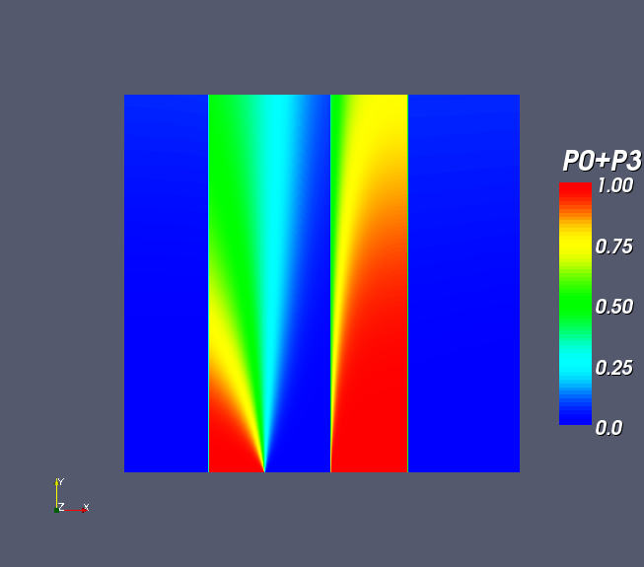
Exact Ground State (Theory) – Freericks and Duan
P(Ferro)=
P(↓↓↓)+P(↑↑↑)
ZIGZAG
TILT
COM
2
1.0
0.8
B/J_{rms}
0.6
0.4
0.2
0
0.0
-2.4
-1
0

Slide 34
Quantum simulation in action
R_{x}(π/2)
R_{y}(π/2)
Initialization
Cooling
Optical Pumping
Detection
t
: uncoupled ground state.

Slide 35
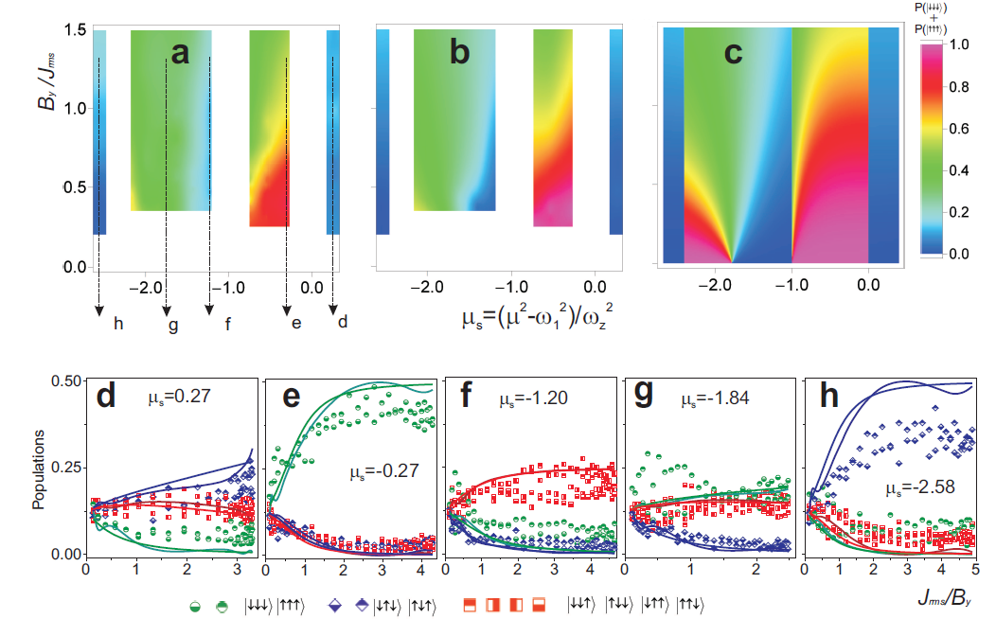
Phase diagram measurement
Measurement
Theory: given ramp
Theory: GS

Slide 36
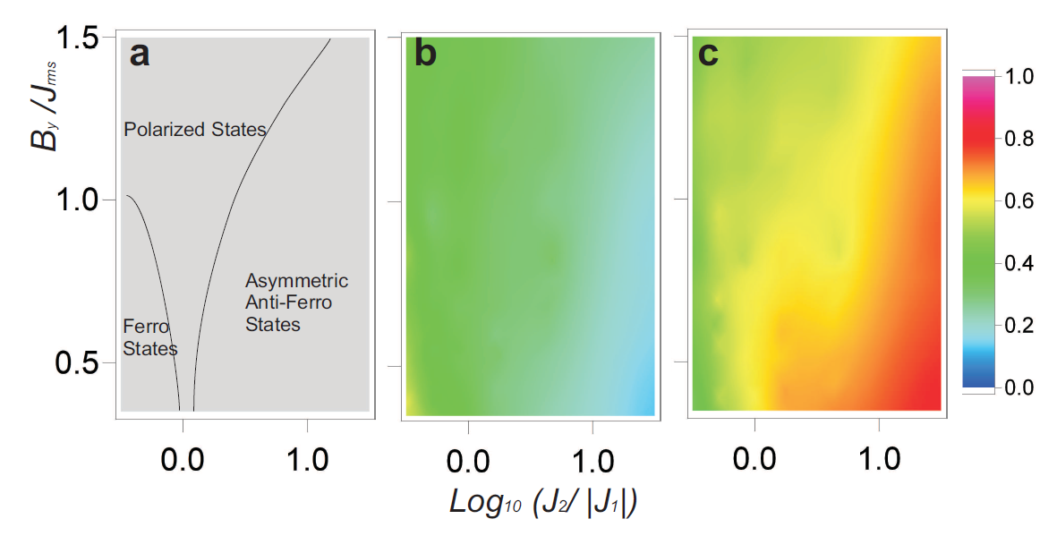
Universal phase diagram
FM
AFM

Slide 37

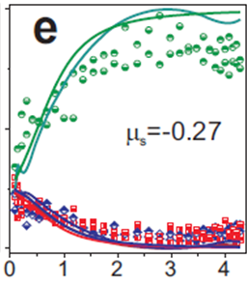

Ground state entanglement or entropy?
FM ground state:
or
This measurement only tells us the population.
Entanglement or entropy?
AFM frustrated ground state:
J>0
To answer this question, we can reconstruct the density matrix (8 x 8). However, it is a hard task to do.
?
Luckily there is a short cut…

Slide 38
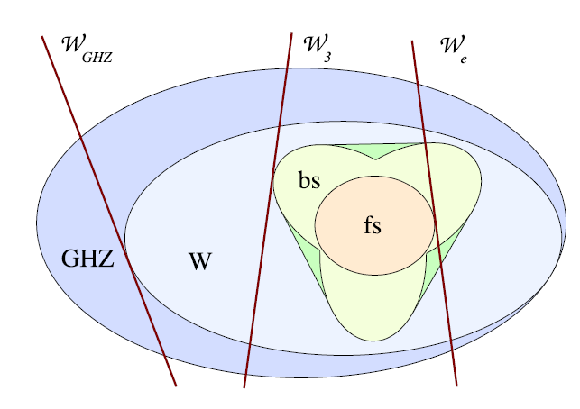
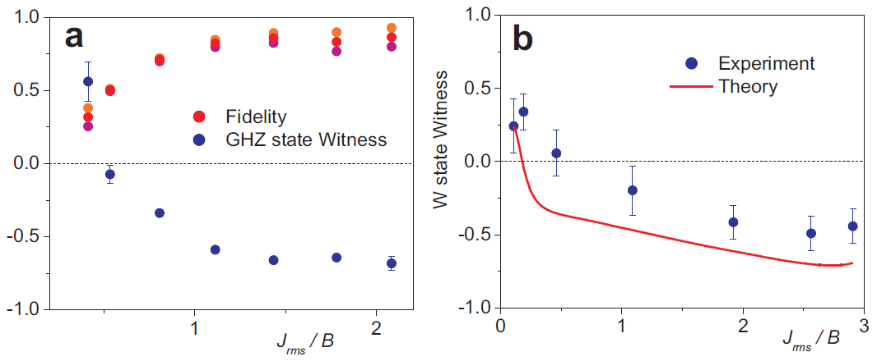
Detecting the frustrated ground state: entanglement detection
FM ground state:
(GHZ state)
AFM frustrated ground state:
(W state)
J>0
?
GHZ state Witness =
W state Witness =
O. Ghne and G. Toth, Phys Rep 474, 1 (2009).
Links frustration to ground state entanglement.
GHZ state witness

Slide 39

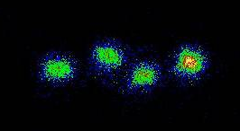
Scalability in a linear Paul trap
375 μm
375 μm
Condition to form linear crystal:
When the crystal is long, it is easy to form different crystal structure (zig-zag).
z
This baffles the scalability of trap-ion scheme.
40 μm

Slide 40
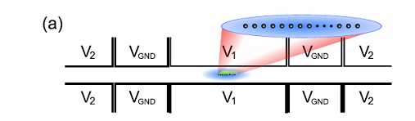
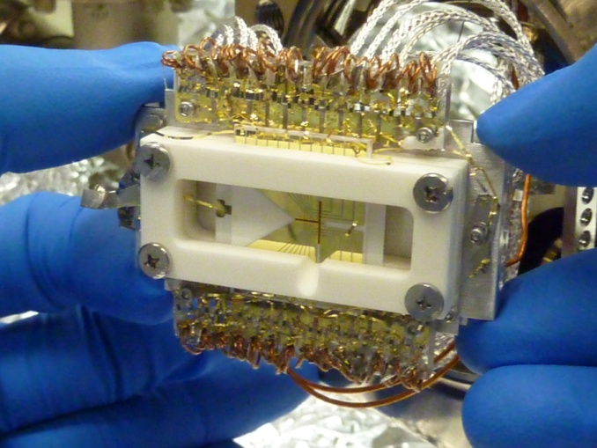
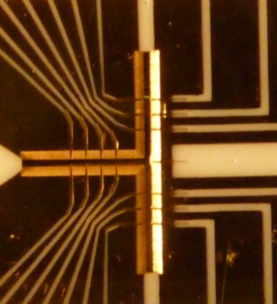
Scaling a single crystal to >> 10 ions
Uniformly-spaced ion crystal (spacing = s)
(quartic)
. . . . . . . . . . . . . .
2R
>0
0
>0
0
>0

Slide 41
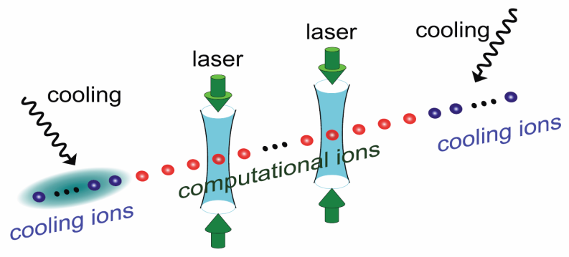
A quantum computer with 100 qubits
G.-D. Lin, et al., quant-ph/0901.0579 (2009)
G.-D. Lin et al., arXiv 0901.0579 (2009).

Slide 42
Summary
Trapped ion quantum simulator
  Coupling ions with transverse normal modes
  Engineer spin-spin interactions
Quantum simulator of a three-spin network
  Phase diagram
  Spin frustration
  Ground state entanglement
Outlook
  Scalable to larger number of spins
  XY or XXY model

