Slide 1
On Kerr Newman/CFTs Dualities
孫佳叡
Jia-Rui Sun
National Central University
National Center for Theoretical Sciences,
September 14, 2010
Based on arxiv:1006.4092 and 1006.4097, C.-M. Chen, Y.-M. Huang, JRS,
M.-F. Wu and S.-J. Zou

Slide 2
Outline:
*Introduction and motivation
*Kerr Newman/CFTs dualities
J-picture----Kerr/CFT duality
Q-picture----RN/CFT duality
*Conclusion and discussion

Slide 3
Introduction and motivation
The studying of quantum gravity (or microscopic) descriptions for black holes has a long story.
Black hole thermodynamics: Semi-classically (General Relativity+Quantum Field Theory), black hole can radiate—Hawking radiation, it is a thermodynamic system with temperature, energy, entropy and chemical potentials (1970s).
Thus it is natural to ask what is the underling microscopic or statistical description of the black hole/gravity—quantum (or microscopic structure of) gravity.
*The entropy of black hole—Bekenstein-Hawking entropy is proportional to the area of black hole (when there is no higher order corrections). This is the holographic property.

Slide 4
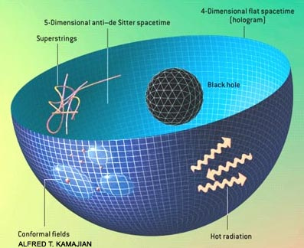
AdS_3/CFT_2 correspondence, Brown and Henneaux 1986
Holographic principle, ’t Hooft 1993, Susskind 1994 ,
especially its first explicit example in string theory
---- AdS_5/CFT_4 correspondence, Maldacena 1997

Slide 5
Recent progresses made along this direction:
Kerr/CFT correspondence
Guica, Hartman, Song and Strominger, 0809.4266
Together with its various extensions:
T.~Hartman, K.~Murata, T.~Nishioka and A.~Strominger, 0811.4393;
H.~Lu, J.~Mei and C.~N.~Pope, 0811.2225;
T.~Azeyanagi, N.~Ogawa and S.~Terashima, 0811.4177;
T.~Azeyanagi, N.~Ogawa and S.~Terashima, 0812.4883;
H.~Isono, T.~S.~Tai and W.~Y.~Wen, 0812.4440;
C.~M.~Chen and J.~E.~Wang, 0901.0538;
A.~M.~Ghezelbash; 0901.1670;
Bredberg, Hartman, Song and Strominger, 0907.3477;
Castro and Larsen, 0908.1121;
C.-M. Chen, JRS and S.-J. Zou, 0910.2076
……

Slide 6
NHEK geometry
R
L
Asymptotical symmetry group
Frolov-Thorne vaccum
Virasoro
quantization

Slide 7
In order to use the technique of the AdS/CFT duality, the background spacetime (in the extremal or near extremal limit) needs to contain some asymptotical or/and near horizon AdS structures.
rotation
Kerr black hole
However, when the black hole is non-extremal, there is no apparent near horizon AdS structures, thus the usual AdS/CFT approaches do not work directly.
Are there CFT descriptions for generic nonextremal black holes?
Probably, via the hidden conformal symmetries
non-extremal Kerr black hole is shown dual to a 2D CFT, there exists a hidden 2D conformal symmetry which can be probed by a scalar field at low frequencies.
Castro, Maloney and Strominger, 1004.0996

Slide 8
Another interesting progress is the studying of the CFT description of the Reissner-Nordstrom (RN) black hole, i.e. the RN/CFT duality
Hartman, Murata, Nishioka and Strominger, 0811.4393
Garousi and Ghodsi, 0902.4387
C. M. Chen, JRS and S. J. Zou, 0910.2076
C. M. Chen, Y. M. Huang and S. J. Zou, 1001.2833
4D RN black hole, contains an AdS_2 structure (near extremal)
two approaches:
Uplifting the 4D RN black hole into 5D
(warped AdS_3/CFT_2 correspondence)
C. M. Chen, Y. M. Huang and S. J. Zou, 1001.2833
Reducing the 4D RN black hole into 2D
(AdS_2/CFT_1 correspondence)
C. M. Chen, JRS and S. J. Zou, 0910.2076

Slide 9
Furhter, it is suggested that the generic nonextremal RN black hole is still dual to a 2D CFT, motivated by the probe of hidden conformal symmetries
5D RN, C.-M. Chen and JRS, 1004.3963;
4D RN, C.-M. Chen, Y.-M. Huang, JRS, M.-F. Wu and S.-J. Zou, 1006.4092
Key point: the U(1) symmetry of the background electromagnetic field can be probed by a charged scalar field. It plays an equivalent role with that of the U(1) symmetry coming from the rotation.
A natural step is to investigate the CFT dual of the Kerr Newman (KN) black hole. There were some trails on this problem, but the results are incomplete
T. Hartman, K. Murata, T. Nishioka and A. Strominger, 0811.4393
Y. Q. Wang and Y. X. Liu, 1004.4661
B. Chen and J. Long, 1006.0157

Slide 10
Geometrically, the KN black hole will return to the Kerr black hole when Q = 0 while to the RN black hole when J = 0.
However, if one takes J = 0 above, it will not recover the information of the corresponding RN black hole.
Thus, a multiple CFTs dual to the KN black hole is expected.

Slide 11
Kerr Newman/CFTs dualities

Slide 12
Considering a probe charged scalar field scattering in the KN
Assuming the following modes expansion
The KG equation decouples into
where is the separation constant.

Slide 13
For the massless probe field, its radial part of eom can be written as
If we further taking the following limits
(*)

Slide 14
J-picture----Kerr/CFT duality
There are twofold 2D hidden conformal symmetries in the solution space of eq. (*), one with as the fiberation, called the J-picture, which is related to the Kerr/CFT duality.
In order to probe the J-picture CFT_2 description to KN black hole, we need to consider a neutral probe scalar field
(2*)
Before making coordinate transformations to the above equation, let us review some basic properties of the AdS_3 spacetime

Slide 15
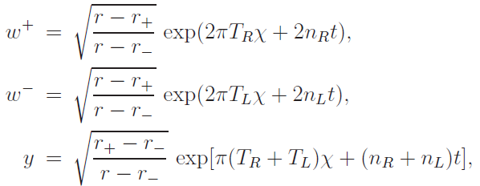
SL(2,R) Lie algebra
Casimir operator
Taking coordinate transformations

Slide 16
Then left hand operator in eq. (2*) is just the Casimir operator of the SL(2,R) Lie algebra with
Since the probe field is neutral, it doesn’t couple with the background gauge field, it can only reveal the angular momentum part of the dual CFT, i.e. J-picture, the Kerr/CFT duality

Slide 17
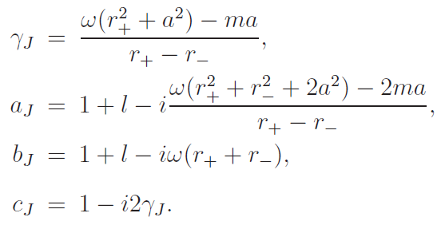
Scattering process
In the near region, define
the general solution of eq.(*) with q=0 is

Slide 18
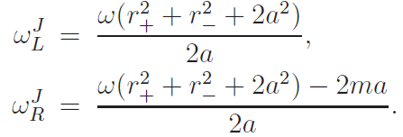
In the near region, the ingoing modes are dominate, taking z->1 and 1-z->1/r
the conformal weights of the operator dual to the scalar field are
where

Slide 19
The essential part of the absorption cross section of the scalar field is
To compare the result with the 2-point function obtained from the dual CFT, we need to identify the conjugate charges
While from black hole 1st law
with

Slide 20
it’s easy to check that
Finally, the absorption cross section becomes
which is exactly the finite temperature 2-point function of operator dual to the neutral scalar field in the J-picture CFT_2.

Slide 21
Real-time correlator
Besides the matching of absorption cross sections, we can further check the retarded Green’s function which is of causal meaning
with

Slide 22
From the CFT side, the Euclidean correlator
where
and
the Euclidean frequencies should take the discrete Matsubara
At these frequencies, the retarded Green’s function agrees with those
calculated from the gravity side up to some normalization factors.

Slide 23
b) Q-picture----RN/CFT duality
Now we will turn off the \phi direction modes by imposing m=0 in
Eq.(*)
(3*)
where the operator acts on “internal space” of U(1) symmetry of the complex scalar field and its eigenvalue is the charge of the scalar field such as
here has a natural geometric interpretation as the radius of the extra circle when embedding the 4D RN black hole into 5D.
C.-M. Chen and JRS, 1004.3963;
C.-M. Chen, Y.-M. Huang, JRS, M.-F. Wu and S.-J. Zou, 1006.4092

Slide 24
Similarly, eq.(3*) is just the Casimir operator of the SL(2,R) Lie algebra
with
Since we have set the mode m=0, the charged scalar field cannot
probe the information of the angular momentum J, which in turn
can only probe the Q-picture, i.e. the RN/CFT duality
The central charges are calculated for the near extremal case

Slide 25
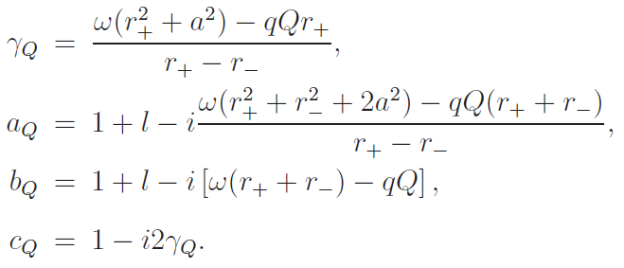
Scattering process
The general solution of eq.(*) with m=0 is
Again, in the near region, the ingoing modes are dominate, taking z->1 and 1-z->1/r

Slide 26
The dominate part of the absorption cross section is from the coefficient

Slide 27
We then need to identify the conjugate charges from
with

Slide 28
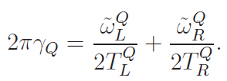
and
Then the absorption cross section becomes
Matches with the CFT’s result.
Real-time correlator

Slide 29
At the Matsubara frequencies, the retarded Green’s function agrees
with the CFT’s result up to some normalization factors depending on the charge of the probe scalar field.

Slide 30
Conclusion and discussion
there are two different individual 2D CFTs holographically
dual to the KN black hole. In fact this is an expectable result since from the gravity side, the KN black hole will return to the Kerr black hole when Q = 0 while to the RN black hole when J = 0.
The 2D conformal symmetries are not derived directly from the KN black hole geometry, there are apparent
U(1) fiber
U(1) fiber
t
r

Slide 31
“microscopic hair conjecture”:
for each macroscopic hair parameter, in additional to the mass of a black hole in the Einstein-Maxwell theory (with dimension D 3), there should exist an associated holographic CFT2 description.
An interesting problem is that can we find a CFT_2 description for the (near) extremal 4D RN black hole from the geometric side, or how can we include the contribution of the background gauge field?

Slide 32
謝謝大家！

