Slide 1
Quantum Theory in Strong Electromagnetic Fields
Sang Pyo Kim
Kunsan Nat’l Univ. & IOA, Nat’l Taiwan Univ.
National Tsing Hua University
February 20, 2012

Slide 2
Outline
Historical Background
Extreme Light Infrastructure
Schwinger Pair Production
Electron-Positron Pair Production/ Condensed Matter Analog
Heisenberg-Euler and Schwinger Action
Vacuum Polarization and Persistence
Conclusion

Slide 3
Dirac Vacuum and Paradox

Slide 4
Dirac Theory of Electron
Dirac, “The Quantum Theory Electron,” PRSL SA 117 (‘28)
“A Theory of Electrons and Protons,” PRSL SA 126(‘30)
The Dirac equation also has negative energy solutions as well as positive solutions for electrons, as for all relativity theories, for instance, the relativity Hamiltonian
In classical theory the dynamical variables must always vary continuously and there will be a sharp distinction between positive solutions and negative solutions (simply ignored).

Slide 5
Dirac Sea or Vacuum
“A Theory of Electrons and Protons,” PRSL SA 126(‘30)
All the states of negative energy are occupied except perhaps a few of small velocity (holes). We expect the exact uniform distribution to be completely unobservable.
“Discussion of the infinite distribution of electrons in the theory of positron,” MPCPS 30 (‘34)
One can give a precise meaning of a distribution of electrons in which nearly all of the negative-energy states are occupied and nearly all of the positive-energy ones unoccupied.
Further work that remains to be done is to examine the physical consequences of the foregoing assumption and to see whether it leads to any physical phenomena of the nature of a polarization of a vacuum by an electromagnetic field.

Slide 6
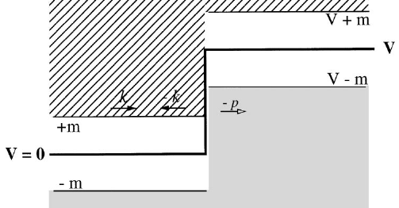
Klein Paradox
O. Klein found [Z. Phys. 53 (’29)] that the Dirac eq could predict the reflection probability greater than one.
The Klein paradox is that fermions can pass through large repulsive potential without exponential damping.

Slide 7
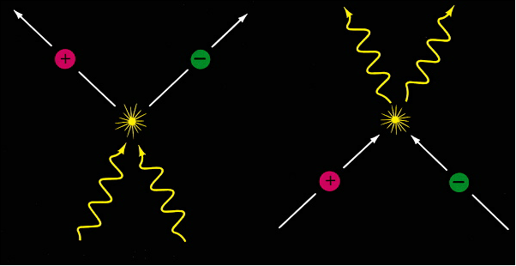
Pair Annihilation and Pair Production
Annihilation of electron-positron pair by Dirac (‘30)
Breit-Wheeler process of electron-positron production in collision of two photons (‘34) with threshold energy

Slide 8
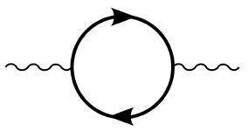
Photon-Photon Scattering
Classical Maxwell theory is linear and thus prohibits a self-interaction (direct γγ scattering) .
QED permits γ and γ to interact with virtual e-e+ pair from the Dirac sea: the cross section in the low energy limit of the two colliding γ in the center of momentum frame) [Euler (‘36); Akhiezer (‘37); Karplus, Neuman (‘50)]: a vacuum polarization effect
We have NOT seen the photon-photon scattering since the early universe, but ELI is highly likely to detect it.

Slide 9
Quest for Vacuum and Pair Production [SPK, JHEP11(‘07)]
Vacuum
Fluctuations
Schwinger Mechanism/ Polarization
QED
Condensed Matter Analogues
Hawking Radiation
Black Holes
Black Hole Analogues

Slide 10
Ultrastrong Laser Sources

Slide 11
PW, Multi-PW and EW Lasers
HiPER
ELI
High Power laser Energy Research (HiPER) facility at CLF in UK for laser-driven fusion or fast ignition.
200 kJ in 40 beams, several nanoseconds, photon energy 3 eV.
70 kJ in 24 beams, 15 ps and photon energy 2 eV.
Extreme Light Infrastructure (ELI) [http://www.extreme-light-infrastructure.eu]
The 4th facility for high intensity physics will achieve 200 PW (10 beams of 10-20 PW), one shot per min and intensity 10²⁵ W/cm².

Slide 12



Four Pillars of ELI
ELI-Beamlines Facility: Czech Republic
ELI-Nuclear Physics Facility: Romania
ELI-Ultra High Energy Field Facility
location to be selected in 2012 and scheduled in commissioning in 2017
ELI-Attosecond Facility: Hungary

Slide 13
Statistics of 4 Pillars of ELI
Country | Facility focus | Power (PW) | Pulse energy (J) | Pulse width (fs) | Rep rate (Hz)
Romania | Nuclear physics | 10 (x 2) | 200 | 20 | 0.1
Hungary | Attosecond physics | 1/20 | 5/400 | 5/20 | 1000/0.1
Czech Republic | Secondary beam radiation, high-energy particles | 1/5/10(x2) | 10/50/200 | 10/10/20 | 10/10/0.1
To be determined | High intensity | 10-20 (x10) | 30-40 kJ | 15 | 0.1
Di Piazza, Muller, Hatsagortsyan, and Keitel, “Extremely high-intensity laser interactions with fundamental systems,” arXiv:1111.3886 [hep-ph]

Slide 14
Physics from Ultra High Field
Particle physics
Nonlinear field theory
Gravitational physics
Astrophysics and cosmology
Nuclear physics
Ultrahigh-pressure physics

Slide 15
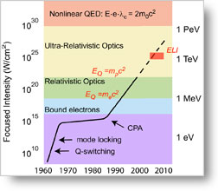
ELI & Schwinger Limit
The Schwinger limit (critical strength) for e-e+ pair production

Slide 16
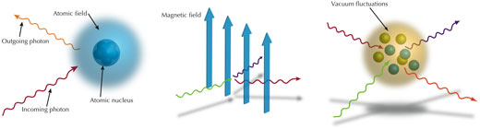
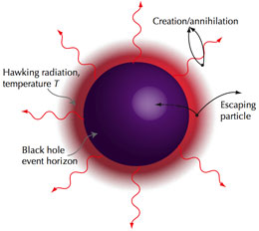
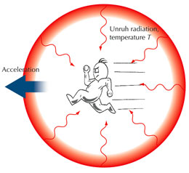
Fundamental Physics with ELI
Can test strong QED
(Delbruck scattering) (Photon splitting) (Pair production)
Can test the Hawking-Unruh radiation( )

Slide 17
Schwinger Pair Production

Slide 18
Klein-Gordon or Dirac Equation
In the space-dependent gauge A(z) for E(z), the Fourier spin-component equation (tunneling)
In the time-dependent gauge A(t) for E(t), the Fourier spin-component equation for Dirac or Klein-Gordon equation

Slide 19
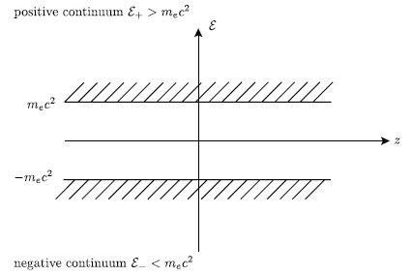
Dirac Theory of Electron & Positron
The vacuum is the Dirac sea, fully occupied with all electrons with momenta and negative energy.
Depletion of a negative energy state means that the sea has a positive net charge and positive net energy (like electron-hole in semiconductor).
The conservation of energy and momentum prohibits spontaneous pair production (jump from a negative energy to a positive one).
Fig. from Ruffini, Vereshchagin, and Xue, Phys. Rep. 487 (2010)

Slide 20
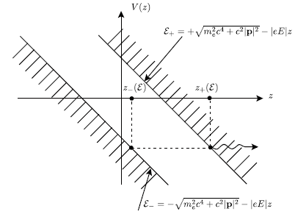
Tunneling Picture for Schwinger Pair Production
Application of a constant E-field changes the energy spectra:
Quantum mechanically, a negative charge from the Dirac sea can tunnel through the tilted barrier, which leads to particle-antiparticle pair.
The tunneling probability is the Schwinger formula for pair production:
Fig. from Ruffini, Vereshchagin, and Xue,
Phys. Rep. 487 (2010)

Slide 21
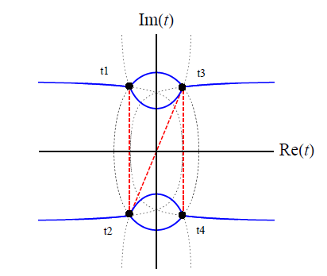
Scattering Picture & Stokes Phenomenon
Scattering over the Barrier
Stokes Phenomenon
[Fig. from Dumlu & Dunne, PRL 104 (2010)]

Slide 22
Boson & Fermion Production
In the phase-integral method, the mean number of pairs in the gauge field with one pair of turning points [SPK, Page, PRD 65 (‘02); 73 (‘06); 75 (‘07)]:
For gauge field with two pairs of turning points, the mean number of boson pairs [Dumlu & Dunne, PRL 104 (2010)]
The mean number of fermion pairs

Slide 23
Quantum Vlasov Equation
In the time-dependent gauge for electric field, the energy of the charged particle takes the form
The pair production rate in the adiabatic approach [Popov, JETP 34 (‘72); Kluger et al, PRL 67 (‘91)]
The pair production rate in the non-adiabatic approach [SPK, Schubert, PRD 84 (‘11)]

Slide 24
Electron-Positron Pair Production

Slide 25
Electron-Positron Pair Production
e-e+ production by a high energy photon propagating in a strong laser field (Breit-Wheeler pair production).
e-e+ production by a Coulomb field in the presence of a strong laser field.
e-e+ production by two counter-propagating strong laser beams forming a standing light wave (spontaneous production in strong electric field).

Slide 26
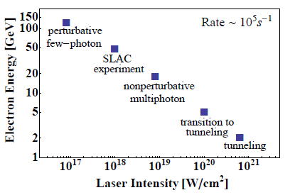
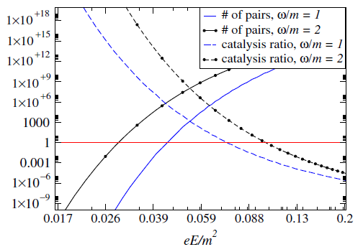
Pair Production
Electron-laser collisions
Dynamically Assisted Schwinger Mechanism
Laser photon energy: 2.4 eV
[Hu et al, PRL 105 (‘10)]
[Dunne et al, PRD 80 (‘09); PRL 101 (’08)]

Slide 27
Condensed Matter Analogue

Slide 28
Condensed Matter Analogue of QED
The relation between the theory of dielectric breakdown in condensed matter and nonlinear QED from the view point of the effective Lagrangian
[Oka, Aoki, Lect. Notes Phys. 762 (‘09)]
 | Condensed Matter | QED
Mechanism Excitation | Landau-Zener tunneling Electron(doublon)-hole pair | Schwinger mechanism Electron-positron pair
Effective action | Nonadiabatic Berry’s phase | Heisenberg-Euler/Schwinger
Nonlinear polarization | Photovoltaic Hall effect Floquet picture | γ-γ interaction (birefringence) Furry picture

Slide 29
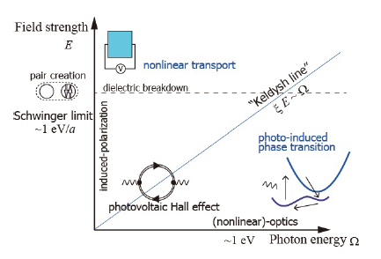
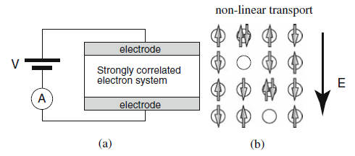
Strong Field Physics in Condensed Matter
Several Phenomena in condensed matter physics in strong electric fields in E(field strength)-Ω(photon energy) space [Oka, Aoki, arXiv:1102.2482; Lect. Notes Phys. 762 (‘09)]
Carriers (doublons and holes) created by an external electric field

Slide 30
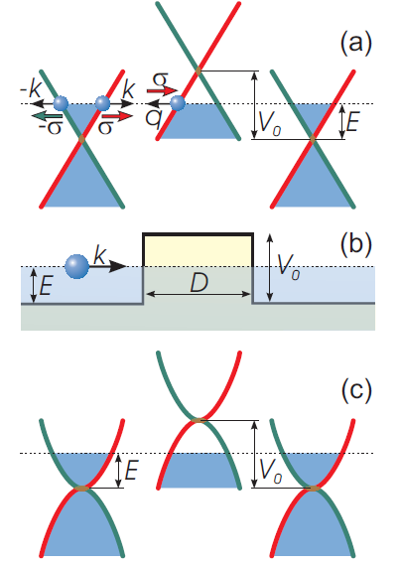
Graphene Analogue of QED
Effectively massless Dirac fermions
The Klein paradox
T = 1 for normal incidence or q_{x}D = πN.
The Klein tunneling was experimentally observed in graphene heterojunctions [A. F. Young and P. Kim, Nat. Phys. 5 (‘09)].
Fig. Katsnelson, Novoselov and Geim, Nat. Phys. 2 (‘06)

Slide 31
Heisenberg-Euler & Schwinger Effective Action

Slide 32
Heisenberg-Euler/Schwinger Effective Action
Maxwell theory and Dirac/Klein-Gordon theory are gauge invariant:
The Heisenberg-Euler/Schwinger effective action per volume and time [J. Schwinger, “On gauge invariance and vacuum polarization,” PR 82 (‘51) 664; B. DeWitt: “This is one of the great papers of all time.”]

Slide 33
Going Beyond Schwinger

Slide 34
One-Loop Effective Actions
The in-/out-state formalism via the Schwinger variational principle [Schwinger, PNAS(‘51); DeWitt, Phys. Rep. (‘75), The Global Approach to Quantum Field Theory (‘03)]
The vacuum persistence

Slide 35
Out-Vacuum from In-Vacuum
For bosons, the out-vacuum is the multi-particle states of but unitary inequivalent to the in-vacuum:
The out-vacuum for fermions:

Slide 36
Effective Actions at T=0 & T
Zero-temperature effective action for scalar and spinor from the gamma function-regularization [SKP, Lee, Yoon, PRD 78, (‘08); 82, 025016 (‘10); SPK, PRD 84 (‘11) ]
finite-temperature effective action for scalar and spinor [SKP, Lee, Yoon, PRD 82, 025016 (‘10)]

Slide 37
Thermofield Dynamics
Thermal vacuum [Takahashi, Umezawa (’75)]
Thermal expectation value: the expectation value in the thermal vacuum
Finite-temperature field theory is equivalent to zero-temperature field theory in the “thermal vacuum”.

Slide 38
Effective Action at T
Expectation value of U in thermal vacuum
Effective action per unit volume and time

Slide 39
Vacuum Polarization & Persistence
Purely thermal part of the effective action
Imaginary part of the effective action
Real part of the effective action

Slide 40
Vacuum Polarization at T
Structure of the effective action at T

Slide 41
Pair Production at T
Imaginary part of the effective action (the limit of small mean number of produced pairs)
Consistent with the pair-production rate at T [SPK, Lee, PRD 76 (‘07); SPK, Lee, Yoon, PRD 79 (‘09)]

Slide 42
QED Effective Action in E=const
The Bogoliubov coefficient for scalar and spinor in constant E-field [SPK, Lee, Yoon, PRD78 (‘08)]
The effective action for scalar/volume and time

Slide 43
QED Vacuum Polarization
Scalar QED: renormalized effective action per volume and per time for a constant E-field
Spinor QED: renormalized effective action per volume and per time for a constant E-field

Slide 44
QED Vacuum Persistence
Spinor QED: Schwinger pair production in a constant E-field
Scalar QED: Schwinger pair production

Slide 45
Vacuum Polarization Beyond Schwinger
Scalar/Spinor QED in a pulsed E-Field [SPK, Lee, Yoon, PRD 78 (‘08)]
Imaginary part from the mean number of pairs

Slide 46
Vacuum Polarization Beyond Schwinger
Scalar/Spinor QED in a localized E-Field [SPK, Lee, Yoon, PRD 82 (‘10)]
Imaginary part from the mean number of pairs

Slide 47
Conclusion
The ultra strong lasers from Extreme Light Infrastructure (ELI) can detect
Direct photon-photon scattering (vacuum polarization)
Schwinger pair production (vacuum persistence)
Other nonperturbative phenomena
Strong Field Physics (& quantum structure of vacuum) will be based on experimentation, direct or indirect:
Strong QED & QCD
QFT in curved spacetimes

