Slide 1
An Introduction to Inflation and Bouncing Cosmology
Taotao Qiu
Chung Yuan Christian University
2009-11-12

Slide 2
Outline
(I) Why Inflation?
The advantages and disadvantages of Standard Big Bang Theory;
How inflation solved the major problems;
The dynamics of inflation;
What remained unsolved.
(II) Why Bounce?
The basic idea and general picture of bouncing scenario;
Calculation on perturbation and signatures on observations;
Other properties of bouncing scenario
(III) Extension of Bouncing: Cyclic Scenario
(IV) Summary

Slide 3

Standard Big Bang Theory
Our Universe comes from a singularity in space-time
Advantages:
The age of galaxies;
(2) The redshift of the galactic
spectrum;
(3) The He abundance;
(4) The pridiction of CMB temperature
However, there are still many disadvantages!

Slide 4
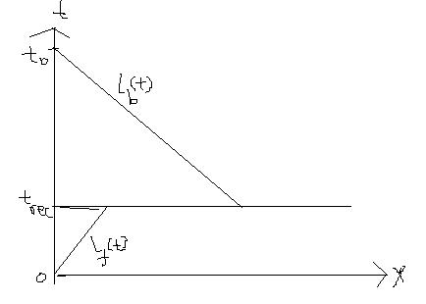
Standard Big Bang Theory
Disadvantage I: Horizon Problem
The backward cone is much larger than the forward cone,
indicating that the observable region today has been
constituted of regions that had been causal irrelative.
Then why is our universe homogeneous?

Slide 5



Standard Big Bang Theory
Disadvantage II: Flatness Problem
From Friedmann equation:
From observation: the universe today is very flat
So we should fine-tune the initial value of
to get the right value for today!

Slide 6

Standard Big Bang Theory
Disadvantage III: Original Structures
The existence of galaxies and obsevations from CMBR
implied that there must be inhomogeneity on small
scales, with tiny density perturbation
How is it formed?

Slide 7
Standard Big Bang Theory
Disadvantage IV: Singularity Problem
At the very beginning of the universe, the space-time
converges into a singular point, where all the physical
variables blew up, and the world became unphysical.
Other disadvantages:
transplanckian problem, entropy problem, etc

Slide 8
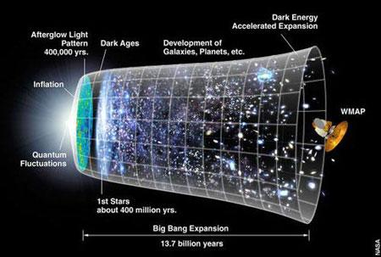
Solution to Standard Big Bang Theory: Inflation
The universe experienced a period of accelerating expansion after the big bang.
During the expansion, the scale of the universe is drawn out of the horizon, all
matters and radiations were diluted and the fluctuations were frozen to form today’s
structures.

Slide 9
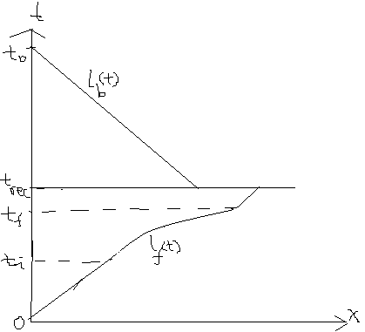
Solution to Standard Big Bang Theory: Inflation
Solution to Horizon Problem:

Slide 10




Solution to Standard Big Bang Theory: Inflation
Solution to Flatness Problem:
In inflation period,
We can define e-folding number as:
Thus we have:
As long as N>70, we can get today’s result assuming
Before inflation being of order 1.

Slide 11
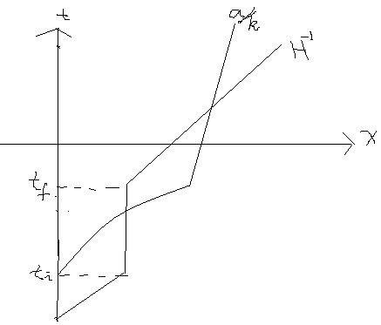



Solution to Standard Big Bang Theory: Inflation
Solution to Structure Problem:
Perturbation evolving
in horizon
Perturbation driven out
of horizon and frozen
to form today’s structure

Slide 12







The Dynamics of Inflation
The Einstein Equation:
w. r. t. FRW metric:
The 0-0 and i-i components:
Conditions for acceleration:
Cosmological constant (with ) satisfies the condition,
but cannot exit to produce matter!!!
Dynamical inflation mechanisms are needed!!!

Slide 13

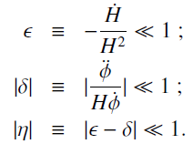
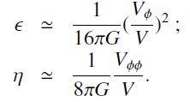
The Dynamics of Inflation
The slow-roll approximation (SRA)
Motivation: (1) provide sufficiently long period in order to solve SBB problems;
(2) produce scale-invariant power spectrum to fit today’s observations
For the simplest single field inflation:
Define slow-roll parameter:
Or equivalently:

Slide 14
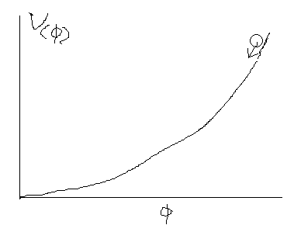


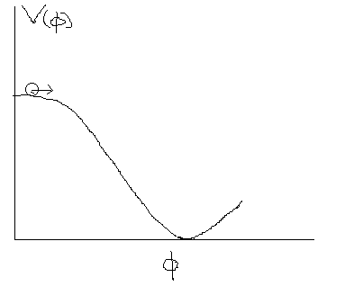

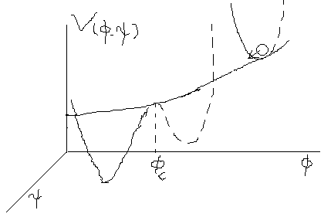

The Dynamics of Inflation
Examples of traditional inflation models:
Large field inflation
Characteristic:
Example: “Chaotic” Inflation
Andrei D. Linde, Phys.Lett.B129:177-181,1983.
Properties: 1) destroy flatness of the potential;
2) can have large gravitational wave
Small field inflation
Characteristic:
Example: CW type Inflation
S. Coleman & E. Weinberg, Phys.Rev.D7:1888-1910,1973.
Properties: 1) initial conditions need fine-tuning;
2) cannot have large gravitational wave
Hybrid inflation
Andrei D. Linde, Phys.Rev.D49:748-754,1994, astro-ph/9307002

Slide 15
Issues remaining unsolved by Inflation
Singularity Problem: Unsolved yet!
Possible solution to this problem:
Pre-Big-Bang Scenario;
Ekpyrotic Scenario;
(III) String Gas Scenario;
(IV) Bouncing Scenario
… …
All go Beyond
Einstein Gravity!!!
Within Einstein Gravity

Slide 16
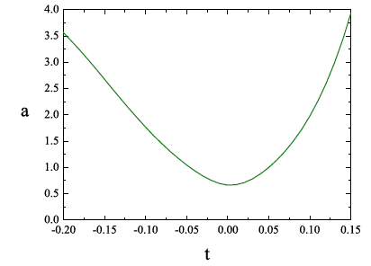


Alternative to Inflation:
Bouncing Scenario
Bouncing Scenario describes a Universe transiting from a contracting period to a expanding period, or, experienced a bouncing process. At the transfer point, the scale factor a of the universe reached a non-vanishing minimum. This scenario can natrually avoid the singularity which is inevitable in Standard Big Bang Theory.
Contraction:
Expansion:
Bouncing
Point:
At the
Neiborhood:
For a realistic scenario, one should connect this process to the observable universe (radiation dominant, matter dominant, etc), whose w>-1, so in the whole process w crosses -1!
Y. Cai, T. Qiu, Y. Piao, M. Li and
X. Zhang, JHEP 0710:071, 2007

Slide 17
How to make EoS cross -1？No-Go Theorem
As for models, which is (1) in 4D classical Einstein Gravity, (2)described by single simple component (either perfect fluid or single scalar field with lagrangian as ), and (3) coupled minimally to Gravity, its Equation of State can never cross the cosmological constant boundary (w=-1).
The set of models with EoS crossing -1 is called Quintom!
Proof skipped, see e.g. Bo Feng et al., Phys. Lett. B 607, 35 (2005); A. Vikman, Phys. Rev. D 71, 023515 (2005); J. Xia, Y. F. Cai, Taotao Qiu, G. B. Zhao and X. M. Zhang, astro-ph/0703202; etc.
According to the No-Go Theorem, there are many models that can realize EoS crossing -1, among which the simplest one is that composed of two real scalar field (Double-field Quintom model).
The Action:
There are also other examples, e. g. vector field, field with higher derivative
operators, etc.

Slide 18






Bouncing Scenario Given by Quintom Matter
I）Paramtrization
II）Double-field Quintom
III）Single field Quintom with HD

Slide 19
What’s the signature of Bouncing models?

Slide 20
Classification of Bouncing Models
Large field inflation
With inflation
Small field inflation
Other inflation models
Bouncing Models
Without inflation
For sake of simplicity, we consider only non-interacting double-field bouncing models!

Slide 21

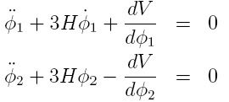
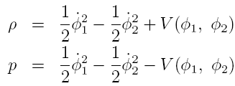
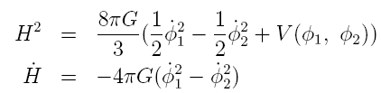

Formulae for Double-field bouncing models (I): background evolution
General Action:
Equations of Motion:
Stress Energy Tensor:
Friedmann Equations:
Equation of State:

Slide 22


Formulae for Double-field bouncing models (II): Perturbative Metric
General Perturbative Metric:
where
For scalar perturbation, the gauge invariant components are
constructed as:
Taking conformal Newtonian gauge (B=E=0), we obtain metric
containing those components only:

Slide 23
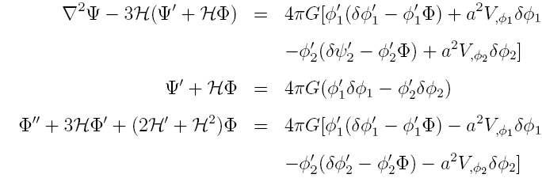

Formulae for Double-field bouncing models (III): Perturbation Equations
With the above metric in hand, we can obtain perturbation equations for the gauge-invariant perturbations:
1）Perturbation Equations for metric: From perturbed Einstein Equation:
2）Perturbation Equations for field: From perturbed Equations of Motion:

Slide 24


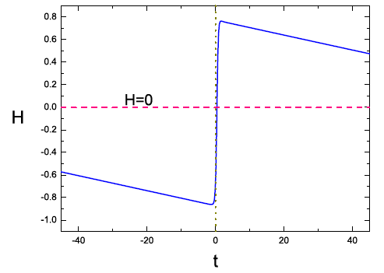
Calculation in Bouncing Models of Double-field Quintom
（I）Models with Large field inflation
Action:
Y. Cai, Taotao Qiu, R. Brandenberger, Y. Piao and X. Zhang, JCAP 0803:013, 2008

Slide 25


（I）Models with Large field inflation
By solving perturbation equations, we obtain:
(I) Heating Phase:
( in horizon, out of horizon）
(II) Slow-climbing
Contracting Phase:
Large k
(III) Bouncing Phase:
Small k
Large k
(IV) Slow-rolling
Expanding Phase:
Large k
Small k
Large k

Slide 26
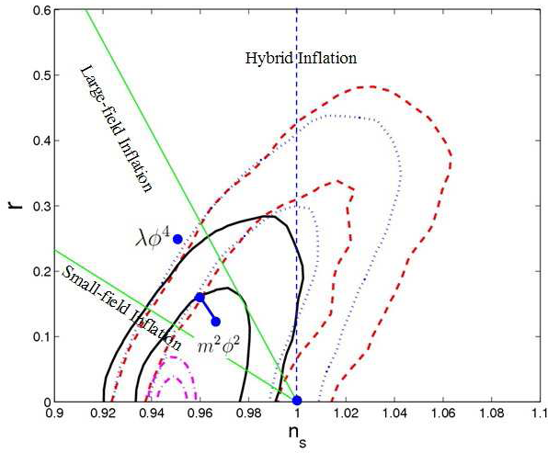
（I）Models with Large field inflation
Numerical results:
Sketch plot of the perturbation:
Signature I：
Scale-Invariant Power spectrum cannot be obtained
by bouncing models with large field inflation！！！
Comparison: normal Large field
Inflation without Bouncing can get
Scale-invariant Power Spectrum!
Jun-Qing Xia, Hong Li, Gong-Bo Zhao, Xinmin Zhang, Int.J.Mod.Phys.D17:2025-2048,2008,
E. Komatsu et al. [WMAP Collaboration], Astrophys.J.Suppl.180:330-376,2009.

Slide 27
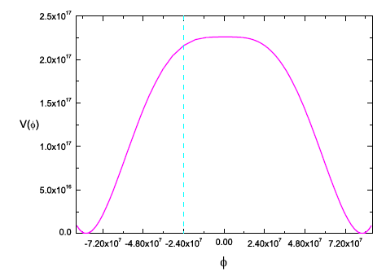
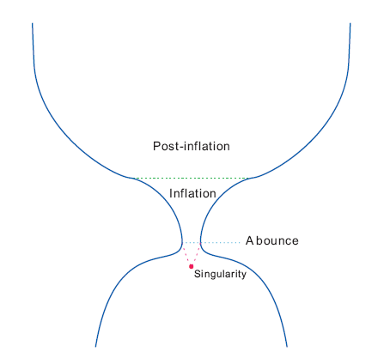

（II）Models with Small field inflation
Action:
Sketch plot of potential:
Sketch plot of scale factor:

Slide 28
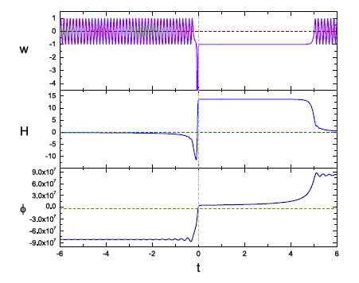
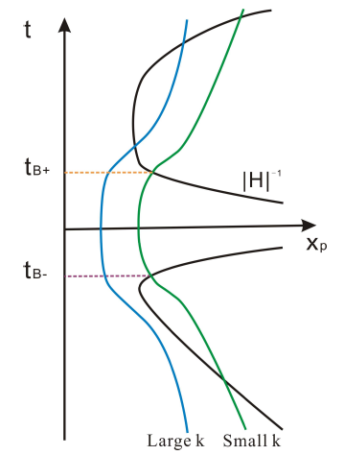
（II）Models with Small field inflation
Background evolution w. r. t. time:
Sketch plot of perturbation:

Slide 29

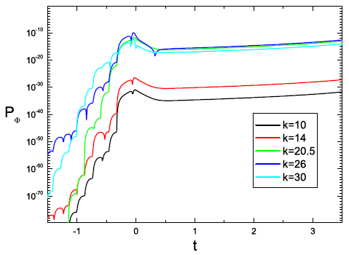
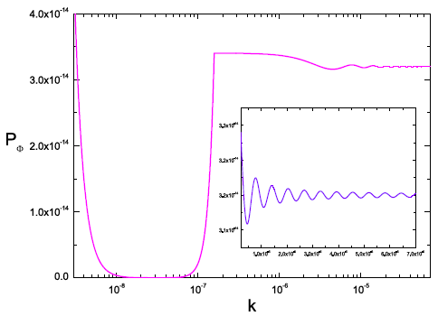
（II）Models with Small field inflation
Analytical results: nearly scale-invariant
Power spectrum!
Numerical results: evolution of spectrum w. r. t. t and k

Slide 30
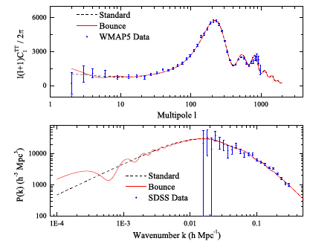
（II）Models with Small field inflation
The comparison of our result to the observational data:
Signature II：
Scale-Invariant Power spectrum can be obtained
by bouncing models with small field inflation,
with oscillating behavior on small l！！！
Y. Cai, Taotao Qiu, J. Xia, H. Li, X. Zhang, Phys.Rev.D79:021303,2009.

Slide 31


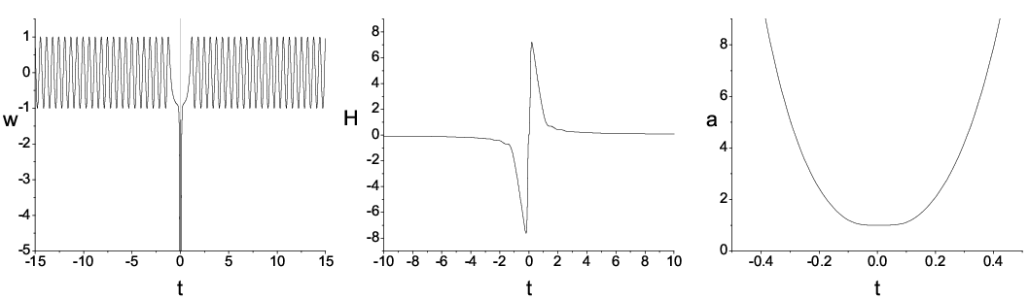
（III）Models without inflation
(Lee-Wick type matter bounce)
Lagrangian:
Or equivalently:
Background evolution:

Slide 32
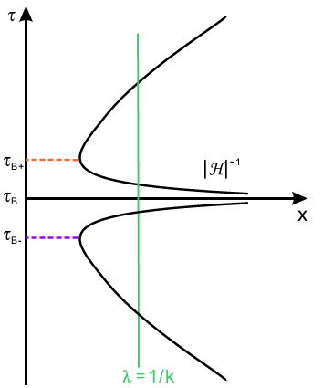


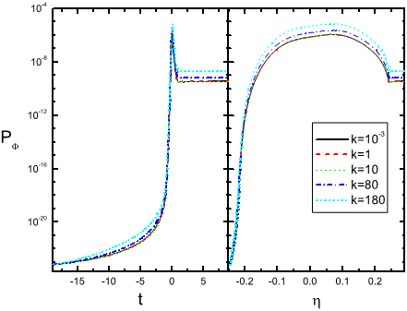
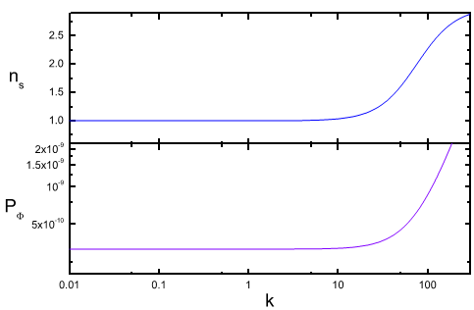
（III）Models without inflation
Analytical solution:
Sketch plot of
perturbation:
Numerical results:
Signature III：
Scale-Invariant Power spectrum can be obtained
at small k region by bouncing models without
inflation, with blue-shift at large k region!!!
Y. Cai, Taotao Qiu, R. Brandenberger and X. M. Zhang, arxiv: 0810.4677[hep-th].

Slide 33
Characteristics of (Quintom) Bouncing scenario:
(1)Can avoid Big-Bang Singularity;
(2)Multi-degree of freedom, thus may induce isotropic
perturbations;
(3)May induce growth of anisotropy in contracting phase, and
form black holes;
(4)May induce large non-gaussianity which cannot be ruled out
by observations;
… …

Slide 34
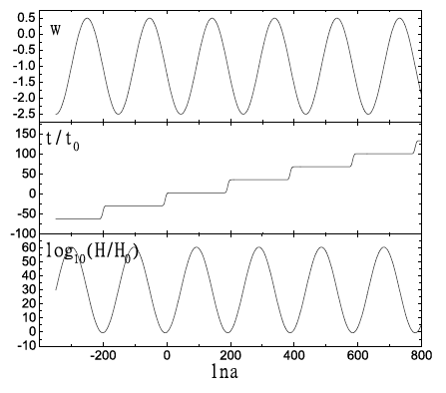

The generalization of bouncing cosmology: cyclic universe
Two definitions: 1) the universe is always expanding with Hubble parameter oscillating;
2) the scale factor is oscillating, and expansion and contraction proceed alternately.
Theoretical motivation: 1) to avoid Big-Bang Singularity
2) to alleviate coincidence problem
Phenomilogical study:
Model building:
R. C. Tolman, Oxford U. Press, Clarendon Press, 1934.
P. J. Steinhardt et al., Phys. Rev. D65, 126003 (2002).
L. Baum et al., Phys. Rev. Lett. 98, 071301 (2007).
T. Clifton et al., Phys. Rev. D75, 043515 (2007);
M. Bojowald et al., Phys. Rev. D70, 083517 (2004);
H. H. Xiong et al., arXiv:0711.4469 [hep-th]
……
B. Feng, M. Li, Y. Piao and X. M. Zhang,
Phys.Lett.B634:101-105,2006.

Slide 35

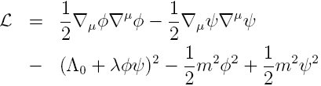


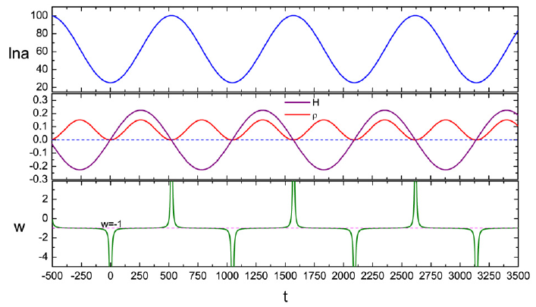
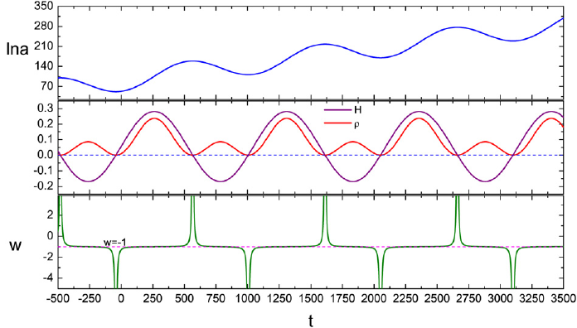
Our models
Einstein equations:
Lagrangian:
Solutions can be classified into 5 cases（where is relative to initial conditions）
Case I:
Case II:

Slide 36


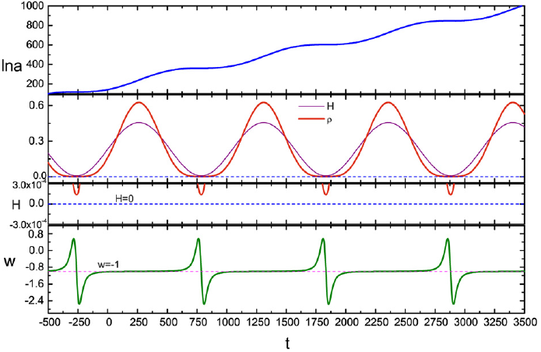
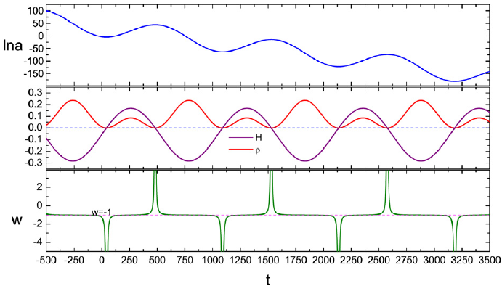

Case III:
Case IV:
Case V:
This case corresponds to a eternally contracting universe and thus contradict with today’s reality. So we’ll not discuss about it.
H. Xiong, Y. Cai, Taotao Qiu, Y. Piao and X. M. Zhang, Phys.Lett.B666:212-217,2008.

Slide 37
Summary
Standard Big Bang Theory can almost explain how our universe comes into being, except for some remaining issues. Inflation can solve the majority of them, but not all.
To solve the singularity problem, a bounce process at the very beginning is generally need. Consistent perturbation theory and signatures on observations are presented.
Extension of Bouncing Scenario: Cyclic Universe. Singularity problem can as well be solved and coincidence problem can be alleviated.

Slide 38
Thank you!!!

