Slide 1
The RN/CFT Correspondence
孫佳叡
Jia-Rui Sun
National Central University
National Tsinghua University
April 22, 2010
based on arXiv:0910.2076 (JHEP 1001:057, 2010), C.-M. Chen, JRS and S.-J. Zou; arXiv:1001.2833, C.-M. Chen, Y.-M. Huang and S.-J. Zou.

Slide 2
Outline:
Introduction
Brief Review of Near Extremal RN
AdS_2/CFT_1 Description
AdS_3/CFT_2 Description
Conclusion and Discussion

Slide 3
1. Introduction
Searching for the full quantum gravity theory is still tough.
New visual angle: the holographic principle
so far only a few well-understood examples
AdS_3/CFT_2 and AdS_5/CFT_4 correspondences, etc.
Recently, an interesting progress has been made along this direction for extremal Kerr black holes
----the Kerr/CFT correspondence
the central charge of the dual chiral CFT (left movers) can be identified by studying the asymptotic symmetry of the near horizon extremal Kerr black hole (NHEK) geometry.
(Guica, Hartman, Song and Strominger, 0809.4266)
new duality--warped AdS_3/CFT_2 correspondence.

Slide 4
NHEK geometry
R
L
Asymptotical symmetry group
Frolov-Thorne vaccum
Virasoro
quantization

Slide 5
Soon , Kerr/CFT correspondence has been generalized into many other spacetimes which contain the warped AdS_3 structure
T.~Hartman, K.~Murata, T.~Nishioka and A.~Strominger, 0811.4393;
H.~Lu, J.~Mei and C.~N.~Pope, 0811.2225;
T.~Azeyanagi, N.~Ogawa and S.~Terashima, 0811.4177;
T.~Azeyanagi, N.~Ogawa and S.~Terashima, 0812.4883;
H.~Isono, T.~S.~Tai and W.~Y.~Wen, 0812.4440;
C.~M.~Chen and J.~E.~Wang, 0901.0538;
A.~M.~Ghezelbash; 0901.1670;
……
The initial work did not address more information about the dual CFT in addition to the central charge.
New schemes should be developed to understand the properties of the CFT and dynamics behind this duality.
Whether we can find the CFT description for extremal non-rotating black holes and for near extremal generalization?

Slide 6
Near horizon (near) extremal Kerr (in AdS_2/CFT_1 description)
(Castro and Larsen, 0908.1121)
BH entropy
CFT entropy
assume the relation

Slide 7
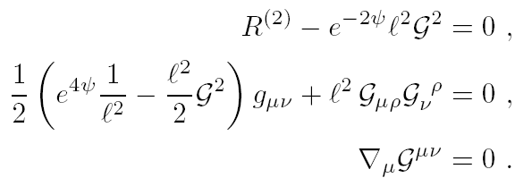
Metric ansatz
2D effective theory
The effective radius of AdS_2 is
NHEK

Slide 8
CFT dual of extremal RN black hole
T.~Hartman, K.~Murata, T.~Nishioka and A.~Strominger, 0811.4393;
M.~R.~Garousi and A.~Ghodsi, 0902.4387.
(warped AdS_3/CFT_2 description)
The U(1) bundle of warped AdS_3 was recovered from the gauge field potential by uplifting the RN black hole into 5D gravity
pure electric charge
electric and magnetic charge
a. The temperature of the dual CFT is charge dependent;
b. The electric-magnetic duality disappears in the CFT side.

Slide 9
2. Brief Review of Near Extremal RN
The action of 4D Einstein-Maxwell theory is
(1)
electric-charged RN
Taking the limit of

Slide 10
near extremal RN
SL(2,R)_R
extremal RN b=0,
ground state degeneracy
It is q that acts as the effective AdS_2 radius
A naive but reasonable guess is

Slide 11
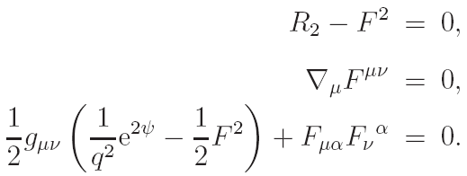
3. AdS_2/CFT_1 Description
Chen, Sun and Zou, 0910.2076 (JHEP 1001:057, 2010)
metric ansatz

Slide 12
Assume the 2D general solution also takes the form
eoms
general solution
extremal case

Slide 13
Boundary counterterms
are constants to be determined.

Slide 14
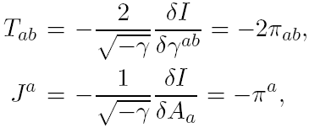
A well-defined variational principle requires all the coefficients
be finite. Similar to the Kerr case, can be determined by ensuring vanishing leading terms of these three boundary momenta, and we obtain
Boundary currents
The boundary currents are defined by

Slide 15
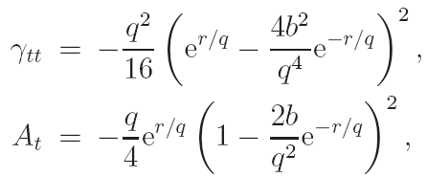
For the near extremal RN
and
Like the near extremal Kerr case,

Slide 16
Conserved Charges
For a chosen asymptotic symmetry of spacetime, the gauge fields need not only be diffeomorphism invariant but also be gauge invariant. Thus, we need to combine the diffeomorphism together with the gauge transformations.
Like the near extremal Kerr case, we can choose the asymptotical boundary conditions
gives

Slide 17
Variation of the time component of gauge field is
and variation of the time component of gauge field is
The central charge can be read out from
(A.~Castro, D.~Grumiller, F.~Larsen and R.~McNees, 0809.4264)

Slide 18
where we have introduced a normalization parameter
this factor -2 endorses the ground value for the level. Finally we can read out the central charge for the extremal RN black hole
The Noether charge generated by the gauge transformation is
and the associated charge is

Slide 19
The level k is defined as
and
The presence of the gravitational constant G_4 is due the overall factor 1/16\pi G_4 in the matter part of the action. In the usual convention, this factor is absorbed in the Maxwell field strength
Thus the normalization factor L in the definition of level ensures the ground value.

Slide 20
Another Derivation of the Central Charge
The effective 2D action of near extremal RN is
The action of 2D Maxwell-dilaton quantum gravity is
(T.~Hartman and A.~Strominger, 0803.3621)
(2)
by simply identifying
The central charge is

Slide 21
Then it’s easy to see that our results of the central charge,
is consistent with
The results indicate that the central charge derived from
the viewpoint of AdS_2/CFT_1 correspondence is the same as the
one derived from the 2D CFT on a strip. This equality seems hint
that CFT_1 can be regarded as an chiral CFT_2.
(M.~Alishahiha and F.~Ardalan, 0805.1861
A.~Sen, 0805.0095
R.~K.~Gupta and A.~Sen, 0806.0053)

Slide 22
Including Magnetic Charge
Central charge for Dyonic black holes
The effective 2D action is
(3)
The magnetic charge parameter, p, modifies the AdS_2 radius and the cosmological constant term. We can quickly calculate the central charge by comparing the (3) with (2)
electric-magnetic duality

Slide 23
4. The warped AdS_3/CFT_2 description
(C.~M.~Chen, Y.~M.~Huang and S.~J.~Zou, 1001.2833)
Consider a 5d Einstein-Maxwell theory
The requirement of const. KK scalar gives

Slide 24
Then the reduced 4d metric is just the RN black hole and the corresponding 5d metric becomes
Define
and taking near horizon limit

Slide 25
The corresponding thermodynamical quantities are
where
Choosing
We can identify the left and right moving modes by

Slide 26
Matching of the greybody factors
from the gravity side
from the CFT side
The results from both sides match to each other.

Slide 27
5. Conclusion and Discussion
We reconsidered the quantum gravity description of near horizon extremal RN black hole and conclude that
pure electric charge
electric and magnetic charges
The near extremal RN black hole has both CFT_2 and CFT_1 descriptions, and it’s a good case to study the relation between AdS_3/CFT_2 and AdS_2/CFT_1 dualities.

Slide 28
Further problems
*CFT dual of near extremal RN black hole
left movers
right movers
The stress tensor need to be further normalized in order to obtain the excitation of right hand movers.
*From the study of scalar field scattering from 5d uplifed RN black hole, we find there is no superradiance. Its natural to study Fermions in this background and see what’s the CFT dual (in progress) .

Slide 29
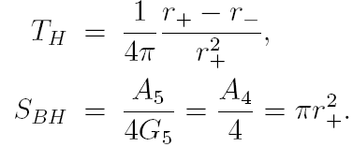
*Is there a CFT dual to near horizon nonextremal RN black hole?
Hidden conformal symmetry (Castro, Maloney, Strominger 1004.0996)
We give evidence that nonextremal RN black hole with
is dual to CFT with
(in preparation)

Slide 30
謝謝大家！

