Slide 1
A critical Point in a AdS/QCD model
Wu, Shang-Yu (NCTU)
in collaboration with
He, Song, Yang, Yi and Yuan, Pei-Hung
1301.0385, to appear in JHEP
3/28 @NCTS

Slide 2
Content
1.Introduction
2.The model
3.Thermodynamics
4.Equations of state
5.Conclusion

Slide 3
1. Introduction
Why study AdS/CFT duality?
It was shown to be a powerful tool to study strongly coupled physics
Applications:
Condensed matter (high Tc superconductor, hall effect, non-fermi liquid, Lifshitz-fixed point, entanglement entropy, quantum quench, cold atom,…), QCD (phase diagram, meson/baryon/glueball spectrum, DIS,….), QGP (thermalization, photon production, jet quenching, energy loss…), Hydrodynamics (transport coefficients,…), cosmology (inflation, non-Gaussianity,…), integrability,…

Slide 4
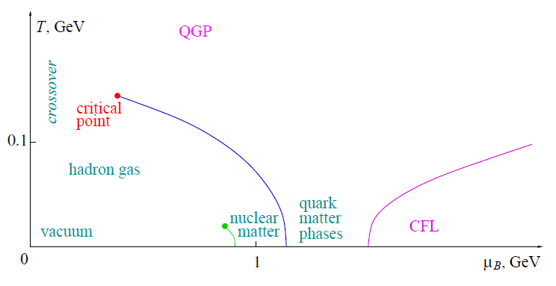
1.Introduction: QCD phase diagram
Conjectured QCD phase diagram of chiral transition with light quarks
Non-perturbative, strongly coupled regime,
Inappropriate to use lattice simulation due to the
sign problem at finite density
1st order phase transition
From hep-lat/0701002

Slide 5
Gauge/Gravity Duality
Claim:
d-dim gauge theory without gravity is equivalent to d+1
dim theory with gravity, where the gauge theory live on the
boundary of the bulk spacetime
Simplest and most well-studied case:
3+1 dim N=4 SYM ↔ SUGRA on ${AdS}_{5}×S^{5}$

Slide 6
Dictionary 1
Isometries in the bulk ↔ symmetries in the boundary field theory
Fields in the bulk ↔ Operators in the boundary theory
Bulk field mass ↔ boundary operator scaling dimension
Strong/Weak duality

Slide 7
Dictionary 2
The boundary value of bulk on-shell partition function = boundary gauge theory partition function
Correlation function:

Slide 8
Dictionary 3
Radial coordinate in the bulk = energy scale in boundary field theory
Boundary ↔ UV , horizon ↔ IR
Finite temperature in field theory => Introduce a black hole in the bulk
Hawking temperature of black hole = Field theory temperature
Hawking-Page transition ↔ confinement/deconfinement transition
(black hole/ non-black hole transition)
Finite density/chemical potential
Introduce some gauge fields in the bulk

Slide 9
Toward a gravity dual of QCD
Some essential ingredients of QCD:
Linear Regge behavior (${m_{n}}^{2}\sim n$)
Chiral symmetry breaking
Asymptotic freedom
Classes of holographic models:
Top-down: D3/D7, D4/D8(Sakai-Sugimoto model)
Bottom-up: Hard-wall, Soft-wall

Slide 10
Field contents in bottom-up AdS/QCD models
5D fields 4D operators 𝚫 bulk mass $m^{2}$
${A_{}^{a}}_{Lμ}$ $\overline{q_{L}}γ^{μ}t^{a}q_{L}$ 3 0
${A_{}^{a}}_{Rμ}$ $\overline{q_{R}}γ^{μ}t^{a}q_{R}$ 3 0
$X^{ab}$ $\overline{{q_{R}}^{a}}{q_{L}}^{b}$ 3 -3
Or define
${V_{μ}}^{a}=\frac{1}{2}\left({A_{L,μ}}^{a}{{+A}_{R,μ}}^{a}\right)$, vector meson
${\tilde{V_{μ}}}^{a}=\frac{1}{2}\left({A_{L,μ}}^{a}{{−A}_{R,μ}}^{a}\right)$, axial-vector meson

Slide 11
Hard wall - break the conformal symmetry
Introduce a IR cut-off $z_{m}$ in AdS space “by hand”
$z_{m}$: confining scale.
another way to break conformal symmetry
⟶introduce non-trivial dilaton or warped factor in the metric
⟶soft-wall model

Slide 12
Soft-wall model 1
Ansatz:
${ds}^{2}=e^{A\left(z\right)}\left(−{dt}^{2}+{dx}^{2}+{dz}^{2}\right), φ=φ(z)$
Regge behavior:
For vector meson ${V_{μ}}^{a}$, EOM of vector meson
$∂_{z}\left(e^{B}∂_{z}v_{n}\right)+{m_{n}}^{2}e^{−B}v_{n}=0$,
$B=φ−A$, ${m_{n}}^{2}=−ω^{2}+k^{2}$

Slide 13
Soft-wall model 2
Define $v_{n}=e^{B/2}ψ_{n}$
$−{ψ_{n}}^{′′}+V\left(z\right)ψ_{n}={m_{n}}^{2}ψ_{n}, V\left(z\right)=\frac{1}{4}{(B^{′})}^{2}−\frac{1}{2}B^{′′}$
When $V\left(z\right)=z^{2}+3/4z^{2}$ and $B=z^{2}+logz$
${m_{n}}^{2}=4(n+1)$
So we can choose $e^{A[z]}=\frac{e^{cz^{2}}}{z^{2}}$ or $e^{A[z]}=\frac{1}{z^{2}}, φ\left(z\right)=cz^{2}$
By matching $n=1$ to 𝜌 meson to determine the value of c

Slide 14
2. The model
Action:
Einstein frame:
$S=S_{b}+S_{m}$
$S_{b}=\frac{1}{16πG_{5}}\int{d^{5}x\sqrt{−g}[R−\frac{f\left(φ\right)}{4}F^{2}−\frac{1}{2}∂_{μ}φ∂^{μ}φ−V\left(φ\right)]}$
$S_{m}=\frac{1}{16πG_{5}}\int{d^{5}x\sqrt{−g}Tr{[\left|DX\right|}^{2}+3X^{2} −\frac{f\left(φ\right)}{4}({F_{V}}^{2}+{F_{\tilde{V}}}^{2})]}$
${V_{μ}}^{a}=\frac{1}{2}\left({A_{L,μ}}^{a}{{+A}_{R,μ}}^{a}\right)$ , ${\tilde{V_{μ}}}^{a}=\frac{1}{2}\left({A_{L,μ}}^{a}{{−A}_{R,μ}}^{a}\right)$
Treat the matter action as probe

Slide 15
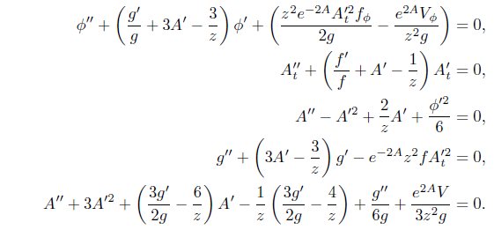
Consider the ansatz (in Einstein frame)
$ds^{2}=\frac{e^{2A(z)}}{z^{2}}\left[−g\left(z\right)dt^{2}+\frac{dz^{2}}{g\left(z\right)}+d{\vec{x}}^{2}\right],$
$φ=φ\left(z\right),A=A_{t}\left(z\right)dt$
Background eoms:
EOMs:

Slide 16
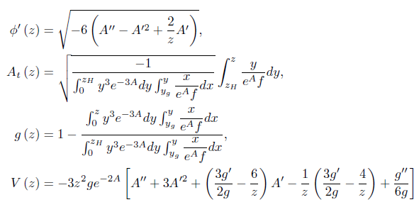
Boundary conditions:
At the horizon, $A_{t}\left(z_{H}\right)=g\left(z_{H}\right)=0$
At the boundary, require the metric in string frame is asymptotic to AdS, so we have in Einstein frame
$A\left(0\right)=−\sqrt{\frac{1}{6}}φ\left(0\right), g\left(0\right)=1$
Solution:

Slide 17
More about the solution
Express $y_{g}$ in terms of chemical potential,
$A_{t}\left(z→0\right)=μ−ρz^{2}$
Fix $f(z)$ by requiring Regge behavior
$f\left(z\right)=e^{±cz^{2}−A(z)}$

Slide 18
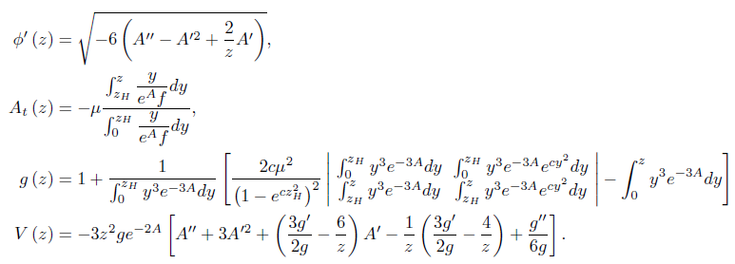
So we have the analytic solution
where $A(z)$ is arbitrary
A simple choice $A\left(z\right)=−\frac{c}{3}z^{2}−bz^{4}$,$b>0$

Slide 19
3.Thermodynamics : Temperature
$$T=\left|\frac{g^{′}(z_{h})}{4π}\right|=$$
b=0.86, c=0.2
as a example
1
2
3

Slide 20
Specific heat

Slide 21
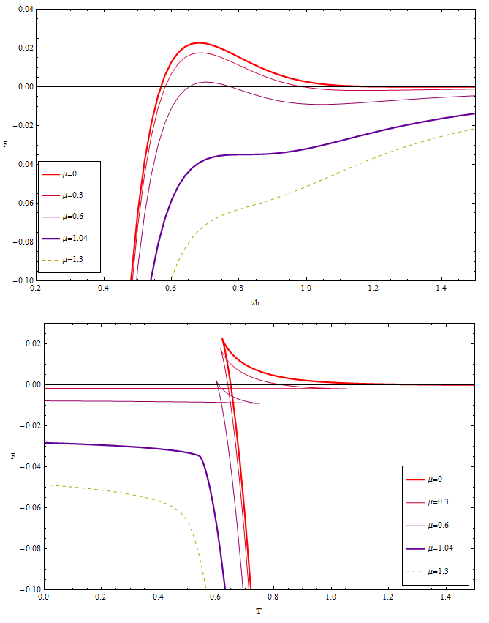
Free energy:
At fixed μ, $F=−\int{sdT}+f_{0}$
$f_{0}$ is chosen by matching
$F\left(z_{h}→∞\right)=0$ (thermal gas) at $μ=0$
For $μ=0$, there is a Hawking-Page transition between the black hole and thermal gas..
For $μ<μ_{c}$, there is a first order large/small black hole transition; for $μ>μ_{c}$, there is no phase transition but crossover.

Slide 22
4.Equations of state: Entropy density
$$s={\left.\frac{A}{4V_{3}}\right|}_{z_{h}}=\frac{e^{3A(z_{h})}}{4{z_{h}}^{3}}$$

Slide 23
Pressure
First law of thermodynamics
$$dε=Tds−p+μdρ$$
Due to the choice of $f_{0}$

Slide 24
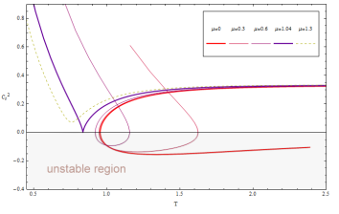
Speed of sound
$$C_{s}^{2}=\frac{d\ln{T}}{d\ln{s}}$$
Conformal limit:
$${c_{s}}^{2}=\frac{1}{3}$$
Imaginary speed of sound, dynamical unstable

Slide 25
Phase diagram
First order
Crossover

Slide 26
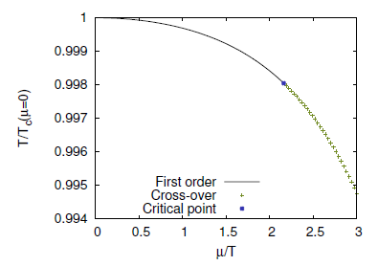
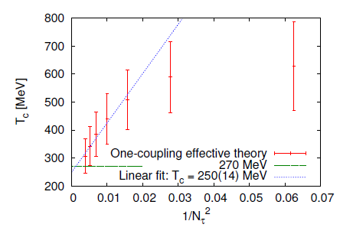
Lattice results: (1111.4953)
Confinement-deconfinement transition for heavy but dynamical quarks:
$$μ=0$$
$N_{τ}$~6

Slide 27
Our interpretation
Compare with lattice results, we would like to interpret our large-small black hole transition as heavy quark
confinement/deconfinement transition. But….is it?
As we know the conventional confinement/deconfinement
transition corresponds to Hawking-Page transition in the bulk,
so is it possible that a large/small black hole transition can
correspond to confinement/deconfinement transition?

Slide 28
Some possibilities
1.Usually, the small black hole is dynamically unstable, so the small black hole might decay to thermal gas soon
2.Because the free energy difference between the small black hole and thermal gas is quite small, so it is possible that these two states are both thermodynamically favored
3.The choice of the integration of constant in free energy is not correct for $μ≠0$ case, it is possible that if we choose it correctly, the black hole transition will coincide with the Hawking-Page transition
More to check: Polyakov loop, conductivity, or entanglement entropy

Slide 29
4.Conclusions
We analytically construct a soft-wall AdS/QCD model by using Einstein-Maxwell-Dilaton model; with some degree of freedom of choosing the warped factor of metric, one can obtain a family of solutions in our AdS/QCD model
We find there exists a swallow-tailed shape of free energy which indicates a 1st order large/small black hole phase transition
There exists a critical chemical potential, below which there is a first order phase transition, and above which there is no phase transition but crossover. This agrees with recent heavy quark lattice results qualitatively
We also compute the equations of state and find interesting critical behavior

Slide 30
4. Discussion
Our model is the first holographic model which shows a critical point and satisfies the linear Regge behavior

Slide 31
Future works
1.Introduce external magnetic field
2.Meson spectral function and quarkonium dissociation
3.Energy loss
4.Quark-antiquark linear potential and Polaykov loop
5.Transport coefficients and hydrodynamics
6.Critical exponents
7.Introduce chiral symmetry
8.Check the stability of the small black hole

Slide 32
Thank you!

