Slide 1
From Pattern Formation to Phase Field Crystal Model
吳國安 (Kuo-An Wu)
清華大學物理系
Department of Physics
National Tsing Hua University
3/23/2011

Slide 2
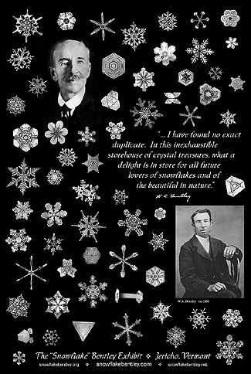
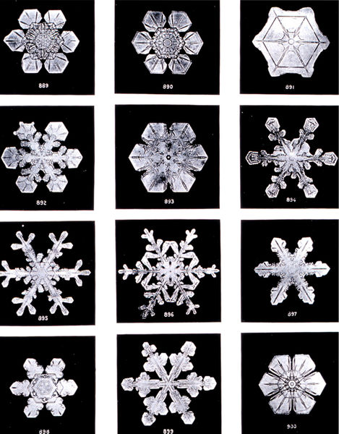
Pattern Formation in Crystal Growth
by Wilson Bentley (The snowflake man), 1885

Slide 3
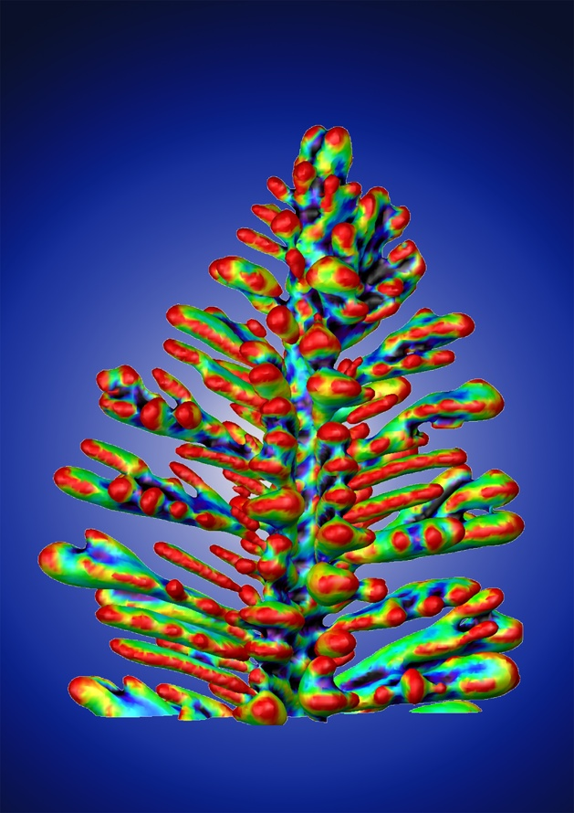
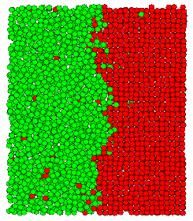
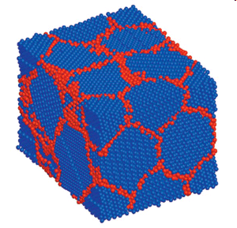
Pattern Formation in Crystal Growth
At the nanoscale (atomistic scale)
Liquid-Solid interfaces
Anisotropy ↔ Morphology
Atomistic details ↔ Anisotropy?
Hoyt, McMaster
Solid-Solid interfaces
Grain boundary
Atomistic details ↔ growth?
Al-Cu dendrite, Voorhees Lab
Northwestern University
Schuh, MIT
Atomistic details ↔ Continuum theory at the nanoscale

Slide 4
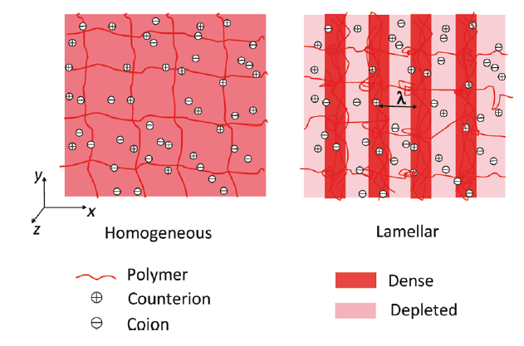
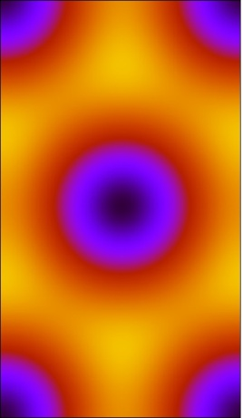
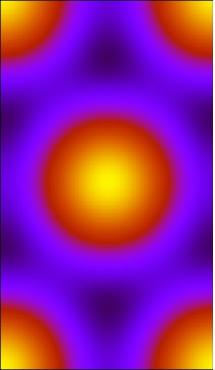
Pattern Formation in Macromolecules
Polyelectrolyte Gels
Hexagonal phase in solvent rich region
Hex (-)
Hexagonal phase in polymer rich region
Competition between Enthalpy, Entropy, Elastic Network Energy,
Electrostatic energy, … etc
Hex (+)

Slide 5
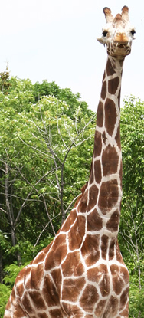
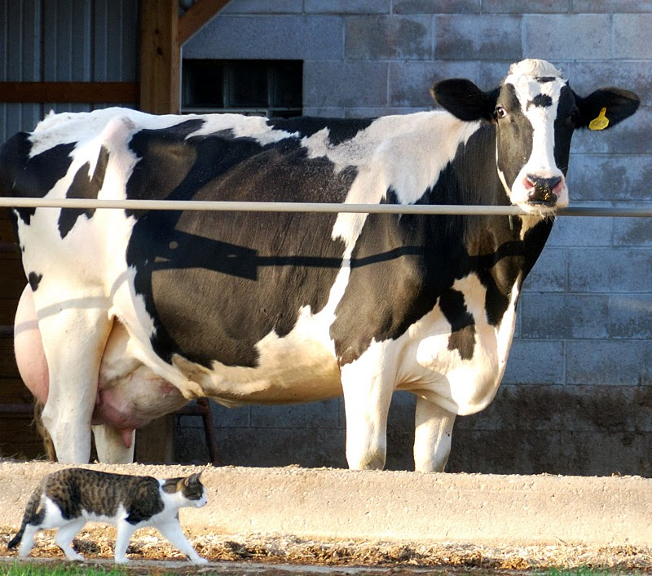
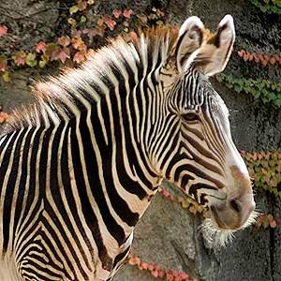

Pattern Formation in Biology
Rural Area, Wisconsin
Lincoln Park Zoo
Chicago

Slide 6
Pattern Formation in Biology
Nuclear Lamina (核纖層)～30-100nm
In animal cells, only composed of 2 types lamins
Lamin (核纖層蛋白) A/C
Lamin B1, B2
Bleb Formation in Breast Cancer Cell Nucleus
Goldman Lab, Northwestern University
Confocal Immunofluorescence of a normal cell nucleus
Goldman Lab, Northwestern University

Slide 7
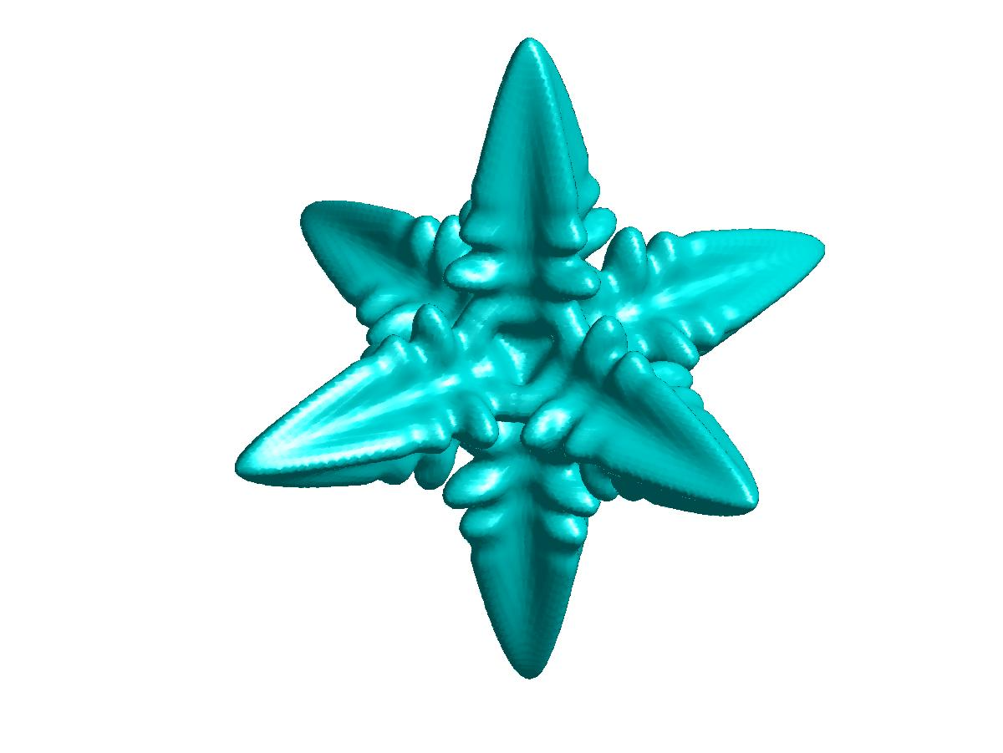
Crystal Growth at the Nanoscale
Solid-Liquid interface
Crystal growth from its
melt with interfacial
anisotropy
Solid-Fluid interface
under stress
Quantum dots
InAs/GaAs
Ng et al.,
Univ. of Manchester, UK
Solid-Solid interface
Grain boundaries
Schuh/MIT

Slide 8
Crystal growth – Solid-Liquid interface
Motivation – γ anisotropy vs. crystal structures
Order-parameter models of equilibrium bcc-liquid interfaces
Ginzburg-Landau theory
Density functional theory (DFT) of freezing
Comparison with MD simulations
Phase-field crystal model
Multi-scale analysis
Determination of phase-field crystal model parameters
Comparison with GL theory and MD simulations

Slide 9
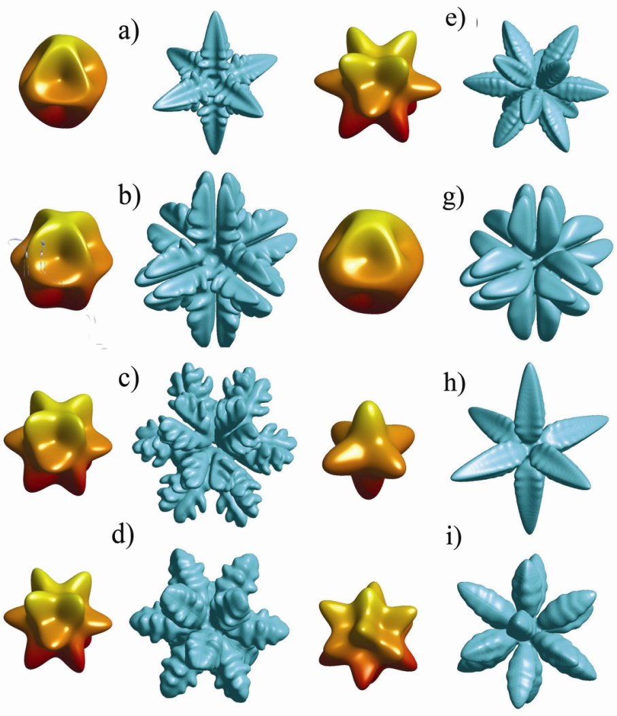
Morphology vs. Anisotropy
Anisotropy of γ
Gibbs-Thomson condition
1/TrS
(Max ΔT)
Phase-field simulations
of solidification
What causes the anisotropy?

Slide 10
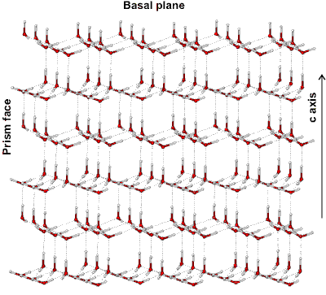
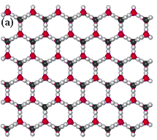
Crystal growth – Solid-Liquid interface
Basal Plane

Slide 11
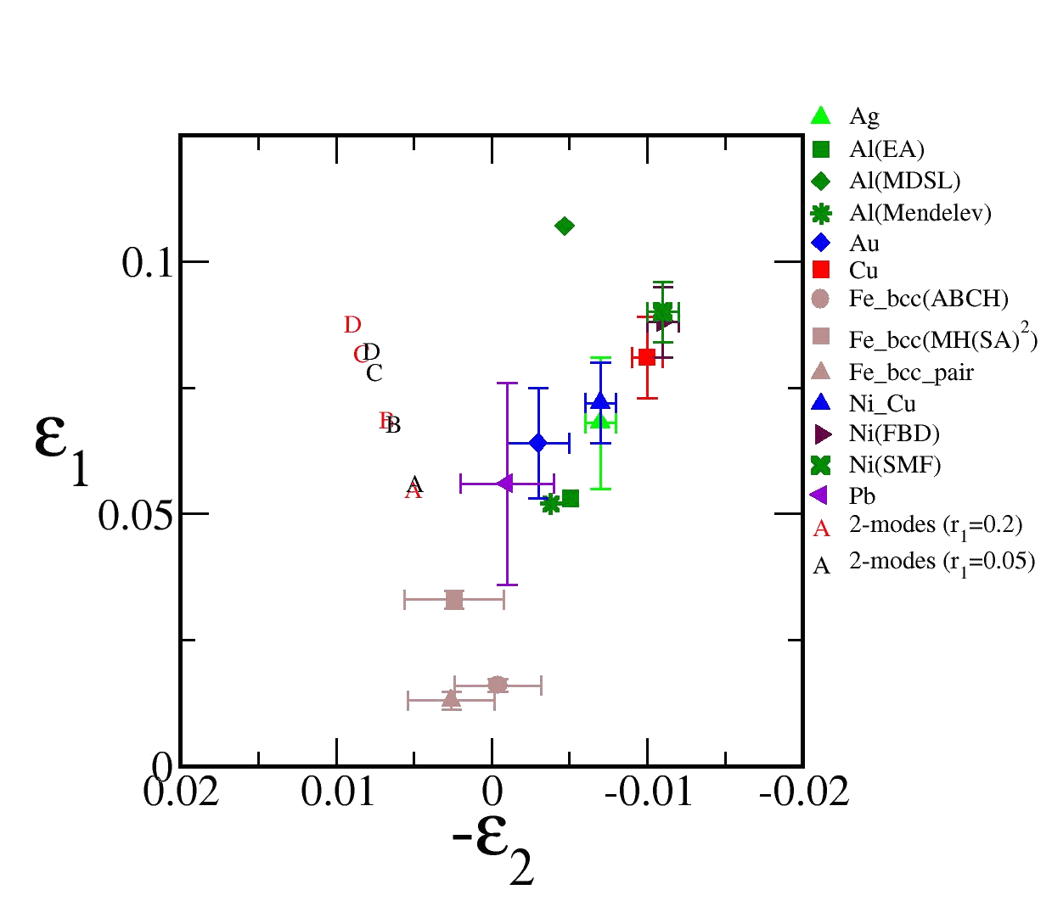
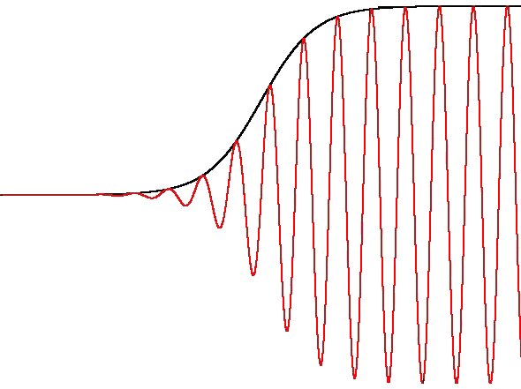
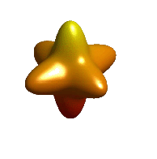
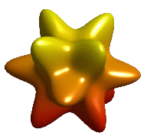
Anisotropy vs. Crystal structures
WHY?
fcc
bcc

Slide 12
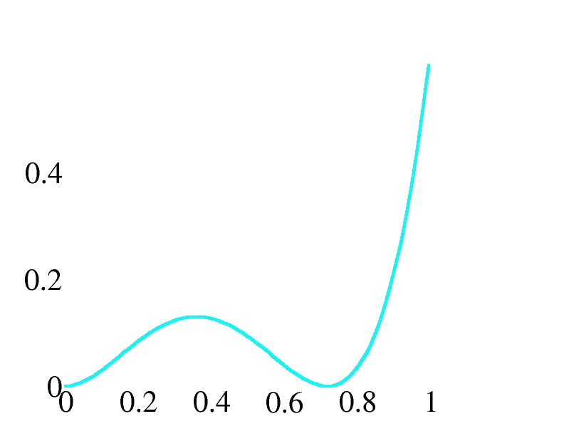
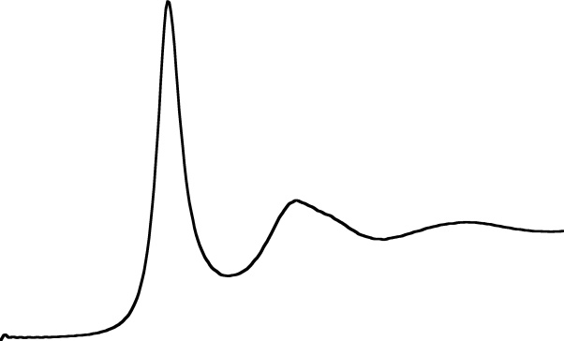
GL Theory for bcc-liquid interface
Free energy functional for a planar
solid-liquid interface with normal
Density Functional Theory of Freezing
ΔF
γ
Liquid structure factor
S(K)
K₀
K (Å⁻¹)
a₃ and a₄ are determined
by equilibrium conditions
Liquid
u₁₁₀
Solid

Slide 13
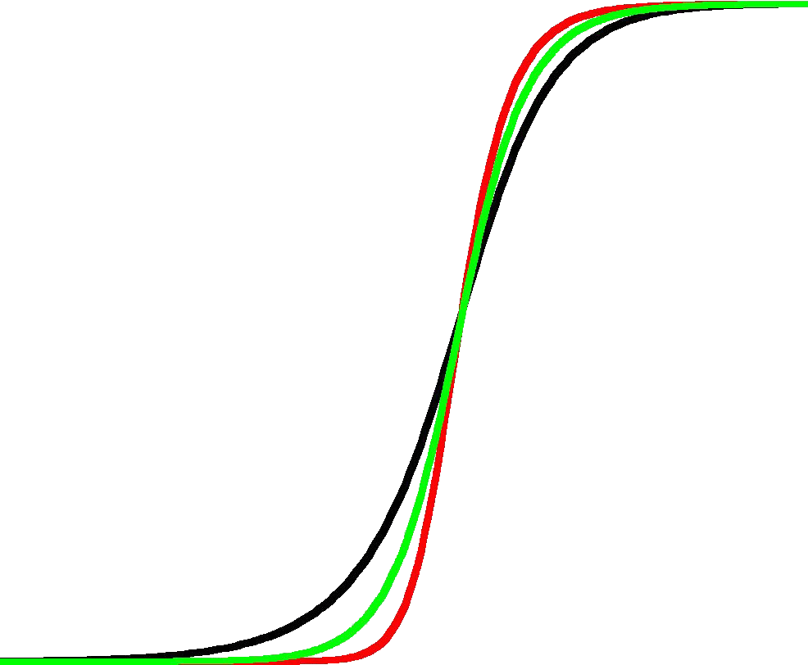
Bcc-liquid interface profile
For the crystal face
{110} is separated into three subsets

Slide 14
Anisotropic Density Profiles
2D Square Lattices
Symmetry breaks at interfaces → Anisotropy

Slide 15
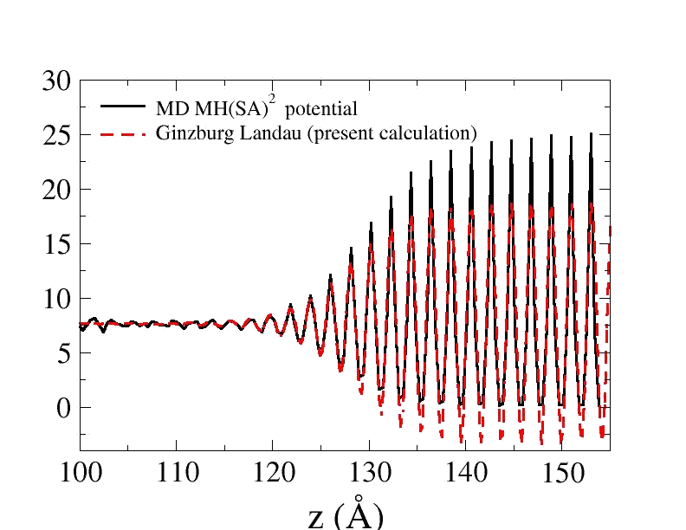
Comparison with MD results
BCC Iron
n x 10⁻²³
(cm⁻³)

Slide 16
Comparison with MD results
Anisotropy
γ (erg/cm²)
Fe | γ₁₀₀ | γ₁₁₀ | γ₁₁₁ | ε_{4 (%)}
MD (MH(SA)²) | 177.0(11) | 173.5(11) | 173.4(11) | 1.0(0.6)
GL theory | 144.26 | 145.59 | 137.57 | 1.02
Predict the correct ordering of γ
and weak anisotropy 1% for bcc crystals
Atomistic details (Crystal structures) matter!

Slide 17
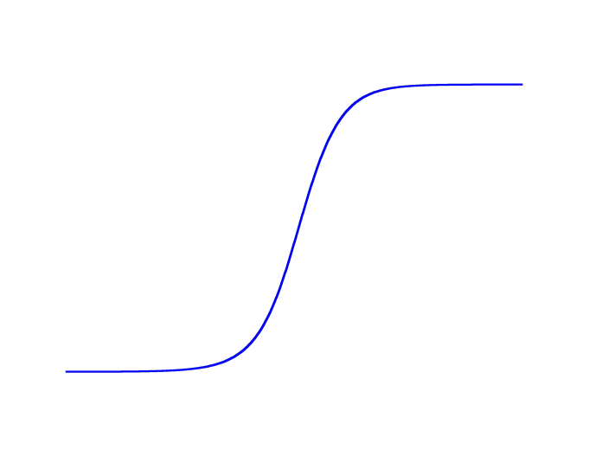
Methodology for atomistic simulations
Molecular Dynamics (MD)
Mean field theory
Ginzburg-Landau theory
Rely on MD inputs
Average out atomistic details
Diffusive dynamics (ms)
Larger length scale (μm)
Elasticity, defect structure, … etc?
Realistic physics
Resolve vibration modes (ps)

Slide 18

Methodology for atomistic simulations
Molecular Dynamics (MD)
Mean field theory
Phase field crystal (PFC)
Realistic physics
Resolve vibration modes (ps)
Average out vibration modes (ms)
Atomistic details – elasticity, crystalline planes,
dislocations, … etc.

Slide 19



Formulation - Phase Field Crystal
(001) plane of
bcc crystals
(100)
(110)
Swift & Hohenberg, PRA (1977)
2D Patterns – Rolls, Hexagons
Elder et al., PRL (2002)
Propose a conserved SH equation
The Free Energy Functional
Equation of Motion
Capillary Anisotropy?
Elasticity?

Slide 20

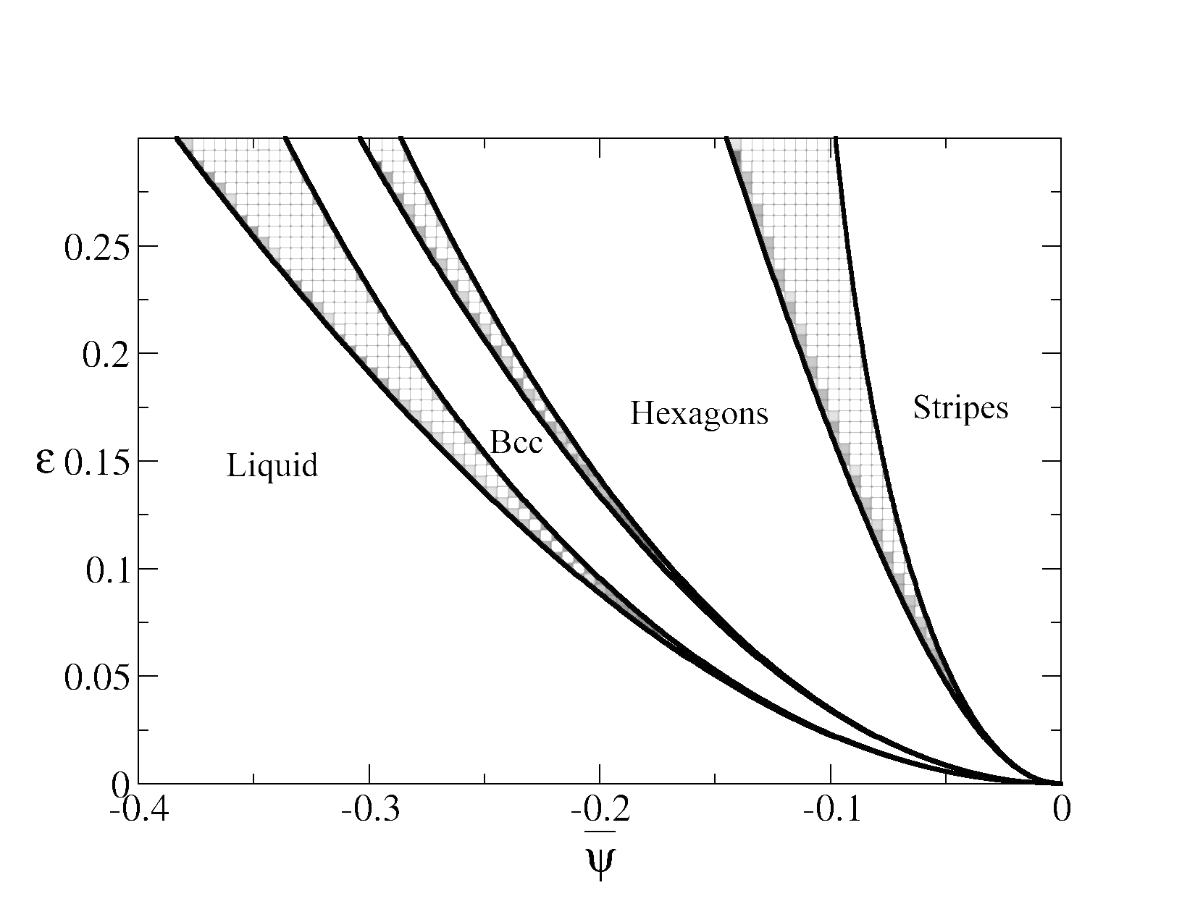


PFC Model – Phase Diagram
Conserved Dynamics
Phase diagram

Slide 21








Multi-scale Analysis
Seek the perturbative solution
Assumption – interface width is much larger
than lattice parameter
Maxwell construction
The solid-liquid coexistence region
A weak first-order freezing transition
(The multi-scale analysis of bcc-liquid interfaces will be carried out around ψ_{c})

Slide 22



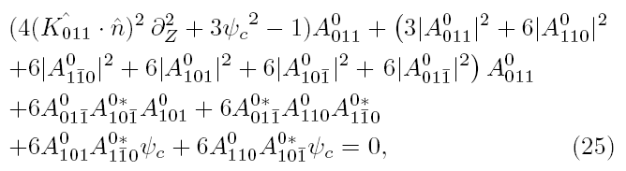
Multi-scale Analysis – Amplitude equation
Small ε limit – diffuse interface
Multi-scale analysis
Equal chemical potential in both phases
One of twelve stationary amplitude equations

Slide 23
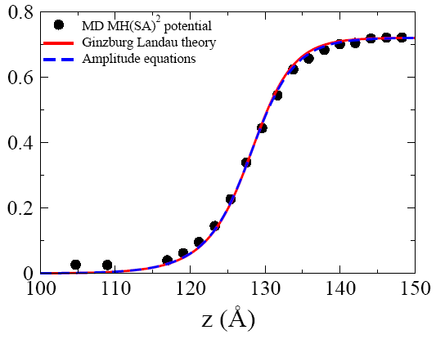
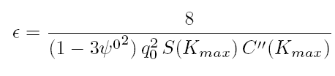
Order Parameter Profile Comparison
For the crystal face
Determination of the PFC
model Parameter from density
functional theory of freezing
u₁₁₀

Slide 24
Comparison with MD results
Anisotropy
γ (erg/cm²)
Fe | γ₁₀₀ | γ₁₁₀ | γ₁₁₁ | ε_{4 (%)}
MD (MH(SA)²) | 177.0(11) | 173.5(11) | 173.4(11) | 1.0(0.6)
GL theory | 144.26 | 141.35 | 137.57 | 1.02
PFC | 144.14 | 140.67 | 135.76 | 1.22
Predict the correct ordering of γ
γ₁₀₀ > γ₁₁₀ > γ₁₁₁
and weak anisotropy 1% for bcc crystals

Slide 25
What about Other Crystal Structures?
Phase diagram

Slide 26
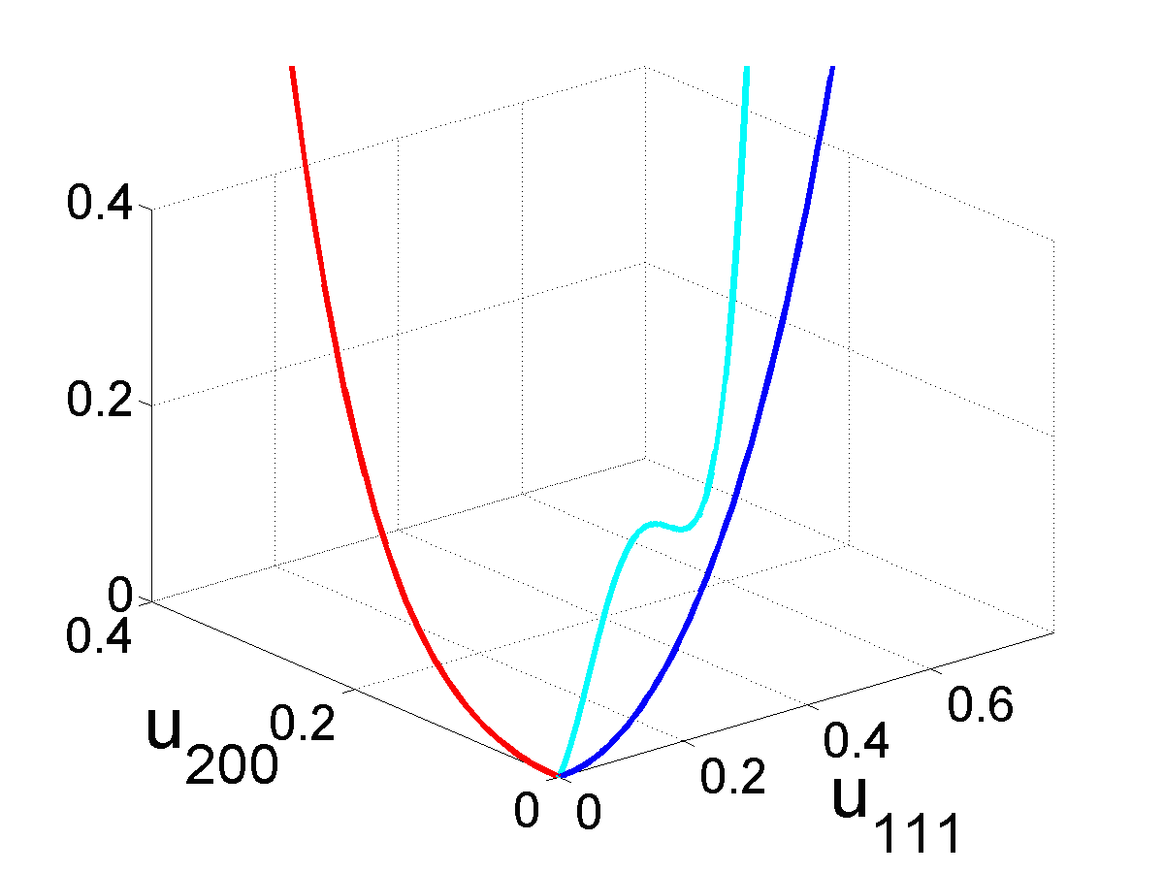
y
x
z
GL theory of fcc-liquid interfaces
BCC-Liquid
FCC-Liquid
F
F
u₁₁₀

Slide 27
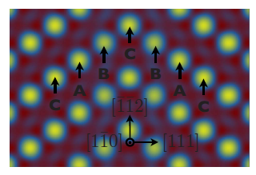



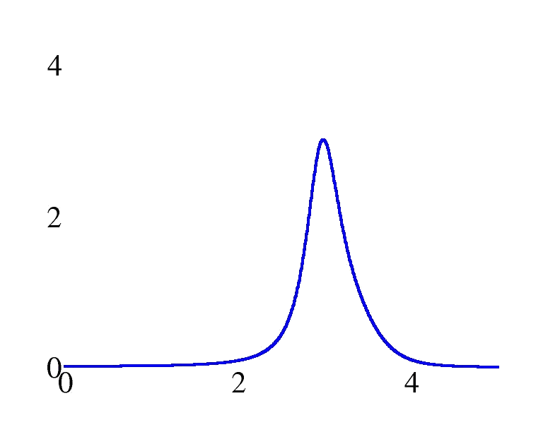
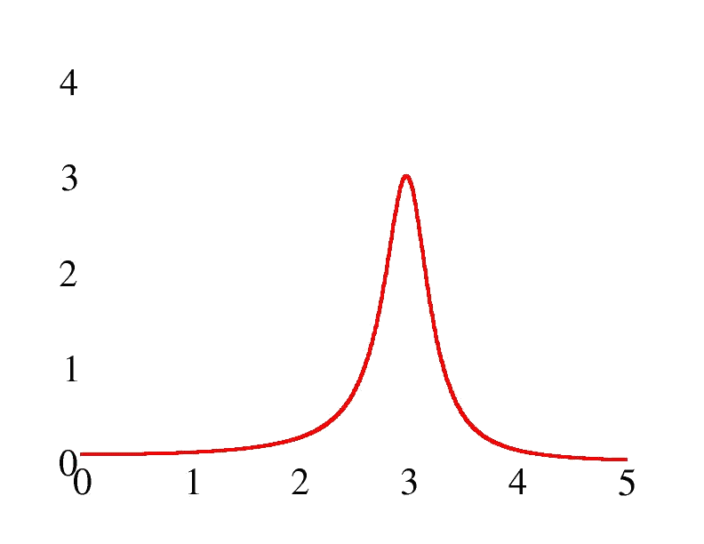
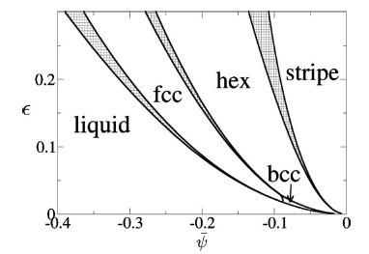
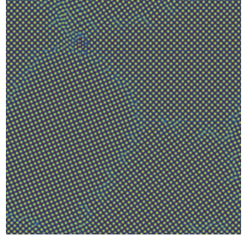
FCC Model
The Two-mode fcc model
The PFC model
Twin Boundary
Phase Diagram
FCC Polycrystal

Slide 28
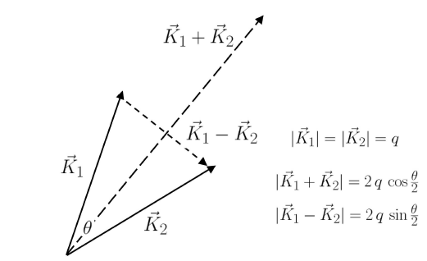
Design Desired Lattices
Example: Square Lattices
Elasticity
Multi-mode model
Single-mode model
Dictate interaction angle
(lattice symmtry)

Slide 29
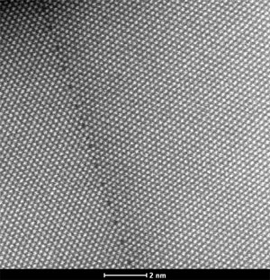
Grain Boundary
Grain boundary is composed of dislocations
Geometric arrangement of crystals determines dislocation distribution
Distinct evolution for low and high angle grain boundary
D
Symmetric tilt planar grain boundary in gold
by STEM

Slide 30
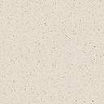
GB sliding and coupling
GB Coupling – Low Angle GB
GB Sliding – High Angle GB
Well described by
continuum theory
Sutton & Balluffi, Interfaces in Crystalline Materials, 1995

Slide 31
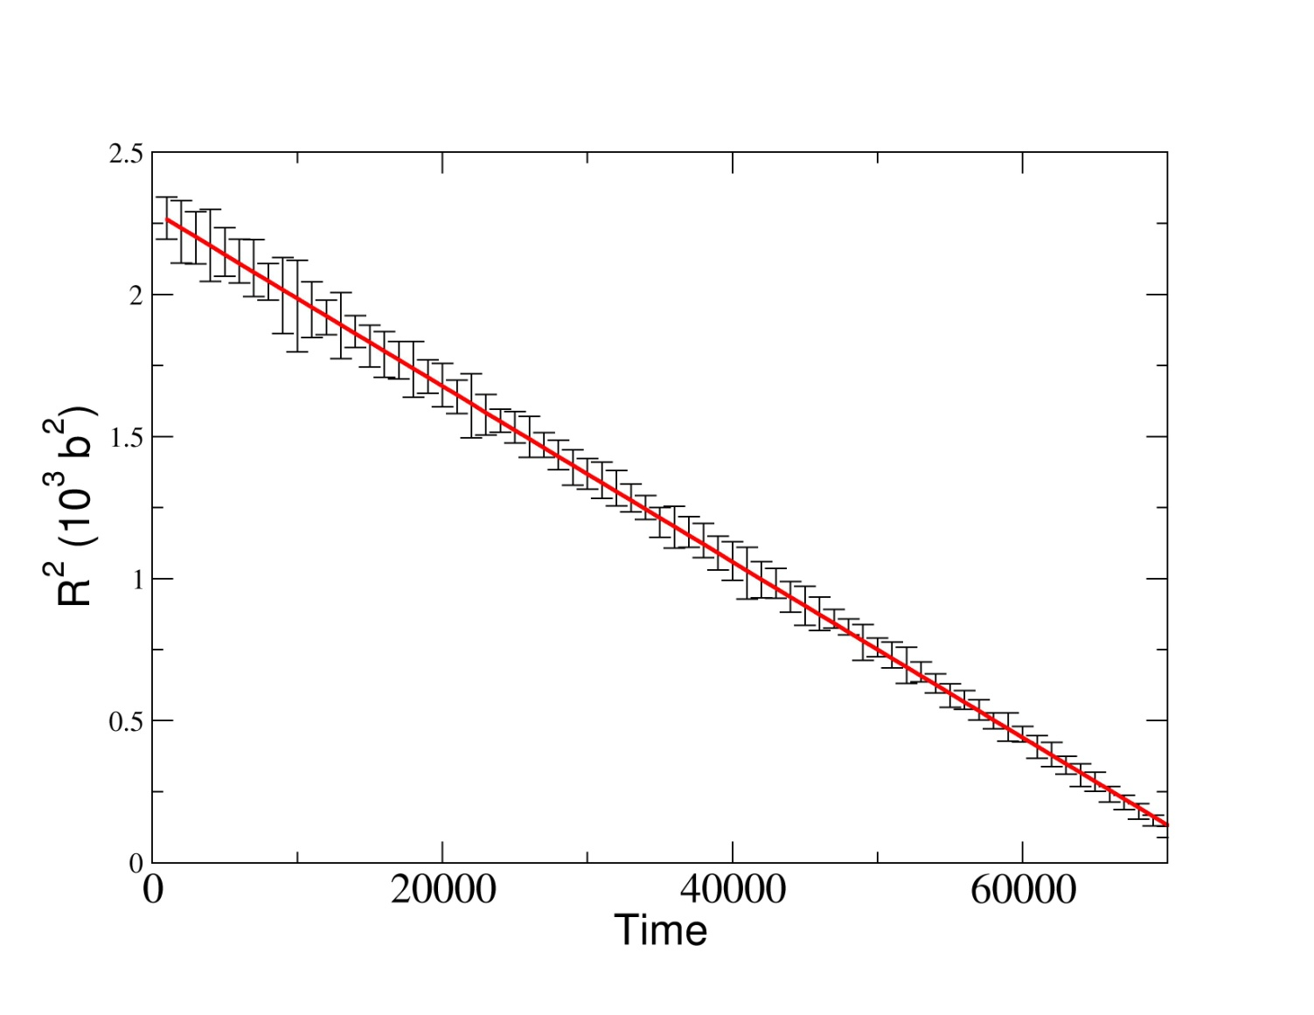
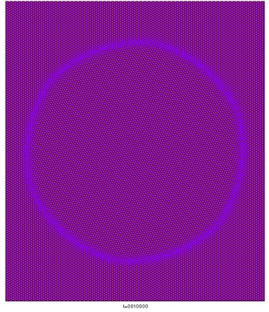
Large Misorientations
Curvature driven motion
G.B. sliding (fixed misorientation)
γ remains constant
Well described by classical continuum theory

Slide 32
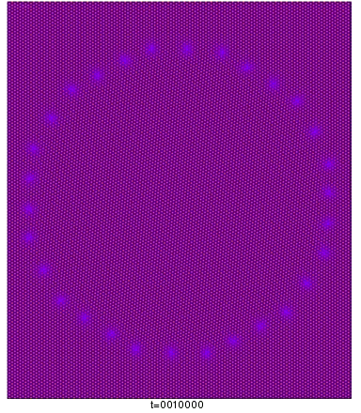
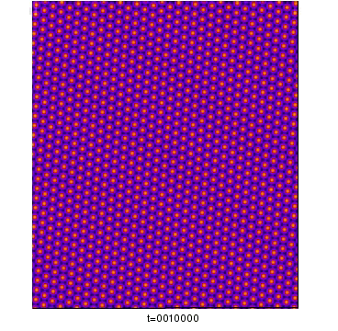
Small Orientations
Theory that only considers γ
Misorientation decreases?
Atoms at the center of the circular grain
Misorientation increases!

Slide 33
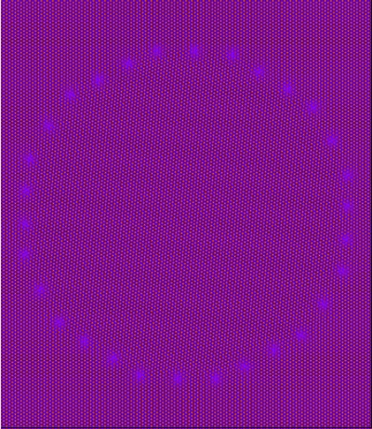

Small Misorientations
G.B. coupling
For symmetric tilt boundaries
Misorientation increases
GB energy increases
Misorientation-dependent mobility:
(Taylor & Cahn)

Slide 34
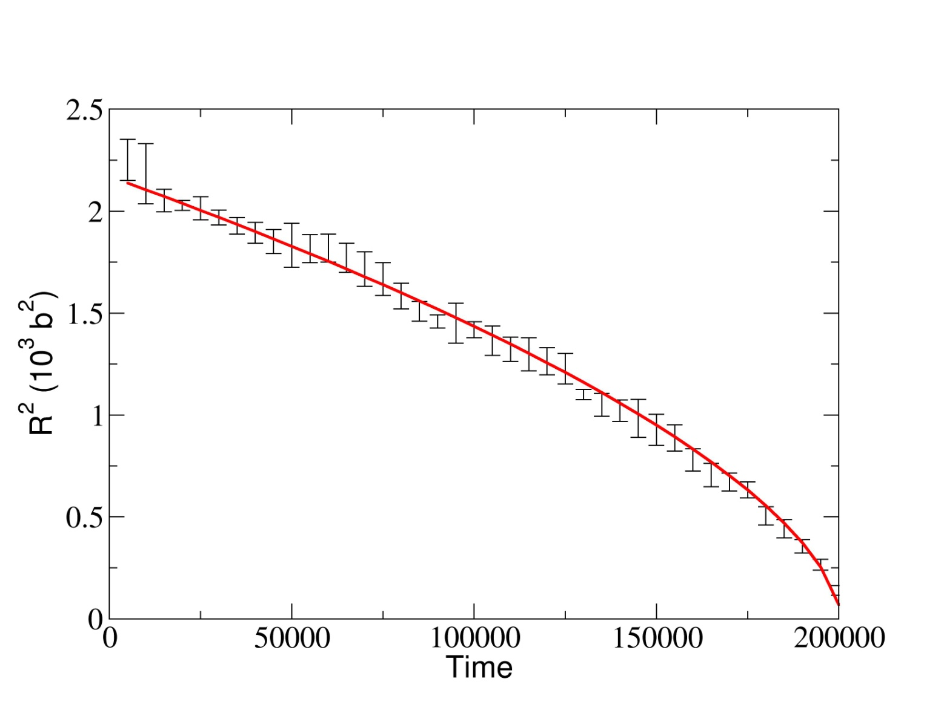
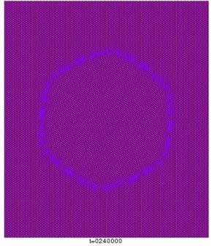
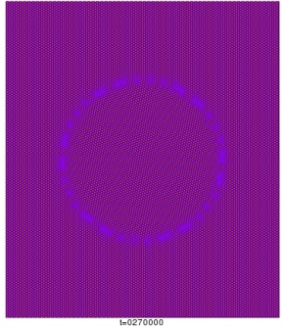
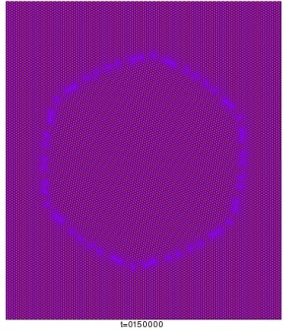
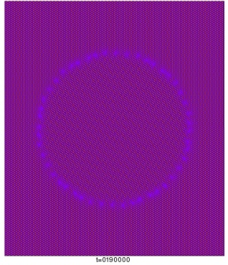
Intermediate Misorientations – cont.

Slide 35
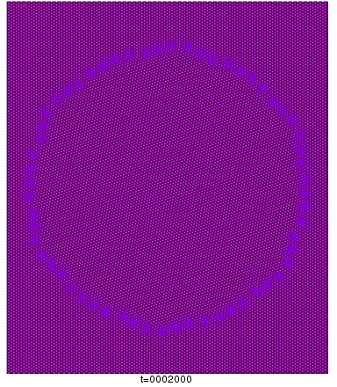
Intermediate Misorientations
Faceted–Defaceted Transition
Frank-Bilby formula
Tangential motion of dislocations
Annihilation of dislocations

Slide 36
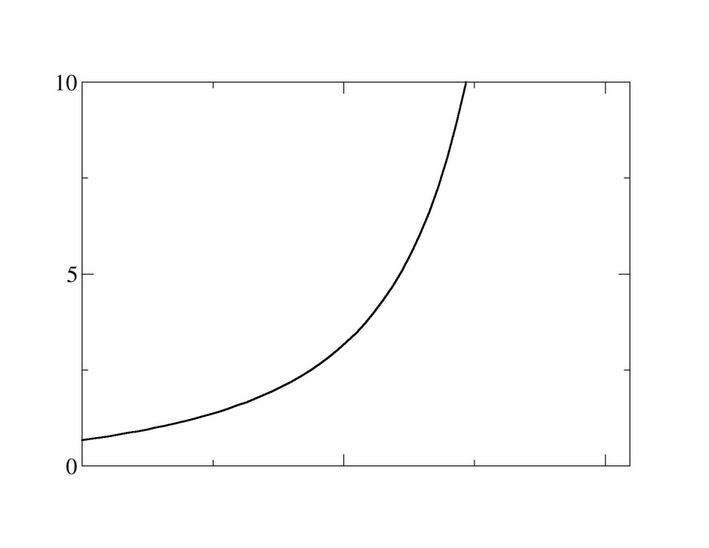
Intermediate Misorientations – cont.
Spacing d₁ is a function of GB normal
Instability of tangential motion occurs when
0
Φ
π/3

Slide 37
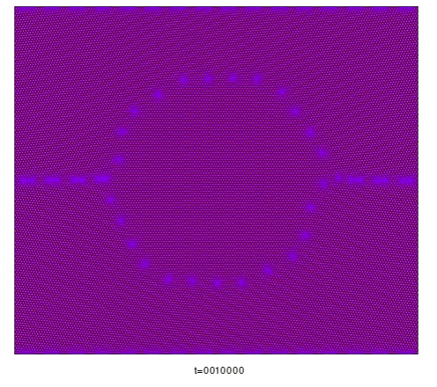
Three-Grain System
Grain Rotation?
GB wiggles

Slide 38

Grain Rotation

Slide 39


Grain Translation

Slide 40

^{5.2º}
GB
Wriggles
^{0º}
^{-5.2º}

Slide 41

Dihedral angle
follows Frank’s formula
not the Herring relation

Slide 42

Self-Assembled Quantum Dots
Quantum-dot LEDs
Other Applications
Tunable QD Laser
Quantum Computing
Telecommunication
and more
Quantum dots
InAs/GaAs
Ng et al.,
Univ. of Manchester, UK
Lee et al., Lawrence Livermore National Laboratory

Slide 43


Stress Induced Instability – Asaro-Tiller-Grinfeld Instability
Cullis et al. (1992): 40 nm thick Si_{0.79}Ge_{0.21} on (001) Si substrate - Grown at 1023 K (Defect-free growth)
Linear perturbation
calculation
Misfit Parameter
Film
a_{f}
Substrate
Schematic plot from Voorhees and Johnson
Solid State Physics, 59
a_{s}

Slide 44

Later Stage Evolution - Cusp Formation - Dislocations
High stress concentration at the tip
Si_{0.5}Ge_{0.5}/Si(001)
Jesson et al., Z-Contrast,
Oak Ridge Natl. Lab.,
Phys. Rev. Lett. 1993

Slide 45
Simulation Parameters
Various sizes
Constant
Phase
The PFC model
Simulation parameters
Hexagonal
Phase
Constant
Phase
(1+ε_{xx})L_{x}

Slide 46


Nonlinear Steady State for a Smaller k
σ
k

Slide 47



Quantitative Comparison of Strain Fields
Correct elastic fields
Elastic fields relax much
faster than the density field

Slide 48

Critical Wavenumber vs Strain
Linear perturbation theory
Sharp Interface
Homogeneous Materials
Classical Elasticity Theory
PFC simulations
PFC simulations
Xie et al., Si_{0.5}Ge_{0.5} films, PRL
Linear Elasticity
k_{c} ~ ε_{xx}² for small strains
Nonlinear elasticity modifies length scale

Slide 49
PFC modeling of nonlinear elasticity
Liquid
Inhomogeneous materials
nonlinear elasticity
Solid

Slide 50
Finite Interface Thickness Effect
Liquid, E=0
Upper bounds
λ_{c}~ε^{1/2}·ε_{xx}⁻²
W~ε^{-1/2}
E(x,y)
Solid, E=E_{o}
Finite interface thickness W
Elastic constants vary smoothly
across the Interface region
Interface thickness is no longer negligible at the nanoscale

Slide 51


Nonlinear Evolution for k ~ k_{m}
σ
k

Slide 52

3D Island – BCC Systems

Slide 53


And More …
VLS nanowires
Nano-particles with defects

Slide 54
And More …

Slide 55






Pattern Formation - Examples
Agular et al, Oxford University
North Pole Hexagon on Saturn
Ice Crystal
Rock Formation in Ireland
Honeycomb
Graphene

Slide 56



Collaborators
Alain Karma
Northeatsern University
Mathis Plapp
Laboratoire de Physique de la Matière Condensée Ecole Polytechnique
Peter W. Voorhees
Northwestsern University

