Slide 1
Likelihood of the Matter Power Spectrum in Cosmological Parameter Estimation
Hu Zhan
National Astronomical Observatories
Chinese Academy of Sciences
Collaborators: Lei Sun & Qiao Wang
3rd International Workshop on
Dark Matter, Dark Energy and Matter-Antimatter Asymmetry
NTHU & NTU, Dec 27—31, 2012

Slide 2
Outline
Likelihood analysis in parameter estimation
Likelihood function of the matter power spectrum
Example: effects of approximate likelihoods on f_{NL}
Example: photometric redshift error distribution
Summary

Slide 3
Bayesian Inference
Bayes’ Theorem:
posterior ∝ prior×likelihood
Parameter Estimation:
Mapping the posterior probability of the parameters from the likelihood of the data.
Likelihood analysis with Markov Chain Monte Carlo (MCMC) sampling becomes a standard method for cosmological parameter estimation.
A crucial element: the likelihood function

Slide 4
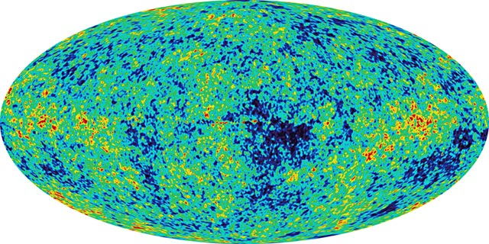
Analysis in Practice
WMAP
Dimension of temperature data: 10⁷ for WMAP
Direct sampling in full map space is not feasible!

Slide 5
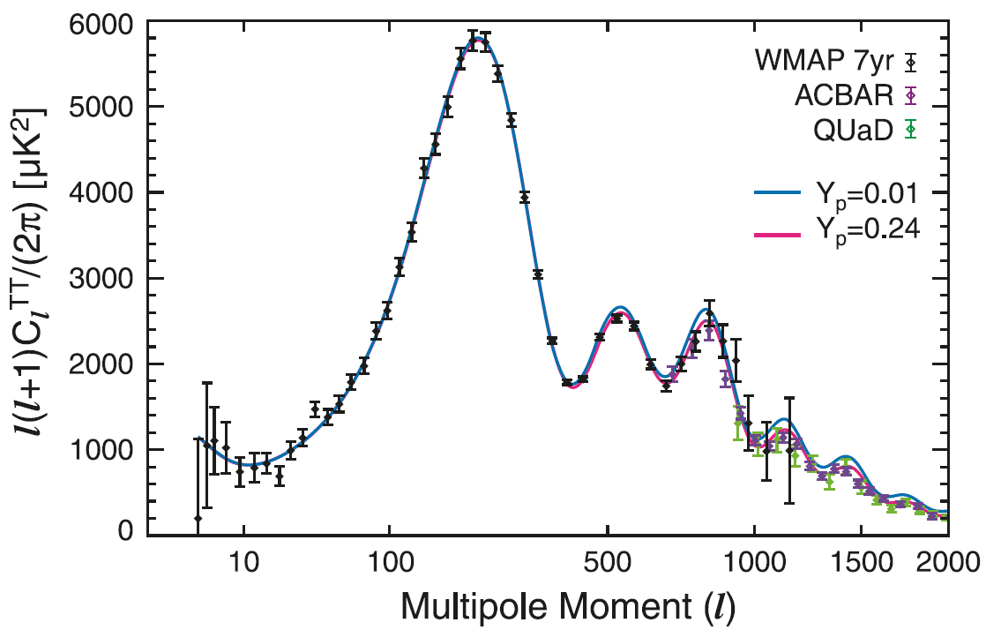
Analysis in Practice
WMAP
Gaussian random field is completely characterized by its power spectrum (PS) ➔ “radical compression” with band power (e.g., Bond et al. 2000).
Analysis now feasible + other benefits

Slide 6
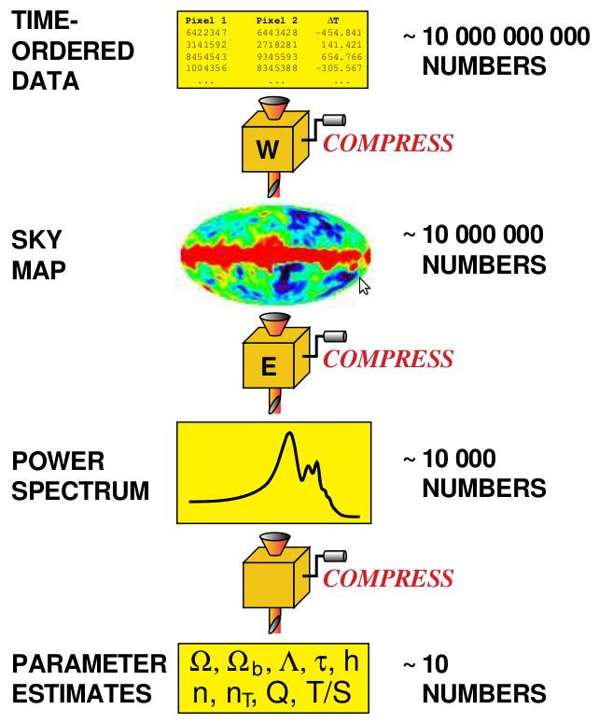
Tegmark 1997

Slide 7
Outline
Likelihood analysis in parameter estimation
Likelihood function of the matter power spectrum
Example: effects of approximate likelihoods on f_{NL}
Example: photometric redshift error distribution
Summary

Slide 8
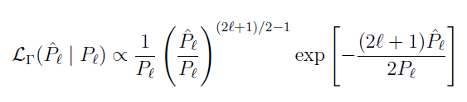



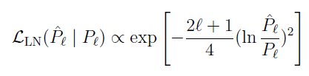
Likelihood Function of the Power Spectrum
Considering the angular power spectrum of a GRF
Likelihood of P_{l} : Gamma distribution
Approximations:
∗ Gaussian without
determinant (G,nod)
∗ Gaussian (G,d)
∗ Gaussian+Lognormal (G+LN)
(WMAP, Verde et al. 2003)

Slide 9
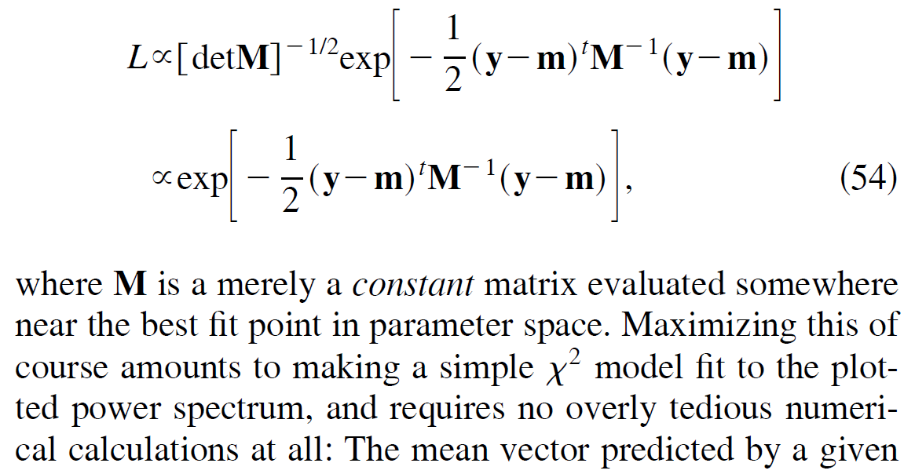
Why Reexamine the Issue?
In analyses of galaxy density fluctuations and weak lensing shear fluctuations, the likelihood of the power spectrum (or correlation function) is commonly assumed to be Gaussian (without the determinant of the covariance, e.g., Tegmark 1997)!

Slide 10
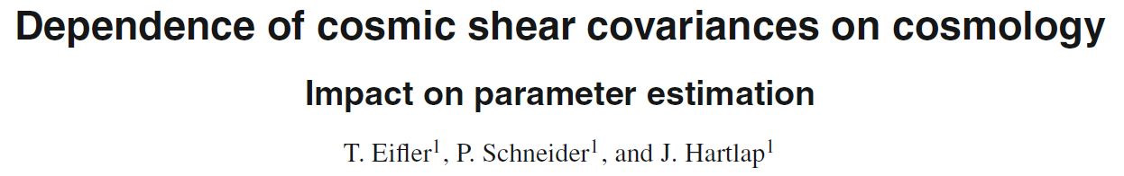
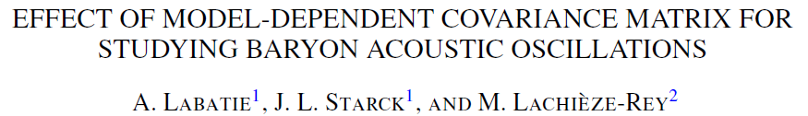
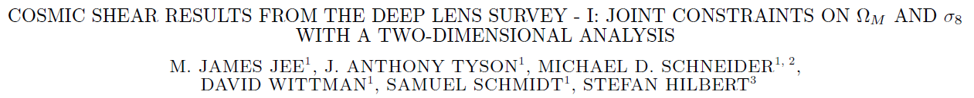
Why Reexamine the Issue?
Recently, it is argued that the determinant should be included in the analysis:
2009
2012
2013

Slide 11
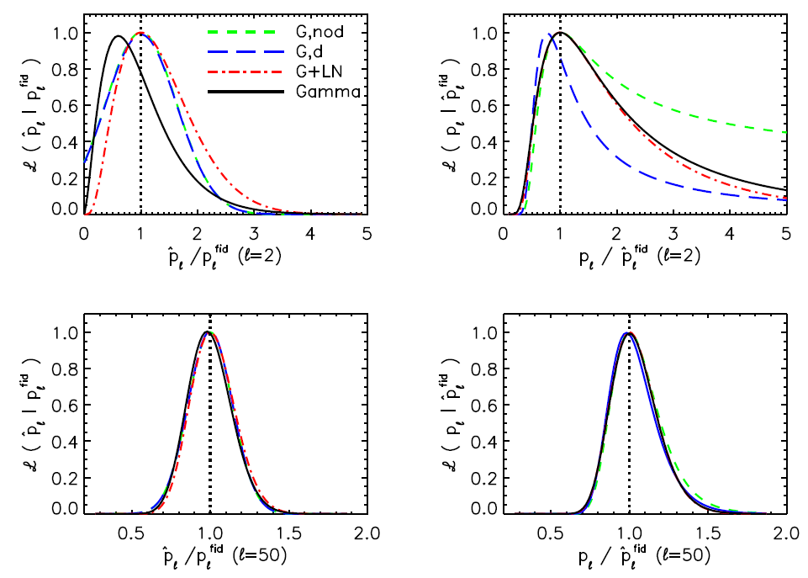
Likelihood & Posterior of P_{l}
Low l :
The complete Gaussian is a biased estimator with a narrower distribution
→ an underestimate of the mode and errors(?).
The Gaussian without determinant term: a quite extended distribution
→ an overestimate of mean and error bars.
High l : all approaching Gaussian.

Slide 12

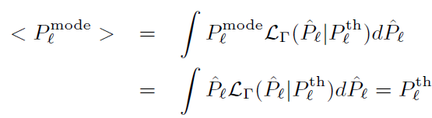

Simple Analysis of the Posterior
Based on one realization (observation):
Gamma/ G, nod/G+LN:
The complete Gaussian (G,d):
with n=(2l+1)/4
The ensemble averaged:
Gamma/ G, nod/G+LN:
The complete Gaussian (G,d):
Effect on parameter θ:
θ ∝ P_{l} → mode-unbiased with G, nod/G+LN /Gamma
Nonlinear dependence → possibly biased
e.g.

Slide 13
Outline
Likelihood analysis in parameter estimation
Likelihood function of the matter power spectrum
Example: effects of approximate likelihoods on f_{NL}
Example: photometric redshift error distribution
Summary

Slide 14





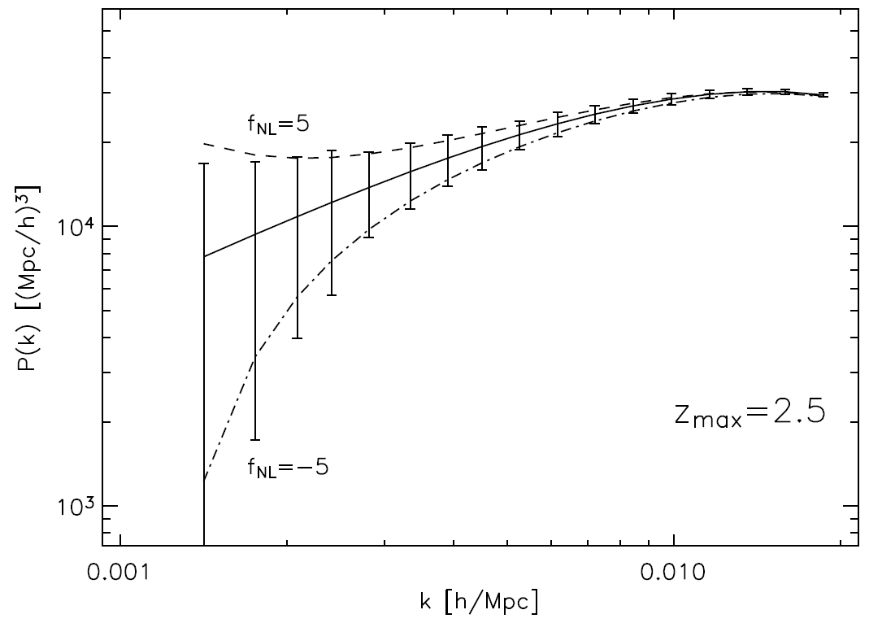
Example: f_{NL}
Survey Data Model:
1 z-bin at z_{m}~1, width σ=0.5, l=[2, 1000], n_{g}=10/arcmin², f_{sky}=0.5
Fiducial “data” P_{l} are calculated theoretically at fiducial values of parameters.
Cosmological Parameters:
ΛCDM with 6 params
Fix
Fiducial values:
Primordial non-Gaussianity, local type, leads to a scale-dependent bias:
f_{NL} sensitive to low l
(i.e., small k)
LSST Science Book
arXiv:0912.0201

Slide 15
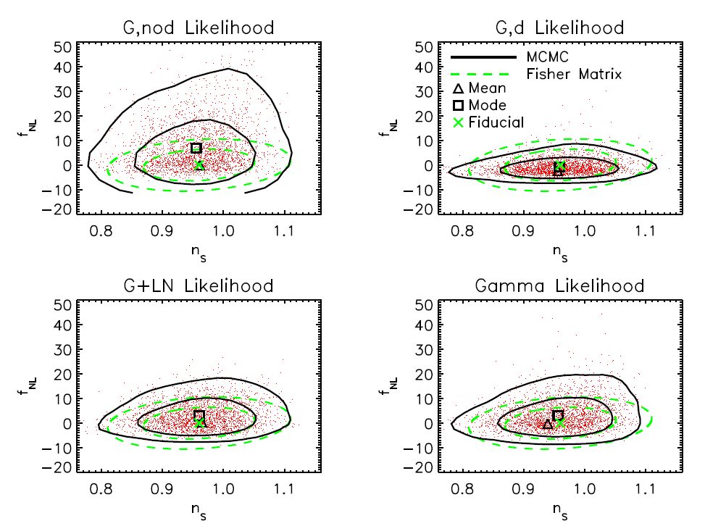
Effects of Approximate likelihoods
Input: fiducial P_{l}
Priors: 20% on bg and b(k,f_{NL})>0.
Given the large error contours with 6 params floating, none of the likelihoods leads to a significant bias.
Based on the shape of the error contours, G+LN outperforms the other approximations.
samples thinned by ~1/50

Slide 16
Effects of Approximate likelihoods
All other parameters fixed:
Mode unbiased but the error too large!
Biased and error too small!
Best match of the exact case.
1D mapping of the posterior

Slide 17
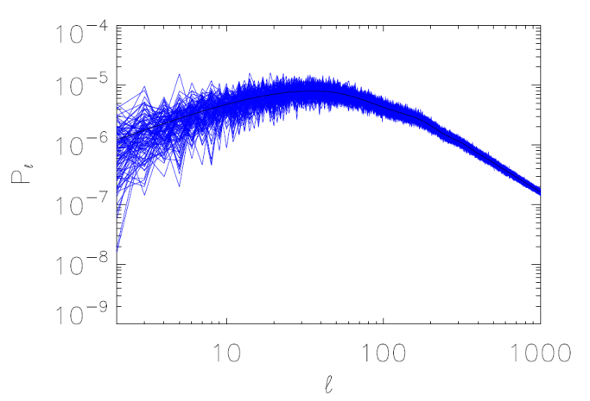
Bias of the f_{NL} Estimators
10,000 random samples of power spectra following Gamma distributions
Only f_{NL} floating (fiducial f_{NL}=0)
first 100 of the 10⁴ power spectra

Slide 18
Bias of the f_{NL} Estimators
Distribution of mean/mode f_{NL} of 10,000 realizations
Strongly biased

Slide 19
Outline
Likelihood analysis in parameter estimation
Likelihood function of the matter power spectrum
Example: effects of approximate likelihoods on f_{NL}
Example: photometric redshift error distribution
Summary

Slide 20
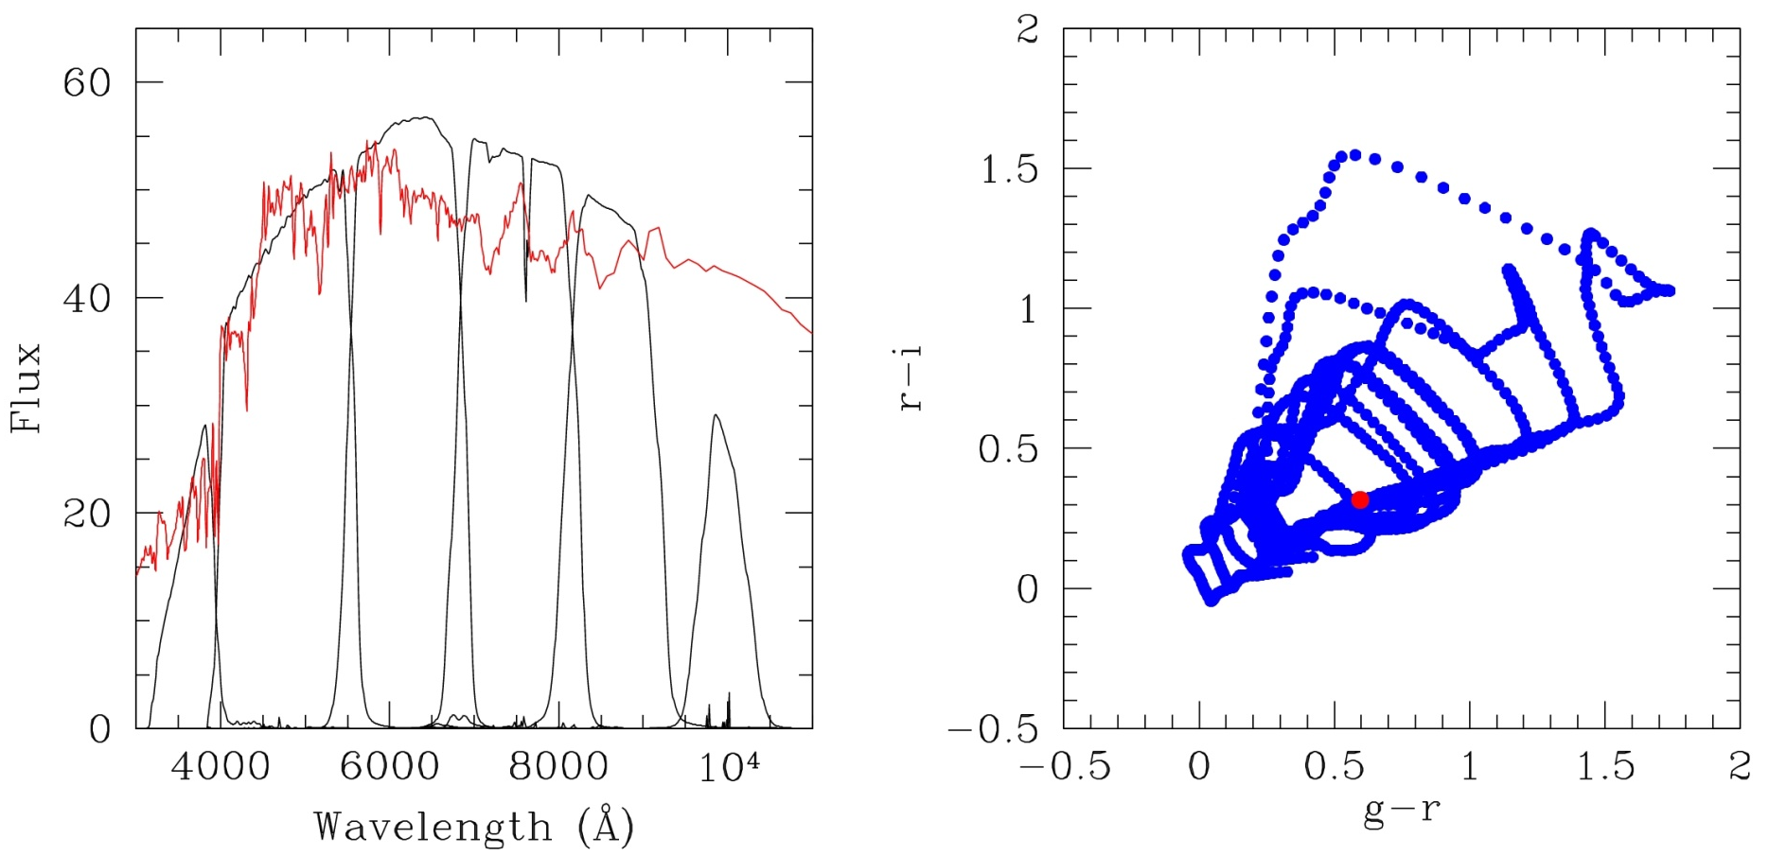
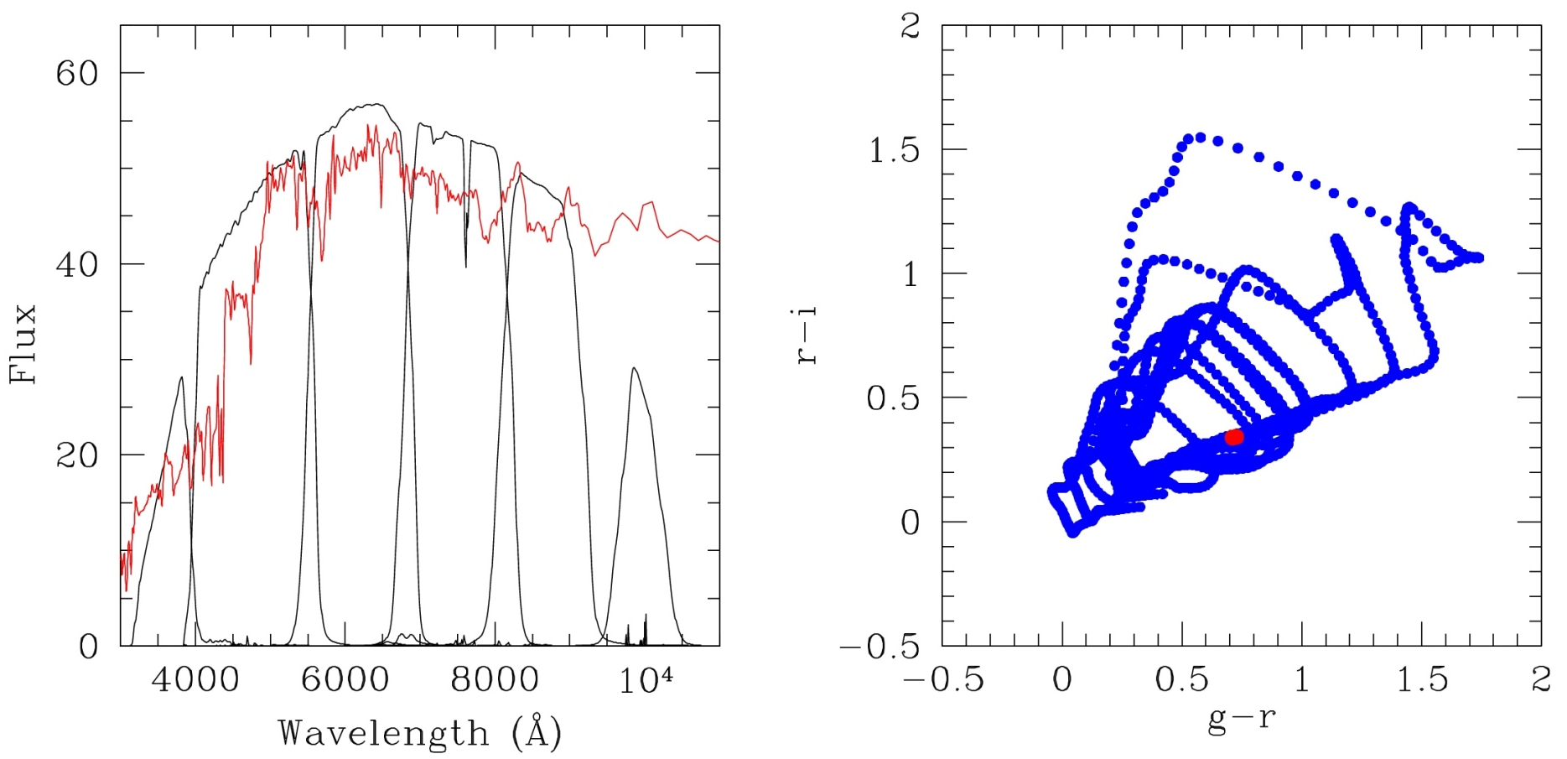
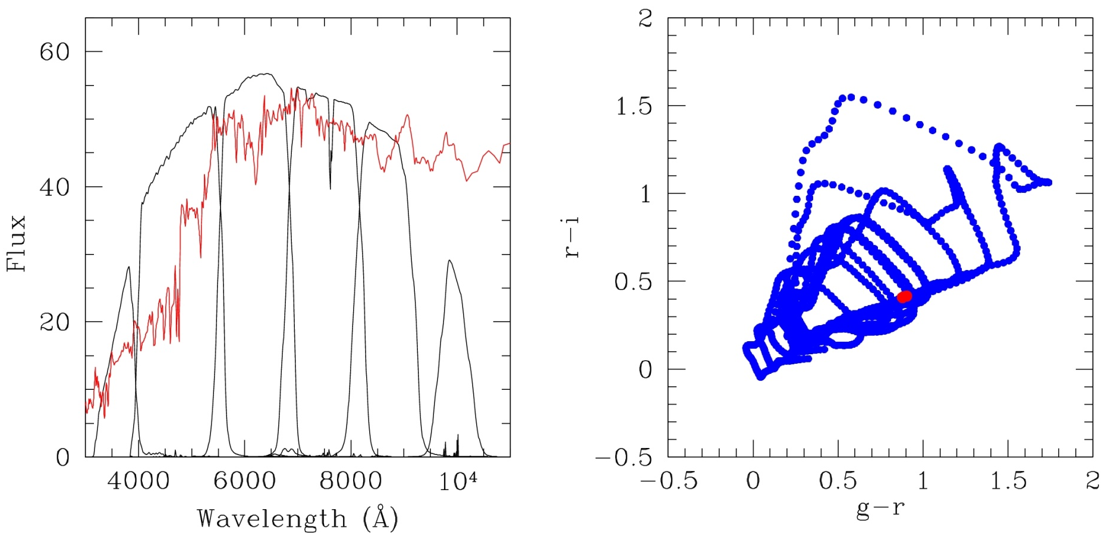
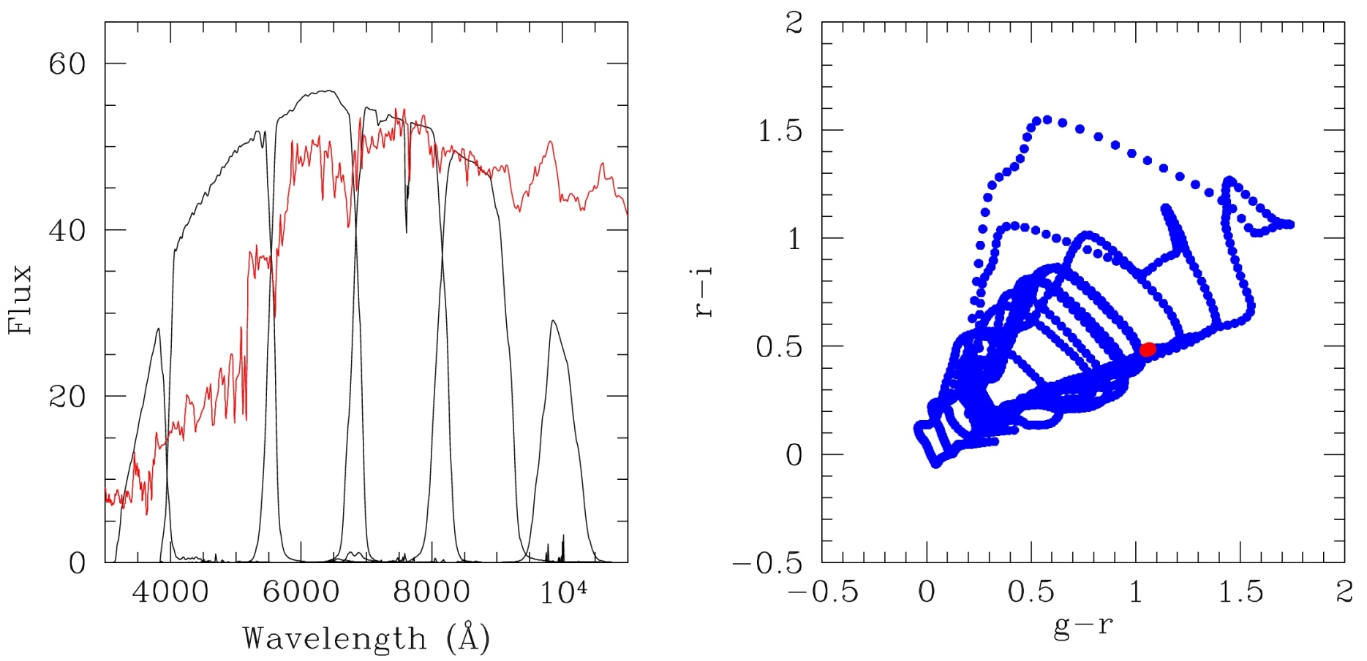
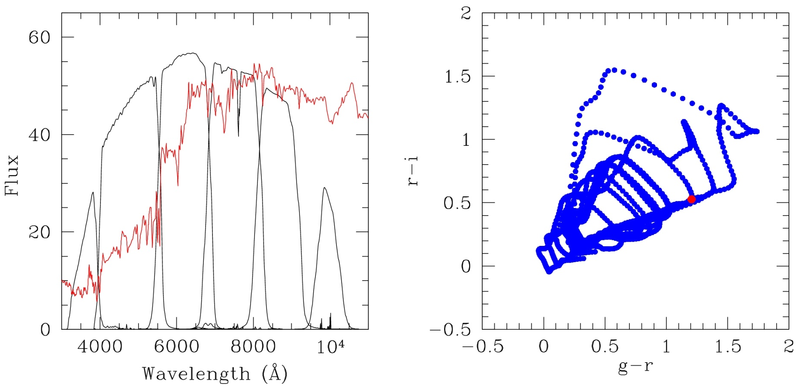
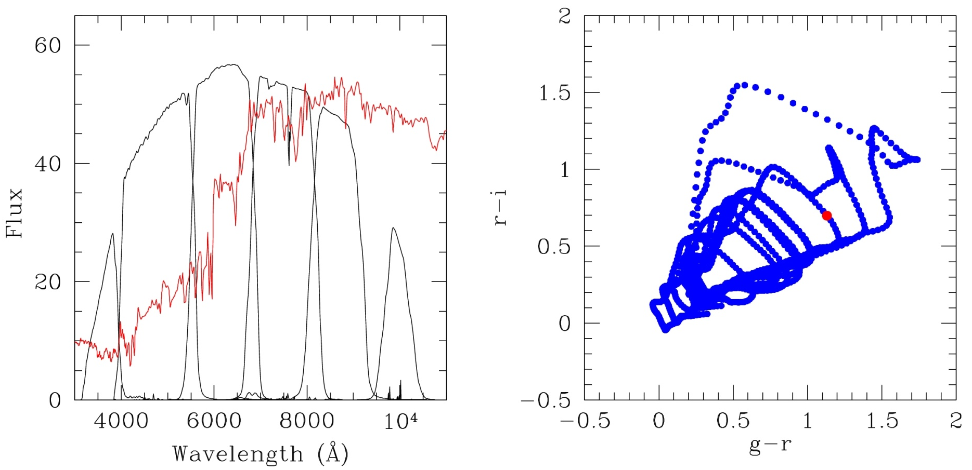
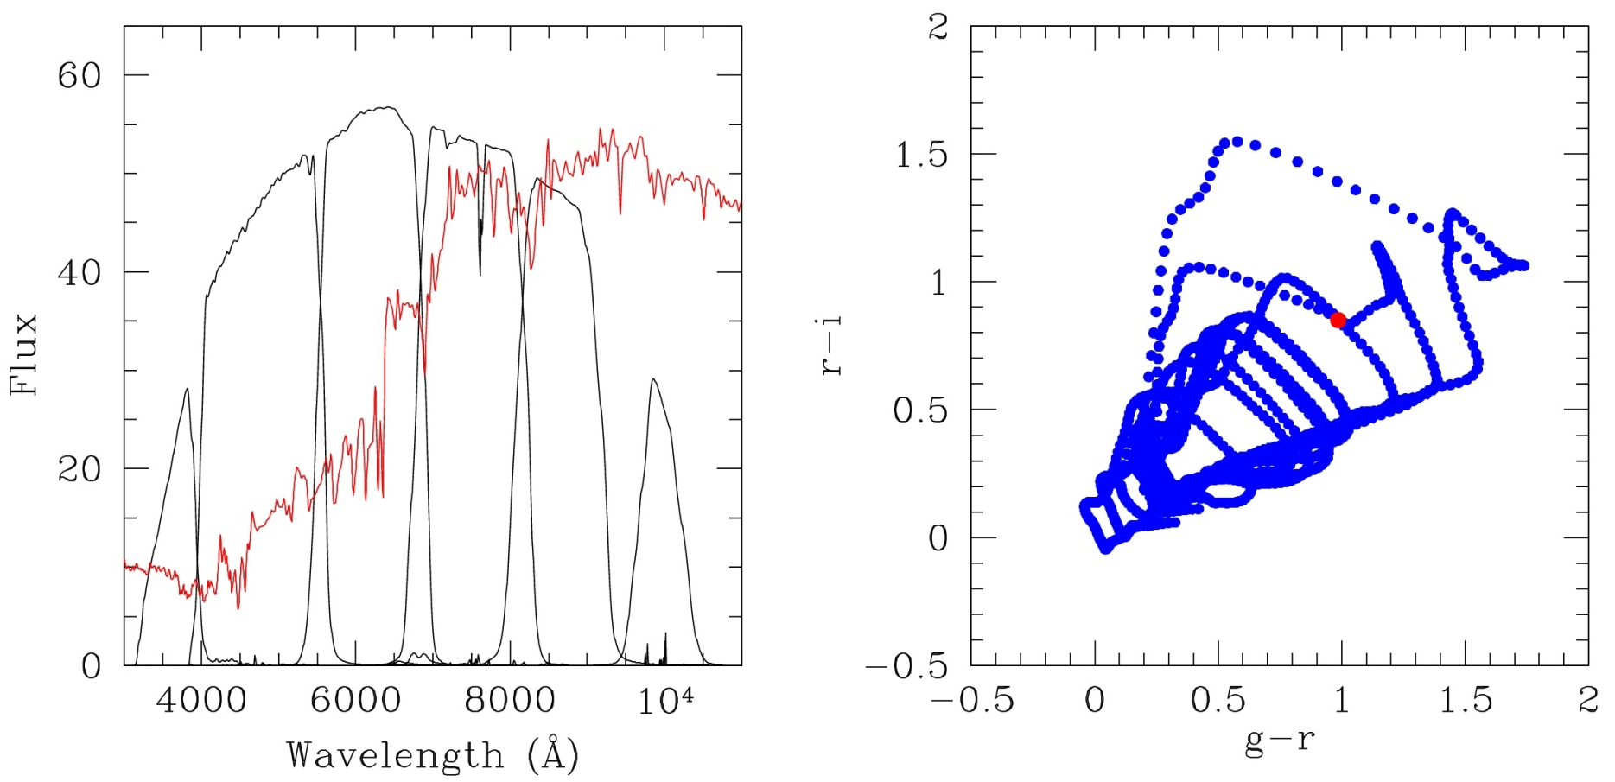
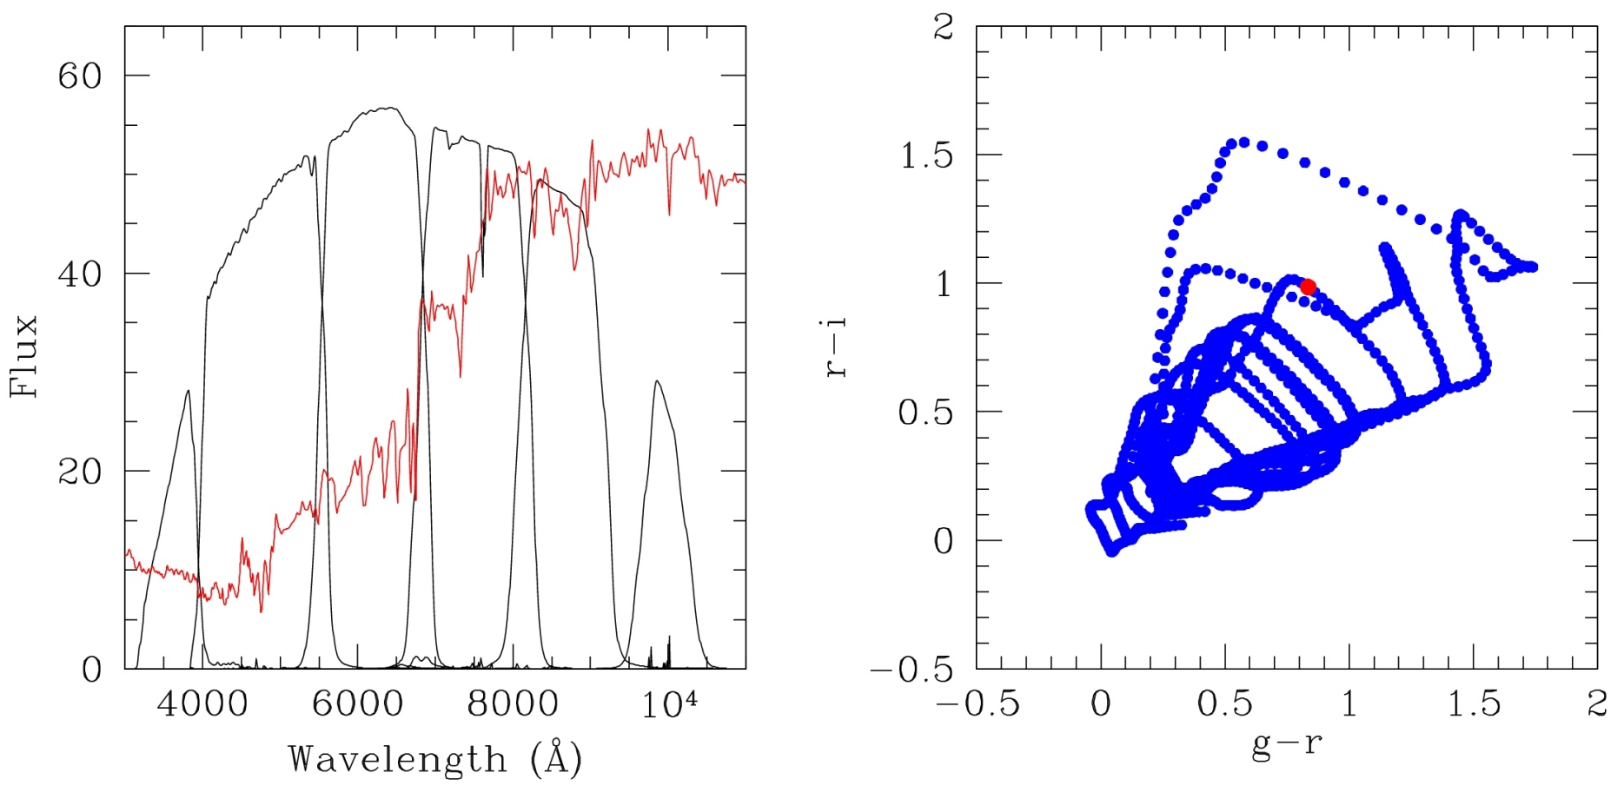
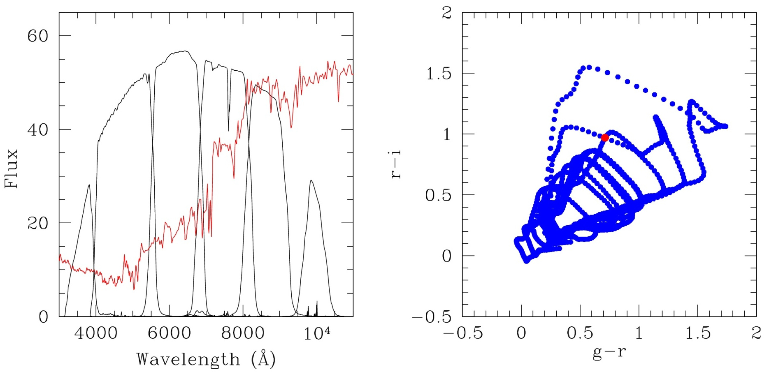
Photometric Redshifts

Slide 21
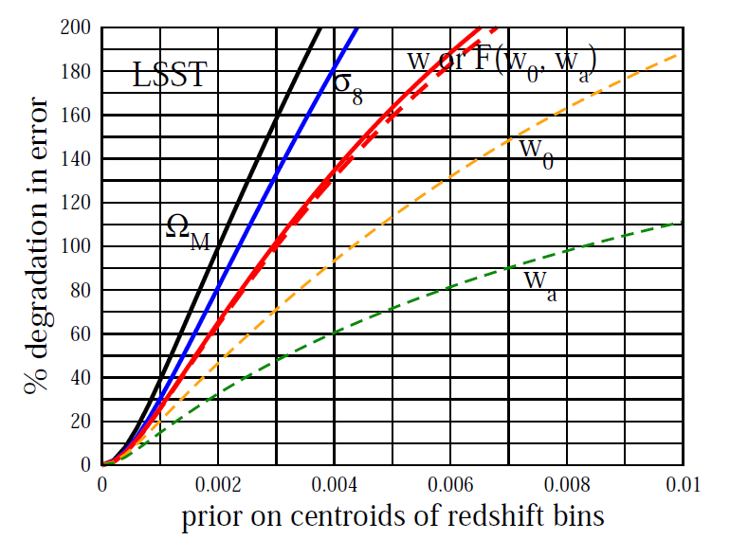
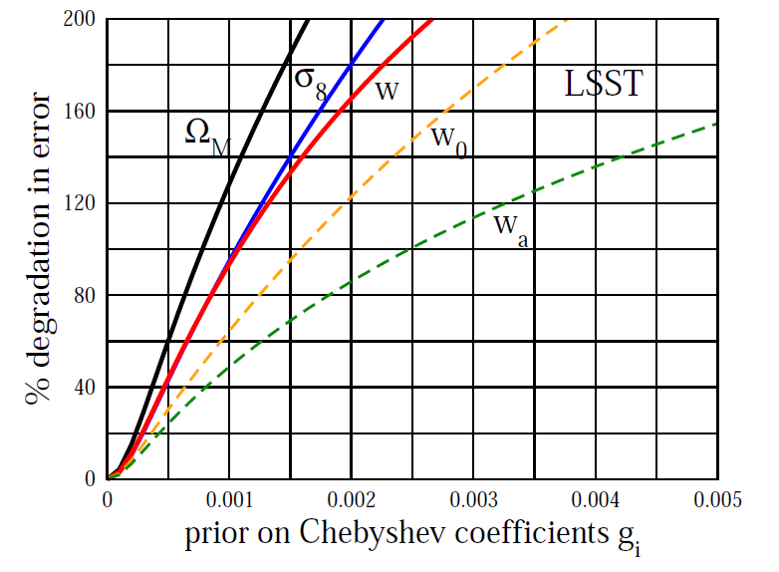
Impact of Photo-z Errors
Future large weak lensing surveys:
photo-z measurement is the only feasible way->an important systematics in constraining cosmological parameters.
Huterer et al. (2006)
Calibrating photo-z errors to obtain a precision galaxy z-distribution n(z) is crucial for future weak lensing surveys!

Slide 22
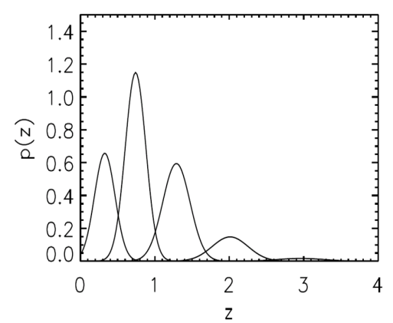
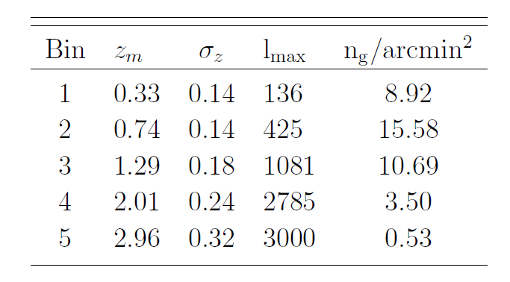

Data Model
Consider 5 z-bins for a LSST-style half-sky (f_{sky}=0.5) survey:
Each bin with a Gaussian shape (z_{m}, σ_{z})i=1,…,5, with galaxy bias bi=1,…,5, also varied and cosmological parameters fixed . Thus, 15 varing parameters, in total.
Fiducial
The “observation”:
15 (cross+auto) spectra in total, held at ensemble average values.

Slide 23
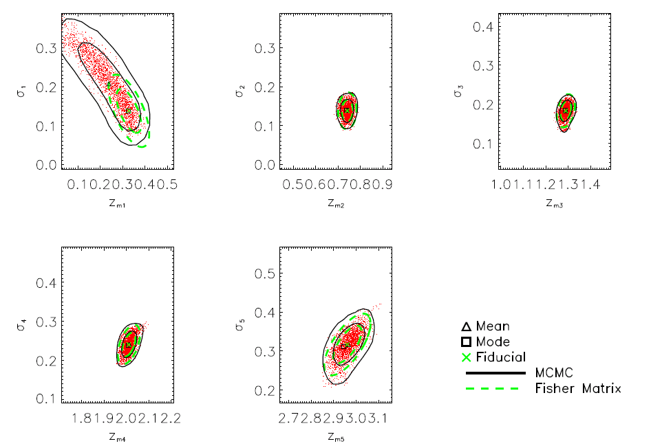
Gaussian+Lognormal

Slide 24
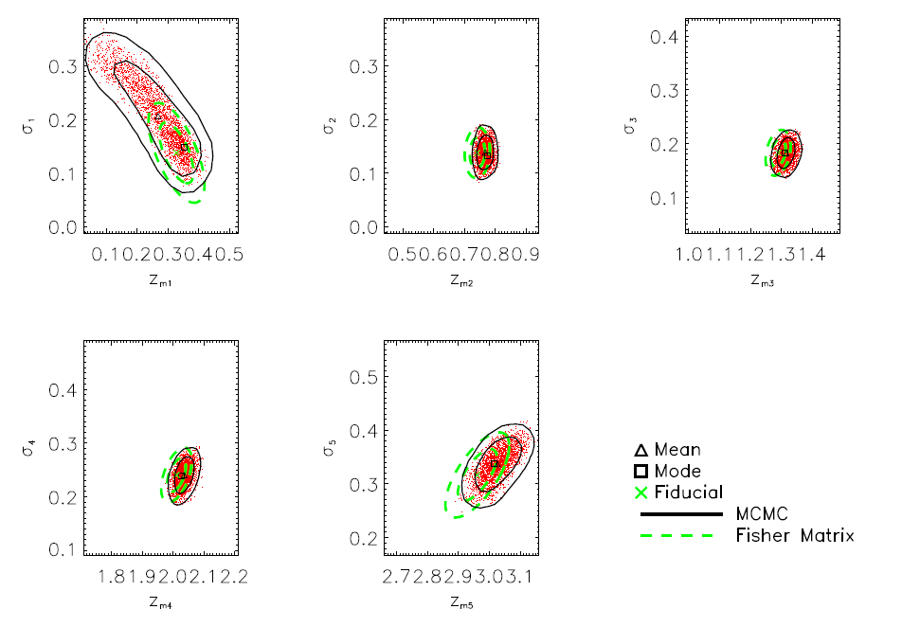
Again, Full Gaussian Shows Bias

Slide 25
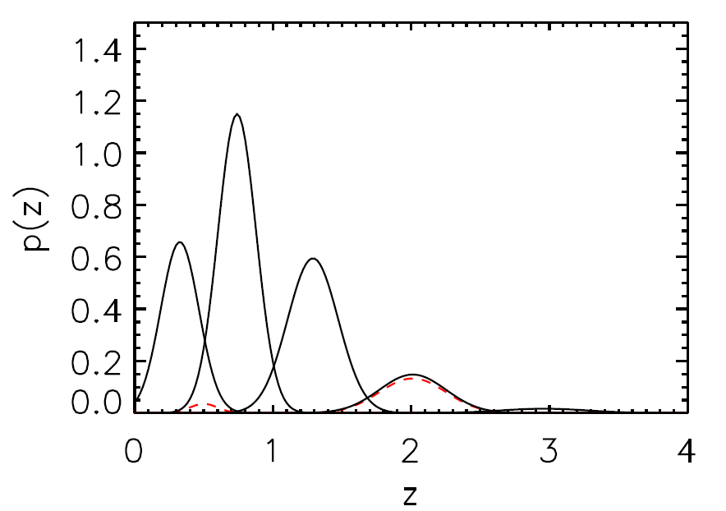
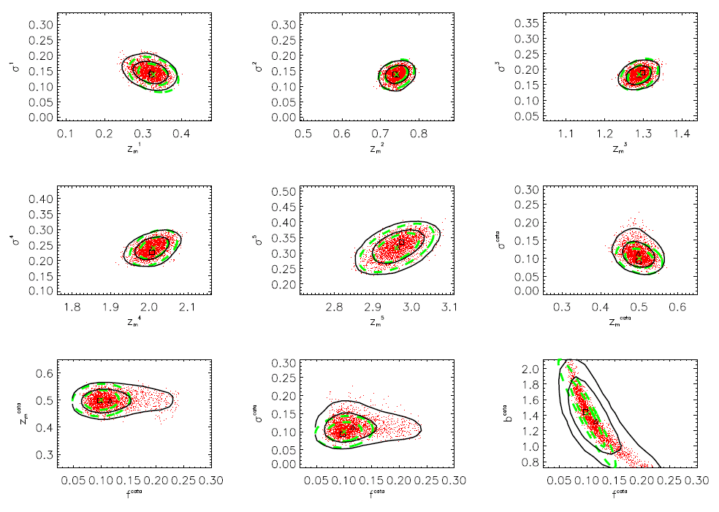
More Complex n(z)
Considering the case with a 10% catastrophic failure fraction (f^{cata}) in bin-4 :
n(z) of bin-4: described with 2-Gaussian, with additional params (f^{cata}, b^{cata}, z_{m}^{cata}, σ_{z}^{cata})
n(z) reconstrution of bins are not significantly disturbed by the catastrophic fraction
But f^{cata} closely degenerates with b^{cata}

Slide 26
Conclusions
The likelihood function is a key element in cosmological parameter estimation and should be modeled accurately.
Gaussian approximations are commonly used in analyses of galaxy density fluctuations and weak lensing shear fluctuations, which has been shown to cause biases in CMB analyses. The bias on f_{NL} can be quite significant, because the constraint is most derived from large scales where the Gaussian approximations are poor.
Gaussian+Lognormal provides a good approximation of the power spectrum likelihood.
Even with the exact likelihood of the power spectrum, biases in the parameters can still exist.
Angular cross power spectra of galaxy are crucial in self-calibrating the photo-z parameters.

