Slide 1
Observational Constraints on the Running Vacuum Model
Student’s name: Lu Yin
National Tsing Hua University

Slide 2
Outline
Introduce the running vacuum model(RVM)
Observational constraints on RVM
Summary

Slide 3
Introduce the running vacuum model
The Einstein equation is given by
set , is the Ricci scalar
and is the energy-momentum tensor of matter and radiation
is the time-dependent cosmological constant

Slide 4
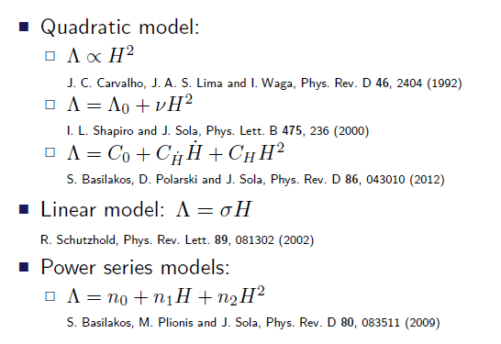

Slide 5
Considering the FLRW metric
We obtain the Friedmann equations
where , is the conformal time
and
the equation of state(EoS) given by

Slide 6


We consider to be a function of the Hubble parameter
where and are two free parameters,
From the conservation equation
we have

Slide 7
Resulting in that dark energy unavoidably couples to matter and radiation , given by
is the decay rate of the dark energy
taken to be
Then we get
where and is the energy density of matter or radiation at

Slide 8
The metric perturbation is given by
i,j=1,2,3 h and are two scalar perturbation in the synchronous gauge
the matter and radiation density perturbation
where and

Slide 9
Observational constraints on RVM
We use the CosmoMC program to perform the
global fitting for the RVM
Dataset:
CMB : Planck 2015
(TT, TE, EE, lowTEB, low-l polarization and lensing from SMICA)
BAO : Baryon acoustic oscillation data from BOSS
Weak lensing
data and data

Slide 10
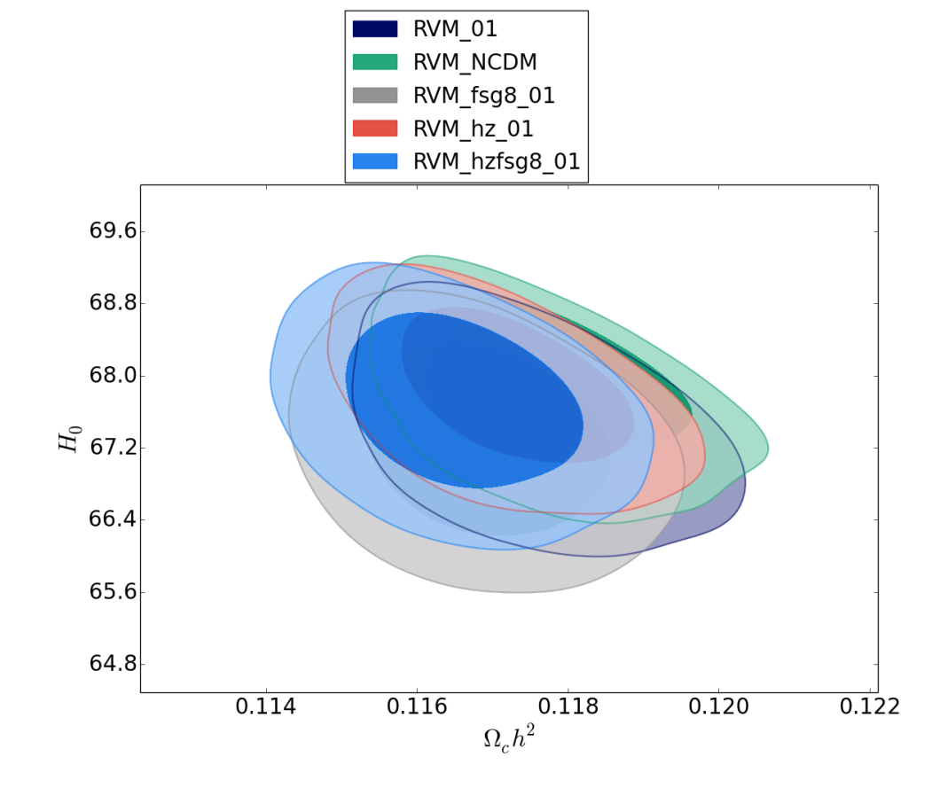
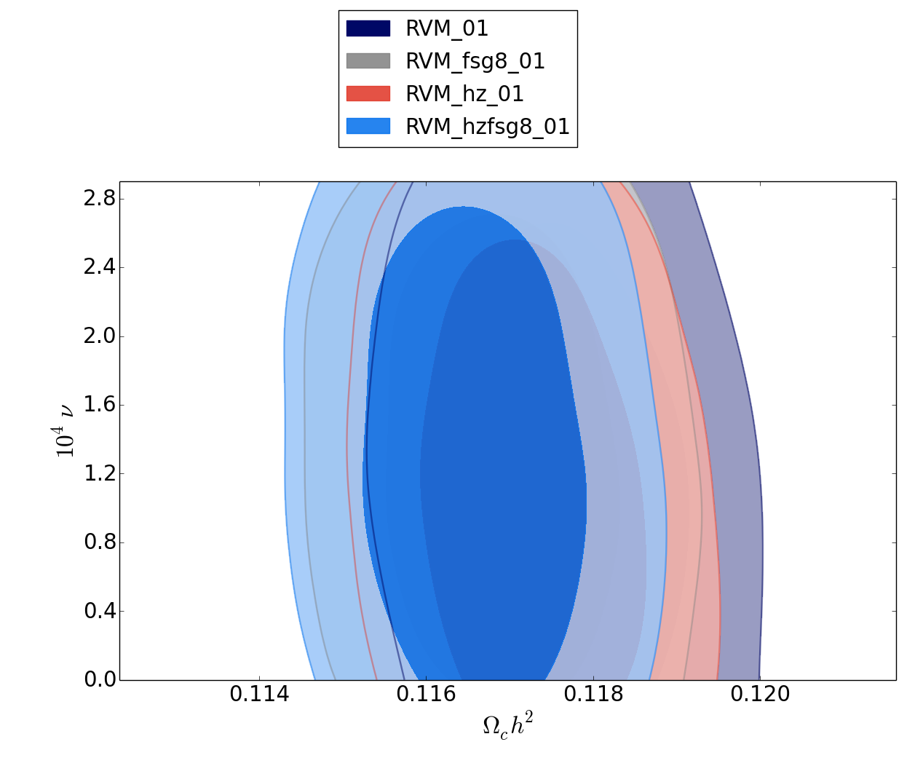

Slide 11
Fitting results for the RVM with
parameter | RVM | RVM+ | RVM+ | RVM+ +
Model parameter ( ) | (68% C.L.) | (68% C.L.) | (68% C.L.) | (68% C.L.)
CDM density ( )
 | 13490.4 （ ~-1.1） | 13509.8 | 13511.4 | 13531.2

Slide 12
Summary
The running vacuum model scenario is suitable to describe the last-time accelerating universe at the background level.
By performing the global fit from the observational data , we have obtained that
< , implying that the current data lll prefers RVM.
Thank you

