Slide 1
Observational Constraints on Viable f(R) Gravity Models
Yow-Chun Chen (National Tsing-Hua University)
Collaborators: Chao-Qiang Geng, Chung-Chi Lee

Slide 2
Outline
f(R) gravity
Viable f(R) gravity models
Observational Constraints on Viable f(R) Gravity Models

Slide 3
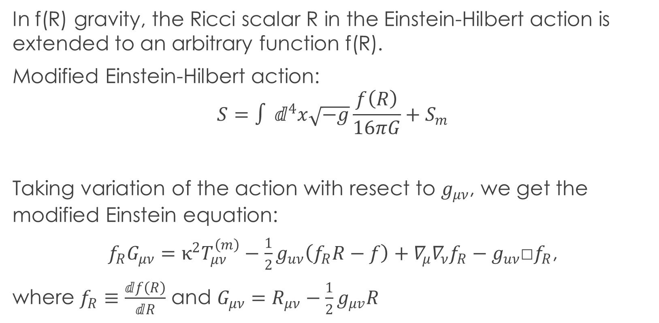
f(R) gravity
In f(R) gravity, the Ricci scalar R in the Einstein-Hilbert action is extended to an arbitrary function f(R).
Modified Einstein-Hilbert action:
$$S=∫ⅆ^{4}x\sqrt{−g}\frac{f\left(R\right)}{16πG}+S_{m}$$
Taking variation of the action with resect to $g_{μν}$, we get the modified Einstein equation:
$f_{R}G_{μν}=κ^{2}T_{μν}^{\left(m\right)}−\frac{1}{2}g_{uν}\left(f_{R}R−f\right)+∇_{μ}∇_{ν}f_{R}−g_{uν}$□$f_{R}$,
where $f_{R}≡\frac{ⅆf\left(R\right)}{ⅆR}$ and $G_{μν}=R_{μν}−\frac{1}{2}g_{μv}R$

Slide 4
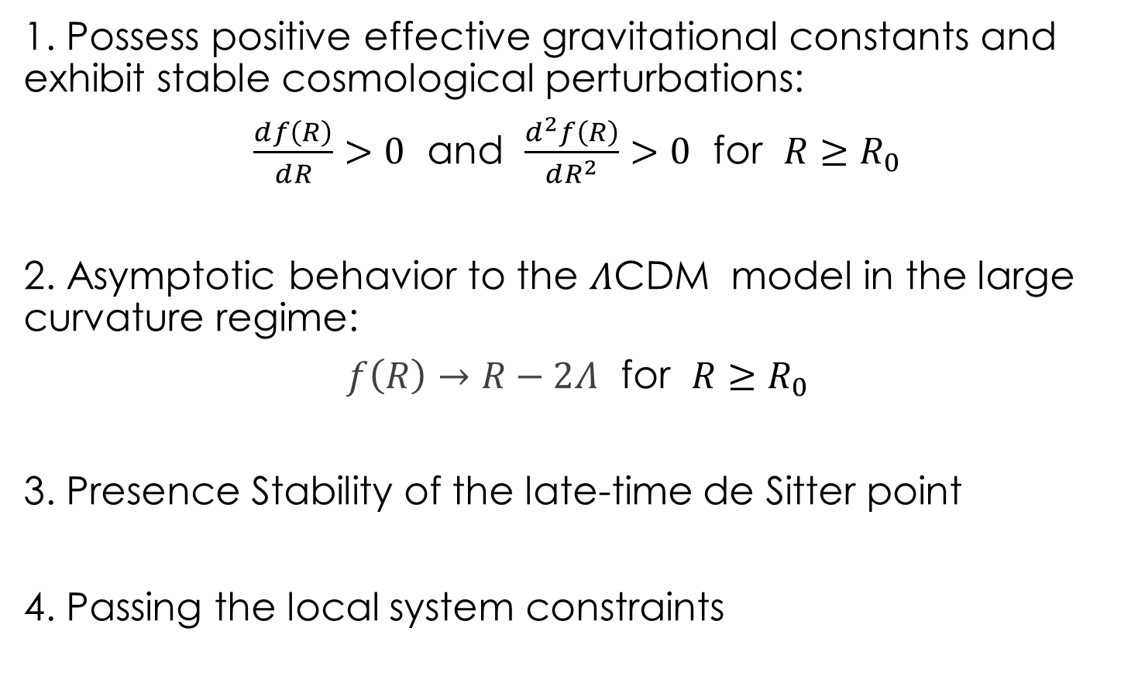
Conditions for viable f(R) gravity model
1. Possess positive effective gravitational constants and exhibit stable cosmological perturbations:
$\frac{ⅆf\left(R\right)}{ⅆR}>0$ and $\frac{ⅆ^{2}f\left(R\right)}{ⅆR^{2}}>0$ for $R≥R_{0}$
2. Asymptotic behavior to the $Λ$CDM model in the large curvature regime:
$f\left(R\right)→R−2Λ$ for $R≥R_{0}$
3. Presence Stability of the late-time de Sitter point
4. Passing the local system constraints

Slide 5
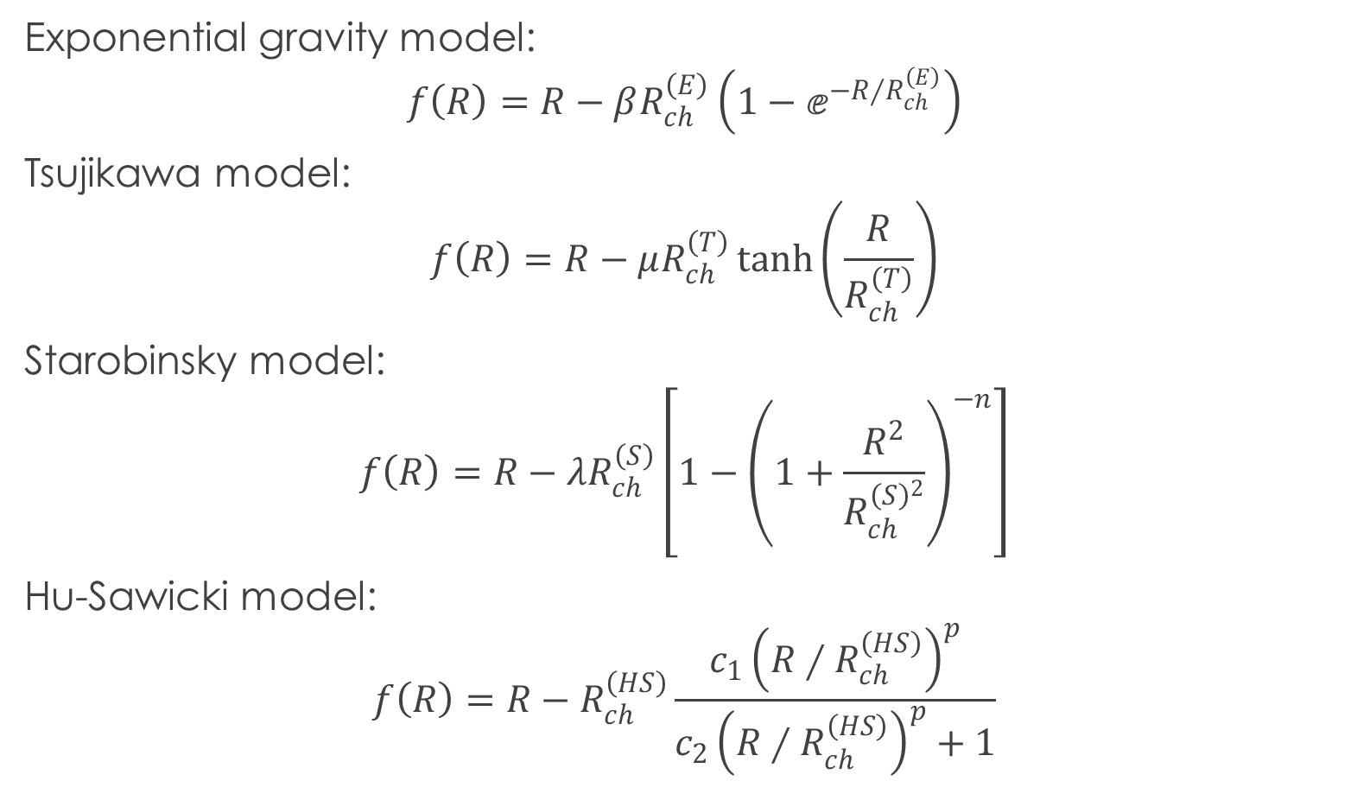
Viable f(R) Gravity Models
Exponential gravity model:
$$f\left(R\right)=R−βR_{ch}^{\left(E\right)}\left(1−ⅇ^{−R∕R_{ch}^{\left(E\right)}}\right)$$
Tsujikawa model:
$$f\left(R\right)=R−μR_{ch}^{\left(T\right)}\tanh\left(\frac{R}{R_{ch}^{\left(T\right)}}\right)$$
Starobinsky model:
$$f\left(R\right)=R−λR_{ch}^{\left(S\right)}\left[1−{\left(1+\frac{R^{2}}{R_{ch}^{{\left(S\right)}^{2}}}\right)}^{−n}\right]$$
Hu-Sawicki model:
$$f\left(R\right)=R−R_{ch}^{\left(HS\right)}\frac{c_{1}{\left(R∕R_{ch}^{\left(HS\right)}\right)}^{p}}{c_{2}{\left(R∕R_{ch}^{\left(HS\right)}\right)}^{p}+1}$$

Slide 6
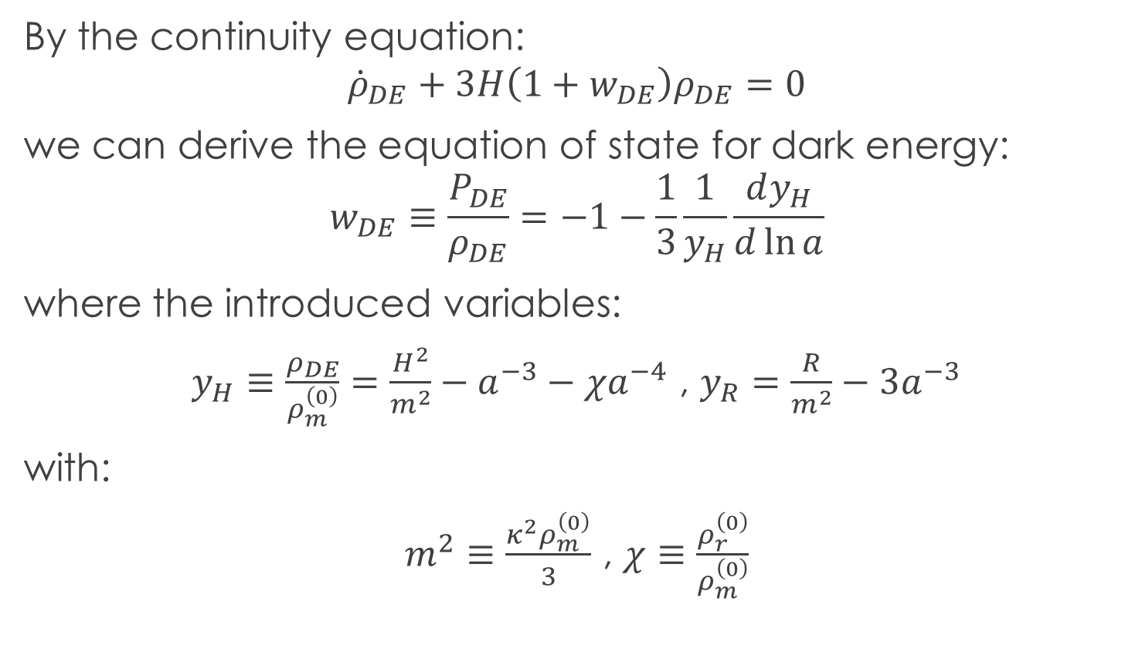
Background Evolution
By the continuity equation:
$${\dot{ρ}}_{DE}+3H\left(1+w_{DE}\right)ρ_{DE}=0$$
we can derive the equation of state for dark energy:
$$w_{DE}≡\frac{P_{DE}}{ρ_{DE}}=−1−\frac{1}{3}\frac{1}{y_{H}}\frac{ⅆy_{H}}{ⅆ\ln{a}}$$
where the introduced variables:
$y_{H}≡\frac{ρ_{DE}}{ρ_{m}^{\left(0\right)}}=\frac{H^{2}}{m^{2}}−a^{−3}−χa^{−4}$ , $y_{R}=\frac{R}{m^{2}}−3a^{−3}$
with:
$m^{2}≡\frac{κ^{2}ρ_{m}^{\left(0\right)}}{3}$ , $χ≡\frac{ρ_{r}^{\left(0\right)}}{ρ_{m}^{\left(0\right)}}$

Slide 7
Observational data
Code utilized:
CAMB and MGCAMB
CosmoMC: Markov-Chain Monte-Carlo
Data utilized:
BAO (baryon acoustic oscillations) data
Planck 2015 likelihoods
SNLS (Supernova Legacy Survey) data

Slide 8
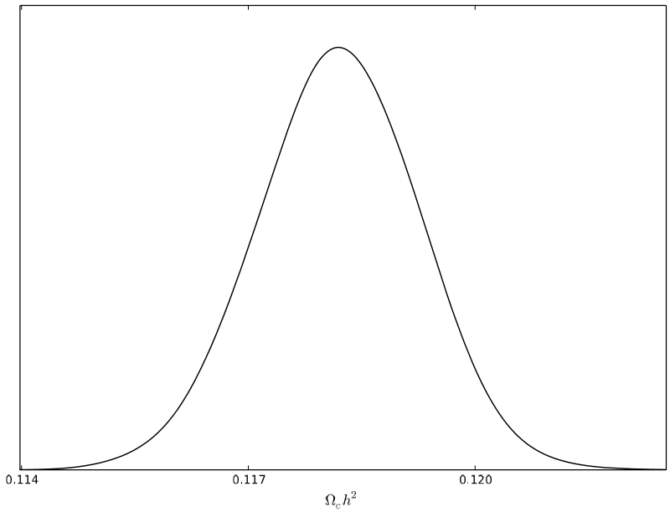
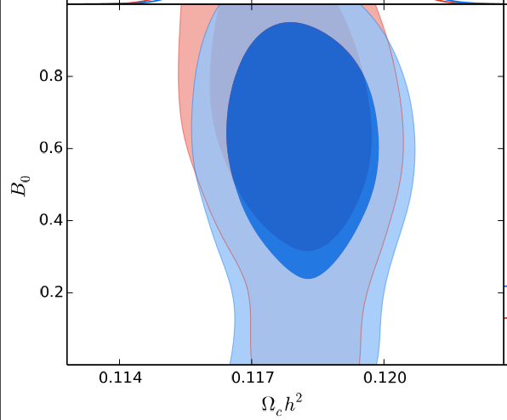
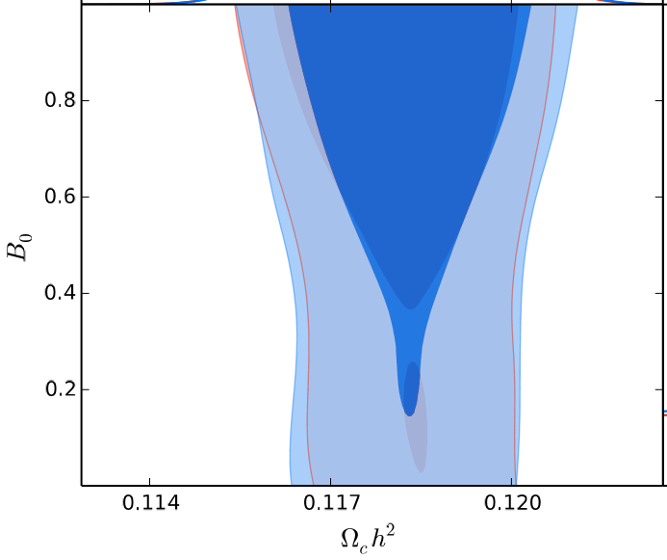

Observational Constraints on Viable f(R) Gravity Models
$Λ$CDM model
Exponential
Tsujikawa

Slide 9
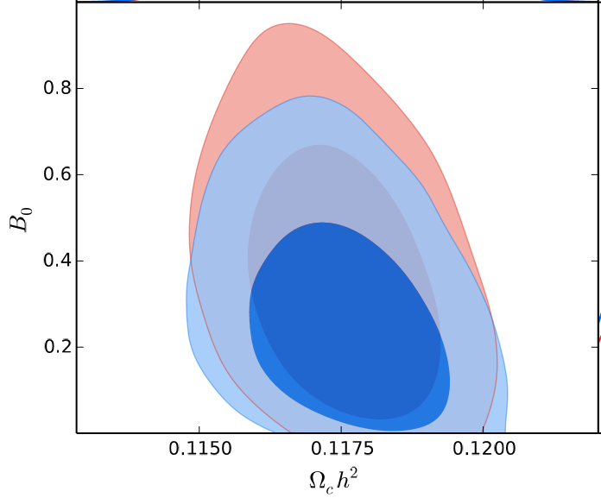
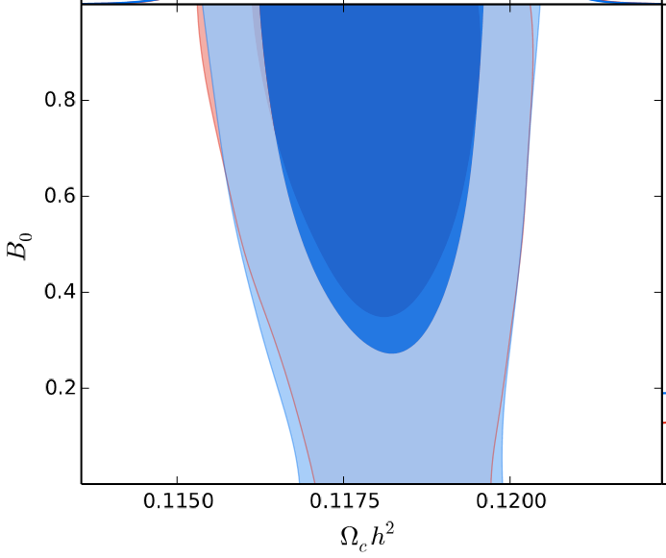
Observational Constraints on Viable f(R) Gravity Models
Starobinsky (n = 1)
Starobinsky (n = 2)

Slide 10
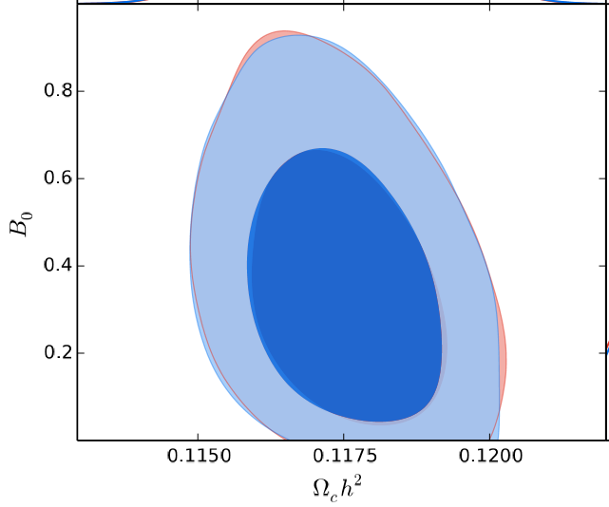
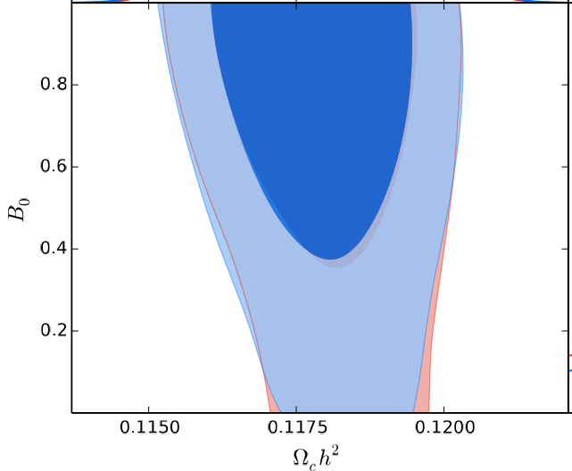
Observational Constraints on Viable f(R) Gravity Models
Hu-Sawicki (p = 2)
Hu-Sawicki (p = 4)

Slide 11

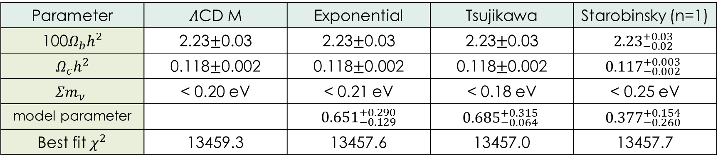
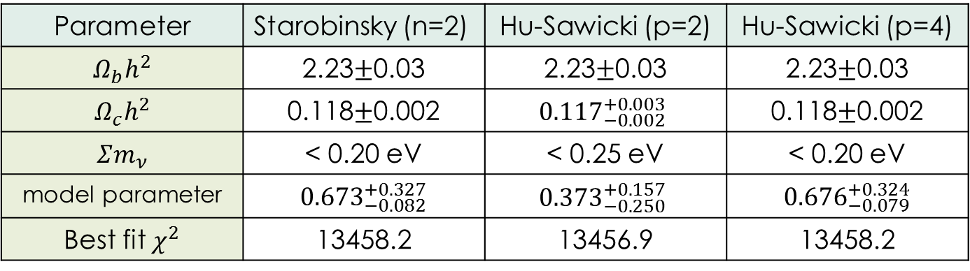
Observational Constraints on Viable f(R) Gravity Models $Λ$CDM background Allowed regions:1 $σ$ (68%) confidence level for model parameter 2 $σ$ (95%) confidence level for the rest
Parameter | $Λ$CD M | Exponential | Tsujikawa | Starobinsky (n=1)
100$Ω_{b}h^{2}$ | 2.23$±$0.03 | 2.23$±$0.03 | 2.23$±$0.03 | $${2.23}_{−0.02}^{+0.03}$$
$$Ω_{c}h^{2}$$ | 0.118$±$0.002 | 0.118$±$0.002 | 0.118$±$0.002 | $${0.117}_{−0.002}^{+0.003}$$
$$Σm_{ν}$$ | < 0.20 eV | < 0.21 eV | < 0.18 eV | < 0.25 eV
model parameter |  | 0${.651}_{−0.129}^{+0.290}$ | $${0.685}_{−0.064}^{+0.315}$$ | $${0.377}_{−0.260}^{+0.154}$$
Best fit $χ^{2}$ | 13459.3 | 13457.6 | 13457.0 | 13457.7
Parameter | Starobinsky (n=2) | Hu-Sawicki (p=2) | Hu-Sawicki (p=4)
$$Ω_{b}h^{2}$$ | 2.23$±$0.03 | 2.23$±$0.03 | 2.23$±$0.03
$$Ω_{c}h^{2}$$ | 0.118$±$0.002 | $${0.117}_{−0.002}^{+0.003}$$ | 0.118$±$0.002
$$Σm_{ν}$$ | < 0.20 eV | < 0.25 eV | < 0.20 eV
model parameter | 0${.673}_{−0.082}^{+0.327}$ | $${0.373}_{−0.250}^{+0.157}$$ | 0${.676}_{−0.079}^{+0.324}$
Best fit $χ^{2}$ | 13458.2 | 13456.9 | 13458.2

Slide 12

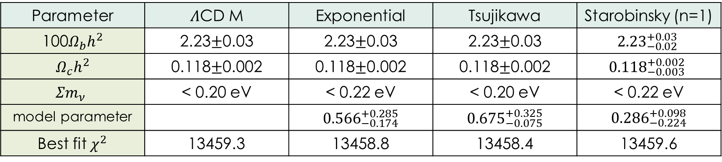
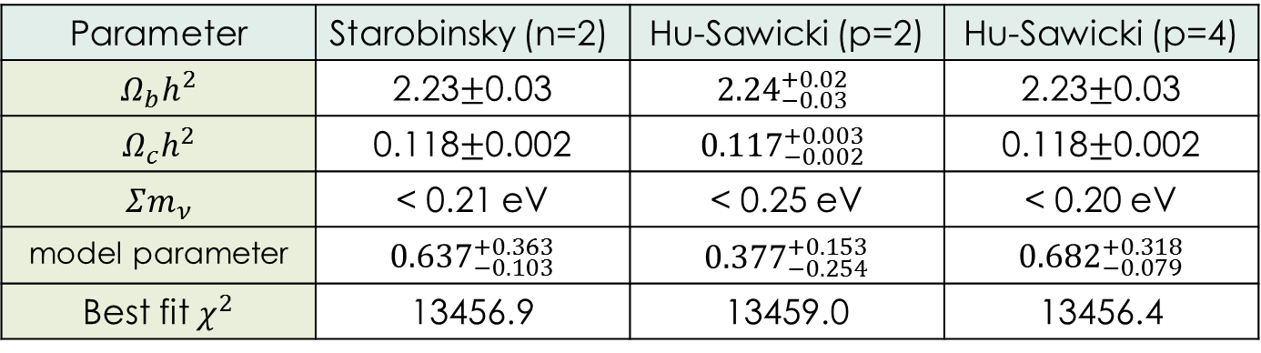
Observational Constraints on Viable f(R) Gravity Models modify background Allowed regions:1 $σ$ (68%) confidence level for model parameter 2 $σ$ (95%) confidence level for the rest
Parameter | $Λ$CD M | Exponential | Tsujikawa | Starobinsky (n=1)
100$Ω_{b}h^{2}$ | 2.23$±$0.03 | 2.23$±$0.03 | 2.23$±$0.03 | $${2.23}_{−0.02}^{+0.03}$$
$$Ω_{c}h^{2}$$ | 0.118$±$0.002 | 0.118$±$0.002 | 0.118$±$0.002 | $${0.118}_{−0.003}^{+0.002}$$
$$Σm_{ν}$$ | < 0.20 eV | < 0.22 eV | < 0.20 eV | < 0.22 eV
model parameter |  | 0${.566}_{−0.174}^{+0.285}$ | 0${.675}_{−0.075}^{+0.325}$ | 0${.286}_{−0.224}^{+0.098}$
Best fit $χ^{2}$ | 13459.3 | 13458.8 | 13458.4 | 13459.6
Parameter | Starobinsky (n=2) | Hu-Sawicki (p=2) | Hu-Sawicki (p=4)
$$Ω_{b}h^{2}$$ | 2.23$±$0.03 | $${2.24}_{−0.03}^{+0.02}$$ | 2.23$±$0.03
$$Ω_{c}h^{2}$$ | 0.118$±$0.002 | $${0.117}_{−0.002}^{+0.003}$$ | 0.118$±$0.002
$$Σm_{ν}$$ | < 0.21 eV | < 0.25 eV | < 0.20 eV
model parameter | 0${.637}_{−0.103}^{+0.363}$ | 0${.377}_{−0.254}^{+0.153}$ | 0${.682}_{−0.079}^{+0.318}$
Best fit $χ^{2}$ | 13456.9 | 13459.0 | 13456.4

