Slide 1
Cosmic Ray Excesses From Multi-Component Dark Matter
Da Huang
Physics Department, NTHU
@ Fo Guang Shan
PRD89, 055021(2014) [arXiv: 1312.0366] &
Invited Paper for the Special Issue of "Indirect Dark Matter Searches"
In collaboration with C.-Q. Geng and L.-H. Tsai [arXiv: 1405.7759]

Slide 2
Content
Motivation and Review of Experimental Status
General Phenomenological Analysis– Single- and Multiple- Component Decaying DM
Diffuse γ-ray Prediction
Summary

Slide 3
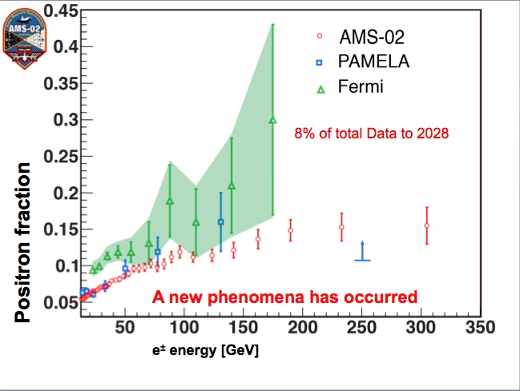
Motivation
Last year, AMS-02 collaboration published a measurement of the positron fraction spectrum , showing an uprise above 10 GeV, extending up to 350 GeV.
This uprise was already observed by many other previous experiments, such as PAMELA, Fermi-LAT, AMS-01, et al., but AMS-02 gives the most accurate one up to now.

Slide 4
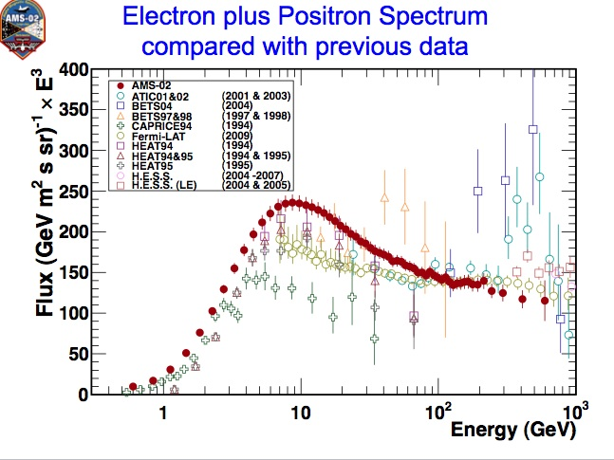
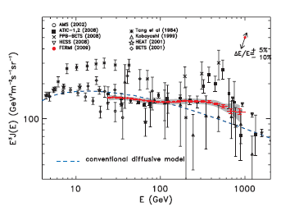
Motivation
The excess is also observed in the total e⁺+e⁻ flux spectrum by AMS-02, PAMELA, Fermi-LAT.
Femi-LAT e⁺+e⁻ Spectrum
Conventional theorectial expectation : Both spectra should show decreasing power law behaviors.

Slide 5
Motivation
Moreover, both the AMS-02 positron fraction spectrum and the Femi-LAT total e⁺+e⁻ flux spectrum show some substructure around 100 GeV.
AMS-02 Positron Fraction Spectrum
Femi-LAT e⁺+e⁻ Spectrum
Substructure?

Slide 6
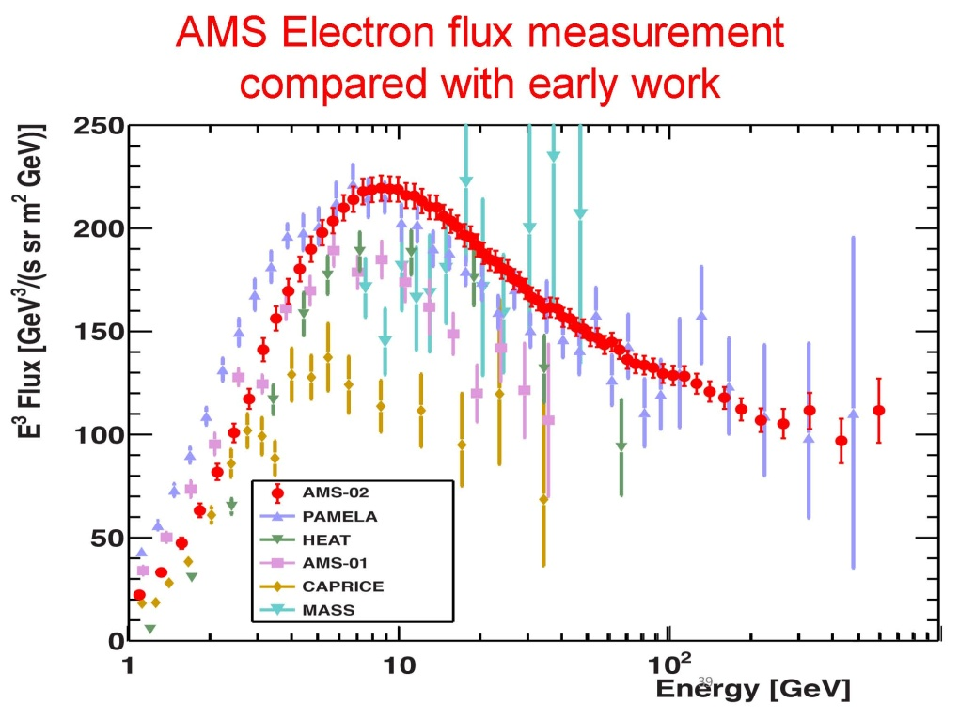
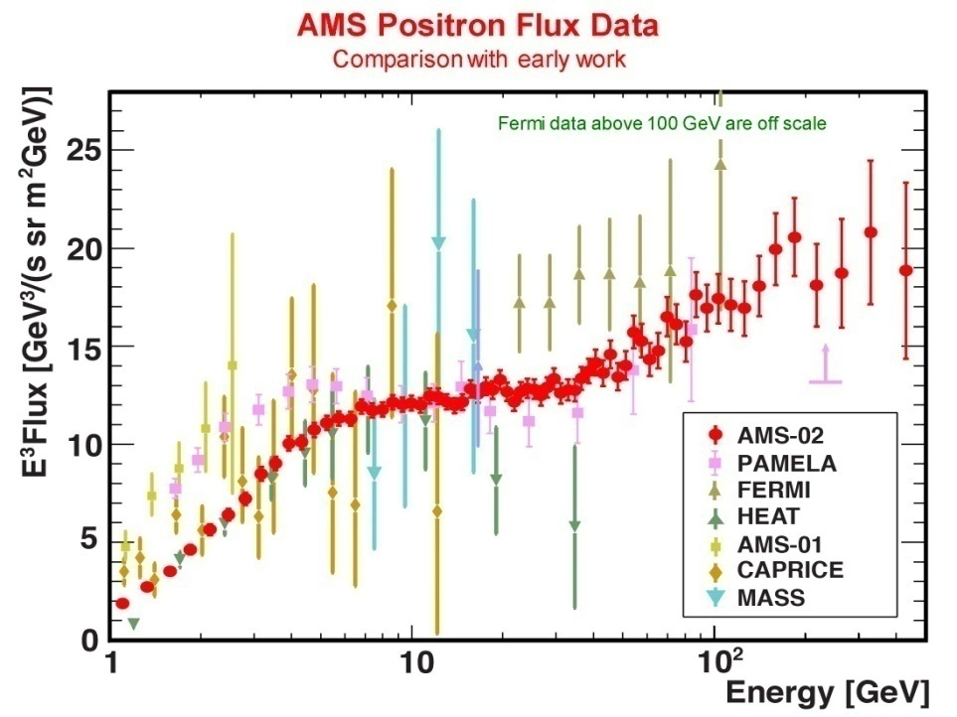
Recent Status
Recently, AMS-02 released new data, including the spectra of positron fraction, e⁺ (e⁻) flux and total e⁺+e⁻ flux.
e⁺ (e⁻) flux: Spectrum hardening above ~30 GeV

Slide 7
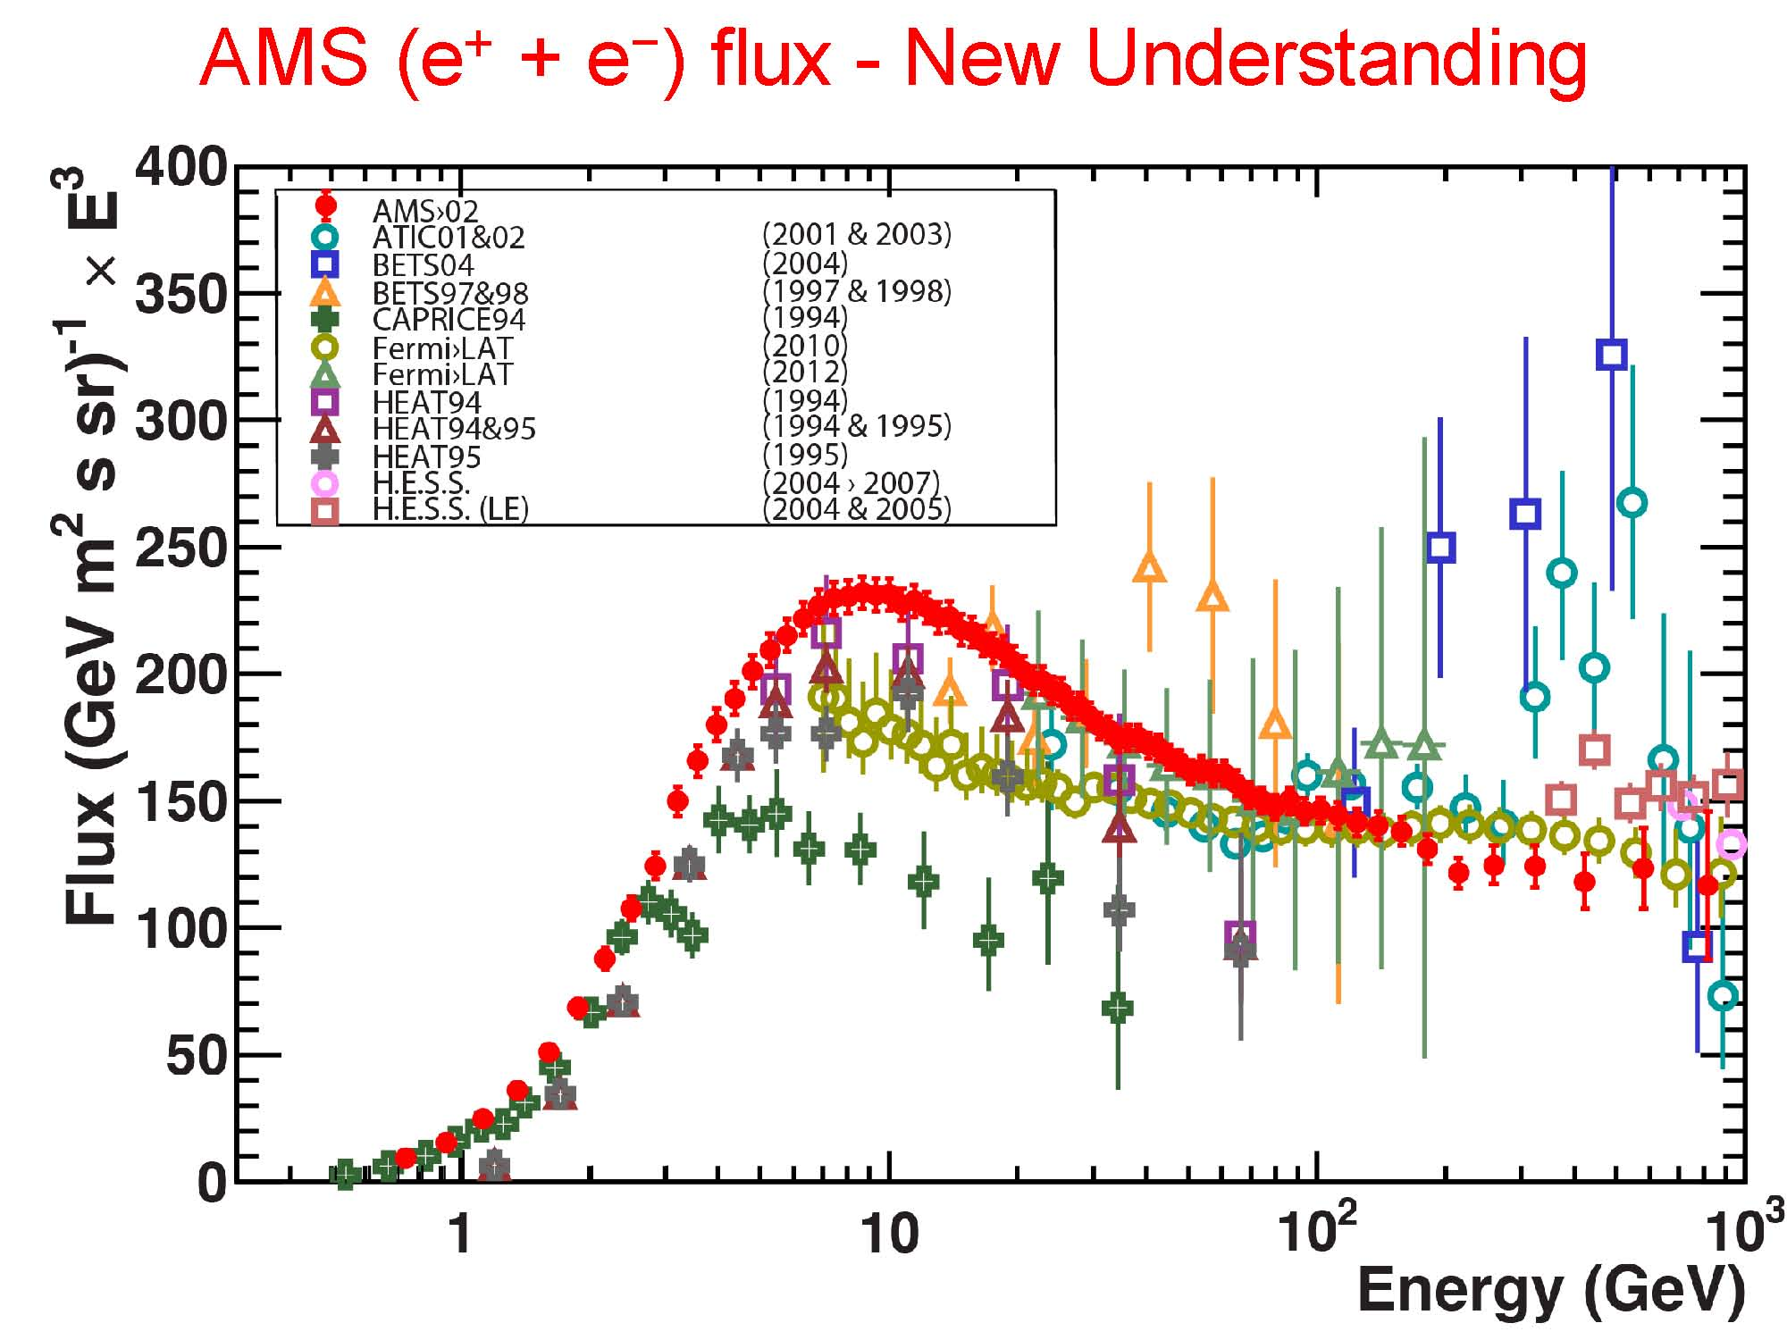
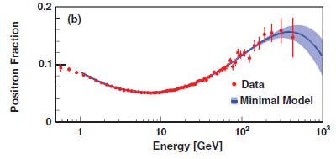
Recent Status
Positron fraction : first evidence that positron fraction stops increasing with energy above ~200 GeV
Total e⁺+e⁻ flux: good fit with a single power law at high energy
AMS-02 Positron Fraction Spectrum

Slide 8
Motivation
All the excesses indicate that there are additional positron and/or electron sources beyond our current knowledge, either in astrophysical or particle physical origin.
In literature, there are two compelling candidate origin for these excesses: Pulsars and Dark Matter.
In this talk, I concentrate on the decaying dark matter interpretation for this AMS-02/Fermi-LAT excess
Requirement
the TeV DM lifetime
τ_{DM}~O(10²⁶)s >> τ_{Universe} ~ O(10¹⁷)s

Slide 9
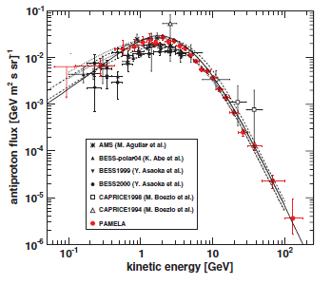
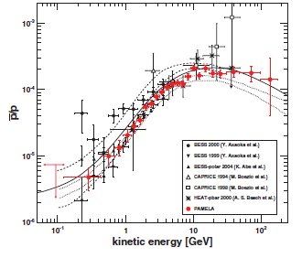
Further Constraints on Decaying DM
The measured antiproton spectrum agrees with the prediction of the conventional astrophysical theory well
Leptophilic DM

Slide 10
Decaying DM: Status
Previous Studies concentrated on the Single-Component Decaying DM models with the dominant decay channels e⁺e⁻, μ⁺μ⁻, τ⁺τ⁻,W⁺W⁻ , b⁺b⁻, … Their general conclusion is that there is some tension between AMS-02 positron fraction and Fermi-LAT total e⁺+e⁻ flux data.
Jin et al APJ (2013) arXiv: 1304.1997; Yuan, et .al. arXiv: 1304.1482 …
We also perform the fitting on the Single-Component DM decaying mainly via two-body leptonic process, confirming their result.
Three-body or four-body decay channels
wayout
Multi-Component DM

Slide 11

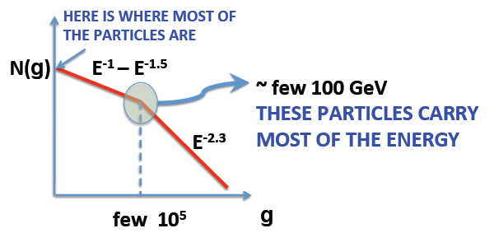
Decaying DM: General Formula
e⁻(e⁺) flux:
Primary electron flux: assumed to be broken power law
Br
κ denotes the uncertainty in primary electron normalization.
=
: Secondary e⁻(e⁺) produced in propagation, modeled by GALPROP

Slide 12

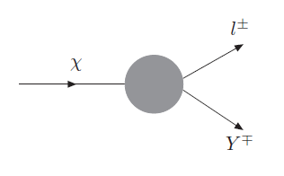

Two-Component Decaying DM
DM Source Term:
Half Density
ρ(x): DM density distribution, here we use isothermal profile
τ_{i}: DM lifetime
M_{i}: DM Mass
DM decay process :
DM Injection Spectra:
with condition:

Slide 13
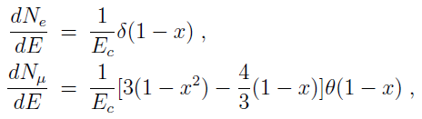
Two-Component Decaying DM
Normalized Injection Spectra for Electrons :
: obtained by fitting the τ-decay electron spectrum simulated by PYTHIA
By adding this term into the electron(positron) diffusion equation and numerically solve them by GALPROP, we can obtain the flux of electron and positron due to DM decaying.
No CPV, so = .

Slide 14
Two-Component Decaying DM
Observations:
The excess of total e⁺+e⁻ flux by Fermi-LAT extends to 1 TeV, so at least one DM cutoff should be larger than 1 TeV;
The substructure observed at around 100 GeV by both AMS-02 and Fermi-LAT indicates something change sharply.
One DM drop at 100GeV
AMS-02 Positron Fraction Spectrum
Femi-LAT e⁺+e⁻ Spectrum
Substructure?

Slide 15
Two-Component Decaying DM
The observations above indicates that DM at least contains two components, with E_{c1} > 1000 GeV and E_{c2} ≈100 GeV. For generic discussion, we take two DMs’ cutoffs E_{ci} and masses M_{i} as follows:
E_{c1} | M₁ | E_{c2} | M₂
1500 GeV | 3030 GeV | 100 GeV | 416 GeV

Slide 16

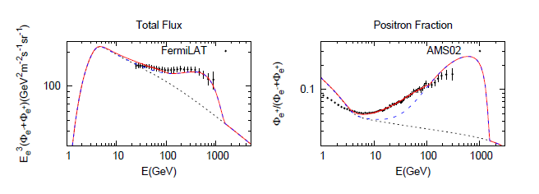
Two-Component Decaying DM
Fitting Results:
Conclusion: Double-Component DM decaying mainly via two-body leptonic decay CAN fit to AMS-02 positron fraction and Fermi-LAT total flux simultaneously.

Slide 17
Diffuse γ-ray Constraint
Previous studies showed that the diffuse γ-ray measured by Fermi-LAT could already give strong constraint to decaying DM
Cirelli et al PRD(2012); Essig et al. PRD (2009); Ibe et al(2013) , 1305.0084; Cirelli & Panci, NPB (2009); …
Question: Does our two-component DM (or multi-component DM) scenario still survive after the consideration of diffuse γ-ray constraints?
Strategy: We compute total various diffuse γ-ray spectrum, including the ones from two-component DM decays, which is compared with the Fermi-LAT data.
Total Predictions of Phen. Model !

Slide 18
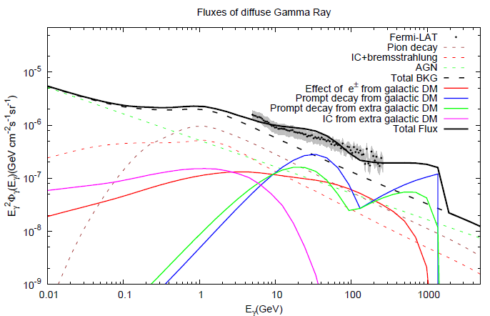
Model Prediction to Diffuse γ-ray
Substructure?
Conclusion: With the parameters fitted by AMS-02 and Fermi-LAT, the predicted γ ray is still allowed by the Fermi-LAT measurement.

Slide 19
Summary
In this talk we investigate the multi-component decaying Dark Matter model to explain AMS-02 and Fermi-LAT e⁺/e⁻ excesses, and show that two DM components are enough to explain the data.
We also show that the predicted diffuse γ-ray spectrum agrees with that observed by Fermi-LAT.

Slide 20
Thanks for your attention!

Slide 21
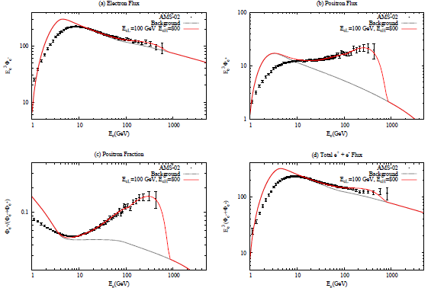
Two-Component DM with New Data

Slide 22
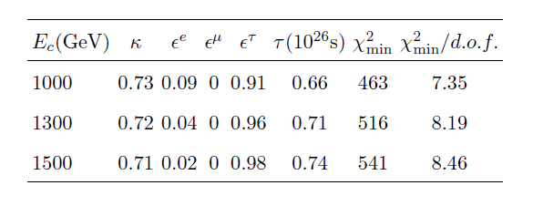
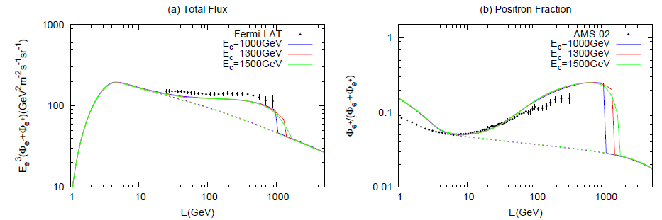
Single-Component Decaying DM
Χ² Fitting Results:

Slide 23
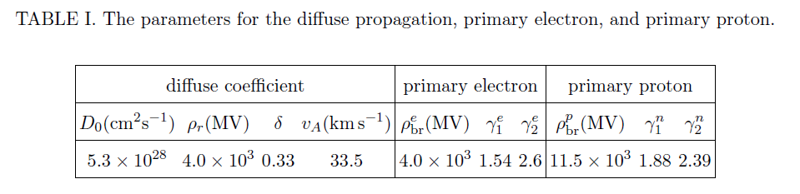
Propagation Parameters

Slide 24
Single-Component Decaying DM
Χ² Fitting Results:
Conclusion: Single-Component DM decaying mainly via two-body leptonic decay CANNOT give reasonable fit to AMS-02 positron fraction and Fermi-LAT total flux simultaneously.
Three-body or four-body decay channels
wayout
Multi-Component DM

Slide 25
Microscopic Realization of Multi-Component DM
Particle Content
Particles | ζ | η | N_{R1} | N_{R2}
SU(2)_{L}×U(1)_{Y} | (2,1) | (2,1) | (1,0) | (1,0)
Z₂ | - | + | + | +
Z₂’ | + | - | - | -
Relevant Lagrangian
Break Z_2 and Z’_2

Slide 26
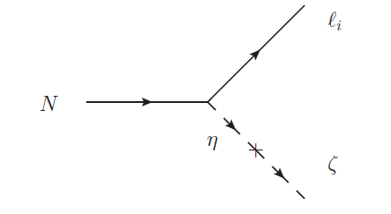


Microscopic Realization of Multi-Component DM
Relevant Feynman Diagram
If N_{h(l)}’s lifetime is O(10²⁶)s, then it only requires

Slide 27
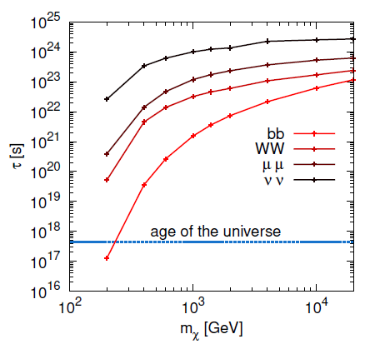
Microscopic Realization of Multi-Component DM
Model Prediction: Since the coupled leptons are left-handed, after SU(2)_{L} transformation, the DM N_{h(l)} can also decay into neutrinos, thus produce the same amount of neutrino flux, which can be observed by IceCube.
Unfortunately, current IceCube’s constraint is very loose for general decaying DM models.

Slide 28
Possible Explanation

Slide 29
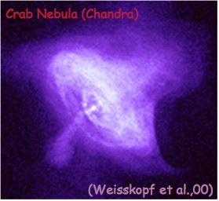
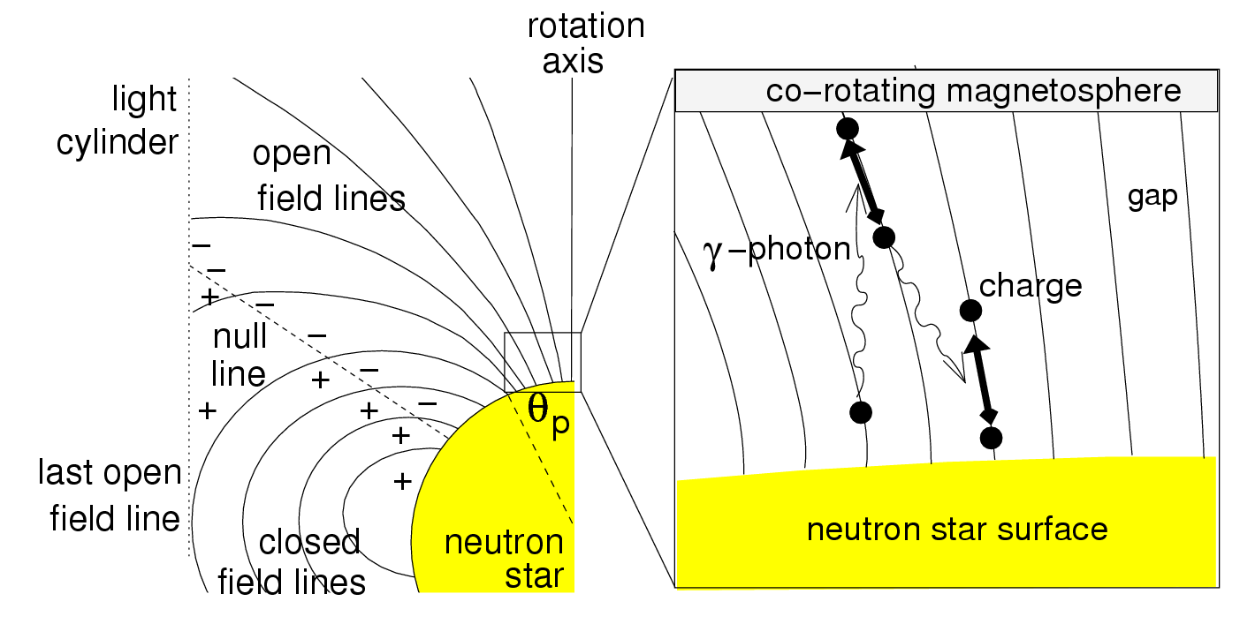
Possible Explanation of the Excess
In literature, there are two compelling candidate origin for these excesses: Pulsars and Dark Matter.
Some Comments on Pulsars:
Pulsars and their wind nebulae (PWN) are ideal electron-positron factories

Slide 30

Comments on Pulsar Scenario
In general, the extra source for e⁺ and e⁻ can be a single nearby pulsar, or the total contribution of many pulsars
Famous nearby pulsars:
Geminga[J0633+1746], Monogem[B0656+14], …
Multiple pulsars:
Spatial Distribution:
Injection Spectrum:
Both scenario can fit the AMS-02 and Fermi-LAT excess spectrum very well.

Slide 31
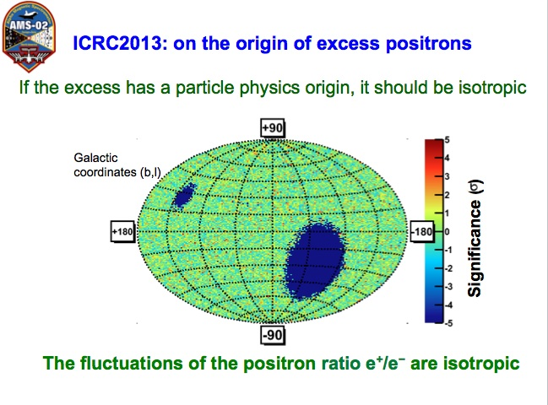
Comments on Pulsar Scenario
General Pulsar Prediction:
Anisotropy
However, current exp. do not see any anisotropy
Not Support
Pulsar Explanation
DM Prediction: Isotropic Spectrum

Slide 32
Annihilating DM v.s. Decaying DM
From the perspective of fitting both experimental results, both scenarios would give essentially the same degree of goodness of fitting, since fitting mainly depends on the injection spectra which can be the same.
Problem for Annihilating DM:
Needing much larger annihilation cross section than that for WIMP relic abundance
Extraordinarily Large boosting factor b~O(1000), possibly due to Sommerfeld Enhancemnet or Resonance Enhancement
Such a large boosting factor is incompatible with the one obtained in numerical simulation of LSS formation

Slide 33
Annihilating DM v.s. Decaying DM
Problem for Annihilating DM: (continued)
Due to DM density square dependence, the associated γ-ray produced by FSR and IC is enhanced much and already exceeds the Fermi-LAT and EGRET bounds for most channels
Decaying DM:
Free of such problems, especially for the γ-ray bound since the final flux only depends on single power of DM density
In order to explain the observed flux, it generically needs the TeV DM lifetime τ_{DM}~O(10²⁶)s >> τ_{Universe} ~ O(10¹⁷)s
Previous fitting shows it seems difficult in fitting AMS-02 and Fermi-LAT simultaneously with leptophilic decaying DM
Jin, Wu, Zhou (2013); Yuan et al. (2013); Bertone et al, PRL(2013); …

Slide 34
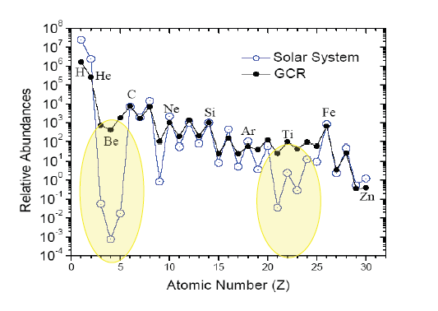
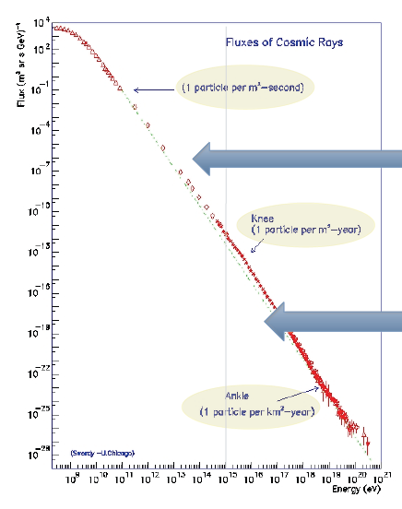


Motivation
Cosmic ray is an important probe to tell us a lot about the information of our Galaxy and our Universe.
Composition of CR:
Energy Range of CR:
H | He | C,O,… | e
90% | 9% | 1% | 1%

Slide 35
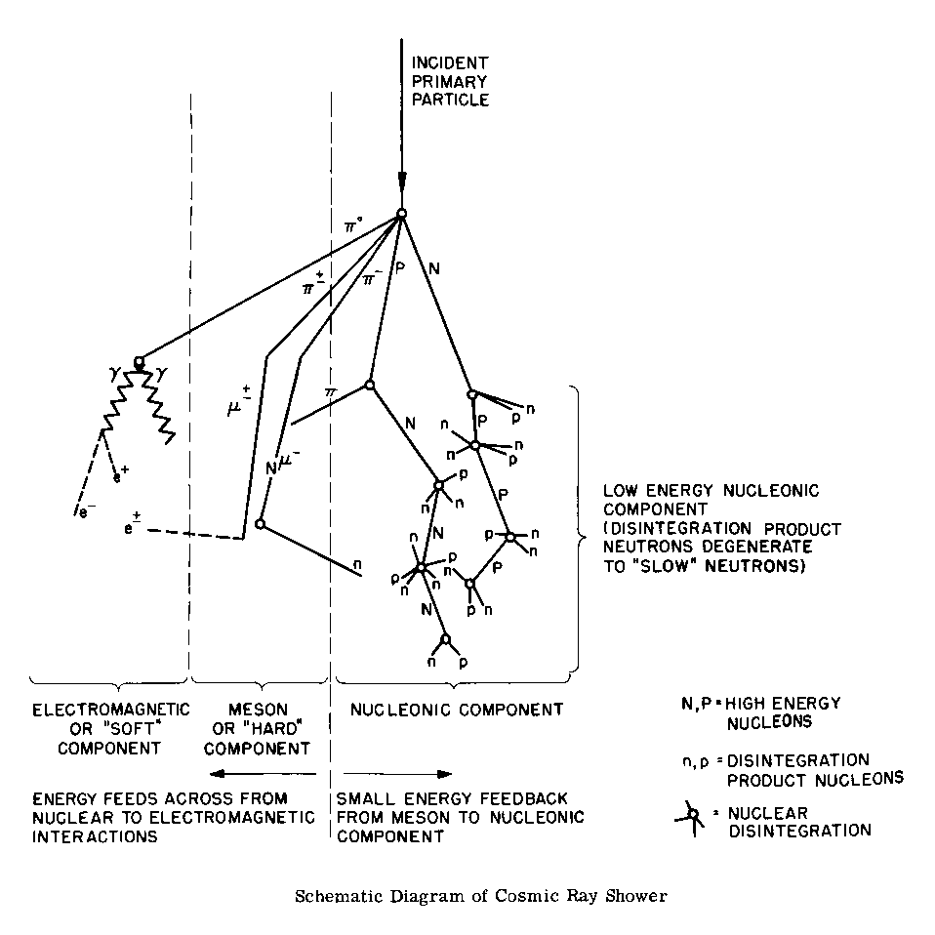
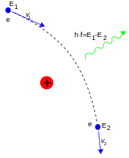
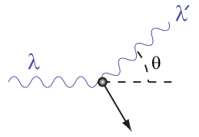
Diffuse γ-ray Origin
Conventional Contributions (Background):
Inside the Galaxy:
Bremsstralung
Inverse Compton(IC) Scattering
GALPROP
π⁰ decay

Slide 36
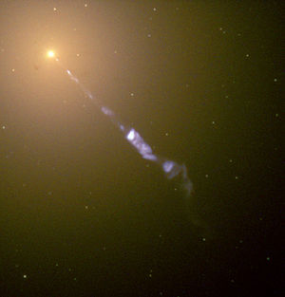

Diffuse γ-ray Origin
Outside the Galaxy: Active Galactic Nuclei (AGN)
obtained by fitting low energy spectrum of EGRET
K.Ishiwata, S. Matsumoto and T. Moroi PRD 78, 063505 (2008)

Slide 37

Diffuse γ-ray Origin
DM Contributions (Signal):
Inside the Galaxy:
DM Electron Diffusion:
Bremsstralung
GALPROP
Inverse Compton(IC) Scattering
Prompt Decay
γ
e⁻(e⁺): FSR
l⁻
l⁻
μ⁻(μ⁺): FSR + μ radiative decay (μ→ eννγ )
τ⁻(τ⁺): FSR + π⁰ decay

Slide 38

Diffuse γ-ray Origin
DM Contributions:
Outside the Galaxy:
DM Electron Diffusion:
Inverse Compton(IC) Scattering: e⁻(e⁺) with CMB
Prompt Decay
e⁻(e⁺): FSR
μ⁻(μ⁺): FSR + μ radiative decay (μ→ eννγ )
τ⁻(τ⁺): FSR + π⁰ decay
Cosmic Expansion:

