Slide 1


New Physics Effects in Higgs Pair Production
Chuan-Ren Chen
(NTNU)
10/8/2014, 2nd International Workshop on Particle Physics and Cosmology after Higgs and Planck @ NTHU

Slide 2
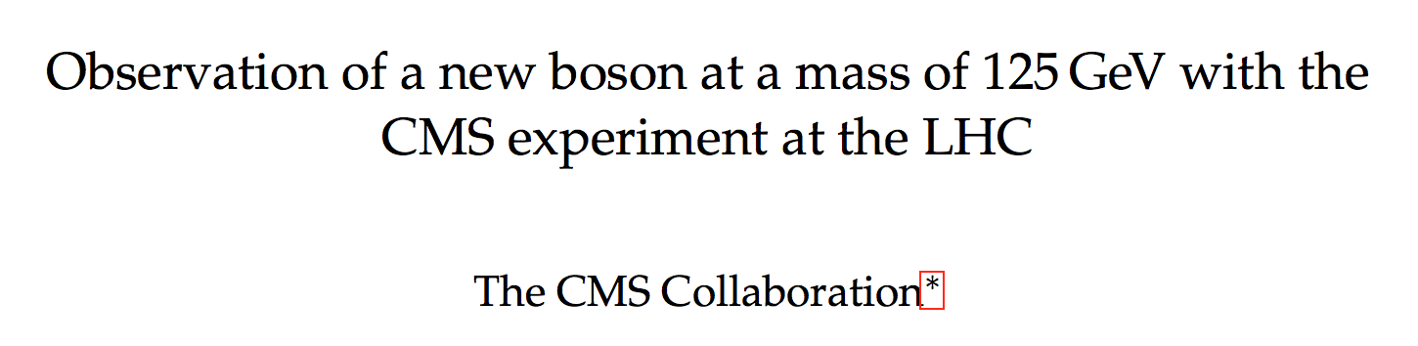
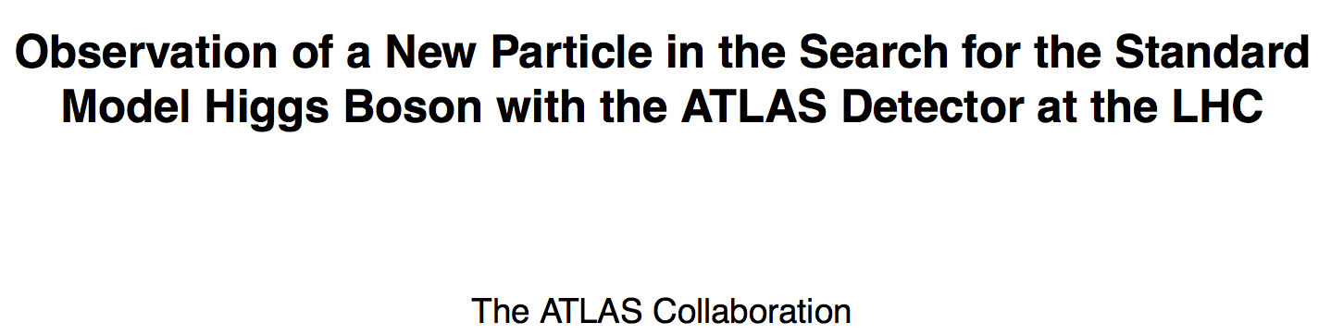
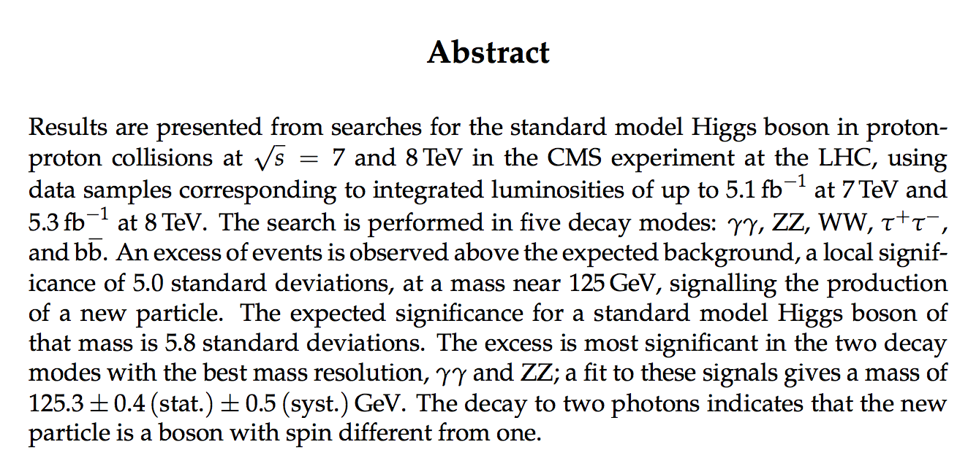
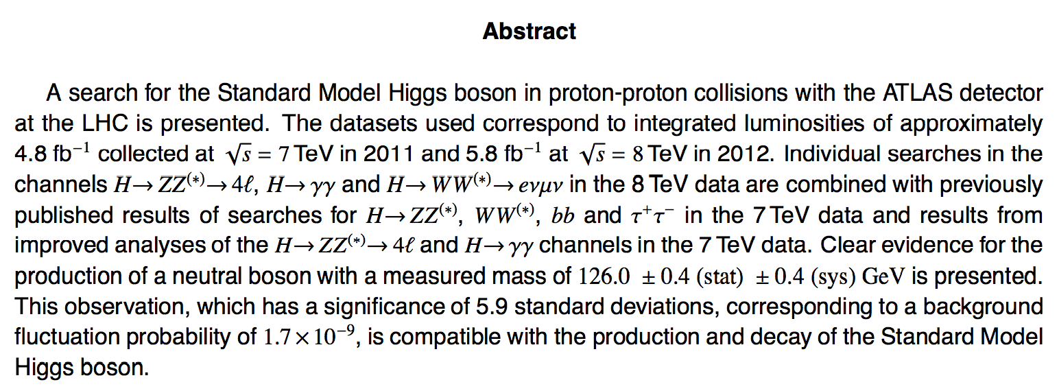

Higgs boson @ LHC
July 4 2012, both CMS and ATLAS announced discovery of new particle
preprint 31 Jul 2012
preprint 31 Aug 2012
> 5 σ standard deviations
Mass: 125.3 GeV (CMS)
126.0 (ATLAS)
Main channel: γγ, ZZ (4 leptons)

Slide 3
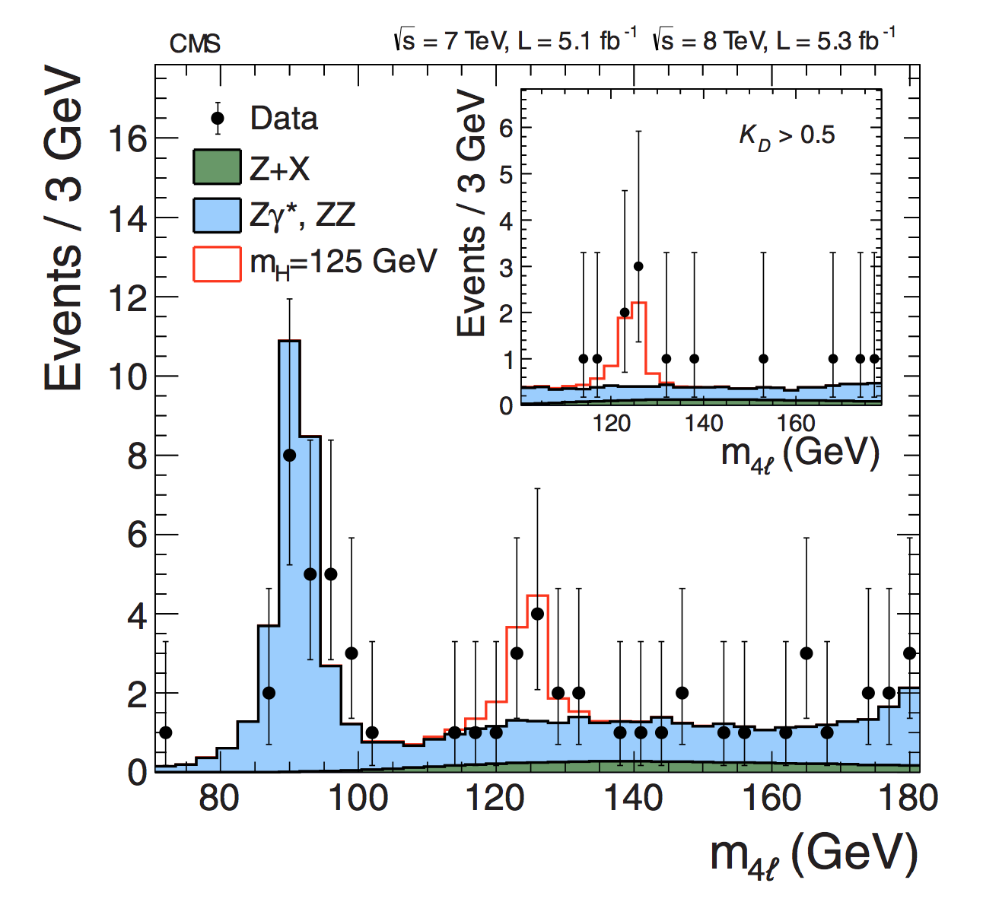
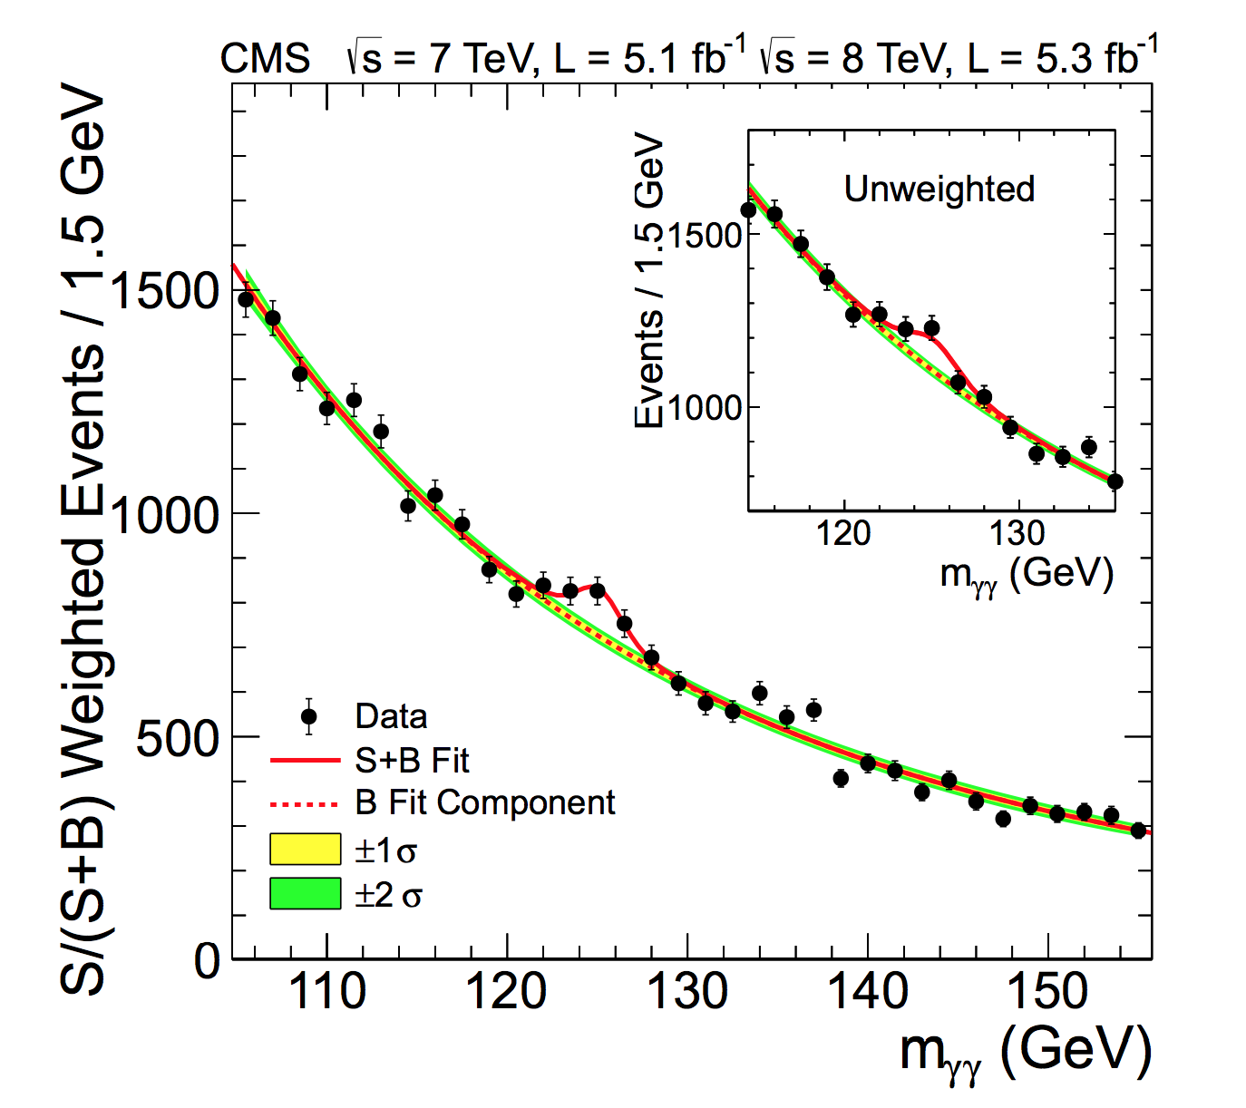
Higgs boson @ LHC

Slide 4
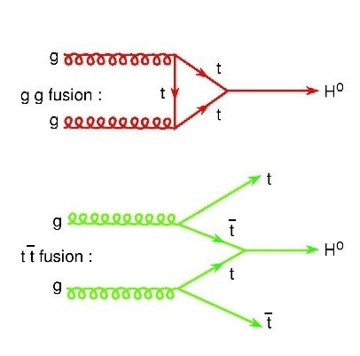
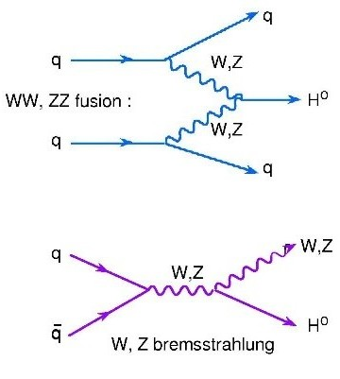
Higgs boson @ LHC
ggh
VBF
ttH
WH
ZH
for M_{H} = 125 GeV
ggh =15.32 pb
VBF =1.211 pb
WH =0.5729 pb
ZH =0.3158 pb
ttH =0.08634 pb

Slide 5
Higgs Decay
dominates total width
ZZ, WW and γγ are important for discovery

Slide 6
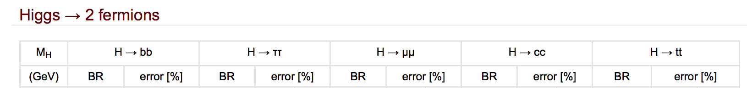
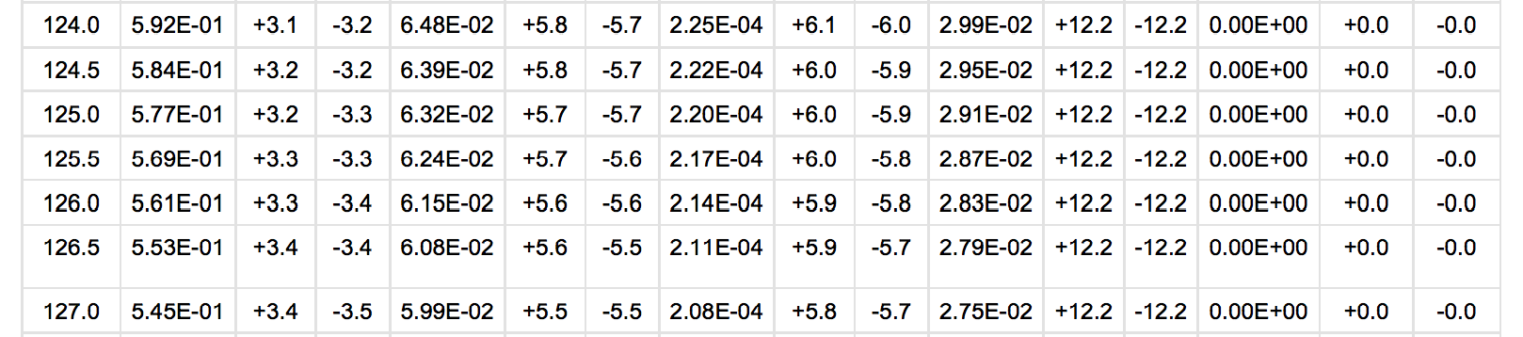
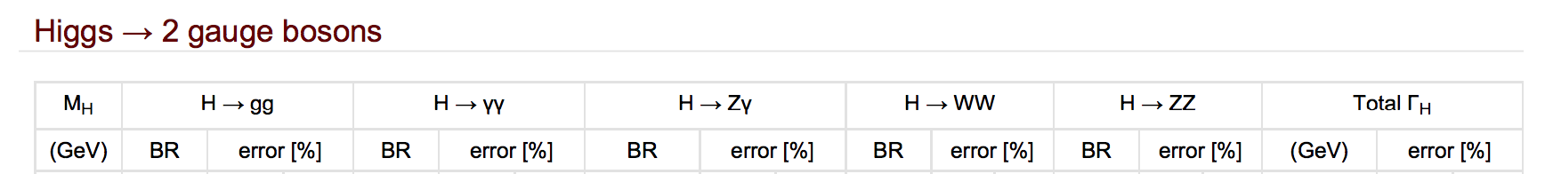
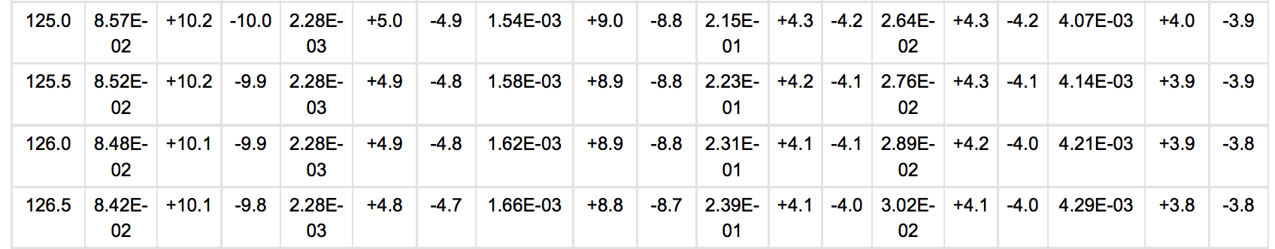
Higgs Decay

Slide 7
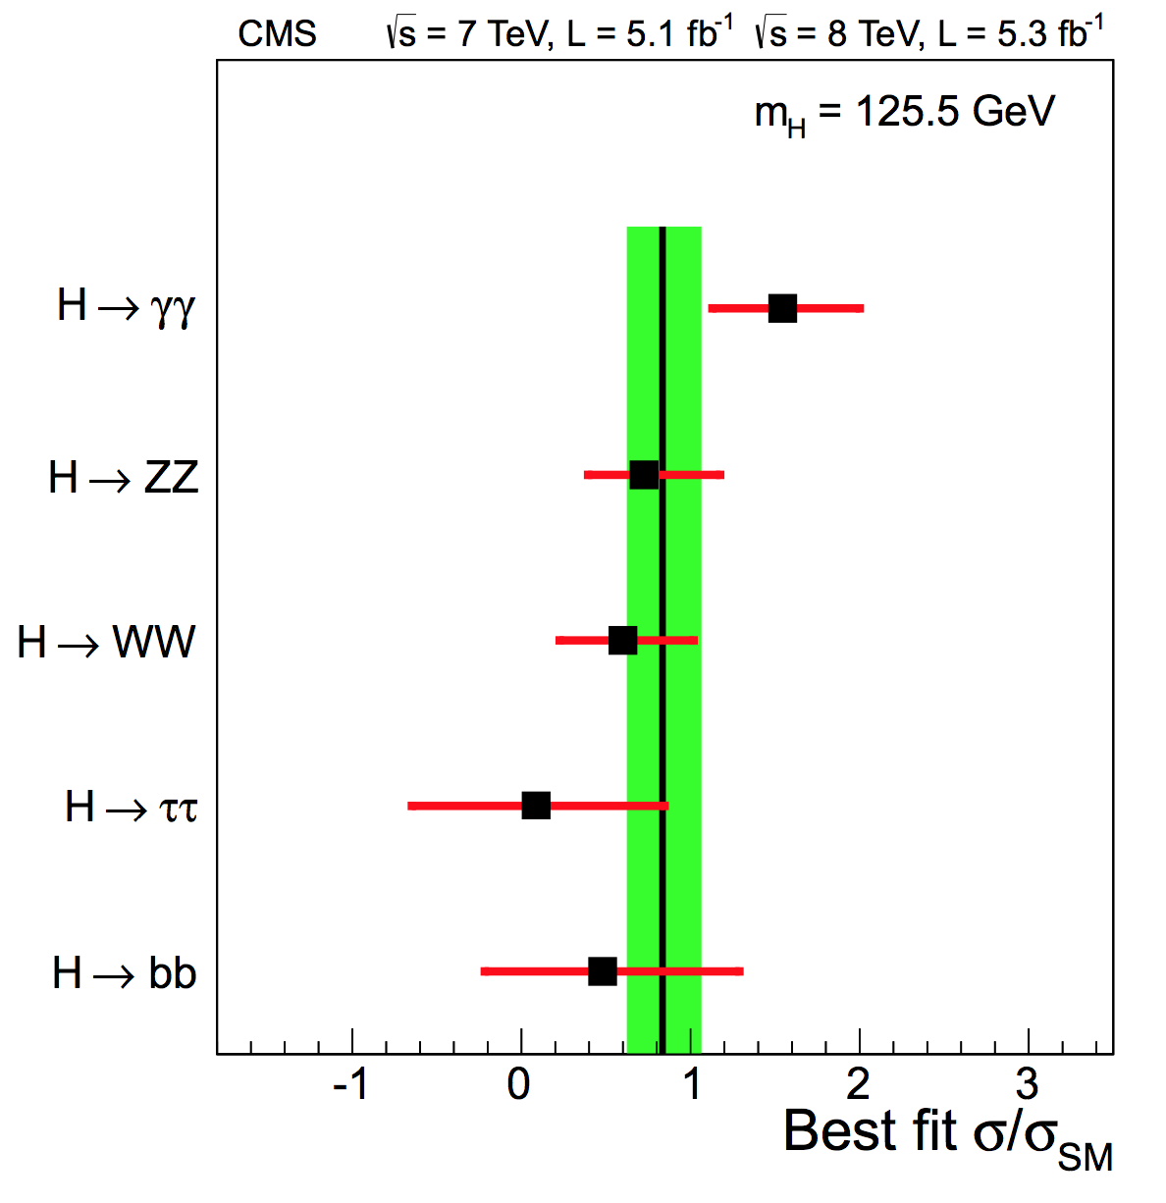
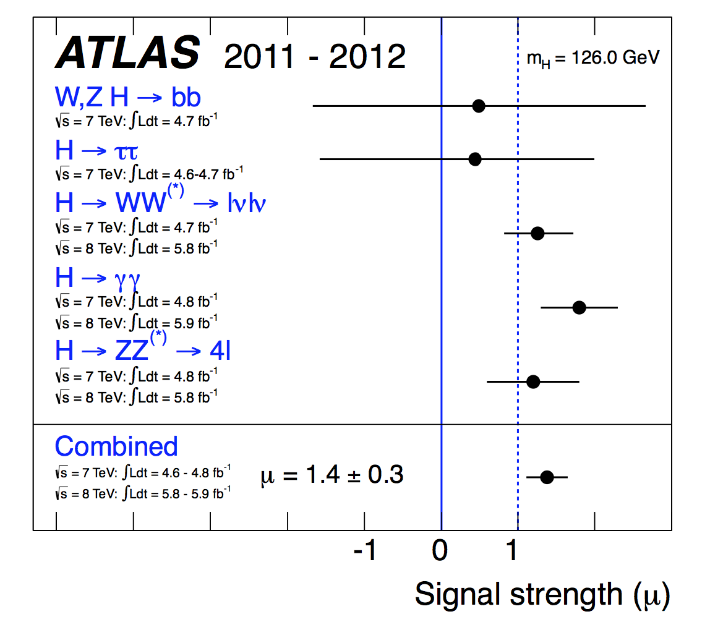
Higgs boson @ LHC
1.3
1.8
1.2
γγ : > 1.5 SM
ZZ, WW ~ SM

Slide 8
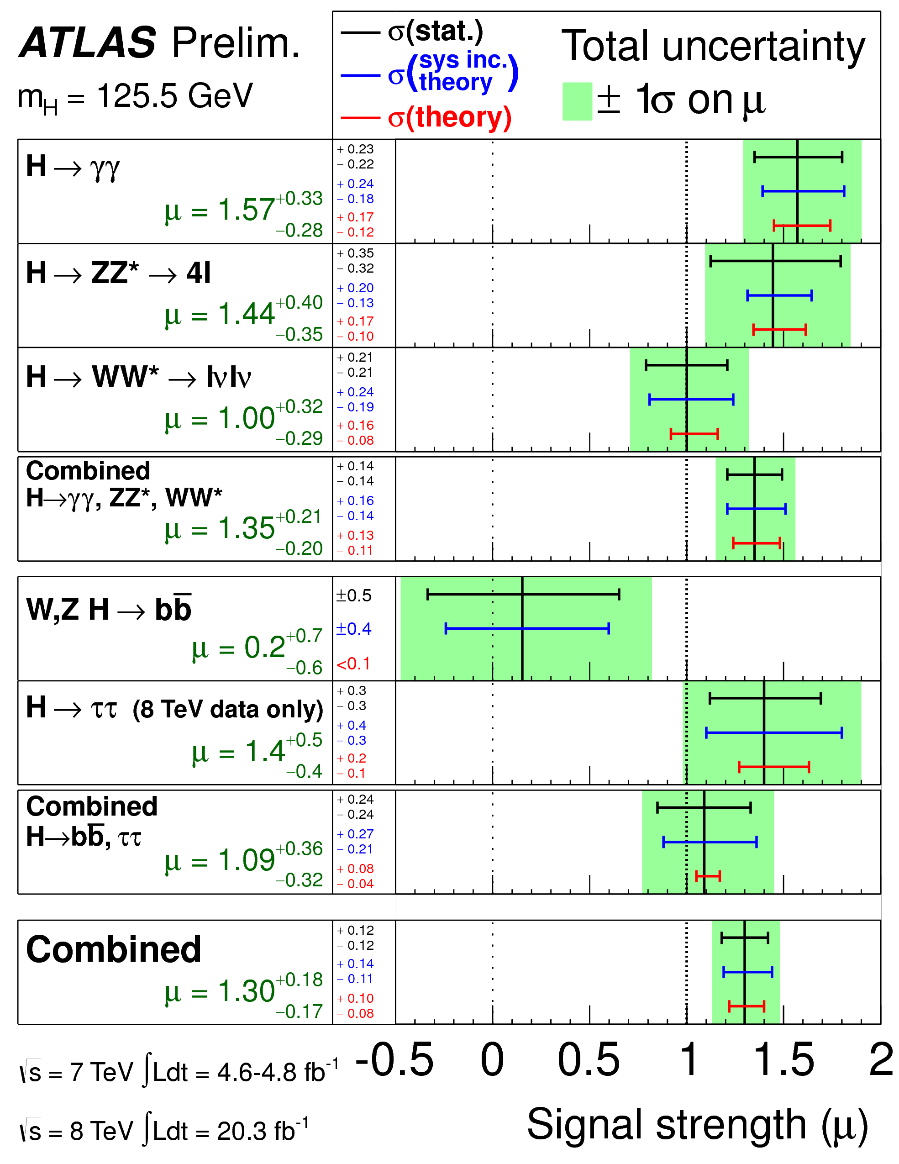
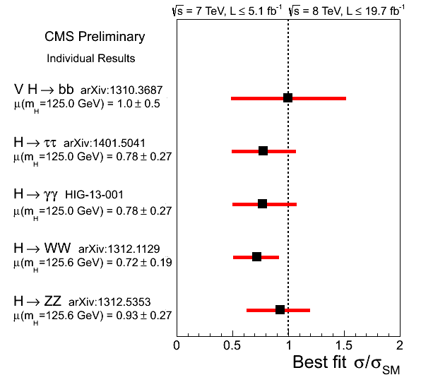
Higgs boson @ LHC
h→γγ : ATLAS still ≳ SM
1.57
0.78

Slide 9
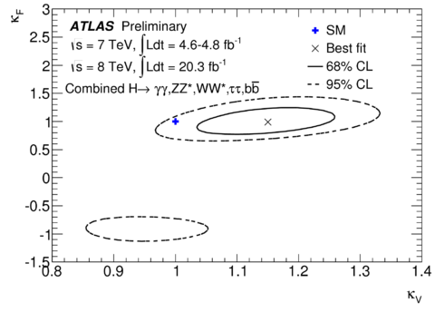
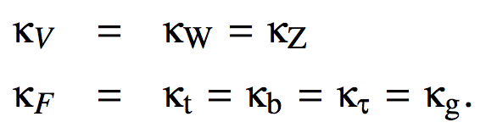
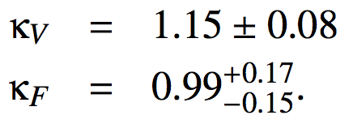
Higgs boson @ LHC
test couplings of Higgs boson to other SM particles
only SM particles are considered
can not determine Higgs boson self coupling!!
Higgs pair production is needed.

Slide 10
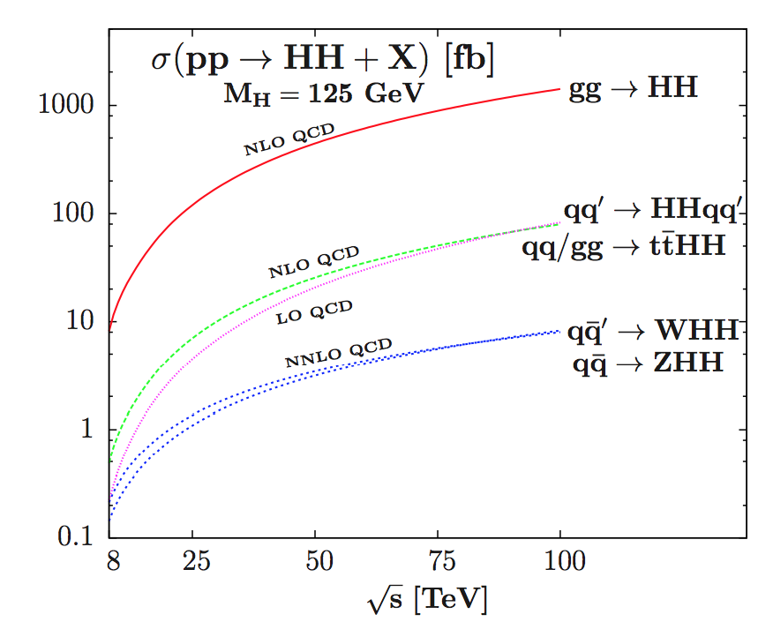
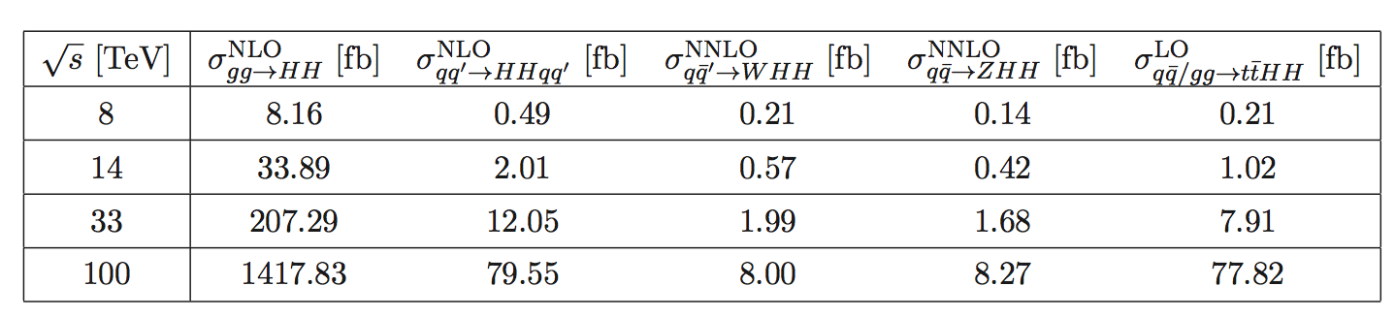
gg → H H
self coupling
Plehn, Spira, Zerwas, NPB 479(1996)46
Glover, van der BIJ, NPB 309(1998)282
Dawson, Dittmaier, Spira, hep-ph/9805244
Djouadi, Kilian, Muhlleitner, Zerwas, hep-ph/9904287
Asakawa, Harada, Kanemura, Okada, Tsumura, 1009.4670
Dawson, Furlan, Lewis, 1210.6663
Baglio, Djouadi, Grober, Muhlleitner, Quevillon, Spira, 1212.5581
* quite promising that one can discover
* w/ 3000 fb⁻¹ @ 100 TeV pp collider, hhh coupling can be measured with 8 % accuracy
Yao, 1308.6302

Slide 11
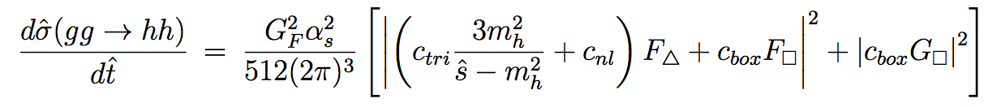
NP effects in gg → H H
CRC, Low, 1405.7040
can fit SM cross section even g_{hhh} vanishes or flips sign
g_{hhh} = SM value

Slide 12
gg → H H
total cross section contour
cross section itself is insensitive to Higgs trilinear coupling!!

Slide 13
gg → H H
SM
triangle → low M_{hh} and low p_{t}
box diagram → higher M_{hh} and higher p_{t}
tthh diagram →even higher M_{hh} and even higher p_{t}

Slide 14
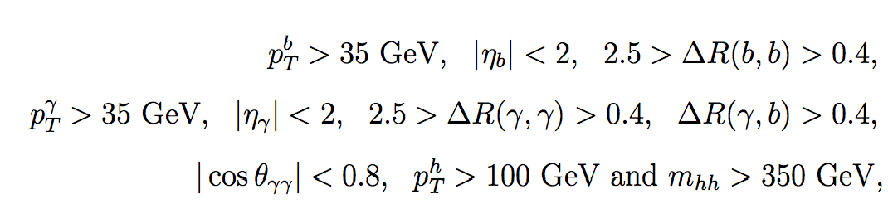
gg → H H
constrain on Ctri is weak
w/ more assumptions, we can have more implications

Slide 15
red: C_{nl}=0, C_{tri}=0.2, C_{box}=0.8
gg → H H
green: C_{nl}=0, C_{tri}=1.2, C_{box}=1.8
blue: C_{nl}=-0.22, C_{tri}=1, C_{box}=0.5
yellow: C_{nl}=0.36, C_{tri}=1, C_{box}=0.5
black: SM
M_{hh} (GeV)
different combinations give same cross section, but different M_{hh} and P_{t} distributions

Slide 16
gg → H H
constrain some parameter space

Slide 17
gg → H H
different combinations of C_{tri}, C_{box} and C_{NL} produce similar distributions
→ need more information to break the degeneracy

Slide 18
Summary
* A new scalar with mass ~ 125 GeV is discovered and its properties are consistent with SM Higgs boson.
* Higgs self-coupling is crucial!! → not measured yet.
* Higgs pair production is important for the trilinear coupling, however, total cross section is not that sensitive to it.
* Kinematic distributions can break some degeneracy but more information is needed for a significant improvement!!

