Slide 1
Searching for light dark matter through neutrino signature
Oct. 8, 2014@NTHU
林貴林
IOP, NCTU
(1). F.-F. Lee and GLL, Phys. Rev. D85, 023529 (2012)
(2). F.-F. Lee, GLL, Sming Tsai, Phys. Rev. D87, 025003 (2013)
(3). F.-F. Lee, GLL, Sming Tsai, Phys Rev. D89, 025003 (2014)
(4). C.-S. Chen, F.-F. Lee, GLL and Yen-Hsun Lin, arXiv: 1408.5471 [hep-ph], to appear
in JCAP.

Slide 2
Outline:
Introduction
DM-induced neutrinos from galactic halo
DM-induced neutrinos from the Earth’s core
DM-induced neutrinos from the Sun
Summary

Slide 3
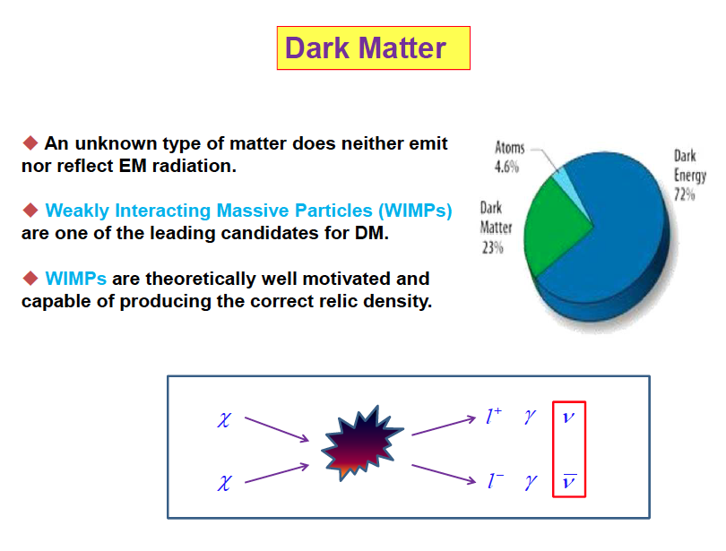

Slide 4
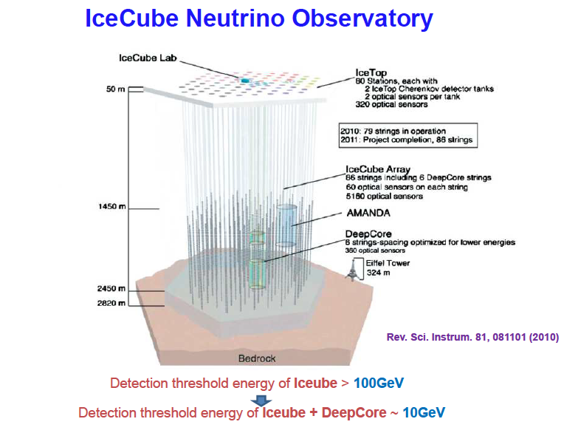
PINGU ~1 GeV
M. G. Aartsen et al. arXiv: 1401.2046

Slide 5
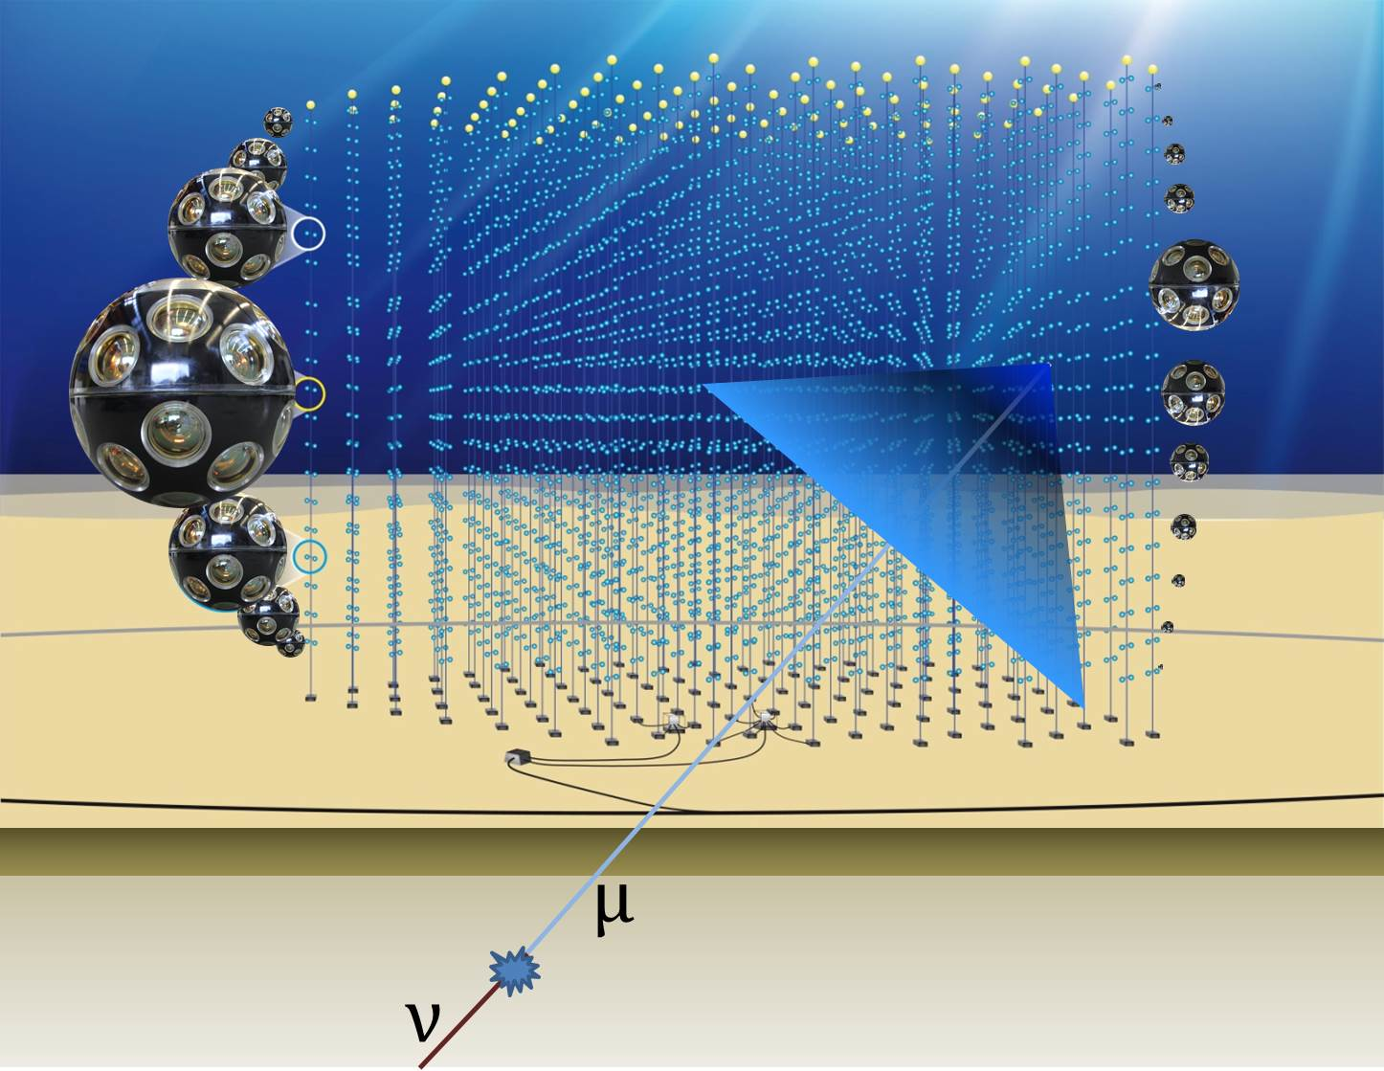
KM3NeT - The Next Generation Deep-Sea Neutrino Telescope
Mediterranean

Slide 6
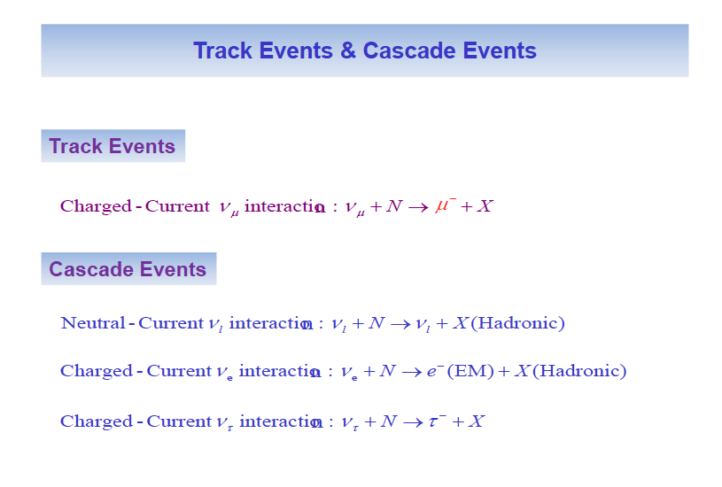
In Water Cherenkov Detector

Slide 7
DM-induced neutrinos
F.-F. Lee and GLL, Phys. Rev. D85, 023529 (2012);
F.-F. Lee, GLL, Sming Tsai, Phys. Rev. D87, 025003 (2013)
from Galactic Halo

Slide 8
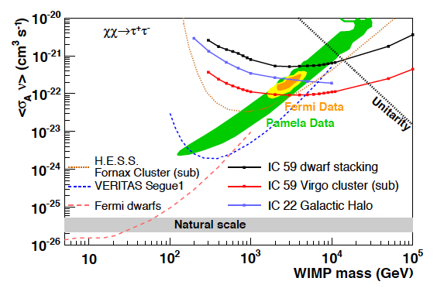
Correlated with Pamela, Fermi and AMS
IceCube new results on DM search
M. G. Aartsen et al., arxiv: 1307.3473 [astro-ph.HE]

Slide 9
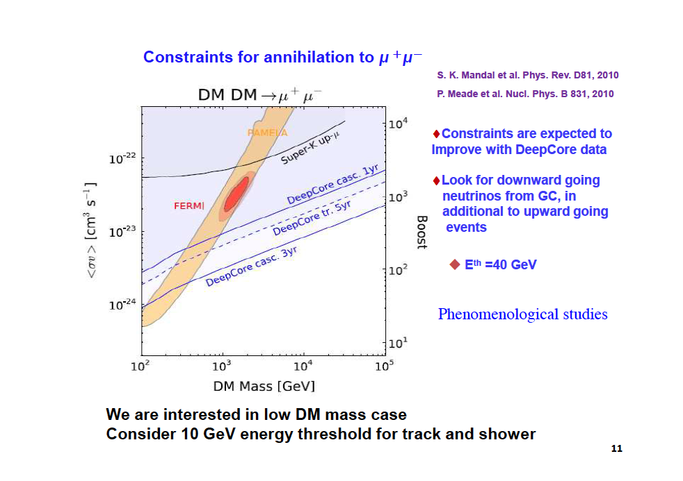
Earlier proposals

Slide 10
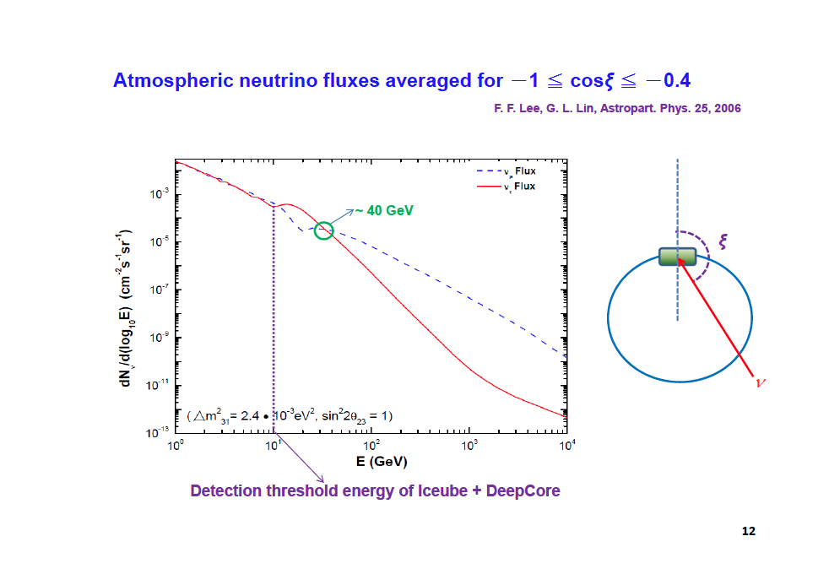
Need to estimate the background to lower energies

Slide 11
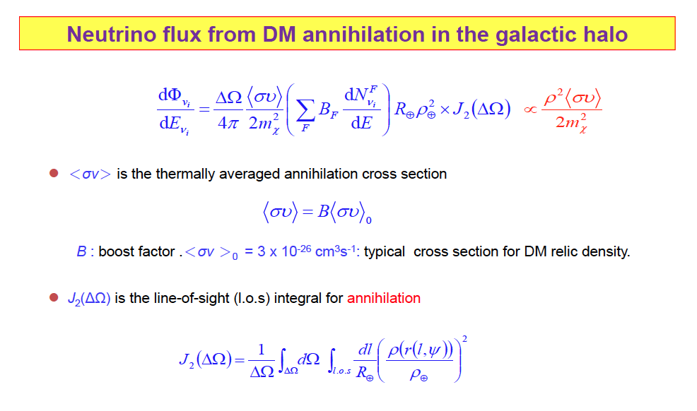
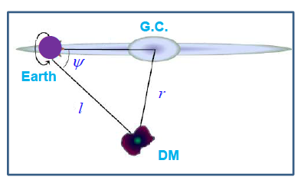

Slide 12
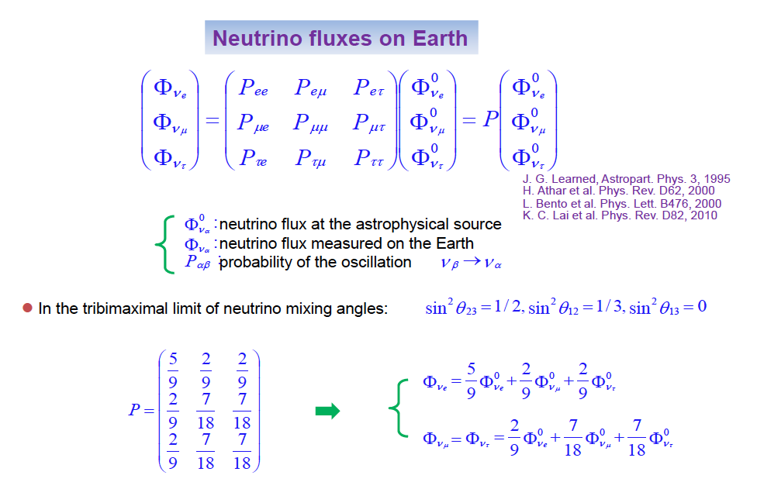

Slide 13
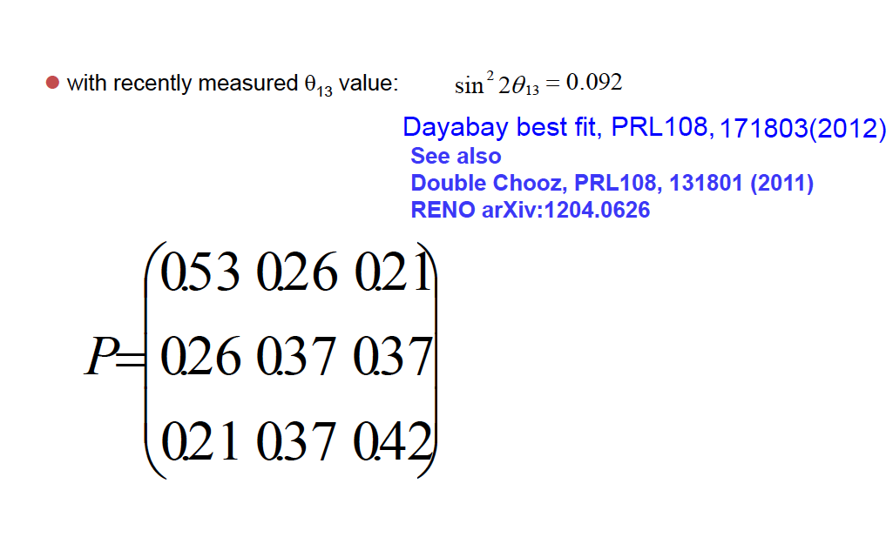

Slide 14
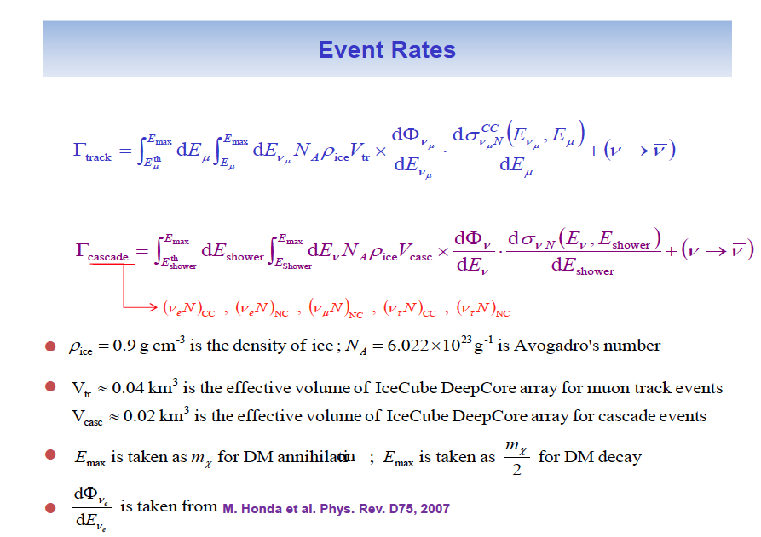

Slide 15
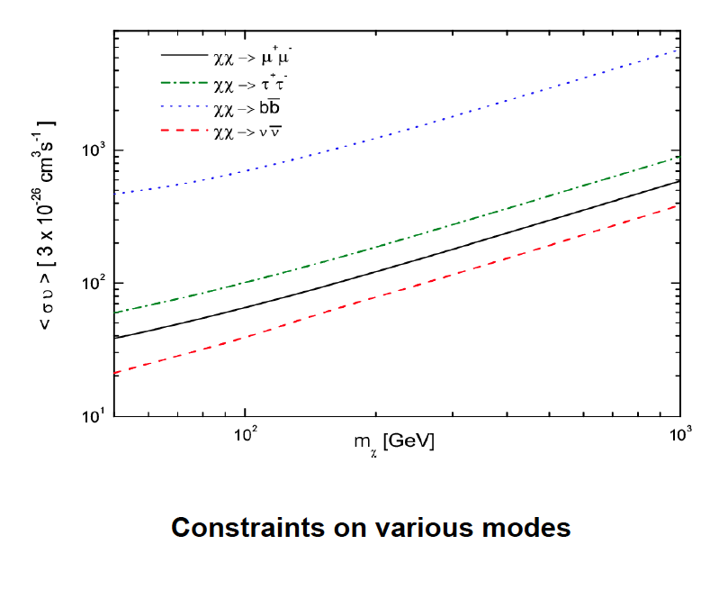
2σ in 5 years; cascade events with
Ψ_{max}=50 degree

Slide 16
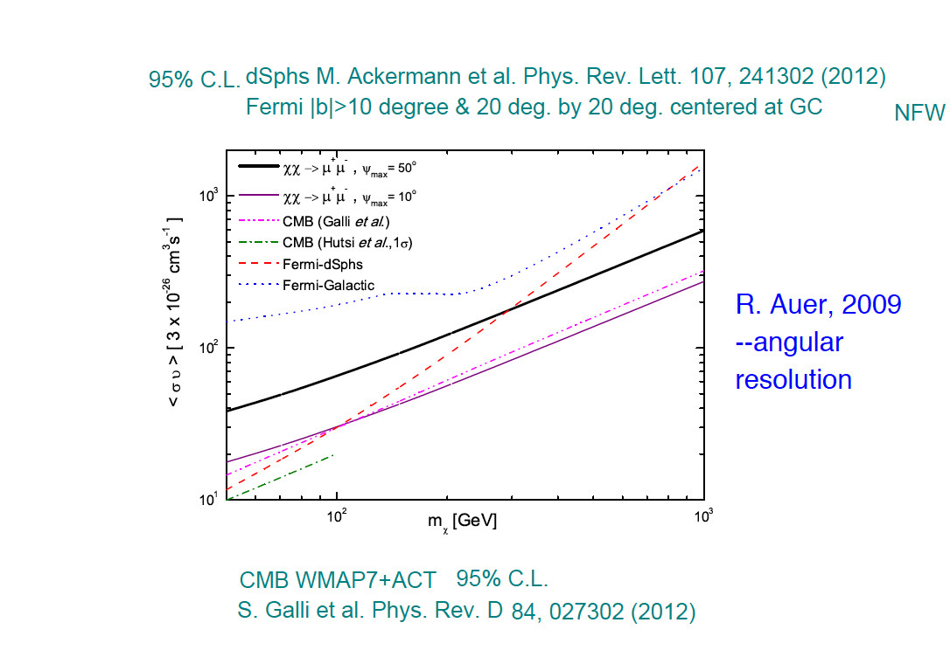

Slide 17
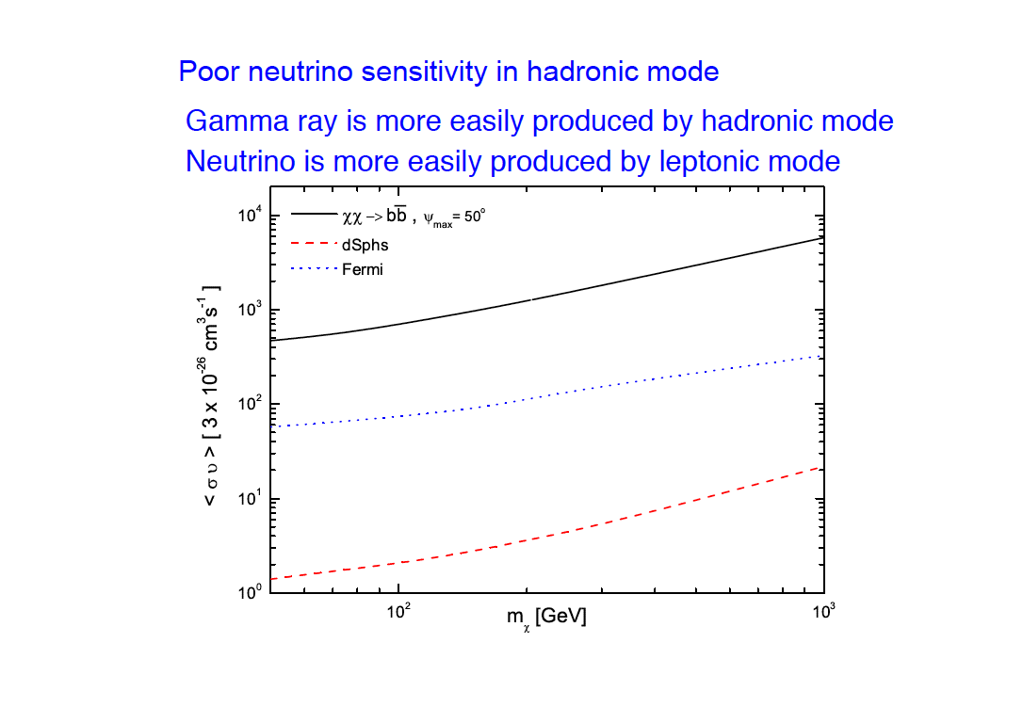

Slide 18
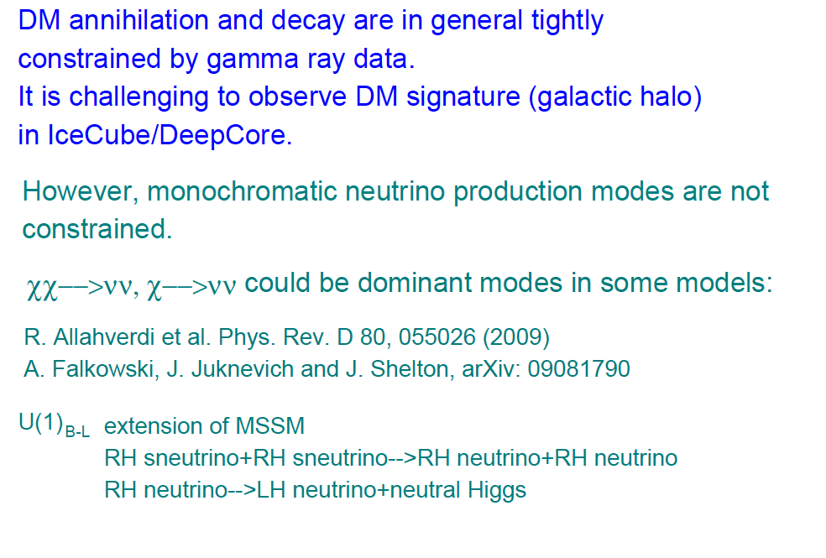

Slide 19
DM-induced neutrinos
F.-F. Lee, GLL, Sming Tsai, Phys Rev. D89, 025003 (2014)
from Earth’s core

Slide 20
Capture and annihilation in the Earth core
Γ_{A}(t): determines the neutrino flux
C_{c}: capture rate depends on σ^{SI}_{p} and
gravitational potential of specific chemical element
τ_{A}≡ equilibrium time scale with the annihilation
coefficient
Hence neutrino flux depends on both σ^{SI}_{p} and ⟨σv⟩
DM induced neutrino flux from the Sun is more sensitive
to σ^{SD}_{p}

Slide 21
General Background
•Probing from Earth core with IceCube
were discussed in I. F. M. Albuquerque, L. J. B. e Silva, and C. P. de los Heros, Phys. Rev. D 85, 123539 (2012), for large DM mass (few hundred GeV to TeV).
•Probing from Earth Core with IceCube were
also discussed in C. Delaunay, P. J. Fox, and G. Perez, J. High Energy Phys.05 (2009) 099 for large DM mass as
well.
•We consider light DM mass as well and include DeepCore capability in our discussions. All possible annihilation channels are discussed.

Slide 22
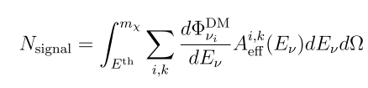

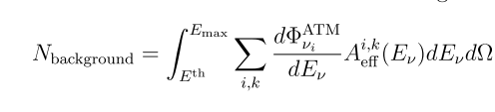
DM signal and atmospheric background
2σ detection
Significance in
5 years
i: neutrino flavor, k: CC or NC interaction
Calculation done by WIMPSIM
M. Blennow, J. Edsjo and T. Ohlsson, JCAP 0801, 021 (2008)

Slide 23
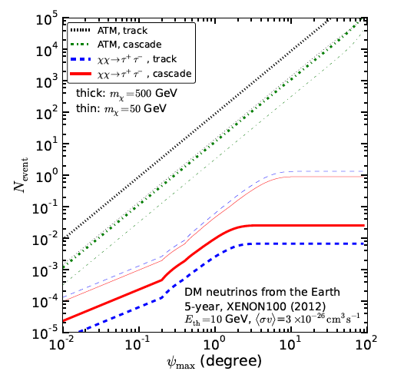
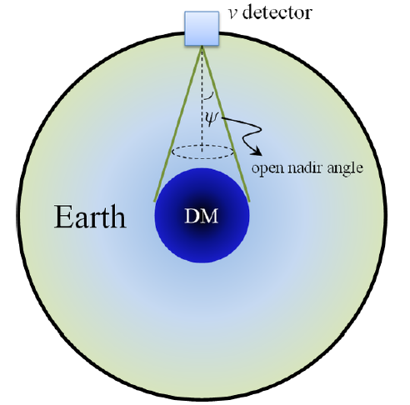
observation open angle toward the Earth core
critical value of
when N_{event} no longer
increases
From YH’s art work

Slide 24
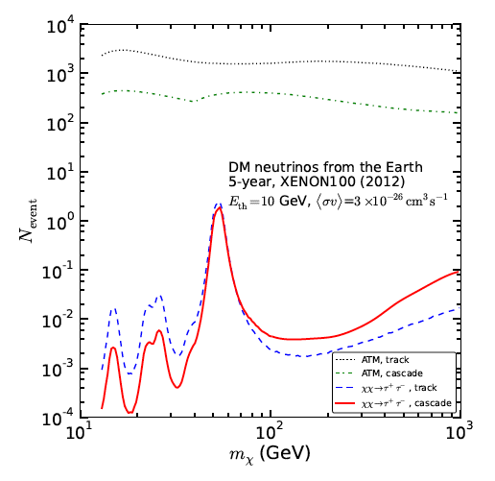
Several resonance peaks for N_{event}

Slide 25
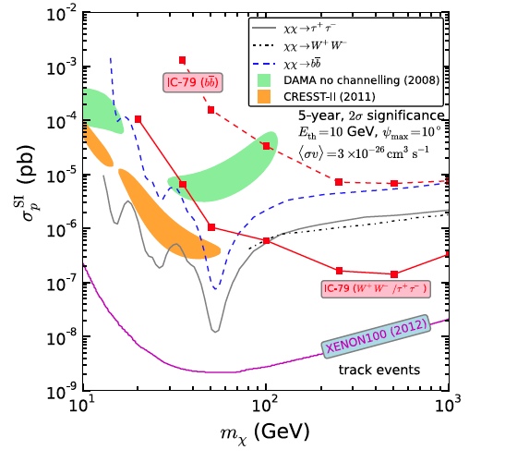
Compare with direct detection and IC-79
•IC-79: IceCube 79 string
result from the search
for DM annihilation in the
Sun
•M. G. Aartsen et al.
[IceCube Collaboration],
Phys. Rev. Lett. 110,
131302 (2013)
Track events
Ψ_{max}=10°
<σv>=3×10⁻²⁶cm³s⁻¹

Slide 26
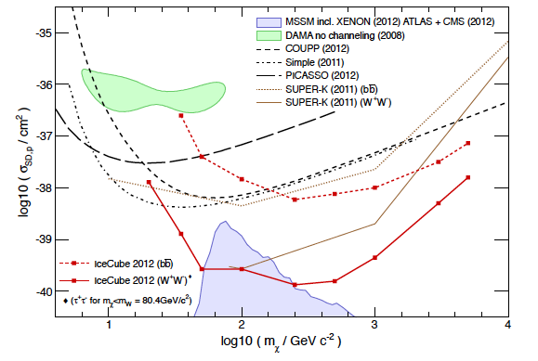
Indirect detection has the advantage in probing spin-dependent cross section

Slide 27
DM-induced neutrinos
from the Sun
C.-S. Chen, F.-F. Lee, GLL and Yen-Hsun Lin, arXiv:
1408.5471, to appear in JCAP
More details to be presented by Y.-H. Lin in this meeting

Slide 28
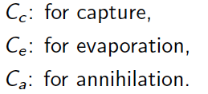
Evolution of DM inside the Earth and Sun
Evaporation leads to the suppression of N and hence the neutrino flux
This happens in the Earth for m_{χ}< 12 GeV, and it happens in the Sun
for m_{χ}< 3-4 GeV.
Gould, Astrophys. J. 321, 571 (1987);
L. M. Krauss, M. Srednicki, and F. Wilczek, Phys. Rev. D33, 2079 (1986);
M. Nauenberg, Phys. Rev. D 36, 1080 (1987);
K. Griest and D. Seckel, Nucl. Phys. B283, 681 (1987);
Nucl. Phys. B296, 1034(E) (1988).

Slide 29

Self-Interacting Dark Matter (SIDM)
SIDM can better explain the small scale structure of the Universe.
On RHS of evolution equation, SIDM enhances the term linear in Nχ for the Earth case, while it cancels the linear term for the Sun case--A. R. Zentner, Phys. Rev. D 80, 063501 (2009).
This favors of detecting DM induced neutrinos from the Sun for m_{χ}< 10 GeV. However, self-interaction induced evaporation has to be taken into account.

Slide 30
Complete evolution equation
C_{s} : self-interaction
Induced capture
>0 for the sun case
C_{se} : self-interaction
induced evaporation

Slide 31
Annihilation rate proportional to (Nχ)²
Cross section values compatible with current bounds
See Y.-H. Lin’s talk for details

Slide 32
Annihilation rate proportional to (Nχ)²
Cross section values compatible with current bounds
See Y.-H. Lin’s talk for details

Slide 33
Sensitivities of IceCube-PINGU
Angular resolution taken to be 10 degree

Slide 34
Sensitivities of IceCube-PINGU
Smaller spin-dependent cross section

Slide 35
Sensitivities of IceCube-PINGU
Angular resolution taken to be 10 degree

Slide 36
Sensitivities of IceCube-PINGU
Smaller spin-dependent cross section

Slide 37
Summary
Illustrated by a few plots

Slide 40
Compare with direct detection and IC-79
•IC-79: IceCube 79 string
result from the search
for DM annihilation in the
Sun
•M. G. Aartsen et al.
[IceCube Collaboration],
Phys. Rev. Lett. 110,
131302 (2013)
Track events
Ψ_{max}=10°
<σv>=3×10⁻²⁶cm³s⁻¹
Look for light DM by Indirect detection!

Slide 41
Self-interaction effect is significant in low mass
Look to the Sun!

