Slide 1




Recent results of OPERA experiment
T. Shiraishi - Nagoya University
On behalf of The OPERA Collaboration
140 physicists, 28 institutions in 11 countries
Belgium
ULB Brussels
Italy
Bari
Bologna
LNF Frascati
L’Aquila
LNGS
Naples
Padova
Rome
Salerno
Korea
Jinju
Croatia
IRB Zagreb
Russia
INR RAS Moscow
LPI RAS Moscow
ITEP Moscow
SINP MSU Moscow
JINR Dubna
France
LAPP Annecy
IPHC Strasbourg
Japan
Aichi edu.
Kobe
Nagoya
Toho
Nihon
Switzerland
Bern
Germany
Hamburg
Israel
Technion Haifa
Turkey
METU Ankara

Slide 2
ν_{μ}→ν_{τ} oscillation in appearance
SK’s observation of the atmospheric neutrino disappearance indicated neutrino oscillation
The oscillation analyses have been mostly done in disappearance
OPERA is designed to observe ν_{μ}→ ν_{τ} oscillation through ν_{τ} appearance

Slide 3
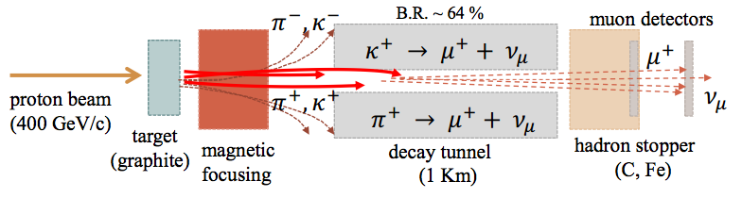
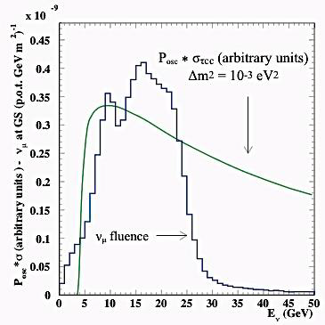
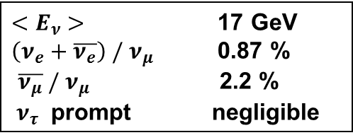
CNGS (CERN Neutrino to Gran Sasso)
CERN SPS
Pure ν_{μ}
732km
ν_{τ}
Appearance
${<E}_{ν} >$ 17 GeV
$\left(ν_{e}+\overline{ν_{e}}\right) /{ ν}_{μ}$ 0.87 %
$\overline{ν_{μ}} /{ ν}_{μ}$ 2.2 %
${ ν}_{τ}$ prompt negligible
Oscillation Prob * Cross Section
OPERA Detector
@ Gran Sasso
High energy neutrino (above 3.5 GeV)
Long baseline
Optimized to maximize tau neutrino interaction

Slide 4
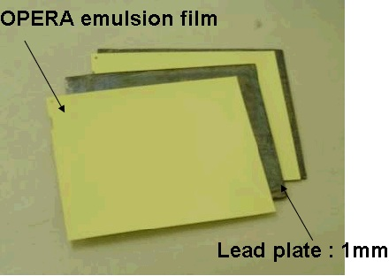
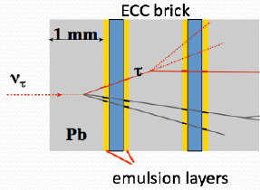
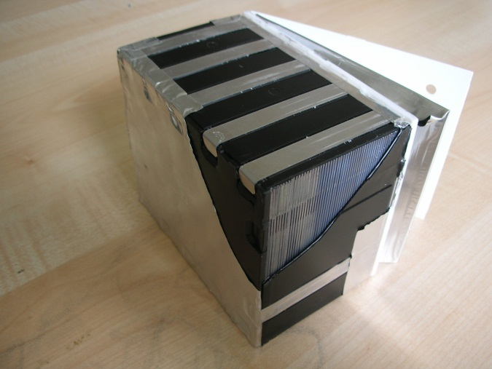
Principle of tau neutrino detection
No-oscillation
11% QE, 89%DIS
Oscillation
35% QE, 65%DIS
ν
μ⁻
decay “kink”
ν_{μ}
ν_{μ}
τ⁻
μ⁻,e⁻,h⁻,3h
ν_{μ}
ν_{τ}
cτ ~ 87μm (~ IP)
Path ~ 600μm
ECC (Emulsion Cloud Chamber) : OPERA main detector
7.5 cm
12.5 cm
ν beam
57 emulsion films
56 lead plates
10 cm
Micrometric accuracy with large target mass
ECC is the only detector which directly observed tau neutrinos in DONUT experiment
8.3 kg, 10 Radiation Length

Slide 5
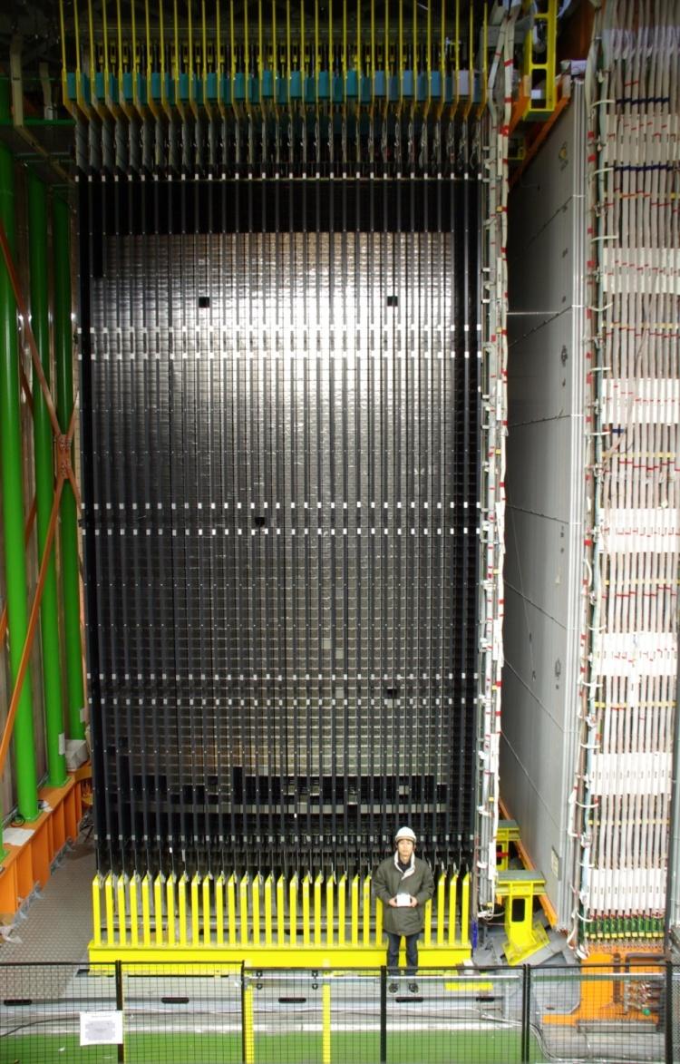
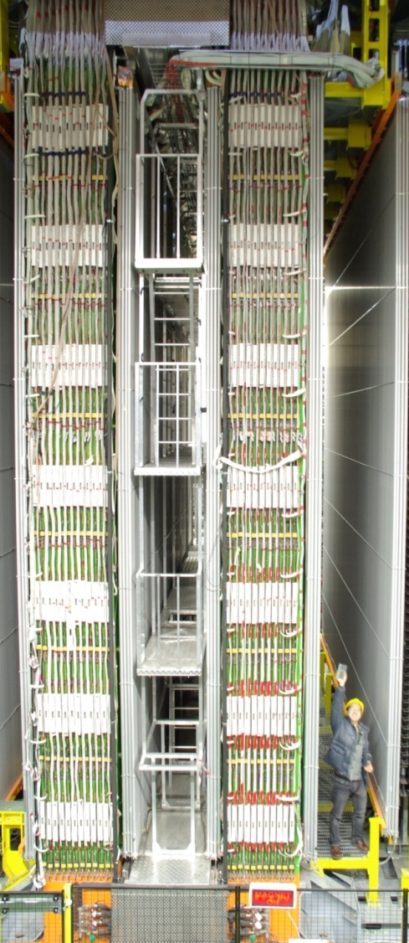
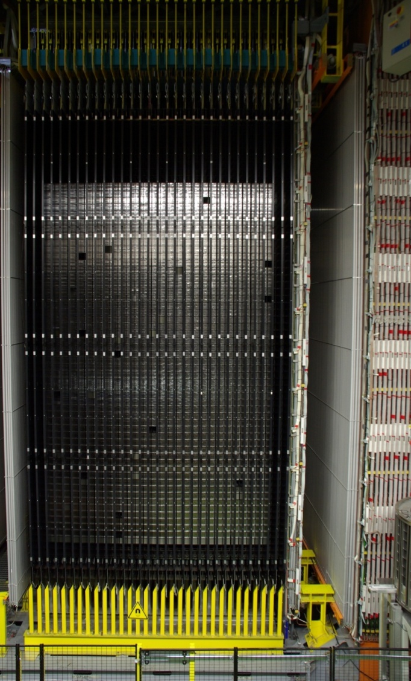
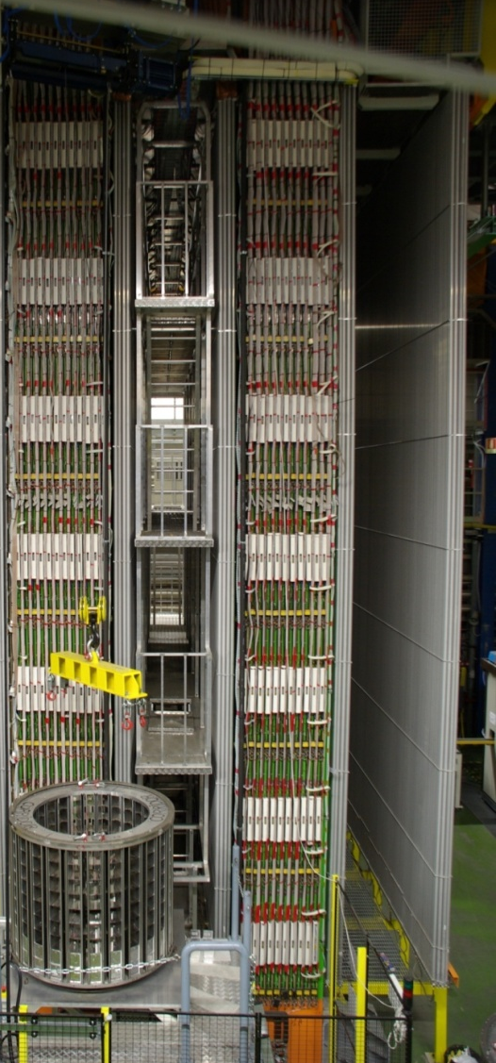
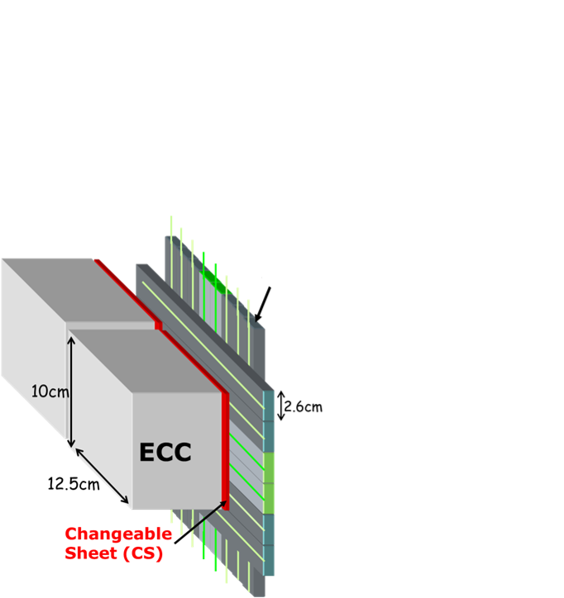
OPERA detector
@ Gran Sasso UnderGround 1,400m (3,800 m.w.e)
Target area
Muon spectrometer (Drift Tube + RPC + Magnet)
Scintillator strips
Target Tracker (TT)
ν
1.0cm
Doublet of emulsion films
150,000 ECC bricks = 1.25 kton target mass

Slide 6
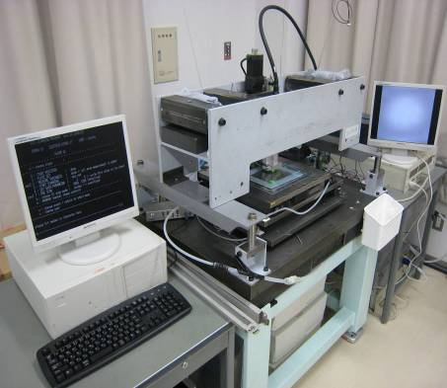
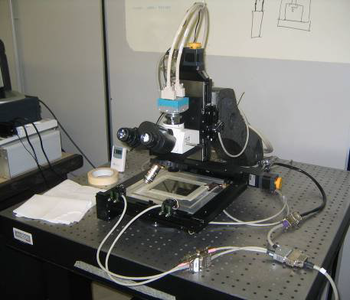
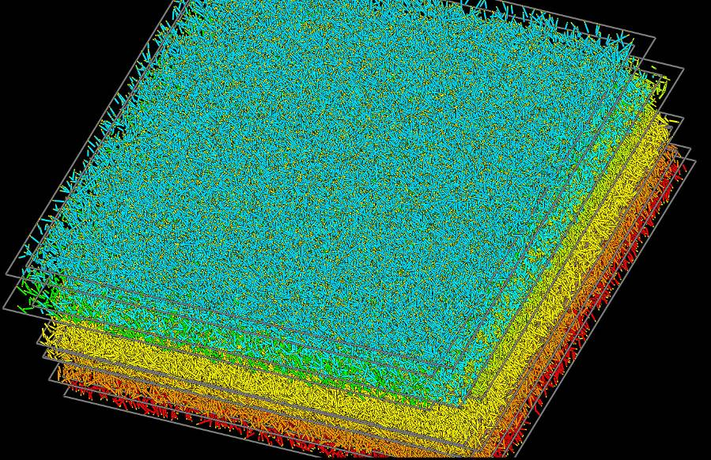
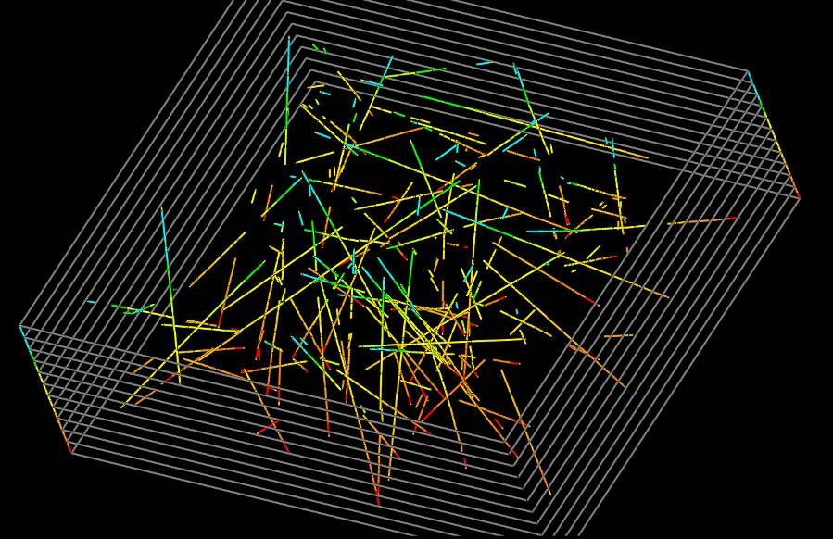
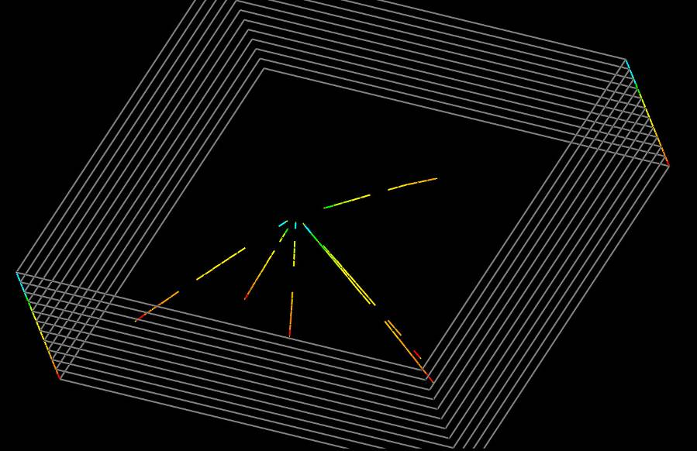
Vertex Location and Decay Search
ECC
emulsion
Scanning system
lead
CS
TT
Japan (S-UTS)
Europe (ESS)
Tracking to the vertex
2.6
cm
Vertex
Scanning speed :
75cm²/h x 5 system 20cm²/h x 10 system
Reconstruction
Raw data
Search for large IP tracks
(Decay Search)
All candidates of tracks
1cm² ×10plate volume scan
Tracks remaining after taking multi layers’ coincidence
After rejection of tracks penetrating the volume

Slide 7
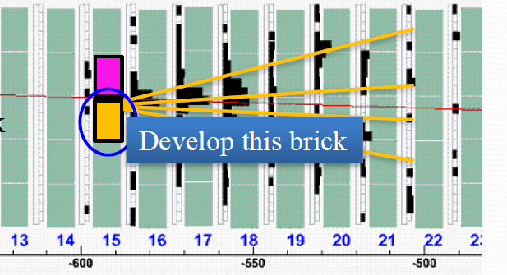
Analysis status
2nd
Analysis strategy is 1st and 2nd probable bricks
1st
Data Sample 2008-2012 Run
Brick probability | Decay Search finished | Expected final sample | Completion rate
1st | 5575 | ~6000 | 425 (93%)
2nd | 420 | ~700 | 280 (60%)
Total | 5995 | ~6700 | 705 (89%)
~10% remained
→ These will be done until July 2015

Slide 8
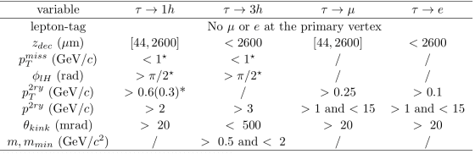
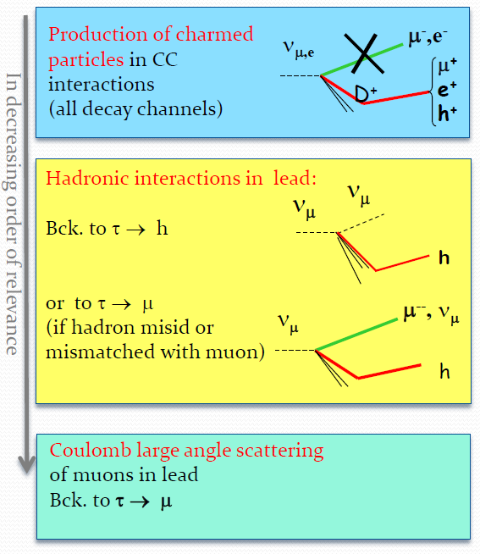
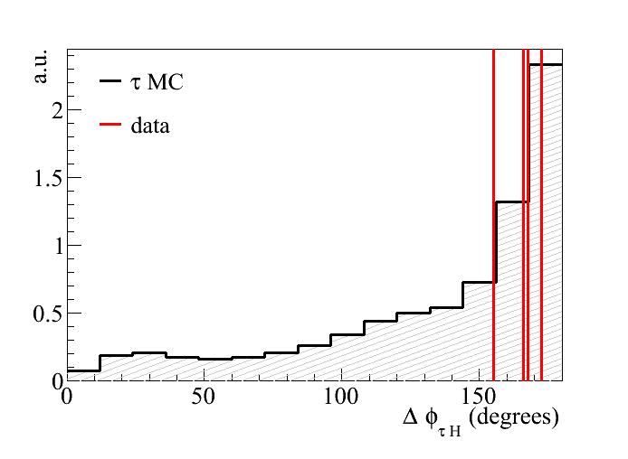
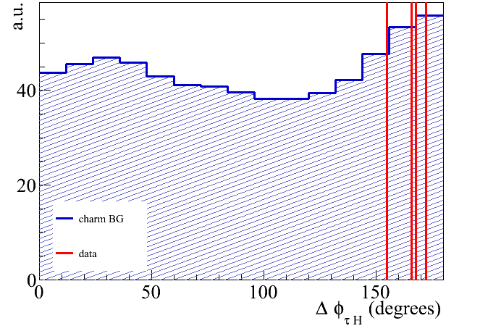

Event selection
ν beam transverse plane
Kinematical cuts
Other visible vectors
φ angle
Parent vector
Neutrino vertex
Background
$$cut φ<90°$$
φ distribution
τ : large φ
Charm : small φ
τ MC
In decreasing order
charm MC

Slide 9
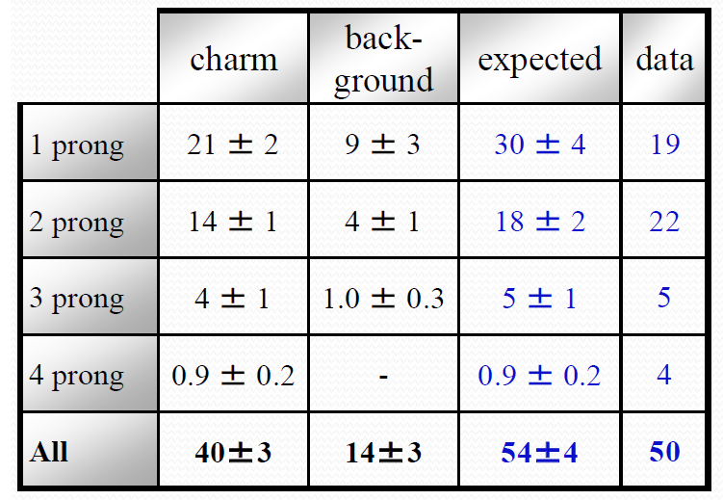
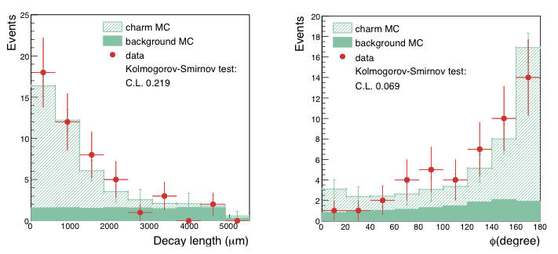
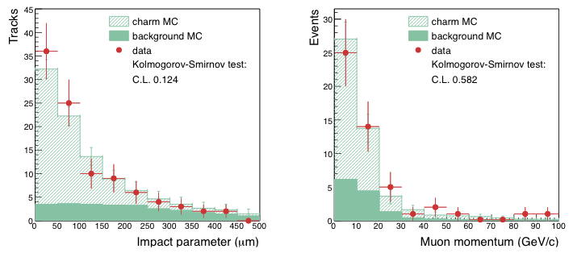
Efficiency control sample
Charm decay has similar topology as tau decay
  Muon attached to the interaction point
  νμ + n → μ + D + p + (anything)
Good agreement between data and MC
Eur. Phys. J. C (2014) 74: 2986

Slide 10
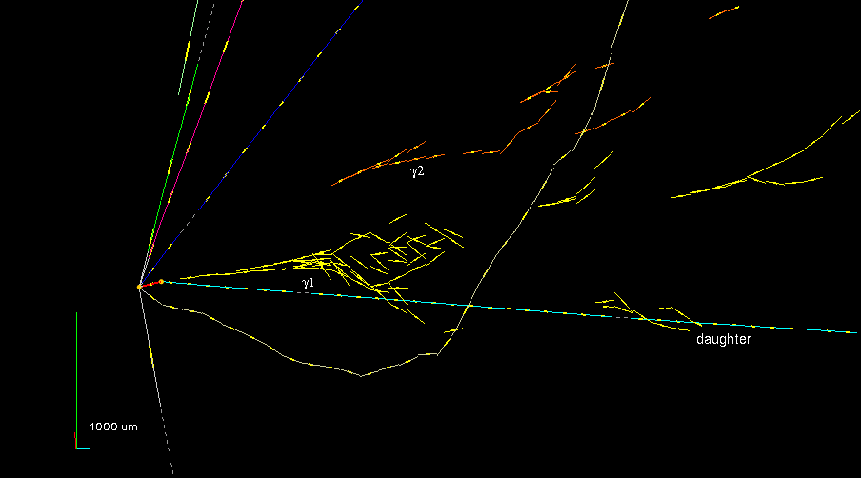
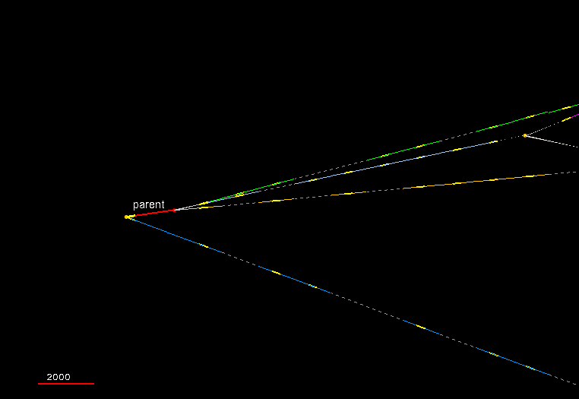

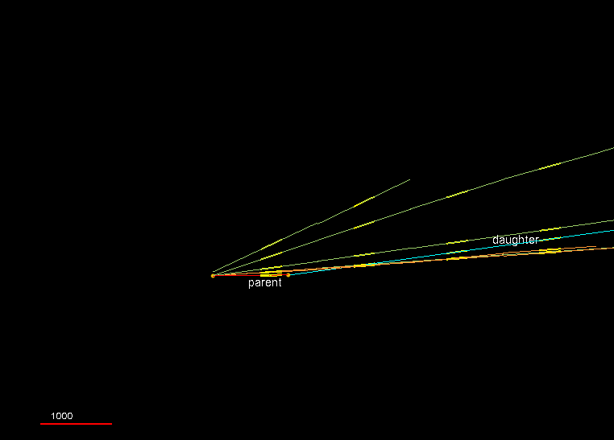
4 tau neutrino events
1st ντ
2nd ντ
τ -> h
τ -> 3h
Phys.Lett. B691 (2010) 138-145
JHEP 1311 (2013) 036
τ⁻→ρ⁻ ν_{τ}
ρ⁻→π⁰ π⁻
π⁰ → γ γ
3rd ντ
4th ντ
τ -> μ (τ⁻ -> μ⁻)
τ -> h
Phys.Rev. D89 (2014) 051102
arXiv : 1407.3513v2
4th ν_{τ} paper has been accepted by PTEP

Slide 11
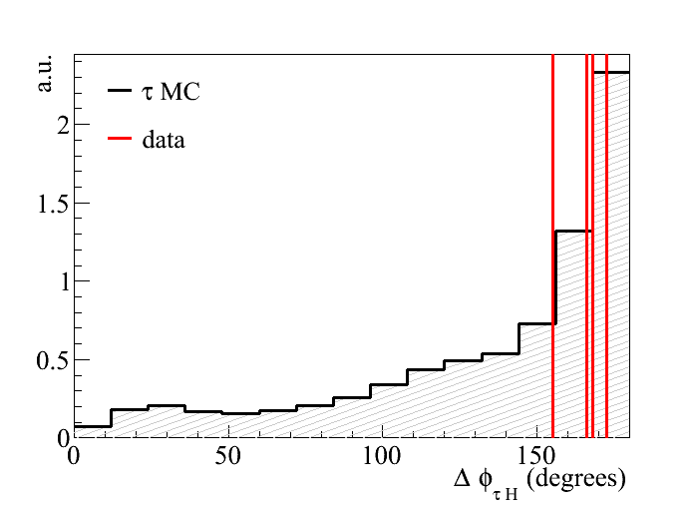
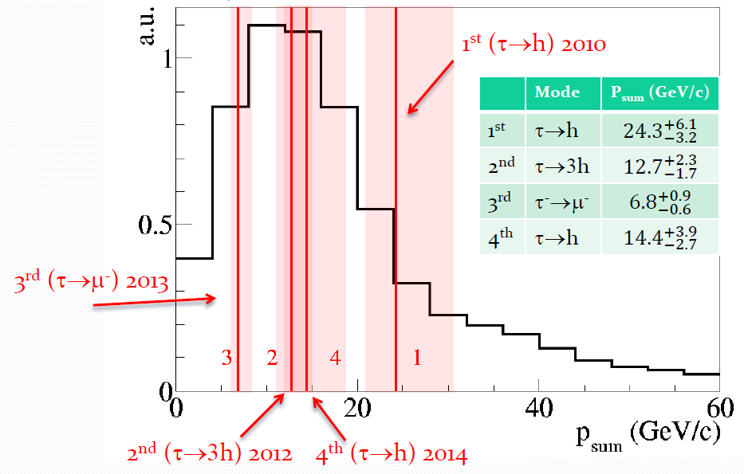
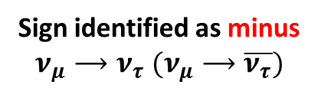

Summary of 4 tau neutrino events
2nd
1st
φ angle
3rd
4th
Visible energy
(Scalar sum of momenta and γ energies)
$$cut φ<90°$$
Sign identified as minus
$$ν_{μ}⟶ν_{τ} (ν_{μ}⟶\overline{ν_{τ}})$$

Slide 12
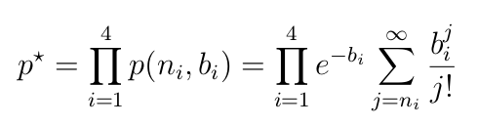
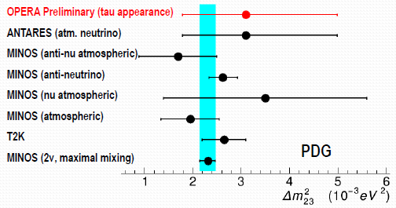
Oscillation analysis
Decay channel | Expected signal Δm² = 2.32x10⁻³ eV² | Total background | Observed
τ → h | 0.41±0.08 | 0.033±0.006 | 2
τ → 3h | 0.57±0.11 | 0.155±0.030 | 1
τ → μ | 0.52±0.10 | 0.018±0.007 | 1
τ → e | 0.62±0.12 | 0.027±0.005 | 0
Total | 2.11±0.42 | 0.233±0.041 | 4
Details of background
Charm | μ scattering | Hadron int
0.015±0.003 |  | 0.018±0.005
0.152±0.030 |  | 0.002±0.001
0.003±0.001 | 0.014±0.007
0.027±0.005
0.198±0.040 | 0.014±0.007 | 0.021±0.006
Combination of four single channel p-value
The first measurement of Δm²₃₂
in tau neutrino appearance
P value = 1.03 x 10⁻⁵
→No oscillation excluded at 4.2σ CL
(Multivariable analysis ongoing)
90% CL intervals assuming sin²(2θ)=1
Feldman&Cousin : [ 1.8, 5.0] x 10⁻³ eV²
Bayesien : [ 1.9, 5.0] x 10⁻³ eV²

Slide 13
Non-standard oscillation model
Number of observed ν_{τ} is a little excess, but consistent with other disappearance results in standard 3 flavors model
LSND indicated existence of 3rd Δm² (4th neutrino)
7.6×10⁻⁵eV², 2.4×10⁻³eV² , 0.5-3 eV²
Number of observed ν_{τ} depends on the oscillation model (standard 3 flavors, 3+1, 3+2 …)
Limiting the non-standard oscillation
(ex. 3+1 model)

Slide 14
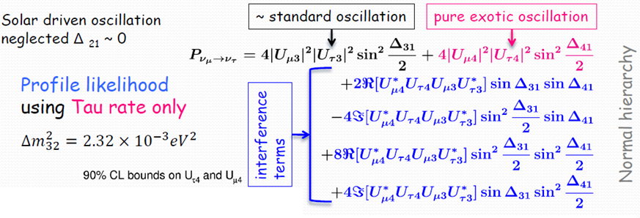
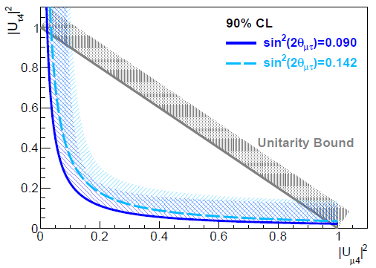
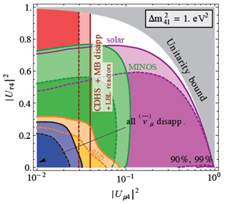

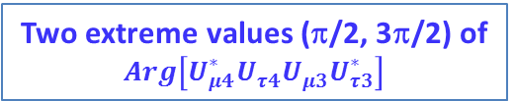

Sterile neutrinos
Preliminary
ν_{τ} appearance in the presence of sterile neutrino (3+1)
$$∆_{ij}≡\frac{{{∆m}^{2}}_{ij}L}{2E}$$
Assuming Δm²₄₁ $≫$ other Δm²
OPERA
Two extreme values (π/2, 3π/2) of $Arg\left[U_{μ4}^{∗}U_{τ4}^{}U_{μ3}^{}U_{τ3}^{∗}\right]$
Koop et al. JHEP 1305 (2013) 050
OPERA allowed region
log scal

Slide 15
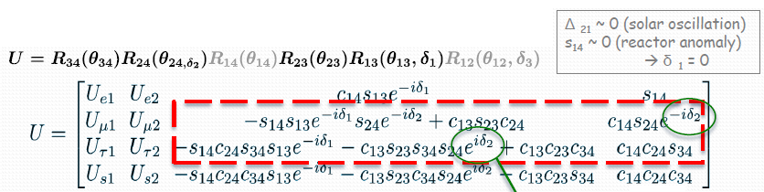
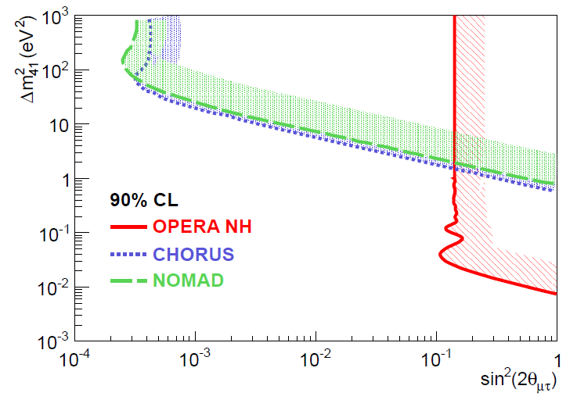
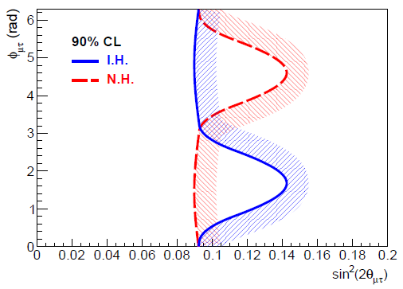

Sterile neutrinos
Preliminary
ν_{τ} appearance in the presence of sterile neutrino (3+1)
OPERA

Slide 16
OPERA analyses
Oscillation analysis
νμ → ντ in appearance
Measurement of TeV atmospheric muon charge ratio
Eur.Phys.J. C74 (2014) 2933
OPERA can also see other oscillations
νμ → νe in appearance
  19 νe events have been reported from 2008~2009 data sample
  JHEP 1307 (2013) 004
  They are consistent with prompt νe
  This analysis will be extended to 2010~2012 data sample
  νμ → νμ disappearance
Study of hadron interactions
PTEP 2014 (2014) 093C01
Cosmic ray events analysis
OPERA detector has also recorded cosmic ray events
No other detectors achieve such the coexistence of micro-metric tracking accuracy and large target mass
  Atmospheric neutrinos analysis
  Exotic events search (such as unsolved Kolar events [ref. Phys. Lett. B57 (1978)105-108])

Slide 17
Conclusion
The achievement of main analysis is about 90%. In them, 4 ντ events have been found.
The significance for the ν_{μ}→ ν_{τ} oscillation in appearance is 4.2 σ. The Δm²₃₂ is consistent with other disappearance results.
Analyzing limitation the non-standard oscillation, preliminary
Some other analyses ongoing

Slide 18
Backup

Slide 19
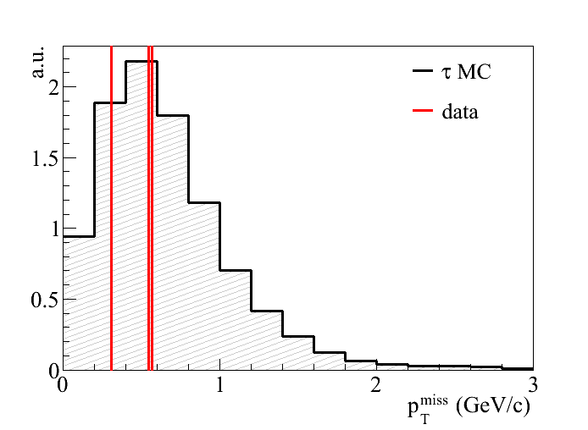
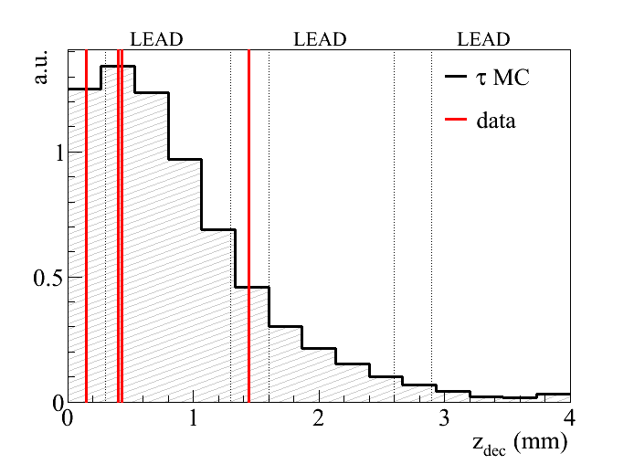
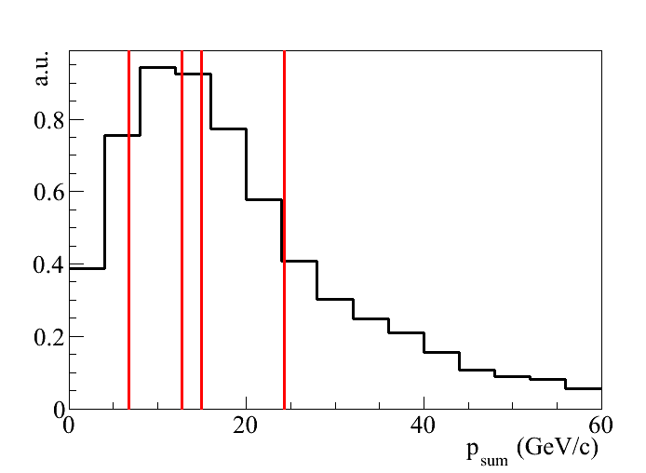
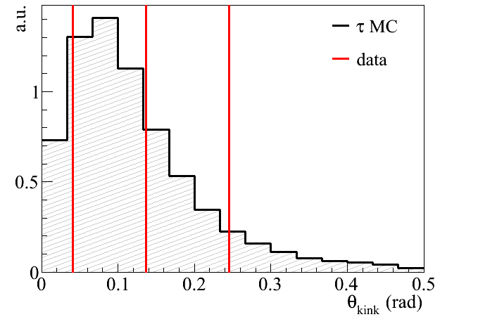
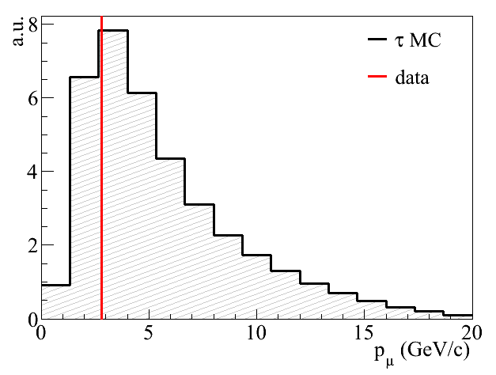
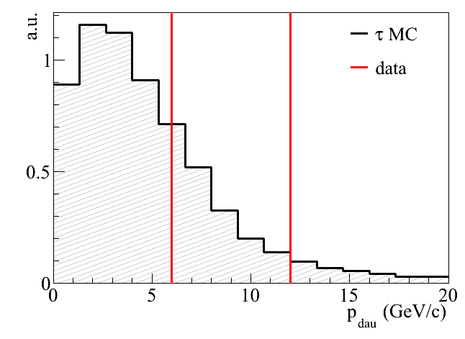
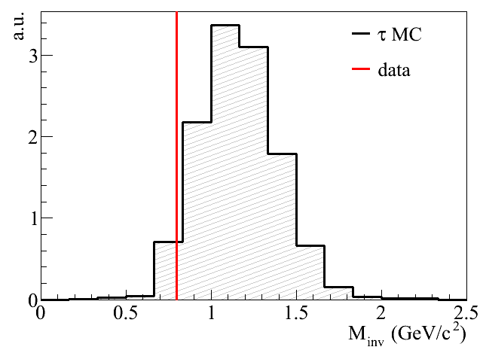
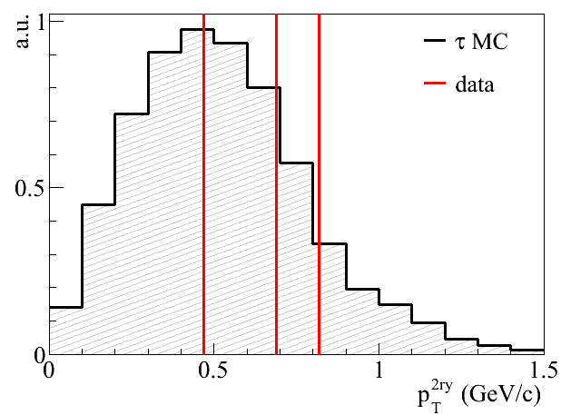
Summary of 4 tau neutrino events
τ → h
τ → 3h
τ → h
τ → 3h
τ → μ
τ → h
τ → 3h
τ → μ
τ → h
τ → 3h
τ → μ
τ → h
τ → μ
τ → μ
τ → h
τ → 3h
τ → h
τ → μ

Slide 20
Marginal events analysis ongoing
大体2倍ぐらいシグナル増える

Slide 21
ν_{μ}→ ν_{e} oscillation analysis ongoing
原子核乾板での分解能により
π⁰とν_{e}反応を区別可能。
BG ~ 1%
(0.2個 19 ν_{e}中)
３種類のニュートリノ
フレーバーとNC反応を
決定できる。
2008-2009 Run sample 19事象同定（prompt ν_{e} コンシステント）
→ JHEP 1307 (2013) 004
現在全サンプルを対象に探索中
45事象同定 updateしたサンプルで次の結果を出す。
Notes:
19x3でエクセス、トントン。2シグマ

Slide 22
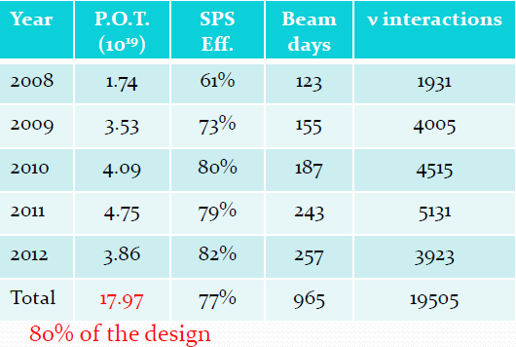
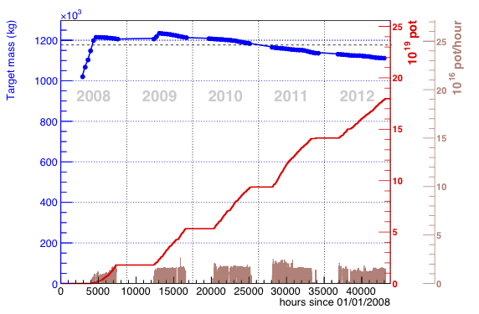
POT and Target Mass

Slide 23
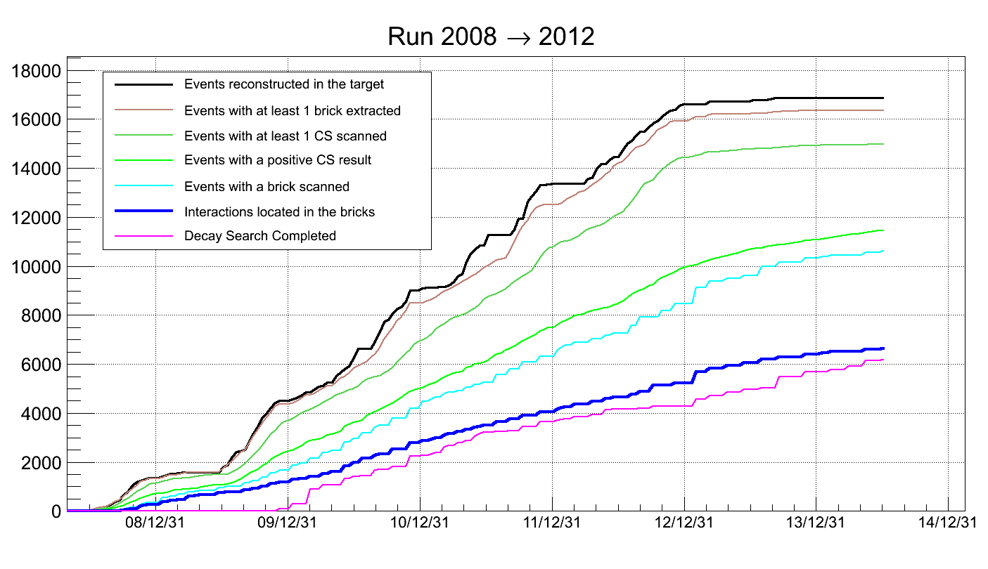

Slide 24


Slide 25


Prompt ν_{τ}
2 modes
$$p+N → D_{s}+\overline{D}+X$$
$$D_{s} → τ^{+}+ν_{τ}$$
$$p+N → \overline{D_{s}}+D+X$$
$$\overline{D_{s}} → τ^{−}+\overline{ν_{τ}}+X$$
$$τ^{−} → ν_{τ}+X$$
$${\left(ν_{τ} prompt\right)}/{ν_{μ}}<{10}^{−7}$$

Slide 26

Charmed mesons creation
Charm production in νμ interactions
・弱い相互作用による世代間混合
CC反応 （1個/${30 ν}_{μ}$CC 程度）
$$ν_{μ}+N→D+μ^{−}+X$$
・強い相互作用による$c \overline{c}$対生成
NC反応 （1個/${1000 ν}_{μ}$NC 程度）
$$ν_{μ}+N→D+\overline{D}+ν_{μ}+X$$

Slide 27


τ leptons creation
$${\left(p_{ν}^{}+p_{p}^{}\right)}^{2}={\left({p_{τ}^{}}^{∗}+{p_{p′}^{}}^{∗}\right)}^{2}$$
実験室系
重心系
$${p_{τ}^{}}^{∗}={p_{p^{′}}^{}}^{∗}=0$$
$$2E_{ν}m_{p}+{m_{p}}^{2}={m_{τ}}^{2}+{m_{p}}^{2}+2m_{τ}m_{p}$$
$$E_{ν}=m_{τ}\left(1+\frac{m_{τ}}{2m_{p}}\right)≈3.44 GeV$$

