Slide 1
2nd Internationl Workshop on
Particle Physics and Cosmology after Higgs and Plank
Tensions in DM Direct Detection
Qing Wang Tsinghua Univ. Beijing
Notes:
In this talk, I will discuss tensions in different dark matter direct detection experiments.

Slide 2
Outline
Motivation & Status
√
Three old Exps: DAMA；CRESST；CoGeNT
Reconciliation Methods
Our Latest Result
Notes:
My talk is divided into four parts: first is the motivation of this work and status of direct detection of dark matter; then is three old experiments which claim they find signals; and introduce two methods we will use to reconcile tension of the experimental results. Finally is our proposal. Now first is the motivation and status.

Slide 3
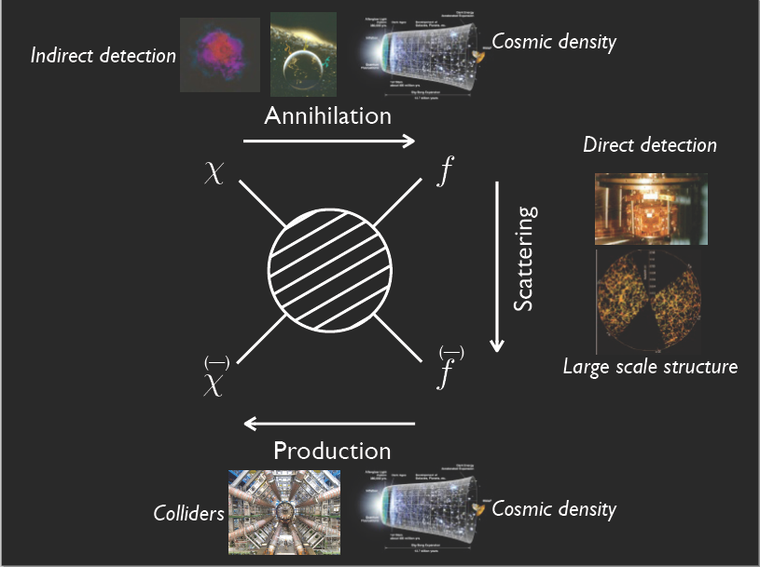
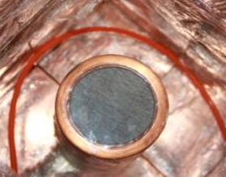
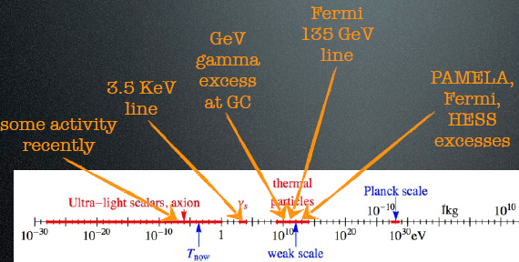
Some anomalies
No evidence
In tension
Notes:
We all know that for the search of dark mater, there are three different ways. Indirect detection, direct detection and collider search. In indirect detection experiments, we find some anomalies which will be discussed by next speaker ZhouYuFeng. For collider search, up to now, there is no evidence of dark matter. While in the direct detection, there are tensions. I will focus on the these tensions in this talk.

Slide 4
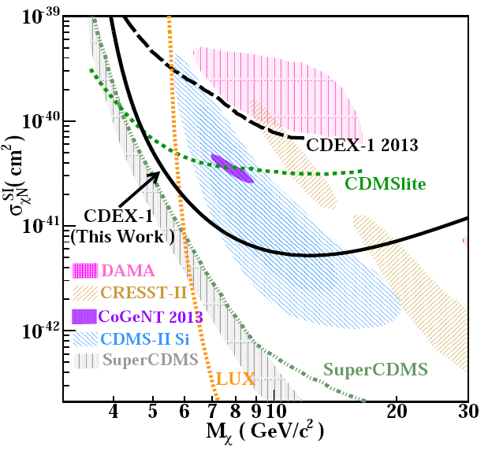
arXiv: 1404.4946[hep-ex]
Notes:
This is the typical plot direct detection of dark matter which is given by latest CDEX published result. It is for the spin independent cross section of dark matter elastically scatter with nucleons. The shaded region are the signals, this is for DAMA, this for Cresst, this for CoGenT, this for CDMS-Silicon. The lines are exclusion line, and the region above the each line are exclude by the experiment. Therefore for this graph, we see that LUX and SuperCDMS experiments already exclude all those singnal regions and OUR CDEX result exclude out most of the singnal regions. This is the tension we will fucos on in this talk.

Slide 5
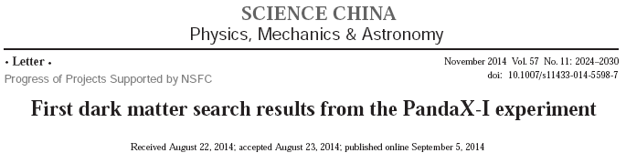
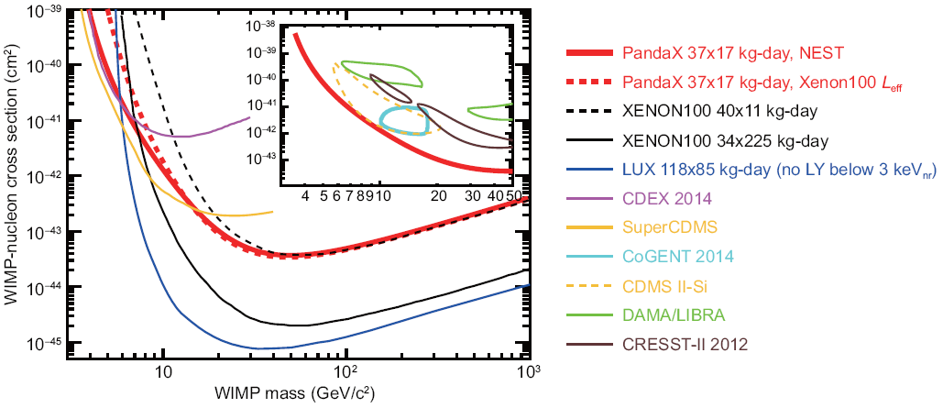
Notes:
In mainland China, except CDEX experiment, we have another dark matter experiment, PandaX. They also publish their first physical result recently.
It also exclude out all those signal regions.

Slide 6
Motivation
If we cannot reconcile different Exp results
Need new theory explanation
Property of DM？
Judge which Exp more reliable discover DM？
If theory cannot reconcile different Exp results
Need new theory explanation
Deep understanding Exp
Possible way out Direction of future theory & Exp
Notes:
Since among different direct detections experiments, some claim to find signals, some not. We need to find ways to reconcile these tensions.
Hope these methods of reconciliation can help us to understand more of property of dark matter and show us the direction of future development of dark matter theory and experiment. This is the motivation of this work.

Slide 7
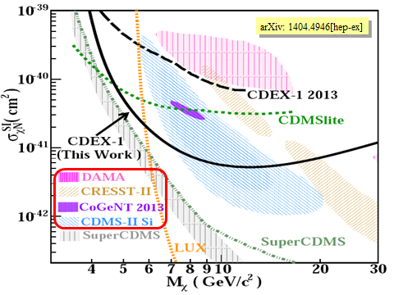
Outline
Motivation & Status
√
Three old Exps: DAMA；CRESST；CoGeNT
Reconcilation Methods
Our Latest Result
Notes:
To reconcile the tension among different experiments, I will first describe to you the latest status of three OLD experiments DAMA, CRESST and CoGeNT, which all claim to find out signals.

Slide 8
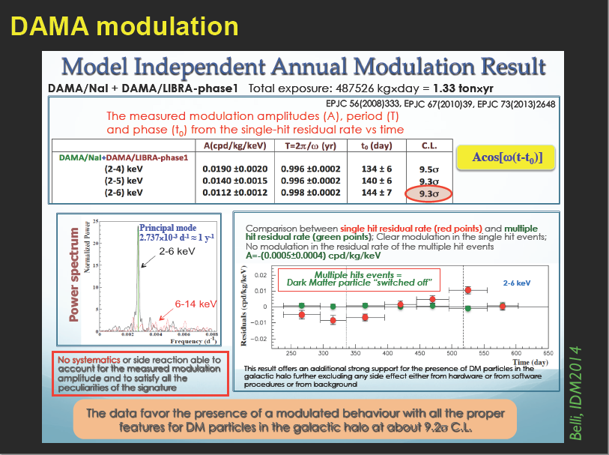

Slide 9
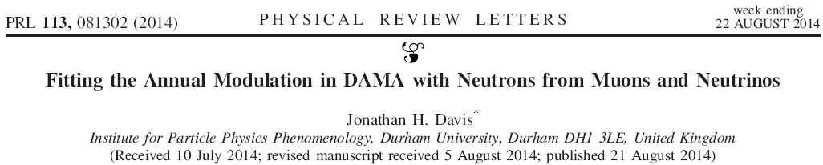
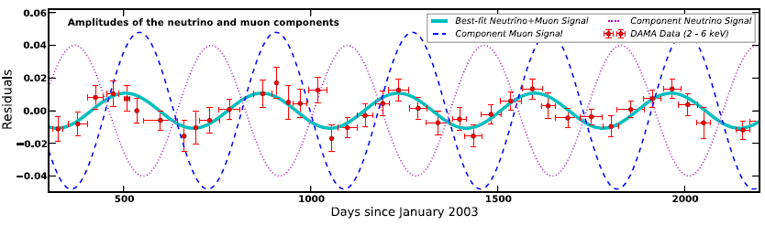
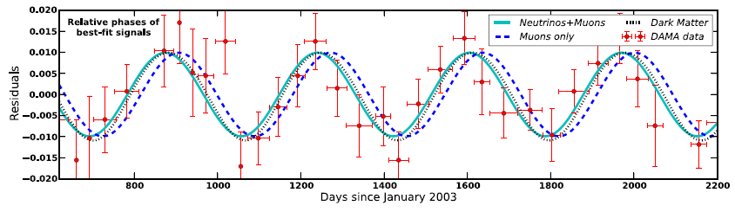
cosmic ray
For experiments with heavier targets such as xenon or germanium the recoil energies would likely be below threshold.
30 days late
Notes:
People now find alternative way to substitute dark matter to explain the modulation of DAMA experiment. This red circles with error bars are original DAMA experiment data. This black dotted line is dark matter explanation. Several years before, people already found that cosmic ray muons also have modulation effects, it is this blue dashed line. Unfortunately, this modulation line from muons is 30 days late than the red circles data and the deviation is 5.2sigma. It is due to this difference, people abandoned the possible interetation of DAMA data in terms of cosmic ray muons. Now people find solar neutrino also has modulation effect, it is this Dotted purple line, the face difference is large. By suitably combine the modulation effects from muons and neutrinos, we can match the DAMA data well, just as this light green line. So to explain DAMA experiment, we donot need dark matter, just consider cosmic ray muon and solar neutrinos are enough.

Slide 10
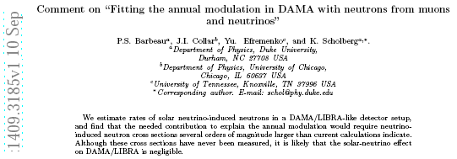
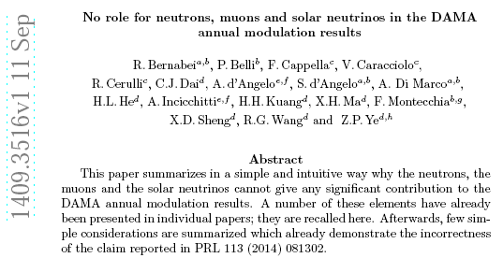
Notes:
But after the PRL paper in August is last month two papers with different opinion. The first paper mentioned that…, and the second paper mentioned that…..The situation is in a mess, it is not clear whether DAMA experiment can have some other explanations without dark matter.

Slide 11
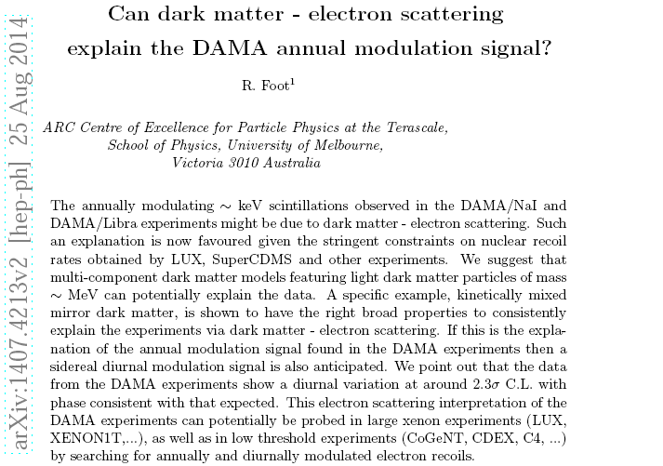
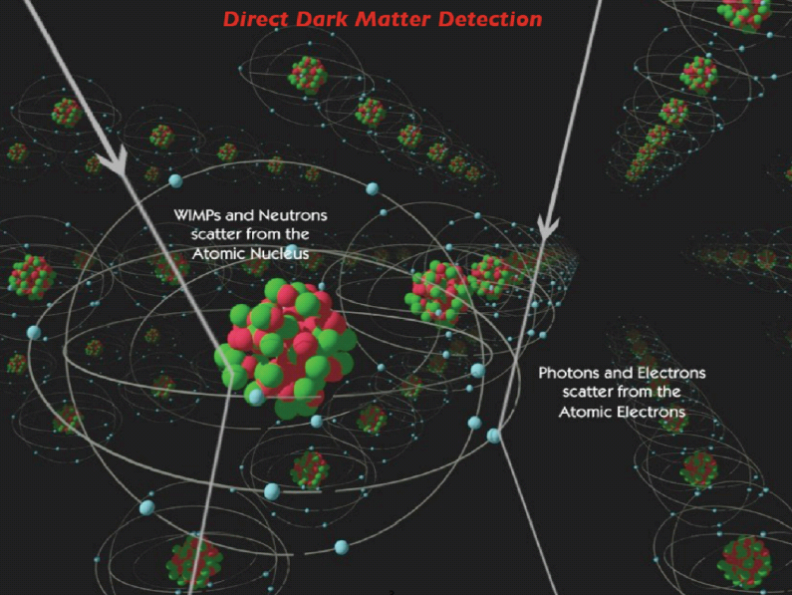

Slide 12
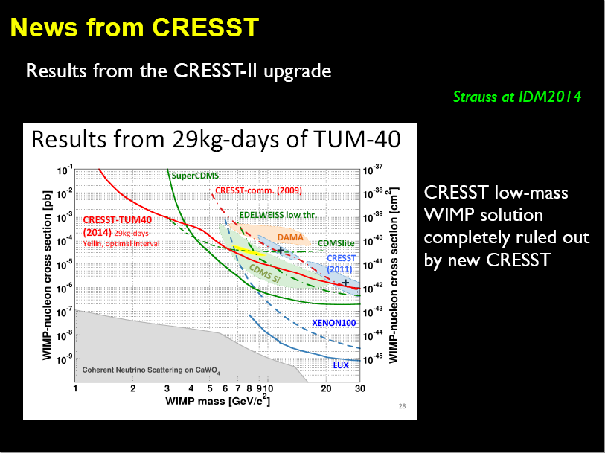
WIMPs via elastic scattering off nuclei in CaWO₄ crystals
Notes:
The news from CRESST is its new result completely rule out its old one. This is the old signal regions, this is new exclusion line. It rule out the old signal regions.

Slide 13
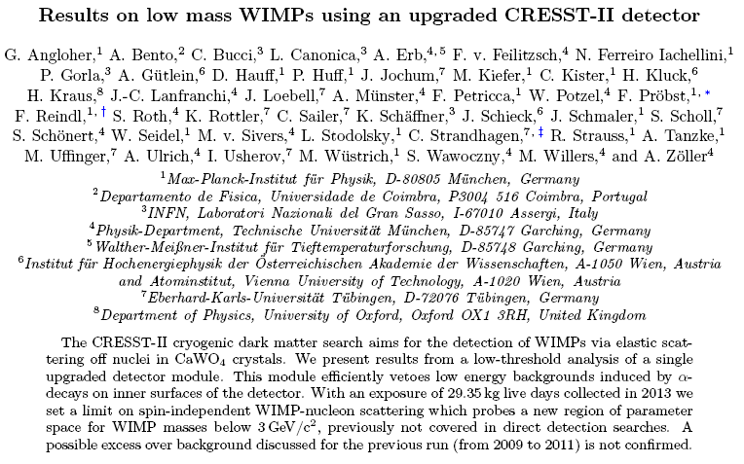
Signals of CRESST II will be forget as earlier CDMS signals ！
1407.3146 [astro-ph.CO]；July 11
Notes:
This is their paper. It mentioned that…. My feeling is that the …

Slide 14
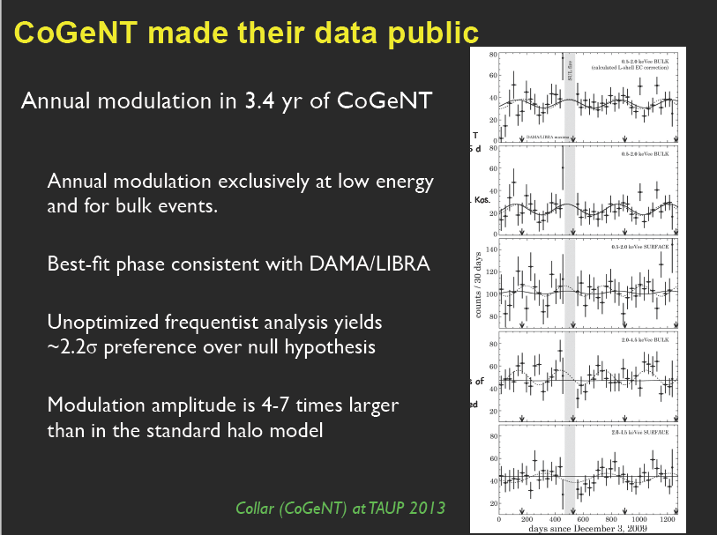
Notes:
For CoGeNT experiment, they publish their data and mentioned that…

Slide 15
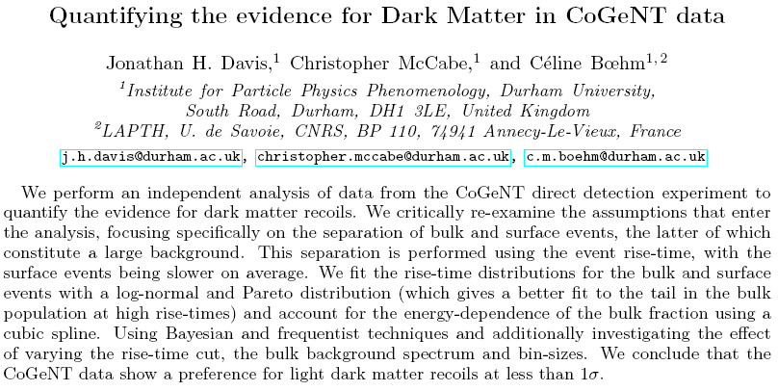
1405.0495 [hep-ph]；May 2
Notes:
But someone reexamine the assumptions and claimed that ….

Slide 16
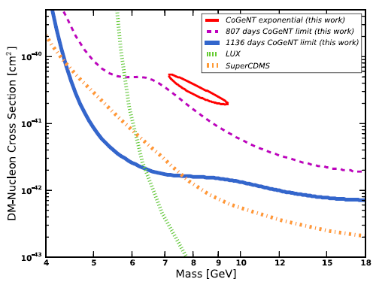
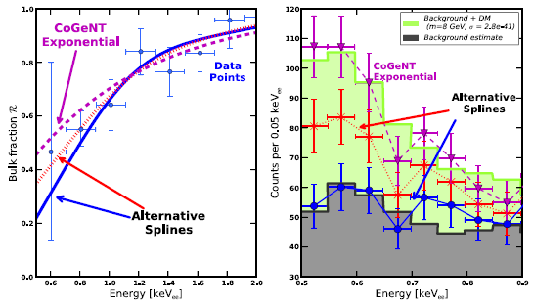
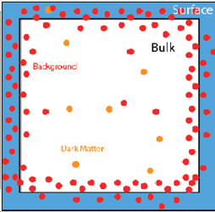
1405.0495 [hep-ph]
An excess above background
arises only for specific
choices of the bulk fraction
R(E), while other equally
plausible spline choices
give no excess.

Slide 17
Nuclear scattering, not EM one
Background well understood
arXiv: 1404.4946[hep-ex]
Notes:
So for those experiments claimed to find signals, two are now questionable and one is dead, only one of CDM-Si is no problem. Which claimed 3sigma excess and is background is well understood.

Slide 18
Outline
Motivation & Status
Three old Exps: DAMA；CRESST；CoGeNT
Reconcilation Methods
√
Our Latest Result
Notes:
Now I introduce three reconciliation methods. These methods supplies ways to enhance signals in some of experiments and suppress signals in some other experiments.

Slide 19
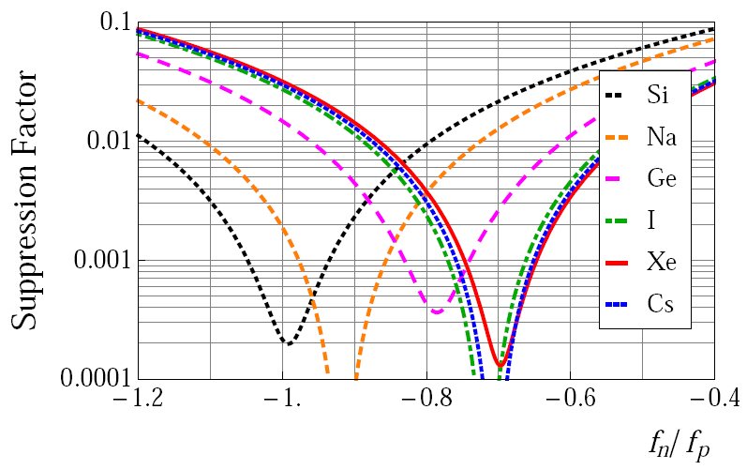

1st
SF=0 for
Ge-phobic
Xenon-phobic
M.T.Frandsen, F.Kahlhoefer, S.Sarkar, K.S-Hoberg
JHEP 1109, 128 (2011)
Notes:
The first method is related to isospin conservation.
This is derivative cross section for elastic scattering of dark matter. It proton form factor fp and neutron form factor fn. Standard way is taken isospin conservation which require fp is equal to fn. If we donot require isospin conservation, in some cases, this term can be small, which will suppress the cross section. In the extreame case, if for some material, fn/fp satisfy this relation, this term is zero, which mean we can see nothing from this material. Here we plot this suppression factor in terms of fn/fp, we see fn/fp=-0.7 is Xenon phobic, -0.8 is Ge-phobic.

Slide 20
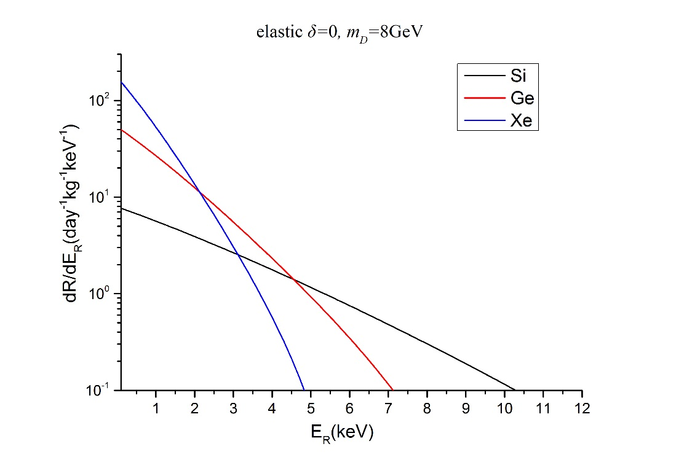
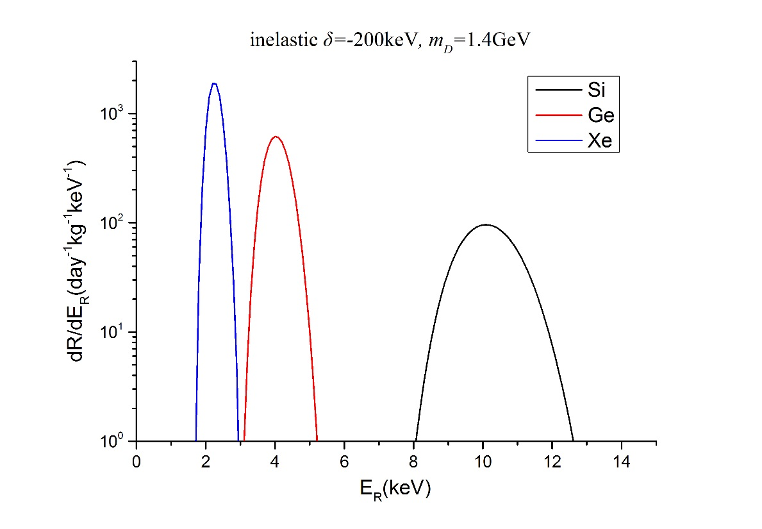
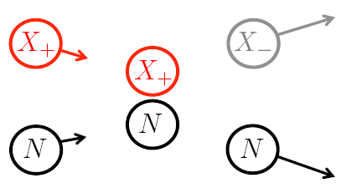
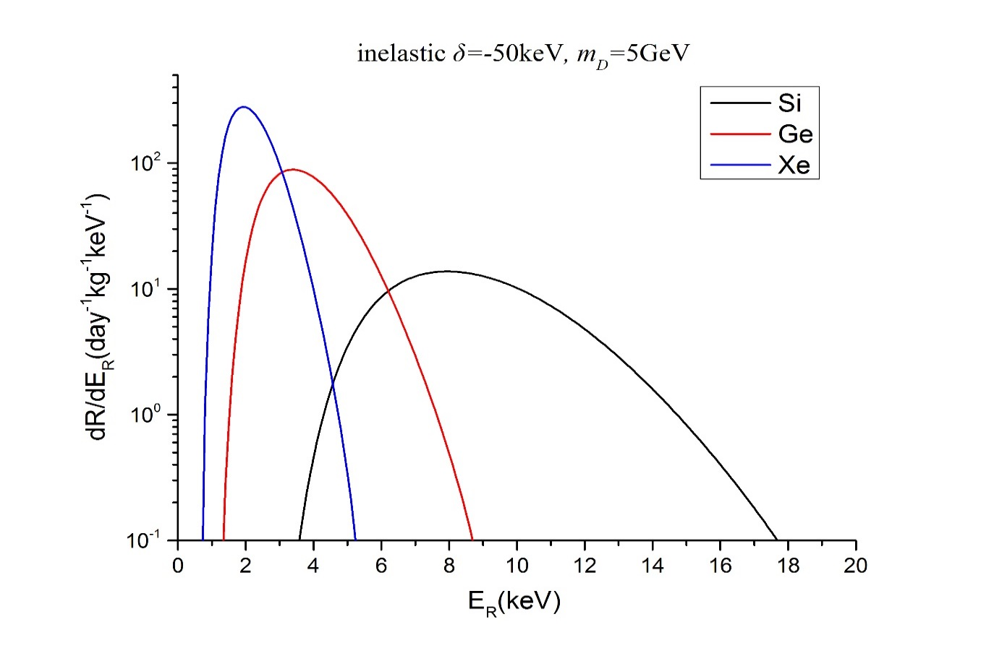
Much more peaked
for larger splitting
2nd
ES is exponential spectrum
IS limit in special region
Larger δ，more separation
Endothermic inelastic
scattering increases
the ratio of the
modulation amplitude
to the unmodulated rate
Endothermic prefer heavy nucleon
Exothermic prefer light nucleon
But reduce relative modulation amplitude
Notes:
The second method is whether scatter is elastic or not. For elastic scattering, the energy spectrum is exponential like this. While for inelastic scattering, the typical energy spectrum is peaked like this. And if mass splitting is large, then the spectrum is more peaked and peak is more separated. There two kinds of inelastic scatterings, one is endothermic scattering, in which incident particle is lighter than the ougoing particle.
Another is exothermic scattering, where incident particle is heavier than outgoing particle. Usually, ……

Slide 21
Other Possible effects
channeling effect
quenching factor
velocity distribution；astrophysics
form factors：nuclear；particle
……

Slide 22
Outline
Motivation & Status
Three old Exps: DAMA；CRESST；CoGeNT
Reconciliation Methods
√
Our Latest Result
Notes:
Now I discuss our proposal

Slide 23
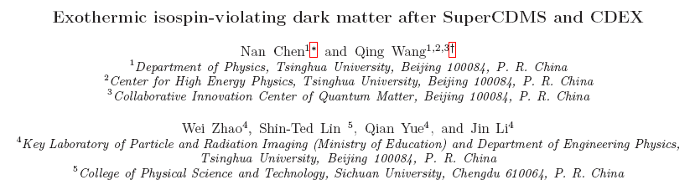
2nd Internationl Workshop on
Particle Physics and Cosmology after Higgs and Plank
arXiv: 1404.6043
no new particle Our Result in combined with CDEX Data

Slide 24
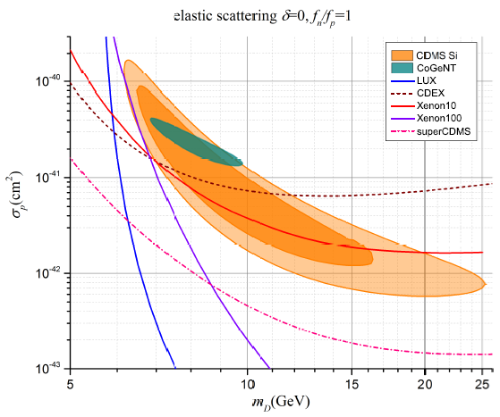
Notes:
This is elastic scattering with isospin conservation case. Delta is outgoing dark matter particle mass minus incident dark matter particle mass

Slide 25
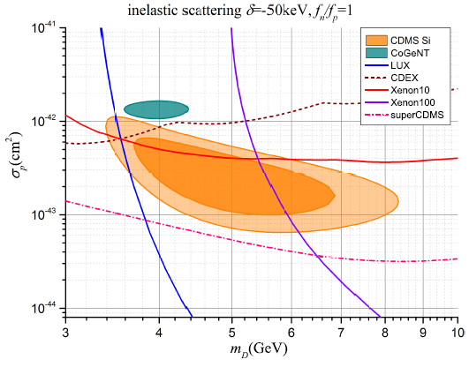
Notes:
If we change from elastic scattering to inelastic scattering, but keep isospin conservation hold, we get this diagram. The situation is improved but still not OK.

Slide 26
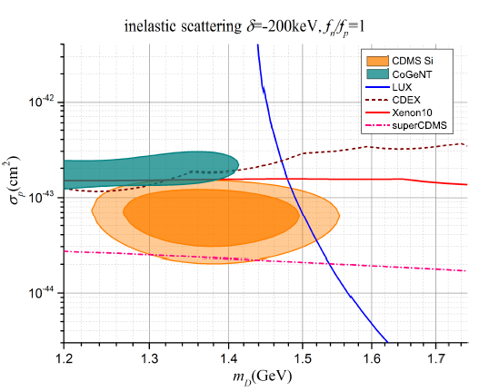
Notes:
Further increase the mass splitting of the inelastic scattering.

Slide 27
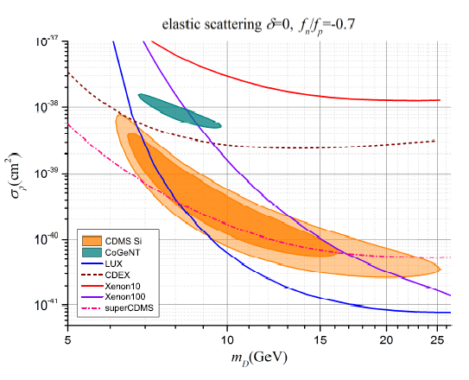
Notes:
If instead of changing scattering from elastic to inelastic, we keep the scattering to be elastic, but consider isospin violation to xenon-phobic. We find the situation is also improved, but still not enough.

Slide 28
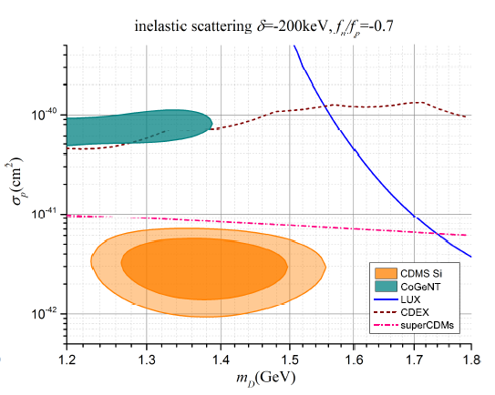
Notes:
Finally combine inelastic scattering with isospin violation together, we find CDMS-Si is free from all exclusion lines.

Slide 29
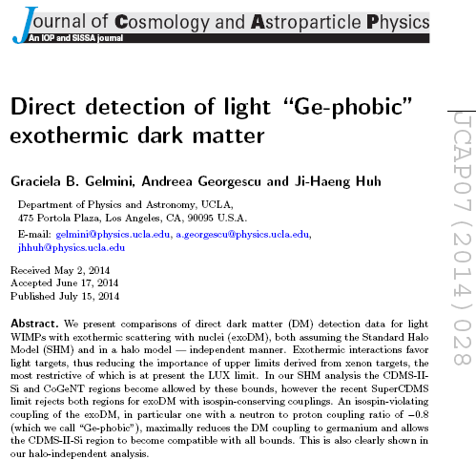
Our work
arXiv: 1404.6043
April，24
arXiv: 1404.7484
May，2
Notes:
One week after our paper, another group also done the similar discussions. Their paper title is Ge-phobic exothermic dark mater, where Ge-phobic means isospin violation, exothermic means inelastic scattering.

Slide 30
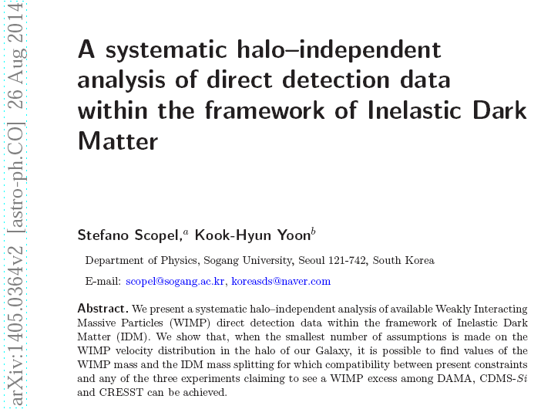
Our work
arXiv: 1404.6043
April，24

Slide 31
Summary
CRESST already kill itself No DM
Exp measurement
IDM+ISV OK！
DAMA may or may not be explained by Atm μ & Solar ν No DM
or explained by electron scattering
IDM+ISV OK！
Exp measurementbbbbbbb
CoGeNT analysis is questioned No DM
Contradic with CDEX result！
CDMS II-Si ISV+Exothermic Inelastic Scatting DM
Suppress modulation strongly，conflict with DAMA、CoGeNT

Slide 32


Slide 33
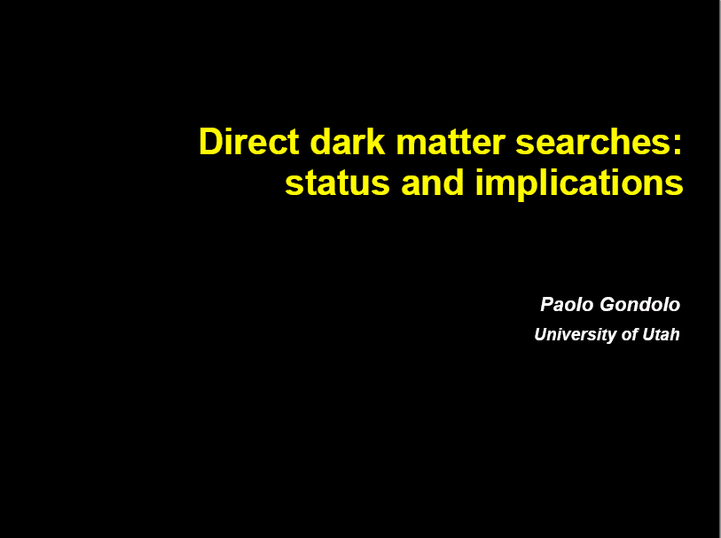


Slide 34
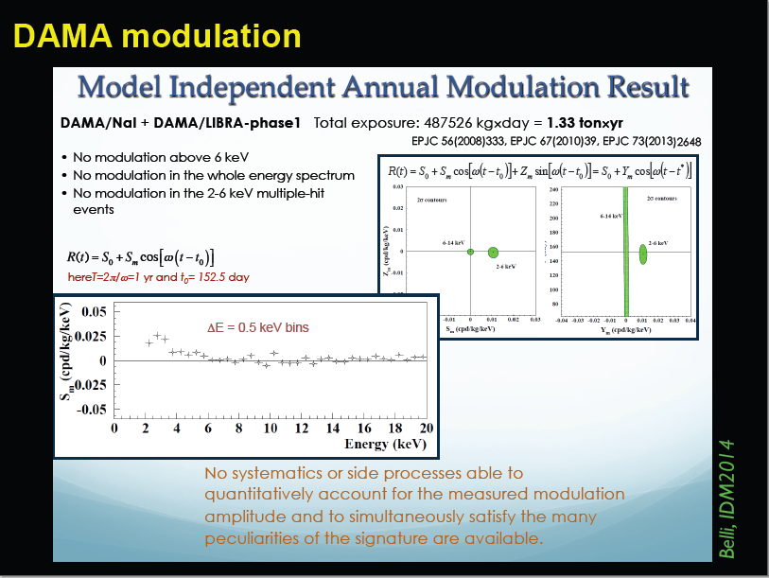

Slide 35
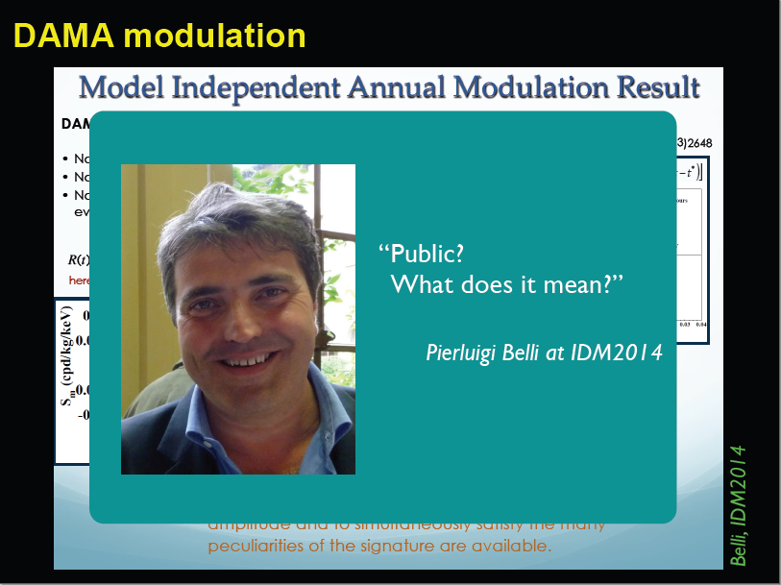

Slide 36
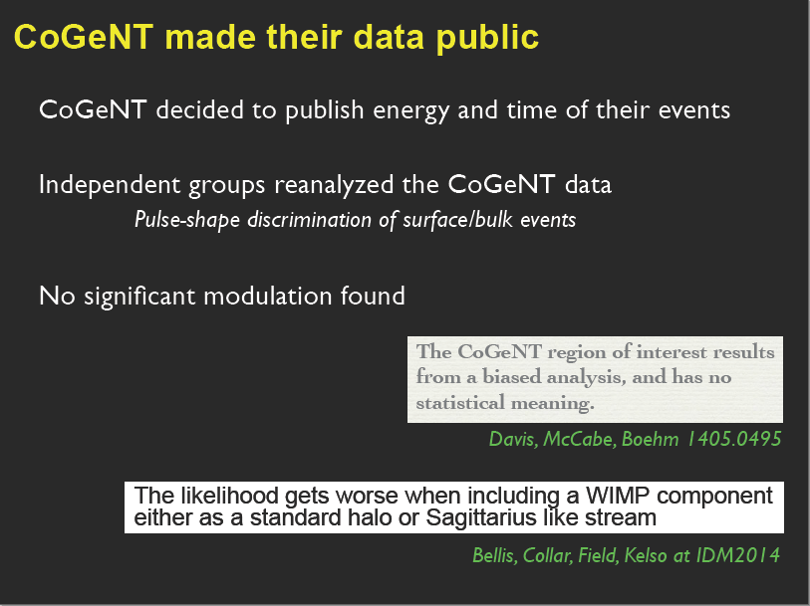

Slide 37
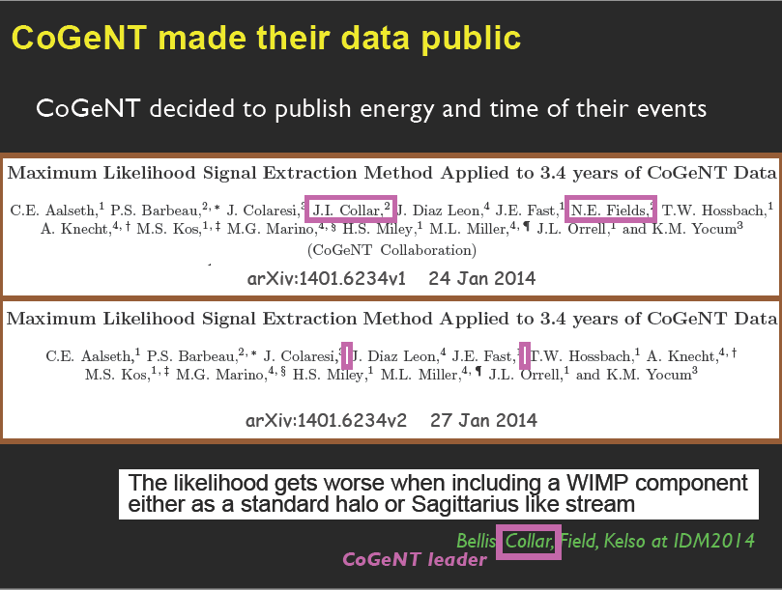

Slide 38
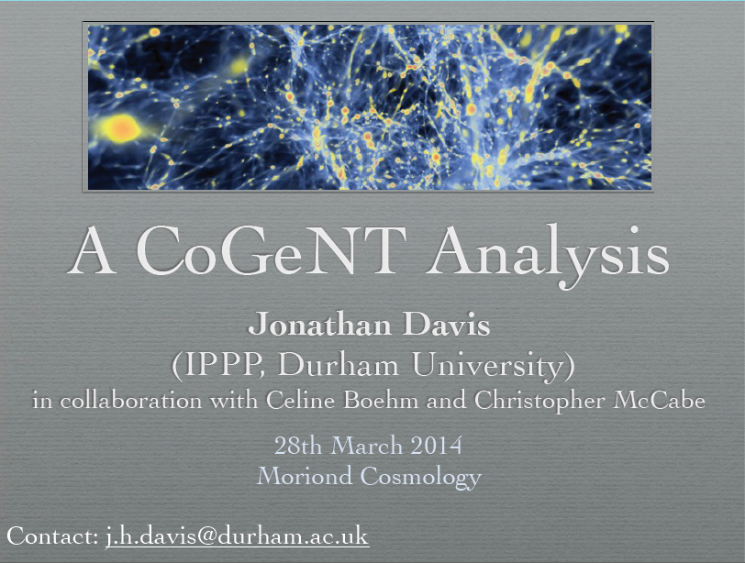

Slide 39
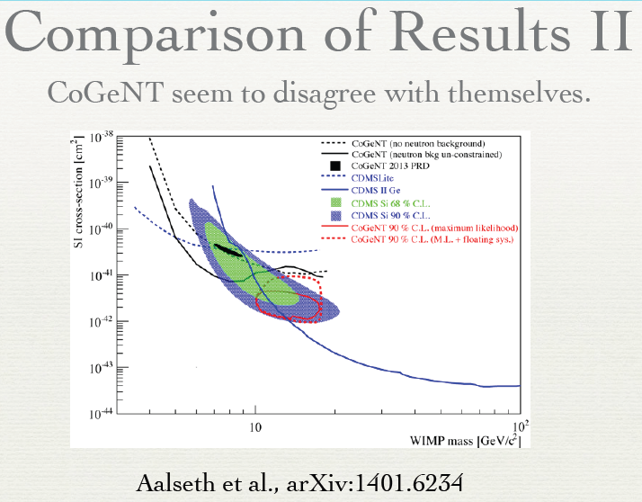
backup slide

Slide 40
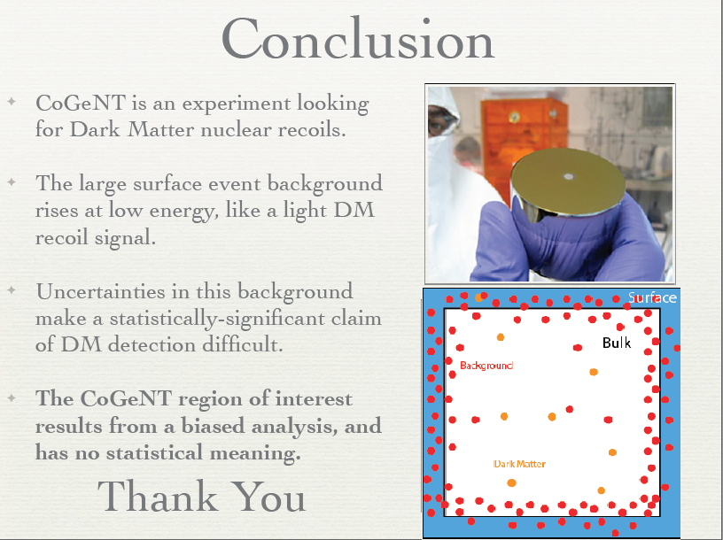

Slide 41
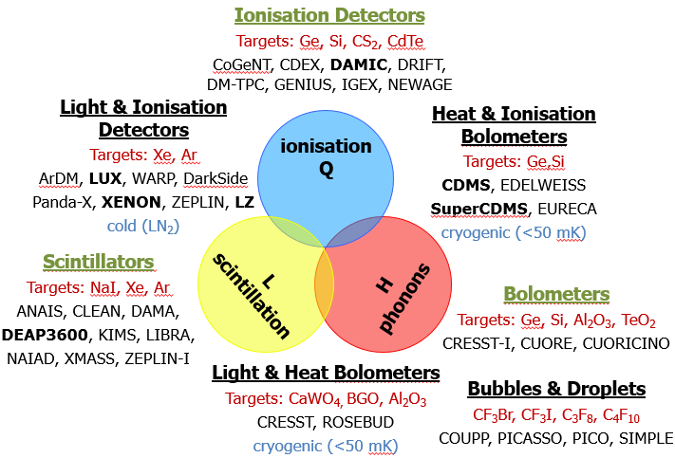
Nuclear scattering, not EM one
Background well understood
arXiv: 1404.4946[hep-ex]

Slide 42
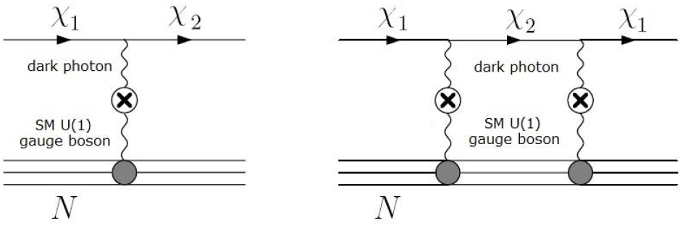

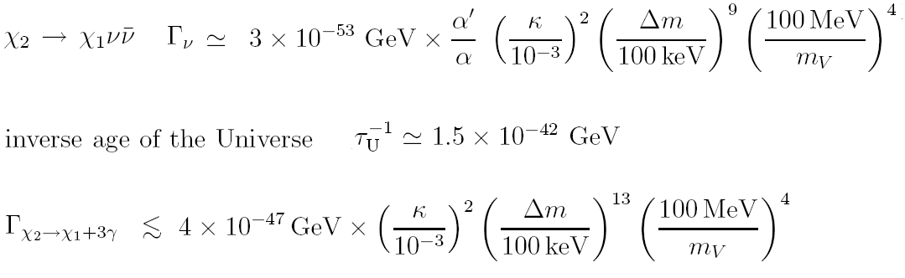
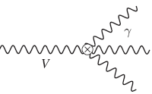
Majorana fermion prohibit self V-current
1st order possible
for inelastic scat
Only 2nd order
for elastic scat
Suppresion for ES
IS Prohibit endothermic
Left exothermic
Brian Batell, Maxim Pospelov Adam Ritz
Phys.Rev. D79 (2009) 115019
2nd

Slide 43
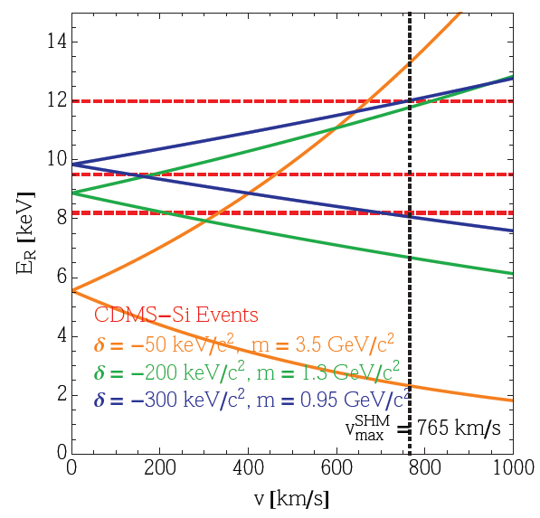
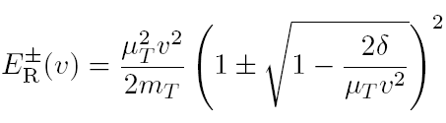

Si
background
G.B.Gelmini, A.Georgescu, J.H.Huh
JCAP07-028-2014
2nd
Positive for
Inelastic Exothermic
Prohibit kinetically for inelastic exothermic

Slide 44
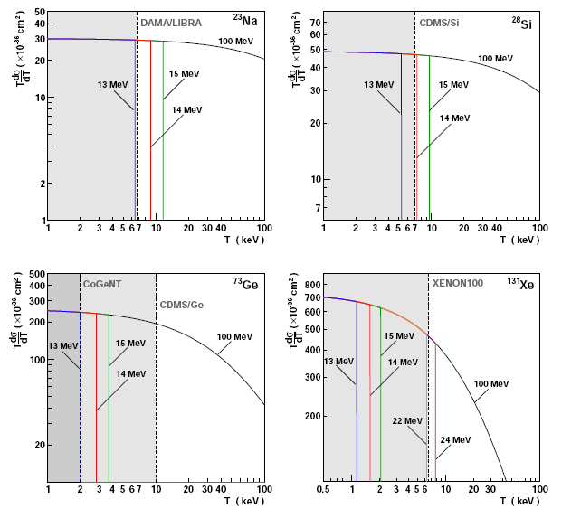
Sterile neutrino?
New Physics or DM ?
Atmospherically-produced
neutral particle with a
relatively large magnetic
dipole moment could fake
a dark matter signal
A. Bueno, M. Masip, P. Sánchez-Lucas, N. Setzer Phys.Rev. D88 (2013) 073010
Contradict with CDEX
Produced in muon decays
with frequency of 1
particle per 100-1000
Decays
Mass in excess of 10 MeV
Lifetime between 10⁶s
and 1s
3rd

Slide 45
Outline
Motivation
Status DAMA；CRESST；CoGeNT
Recociliation Methods
Lates CDEX Result
Works of OthersDD、Ge phobic---exothermic DM
Exothermic & ISV Model
√

Slide 46



M.T.Frandsen,F.Kahlhoefer,J.M.Russell,
C.McCabe,M.McCullough,K.S.Hoberg PRD84,041301(2011)1st
X.Gao,Z.Kang and T.Li,JCAP 1301,021(2013)3rd
J.M.Cline, A.R.Frey, PRD84,075003 (2011)4th
Dark Z’
M.T.Frandsen, F.Kahlhoefer, S.Sarkar, K.S-Hoberg JHEP 1109, 128 (2011)；1107.2118Not point out IS 2nd
Whether exits such kind DM model ？
Baryonic Z’
Baryonic Z’

Slide 47

Extension of DM
No ISV

Slide 48

1105.3734
May 18,2011,
Endothermic
CoGeNT non-modulation excess result published in April 1,2014

Slide 49

July 18,2011；v2 title changed；Endothermic

Slide 50

1108.1391
Sep 19,2011
ES & Endothermic
Exothermic for complet

Slide 51



Slide 52


Slide 53
Outline
Motivation
Status DAMA；CRESST；CoGeNT
Recociliation Methods
Lates CDEX Result
Works of OthersDD、Ge phobic---exothermic DM
√
Exothermic & ISV Model

Slide 54





1403.0576；Mar 3
Last year…

Slide 55


Slide 56


Slide 57


Slide 58


Slide 59


Slide 60


Slide 61


Slide 62


Slide 63


Halo independent analysis

Slide 64


Slide 65


