Slide 1
About this course
Course code: 11120PHYS114305
Course title: General Physics B (II)
Instructor: CHANG, Hsiang-Kuang (張祥光)
(hkchang@mx.nthu.edu.tw)
TA: 黃千祐 (Jason Huang, ak119ka@gmail.com)
王昱璟 (Daniel Wang, d10142000@gmail.com)
(TA office hour: W7W8 (Daniel), R3R4 (Jason), maybe on-line first)
Interaction platform at NTHU/eLearn (https://elearn.nthu.edu.tw/)

Slide 2
About this course
Why are you here?

Slide 3
About this course
This course is the second part of college physics.
It covers electromagnetism and modern physics.
The purpose of this course is to provide basic, general, broad physics knowledge to students.
The emphasis will be on questions and concepts, followed by some technical details and applications.

Slide 4
About this course
Textbook
Author: Jearl Walker
Title: Halliday and Resnick's Principles of
Physics, global edition (2020)
Publisher: Wiley
ISBN: 978-1-119-45401-4
References
1. "The Feynman Lectures on Physics"
(There are various published editions)
2. "University Physics", Harris Benson
(1996, John Wiley & Sons)

Slide 5
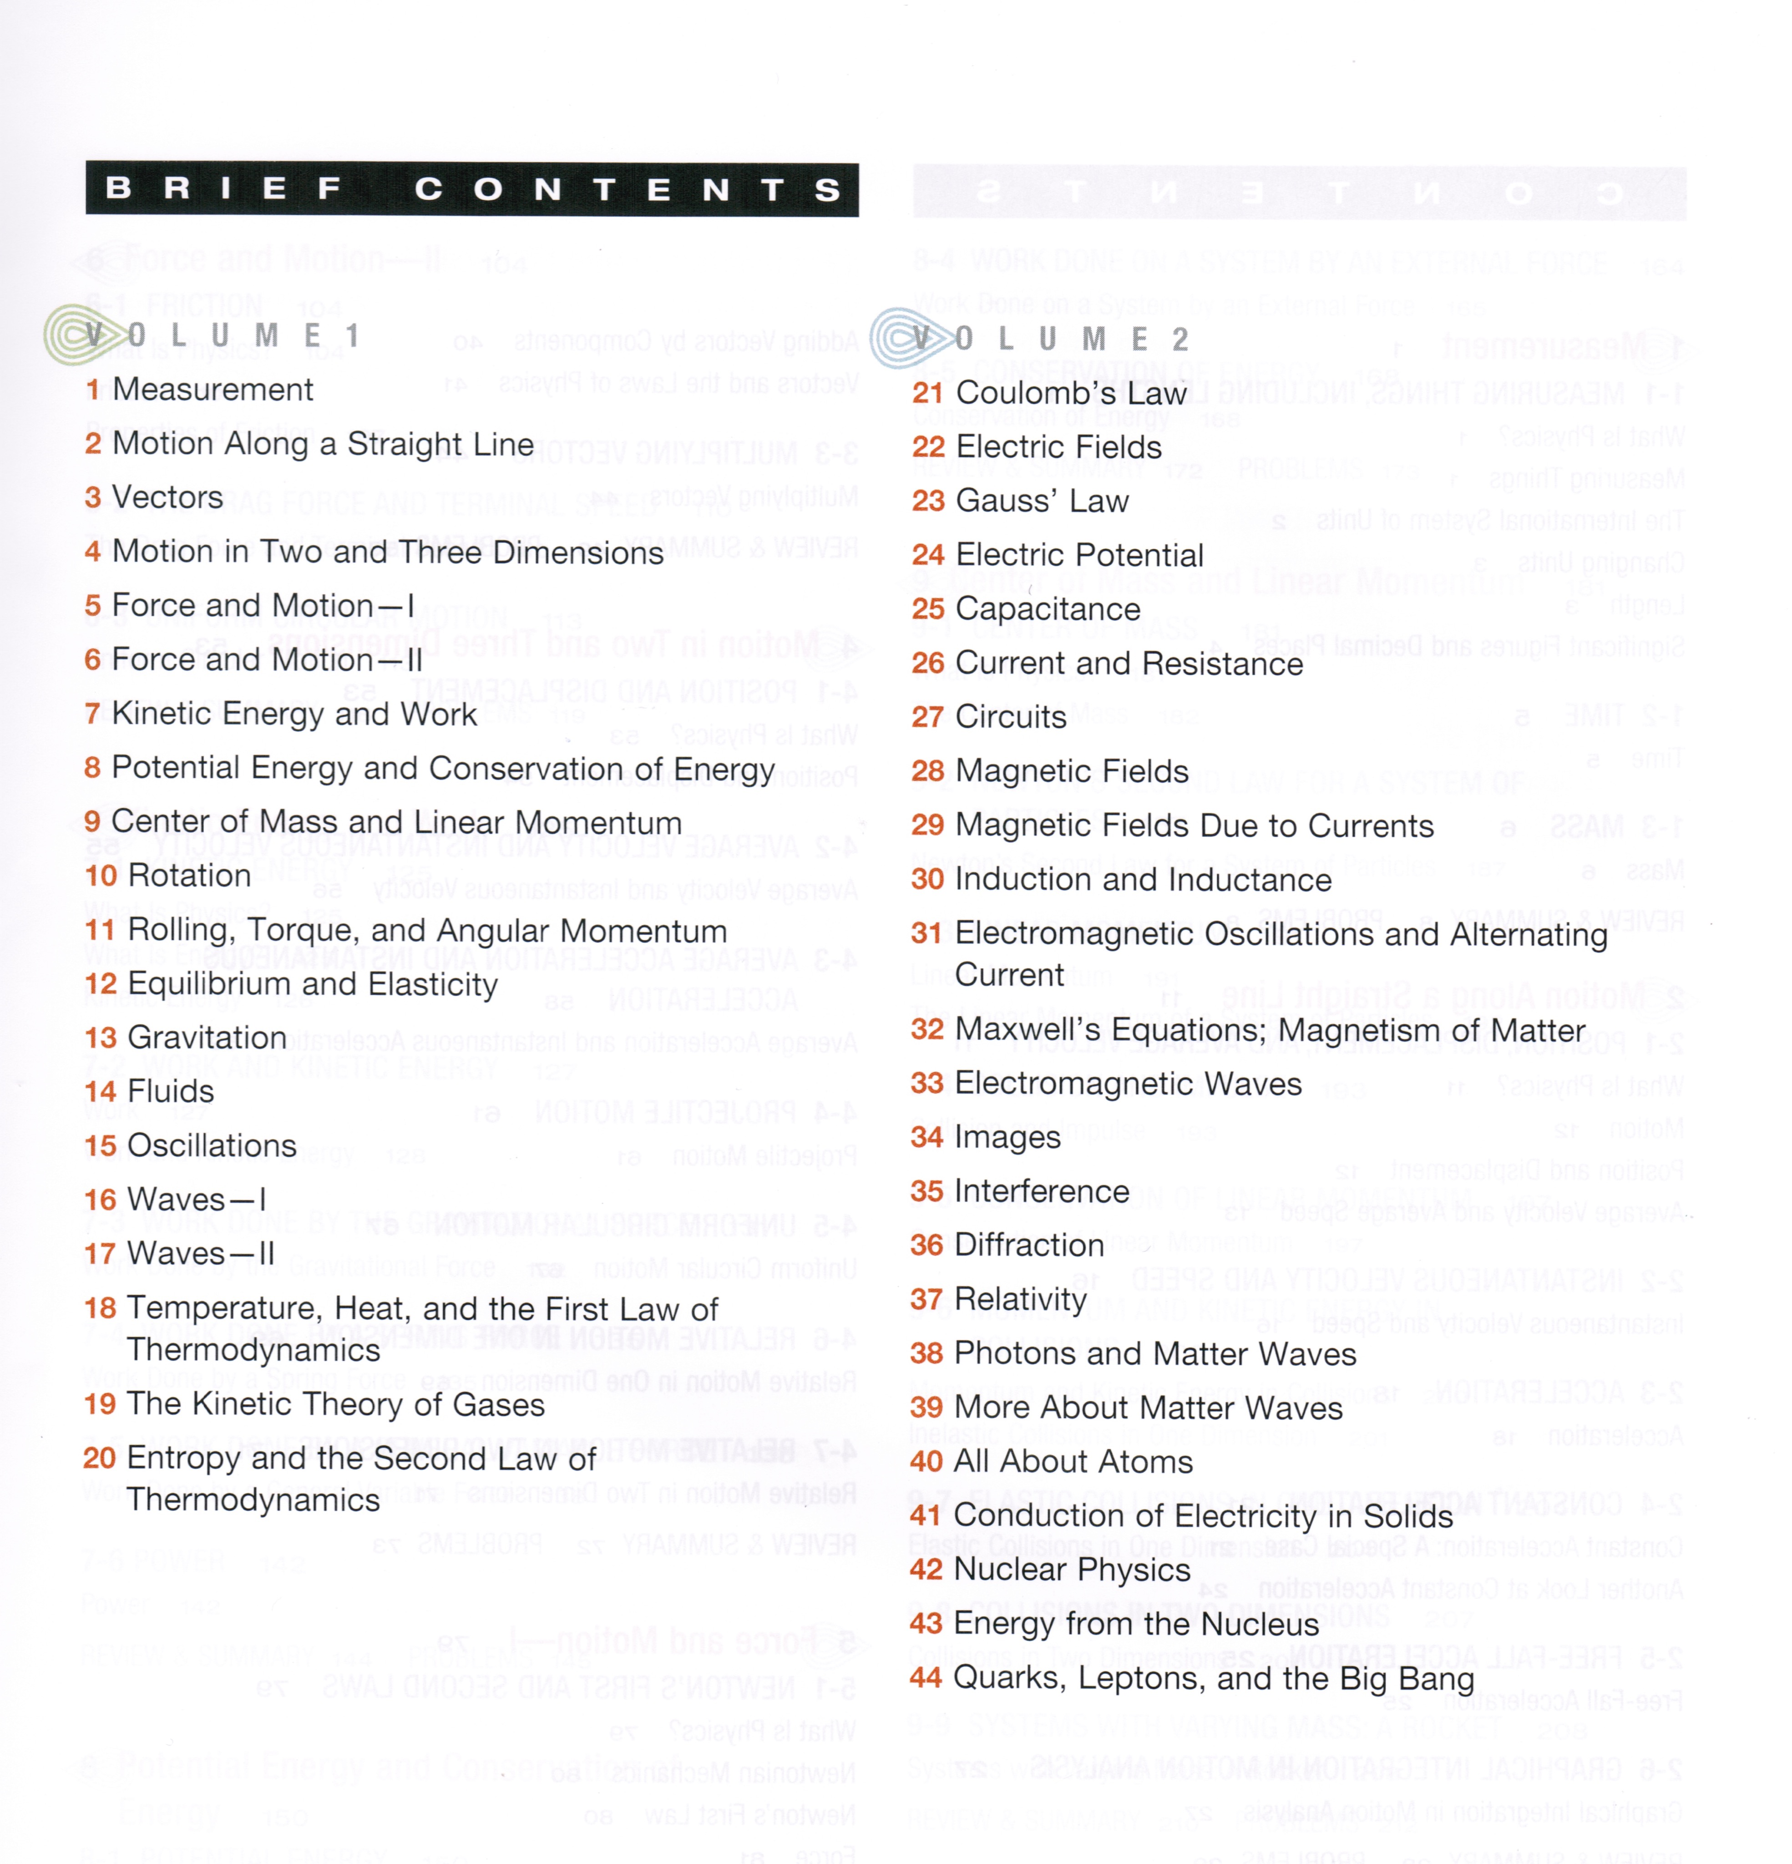

Slide 6
About this course
The course will go mainly with lectures.
Classroom discussion is very much welcome and encouraged.
The 2nd hour on Fridays will be used for mini-tests.
Exams:
Midterm: Apr. 21, 2023; Ch21 – Ch31
Final: June 13, 2023; Ch32 – Ch44 (excluding Ch34-Ch36)
Evaluation
GD=F(PT)
PT=MTx20% + MEx40% + FEx40%
Interaction platform at NTHU/eLearn (https://elearn.nthu.edu.tw/)

