Slide 1
Magnetic Fields in Supernova Remnants and Pulsar-Wind Nebulae
S.P. Reynolds et al.
Martin, Tseng Chao Hsiung
2013/12/18

Slide 2
Which contents I will cover…
Shell Supernova Remnants: Obliquity Dependence, and Summary!
Magnetic Fields in Pulsar-Wind Nebulae.
Usually, a review paper will let you know a little, but make you feel more confused…
I hope I will not make you feel “more more” confused!

Slide 3
Shell SNR Summary
1. From radio observations, equipartition values of magnetic field strength are in the∼10 μG range, but there is little physical motivation to assume equipartition.
2. Radio polarization studies show that in young SNRs, the magnetic field is largely disordered, with a small radial preponderance. In older, larger SNRs, the field is often disordered but sometimes tangential.
3. Curvature (spectral hardening to higher frequency) is observed in the radio spectra of Tycho and Kepler. A nonlinear shock acceleration model can explain this with magnetic field strengths of 0.1–1 mG (average over the emitting regions).
4. Thin rims of X-ray synchrotron emission in a few young remnants require B ∼50–200 μG in the rims, if they are due to synchrotron losses on down-stream-convecting electrons. However, thin radio rims are sometimes seen as well; they require that the magnetic field disappear somehow, presumably because it is a wave field which damps.
5. Brightening and fading of small X-ray synchrotron features in G347.3-0.5 and Cas A require B ∼ 1 mG, if they represent acceleration and loss times for electrons. Fields smaller by a factor of several are possible if the fluctuations are due to strong magnetic turbulence.
6. Large azimuthal variations in the rolloff frequency in SN 1006 and G1.9+0.3 are difficult to explain for a conventional picture of loss-limited acceleration in parallel shocks.
7. For Cas A, the detection at GeV energies with Fermi requires B~0.1 mG to avoid overproducing the GeV emission with electron bremsstrahlung.
8. TeV emission seen in four shell SNRs is not well explained by either leptonic or hadronic processes. However, if it is hadronic, the magnetic fields implied are of order 100 μG,while leptonic models require much lower fields.

Slide 4
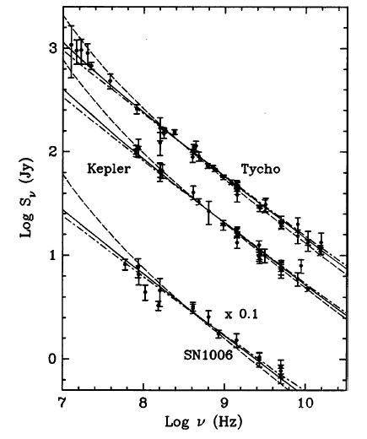
Shell SNR conclusion
1. From radio observations, equipartition values of magnetic field strength are in the∼10 μG range, but there is little physical motivation to assume equipartition.
2. Radio polarization studies show that in young SNRs, the magnetic field is largely disordered, with a small radial preponderance. In older, larger SNRs, the field is often disordered but sometimes tangential.
3. Curvature (spectral hardening to higher frequency) is observed in the radio spectra of Tycho and Kepler. A nonlinear shock acceleration model can explain this with magnetic field strengths of 0.1–1 mG (average over the emitting regions).
4. Thin rims of X-ray synchrotron emission in a few young remnants require B ∼50–200 μG in the rims, if they are due to synchrotron losses on down-stream-convecting electrons. However, thin radio rims are sometimes seen as well; they require that the magnetic field disappear somehow, presumably because it is a wave field which damps.
5. Brightening and fading of small X-ray synchrotron features in G347.3-0.5 and Cas A require B ∼ 1 mG, if they represent acceleration and loss times for electrons. Fields smaller by a factor of several are possible if the fluctuations are due to strong magnetic turbulence.
6. Large azimuthal variations in the rolloff frequency in SN 1006 and G1.9+0.3 are difficult to explain for a conventional picture of loss-limited acceleration in parallel shocks.
7. For Cas A, the detection at GeV energies with Fermi requires B~0.1 mG to avoid overproducing the GeV emission with electron bremsstrahlung.
8. TeV emission seen in four shell SNRs is not well explained by either leptonic or hadronic processes. However, if it is hadronic, the magnetic fields implied are of order 100 μG,while leptonic models require much lower fields.

Slide 5
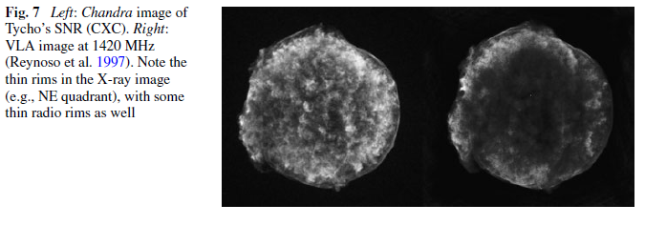
Shell SNR conclusion
1. From radio observations, equipartition values of magnetic field strength are in the∼10 μG range, but there is little physical motivation to assume equipartition.
2. Radio polarization studies show that in young SNRs, the magnetic field is largely disordered, with a small radial preponderance. In older, larger SNRs, the field is often disordered but sometimes tangential.
3. Curvature (spectral hardening to higher frequency) is observed in the radio spectra of Tycho and Kepler. A nonlinear shock acceleration model can explain this with magnetic field strengths of 0.1–1 mG (average over the emitting regions).
4. Thin rims of X-ray synchrotron emission in a few young remnants require B ∼50–200 μG in the rims, if they are due to synchrotron losses on down-stream-convecting electrons. However, thin radio rims are sometimes seen as well; they require that the magnetic field disappear somehow, presumably because it is a wave field which damps.
5. Brightening and fading of small X-ray synchrotron features in G347.3-0.5 and Cas A require B ∼ 1 mG, if they represent acceleration and loss times for electrons. Fields smaller by a factor of several are possible if the fluctuations are due to strong magnetic turbulence.
6. Large azimuthal variations in the rolloff frequency in SN 1006 and G1.9+0.3 are difficult to explain for a conventional picture of loss-limited acceleration in parallel shocks.
7. For Cas A, the detection at GeV energies with Fermi requires B~0.1 mG to avoid overproducing the GeV emission with electron bremsstrahlung.
8. TeV emission seen in four shell SNRs is not well explained by either leptonic or hadronic processes. However, if it is hadronic, the magnetic fields implied are of order 100 μG,while leptonic models require much lower fields.

Slide 6
Shell SNR conclusion
1. From radio observations, equipartition values of magnetic field strength are in the∼10 μG range, but there is little physical motivation to assume equipartition.
2. Radio polarization studies show that in young SNRs, the magnetic field is largely disordered, with a small radial preponderance. In older, larger SNRs, the field is often disordered but sometimes tangential.
3. Curvature (spectral hardening to higher frequency) is observed in the radio spectra of Tycho and Kepler. A nonlinear shock acceleration model can explain this with magnetic field strengths of 0.1–1 mG (average over the emitting regions).
4. Thin rims of X-ray synchrotron emission in a few young remnants require B ∼50–200 μG in the rims, if they are due to synchrotron losses on down-stream-convecting electrons. However, thin radio rims are sometimes seen as well; they require that the magnetic field disappear somehow, presumably because it is a wave field which damps.
5. Brightening and fading of small X-ray synchrotron features in G347.3-0.5 and Cas A require B ∼ 1 mG, if they represent acceleration and loss times for electrons. Fields smaller by a factor of several are possible if the fluctuations are due to strong magnetic turbulence.
6. Large azimuthal variations in the rolloff frequency in SN 1006 and G1.9+0.3 are difficult to explain for a conventional picture of loss-limited acceleration in parallel shocks.
7. For Cas A, the detection at GeV energies with Fermi requires B~0.1 mG to avoid overproducing the GeV emission with electron bremsstrahlung.
8. TeV emission seen in four shell SNRs is not well explained by either leptonic or hadronic processes. However, if it is hadronic, the magnetic fields implied are of order 100 μG,while leptonic models require much lower fields.

Slide 7
Shell SNR conclusion
1. From radio observations, equipartition values of magnetic field strength are in the∼10 μG range, but there is little physical motivation to assume equipartition.
2. Radio polarization studies show that in young SNRs, the magnetic field is largely disordered, with a small radial preponderance. In older, larger SNRs, the field is often disordered but sometimes tangential.
3. Curvature (spectral hardening to higher frequency) is observed in the radio spectra of Tycho and Kepler. A nonlinear shock acceleration model can explain this with magnetic field strengths of 0.1–1 mG (average over the emitting regions).
4. Thin rims of X-ray synchrotron emission in a few young remnants require B ∼50–200 μG in the rims, if they are due to synchrotron losses on down-stream-convecting electrons. However, thin radio rims are sometimes seen as well; they require that the magnetic field disappear somehow, presumably because it is a wave field which damps.
5. Brightening and fading of small X-ray synchrotron features in G347.3-0.5 and Cas A require B ∼ 1 mG, if they represent acceleration and loss times for electrons. Fields smaller by a factor of several are possible if the fluctuations are due to strong magnetic turbulence.
6. Large azimuthal variations in the rolloff frequency in SN 1006 and G1.9+0.3 are difficult to explain for a conventional picture of loss-limited acceleration in parallel shocks.
7. For Cas A, the detection at GeV energies with Fermi requires B~0.1 mG to avoid overproducing the GeV emission with electron bremsstrahlung.
8. TeV emission seen in four shell SNRs is not well explained by either leptonic or hadronic processes. However, if it is hadronic, the magnetic fields implied are of order 100 μG,while leptonic models require much lower fields.

Slide 8
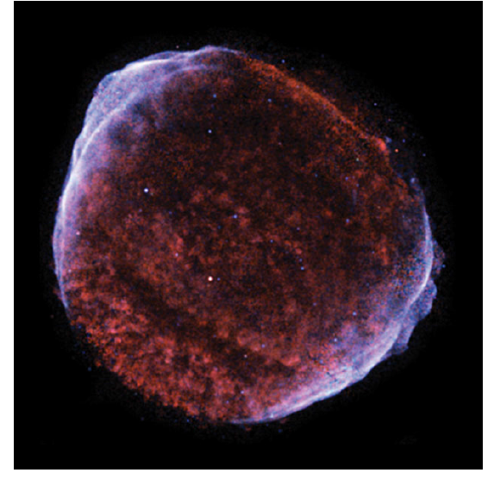
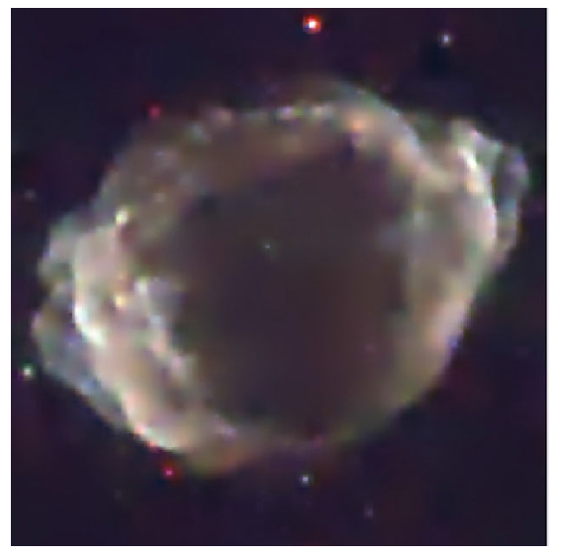
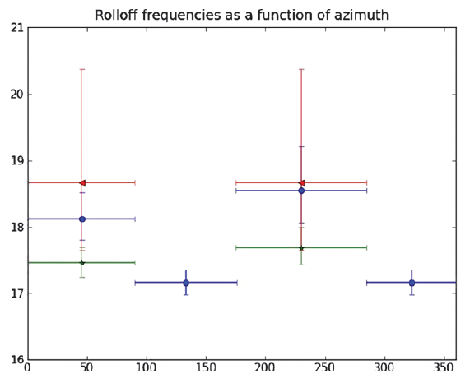
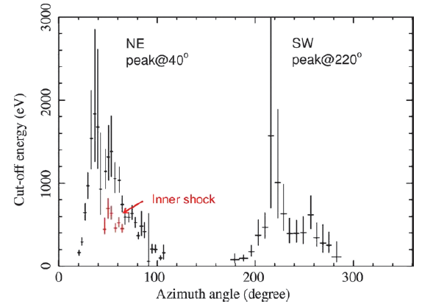
Obliquity Dependence

Slide 9
Shell SNR conclusion
1. From radio observations, equipartition values of magnetic field strength are in the∼10 μG range, but there is little physical motivation to assume equipartition.
2. Radio polarization studies show that in young SNRs, the magnetic field is largely disordered, with a small radial preponderance. In older, larger SNRs, the field is often disordered but sometimes tangential.
3. Curvature (spectral hardening to higher frequency) is observed in the radio spectra of Tycho and Kepler. A nonlinear shock acceleration model can explain this with magnetic field strengths of 0.1–1 mG (average over the emitting regions).
4. Thin rims of X-ray synchrotron emission in a few young remnants require B ∼50–200 μG in the rims, if they are due to synchrotron losses on down-stream-convecting electrons. However, thin radio rims are sometimes seen as well; they require that the magnetic field disappear somehow, presumably because it is a wave field which damps.
5. Brightening and fading of small X-ray synchrotron features in G347.3-0.5 and Cas A require B ∼ 1 mG, if they represent acceleration and loss times for electrons. Fields smaller by a factor of several are possible if the fluctuations are due to strong magnetic turbulence.
6. Large azimuthal variations in the rolloff frequency in SN 1006 and G1.9+0.3 are difficult to explain for a conventional picture of loss-limited acceleration in parallel shocks.
7. For Cas A, the detection at GeV energies with Fermi requires B~0.1 mG to avoid overproducing the GeV emission with electron bremsstrahlung.
8. TeV emission seen in four shell SNRs is not well explained by either leptonic or hadronic processes. However, if it is hadronic, the magnetic fields implied are of order 100 μG,while leptonic models require much lower fields.

Slide 10
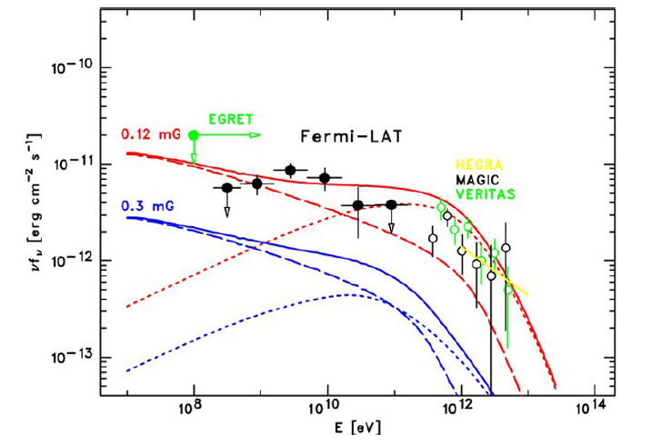
Shell SNR conclusion
Spectrum of GeV emission from Cas A as seen by Fermi (Abdo et al. 2010a). The solid curves
are leptonic models (dots, IC; dashes, bremsstrahlung) with magnetic-field values shown.
1. From radio observations, equipartition values of magnetic field strength are in the∼10 μG range, but there is little physical motivation to assume equipartition.
2. Radio polarization studies show that in young SNRs, the magnetic field is largely disordered, with a small radial preponderance. In older, larger SNRs, the field is often disordered but sometimes tangential.
3. Curvature (spectral hardening to higher frequency) is observed in the radio spectra of Tycho and Kepler. A nonlinear shock acceleration model can explain this with magnetic field strengths of 0.1–1 mG (average over the emitting regions).
4. Thin rims of X-ray synchrotron emission in a few young remnants require B ∼50–200 μG in the rims, if they are due to synchrotron losses on down-stream-convecting electrons. However, thin radio rims are sometimes seen as well; they require that the magnetic field disappear somehow, presumably because it is a wave field which damps.
5. Brightening and fading of small X-ray synchrotron features in G347.3-0.5 and Cas A require B ∼ 1 mG, if they represent acceleration and loss times for electrons. Fields smaller by a factor of several are possible if the fluctuations are due to strong magnetic turbulence.
6. Large azimuthal variations in the rolloff frequency in SN 1006 and G1.9+0.3 are difficult to explain for a conventional picture of loss-limited acceleration in parallel shocks.
7. For Cas A, the detection at GeV energies with Fermi requires B~0.1 mG to avoid overproducing the GeV emission with electron bremsstrahlung.
8. TeV emission seen in four shell SNRs is not well explained by either leptonic or hadronic processes. However, if it is hadronic, the magnetic fields implied are of order 100 μG,while leptonic models require much lower fields.

Slide 11
What are you talking about….

Slide 12
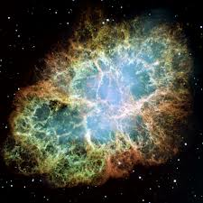
Magnetic Fields in PWN
PWN?
SNR?
CRAB?

Slide 13
Definitions are always boring…
Please pay a littttttttttle attention…

Slide 14
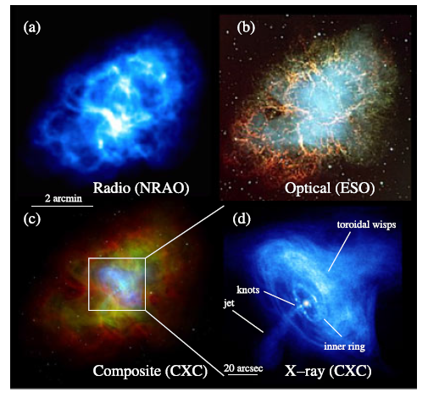
PWNe vs. SNRs
Energy Source
Radio Morphology
Radio Spectral Index
Angular Extent
Fractional Polariza-
tion

Slide 15
PWNe vs. SNRs
Energy Source
SNRs result from an essentially instantaneous deposition of energy, in the form of a blast wave driven into the ISM by a supernova explosion.
PWNe have a continuous power source, the bulk relativistic flow of electron/positron pairs from an energetic neutron star.

Slide 16
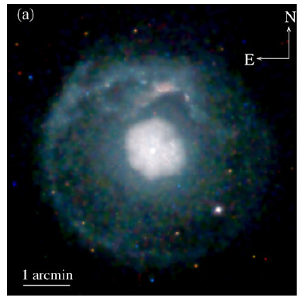
PWNe vs. SNRs
Radio Morphology
SNRs are usually limb-brightened shells of synchrotron emission
PWNe are typically amorphous or filled-center synchrotron nebulae brightest at the pulsar’s position.

Slide 17
PWNe vs. SNRs
Radio Spectral Index:
SNRs usually have relatively steep radio spectral indices, α≈0.3–0.8.
PWNe have spectral indices in the range, α ≈
0–0.3.

Slide 18
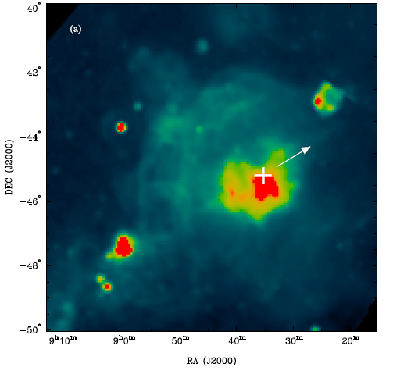
PWNe vs. SNRs
Angular Extent
SNRs are long-lived objects with a wide range of sizes, with angular extents ranging from ∼1’ to >5◦.
PWNe are usually relatively small, with sizes in the range 10’ to 30’’ , although a few older PWNe may be significantly larger.

Slide 19
PWNe vs. SNRs
Fractional Polarization
At radio frequencies near 1 GHz, SNRs typically have modest amounts of linear polarization, at the level of 5%–10%.
PWNe usually have very well organized
magnetic fields, with correspondingly higher polarization fractions, in the range 30%–50%.

Slide 20
PWN Evolution
the word "pwn" which is a typographical error of the word "own"

Slide 21
PWN Evolution
The expansion of the PWN
Interaction of the PWN with the surrounding SNR
The motion of the pulsar powering the PWN

Slide 22
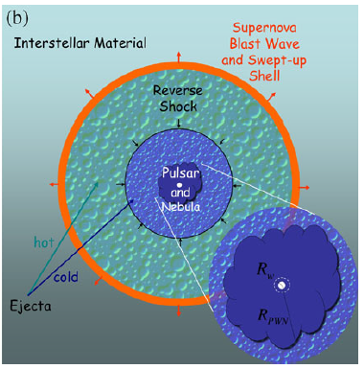
PWN Evolution
Deep Chandra image of the composite SNR G21.5-0.9
The expansion of the PWN

Slide 23
PWN Evolution
Interaction of the PWN with the surrounding SNR
2.4 GHz Parkes image of the Vela supernova remnant. The white cross indicates
the pulsar, and the arrow its proper motion .

Slide 24
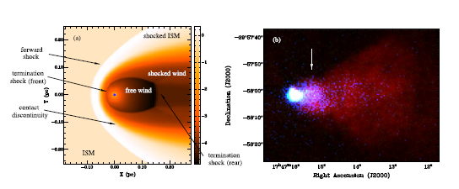
PWN Evolution
The motion of the pulsar powering the PWN

Slide 25
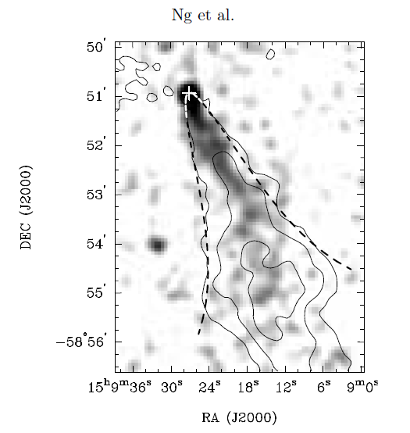
Measuring PWN B-Fields
Various techniques
Different viewing angle
The only limited observation of B-Fields is in pulsar bow shocks

Slide 26
I think after this talk…
For PWN, maybe you know a little
For B-Field in PWN….
If you have any question, please ask next speaker, thank you!!!

