Slide 1
Plasma Astrophysics
Chapter 1: Basic Concepts of Plasma
Yosuke Mizuno
Institute of Astronomy
National Tsing-Hua University

Slide 2
What is a Plasma?
A plasma is a quasi-neutral gas consisting of positive and negative charged particles (usually ions & electrons)
Liquid is heated, atoms vaporize => gas
Gas is heated, atoms collide each other and knock their electrons => decompose into ions & electrons (plasma)
Plasma state: fourth state of matter

Slide 3
What is a Plasma? (cont.)
Ions & electrons interact
  via short-range atomic forces (during collision)
  via long-range electro-magnetic forces due to currents and charge
Long range nature of electromagnetic forces means that plasma can show collective behavior (oscillations, instabilities)
Plasmas can also contain some neutral particles
  Which interact with charged particles via collisions or ionizations
  Ex. interstellar medium, molecular clouds etc.
Simplest Plasma: equal numbers of electrons and protons (formed by ionization of atomic hydrogen)

Slide 4
Examples of Plasmas
Liquid => gas
  thermal energy > Van del Waasl force (10⁻² eV)
Ionize to neutral atoms
  Need 1~ 30 eV (10⁴ ~ 10^{5.5} K in temperature)
To make a fully ionized gas, we must give large energies on the matter
Most of matter are not in plasma state on the earth

Slide 5
Plasmas in the Universe
Most of (visible) universe is in form of plasma
Plasma form wherever temperatures are high enough or radiation is strong enough to ionize atoms
For examples
  Sun’s and star’s atmosphere and winds
  Interstellar medium
  Astrophysical jet, outflows
  Pulsars and their magnetosphere
  Accretion disk around stars and compact objects etc.
Plasma exist wide range of number densities and temperatures

Slide 6
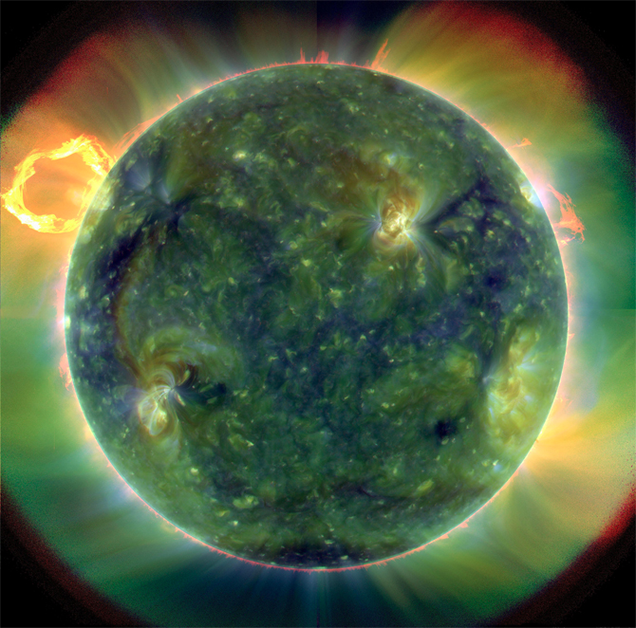
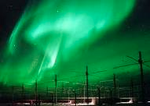
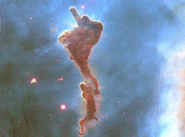
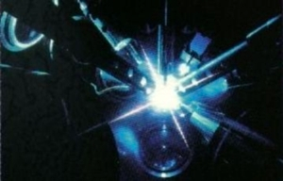
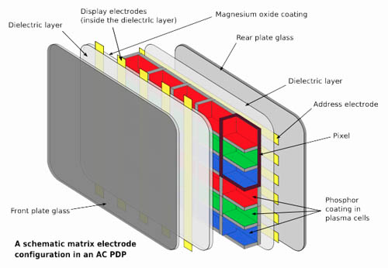
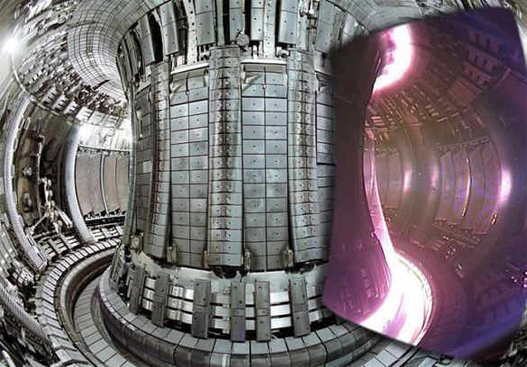
Plasma in Nature and Technology
Sun & stars
Aurorae
Molecular cloud
Laser produced plasma
plasma TV
Tokamaks

Slide 7
Basic parameters
For ensemble of N particles of mass m and velocity v, average energy per particle is
In thermal equilibrium, particles have Maxwell-Boltzmann distribution of speeds.
Average kinetic energy can be calculated using
Integrating numerator by parts, and using
we have <E> = 1/2 k_{B}T or in 3D,

Slide 8
Condition for a ionized gas
The gas particles are freely moving, the averaged kinetic energy is much greater than interaction energy among them
For hydrogen gas (atomic number Z=1)
k_{B}: Bolzmann constant, T: Temperature, ε₀: vacuum permittivity, e: charge on the electron, r: average distance between two particles
Introducing particle number density n=3/(4πr³)
In Plasma physics, energy units are used for temperature. Because Joules are very large, electron volts (eV) are usually used
1 eV = 1.16 x 10⁴ K = 1.602 x 10⁻¹⁹ Joules
(1.1)
(1.2)
(1.3)

Slide 9
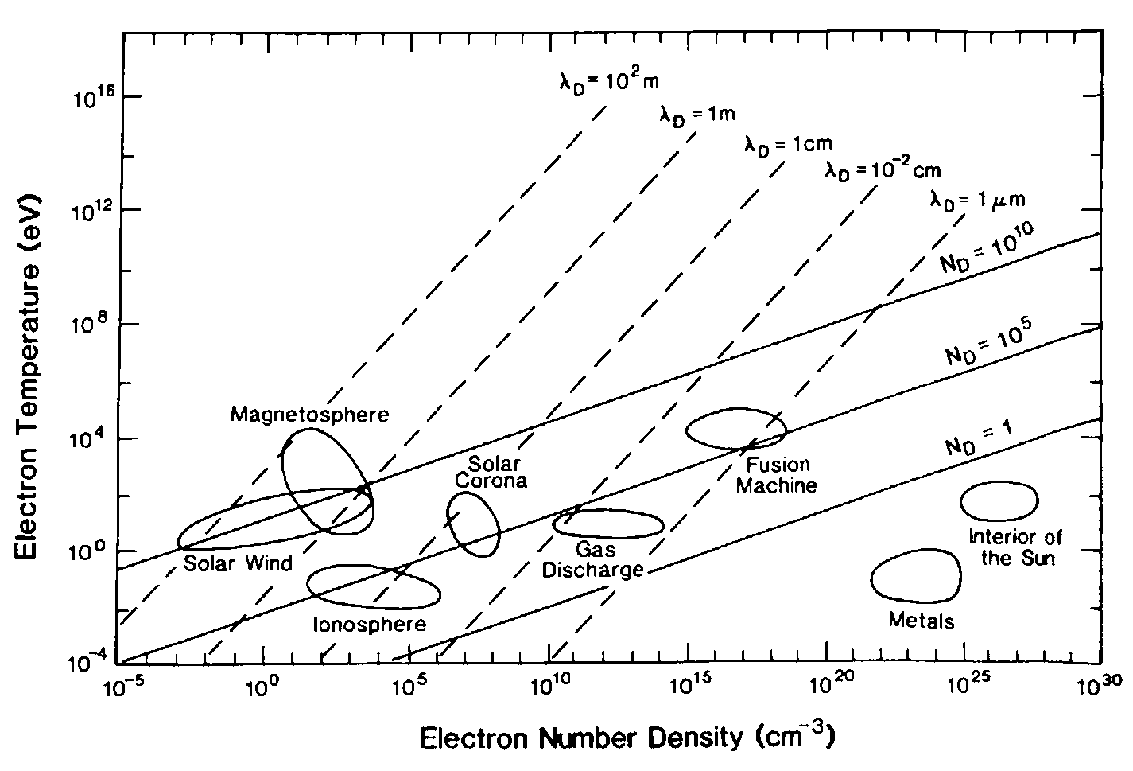
Condition for a ionized gas (cont.)
The condition (1.2) is satisfied under various situations in the Universe (density scale ~ 30 order, temperature scale ~ 10 order)
Accretion disk
Inter stellar medium

Slide 10
Quasi-neutrality
Plasma tends to be electrically neutral at each point due to large charge-to-mass ratio (e/m_{e}=1.8 x 10¹¹ C /kg) of electrons
If charge neutrality breaks down at some point
Electric field is exerted around it
Electrons are accelerated towards positive charge region
Recovering a charge neutrality in a very short time

Slide 11
Quasi-neutrality (cont.)
Examples: laboratory plasma
  contains 10¹⁵m⁻³ ions and neutral atoms
  Small spherical region (r~10⁻²m), 1% deviation from change neutrality
  Electric field arises (from Gauss’s theorem)
  This electric field accelerate an electron at the rate
  10¹³ times greater than the gravitational acceleration
Even small deviation occurs from charge neutrality, electrons immediately migrate to recover the charge neutrality
(1.4)
(1.5)

Slide 12
Plasma Oscillation
A dynamic aspect of the plasma’s tendency toward neutralization shows as plasma oscillation
If some region is (slightly) charged positively,
Incurred electric field attract (accelerate) electrons toward the region (for cancelling the charge inhomogeneity)
However, electron’s motion overshoots
Electrons are pulled back (oscillations)
Note: the electrons move much faster than the ions because of their masses
We consider such a high-frequency variation of electrons’ position in a static ion system

Slide 13
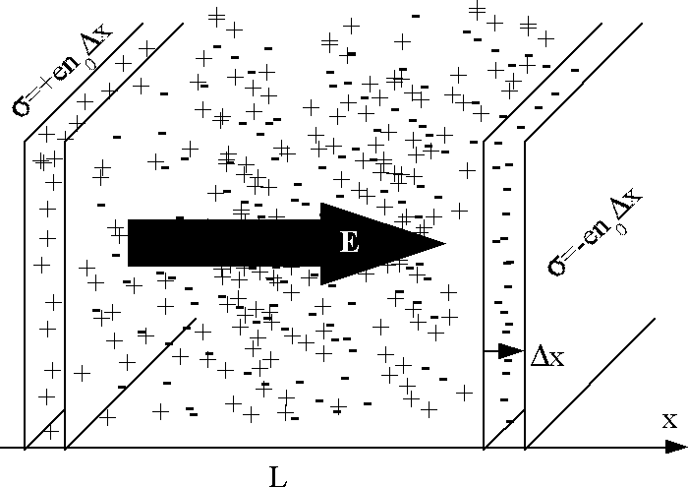
Plasma Oscillation (cont.)
Consider plasma of equal number of positive and negative charges. Overall, plasma is neutral, so n_{e} = n_{i} = n
Now displace group of electrons by Δx.
Charge separation gives E, which accelerates electrons towards initial position. Electrons overshoot equilibrium position.
Using Newton’s Law
(1.6)
Displacement sets up E across distance L, similar to parallel plate capacitor.
Charge per unit area of slab is σ = -neΔx => E = σ/ε₀ = -neΔx / ε₀

Slide 14
Plasma Oscillation (cont.)
Therefore, Eq. (1.16) can be written
Where
Plasma oscillations are result of plasma trying to maintain charge neutrality.
Plasma frequency commonly written
where n_{e} is in cm⁻³
In Solar System, f_{p} ranges from hundreds of MHz (in solar corona) to <1 kHz (near outer planets).
Plasma frequency

Slide 15
Plasma criteria
In a partially ionized gas where collisions are important, plasma oscillations can only develop if the collision time (τ_{c}) is longer than the oscillation period (τ_{p}=1/ω_{p}).
That is, τ_{c} >> τ_{p} or τ_{c}/τ_{p} >>1
Above is a criterion for an ionized gas to be considered a plasma.
Plasma oscillations can be driven by natural thermal motions of electrons (E=1/2k_{B}T_{e}). Work by displacement of electron by Δx is (using E = -neΔx / ε₀ )
Plasma criteria #1

Slide 16
Plasma criteria (cont.)
Equating work done by displacement with average energy in thermal agitation
The maximum distance an electron can travel is Δx_{max} = λ_{D}, where
Gas is considered a plasma if length scale of system is larger than Debye Length:
Debye Length is spatial scale over which charge neutrality is violated by spontaneous fluctuations.
Debye Number is defined as
Debye length
Plasma criteria #2

Slide 17
Debye shielding
Even though a plasma is electrically neutral in an average sense, charge density deviates from zero if we look at a very small region
Electro-static potential around an ion
  In the vicinity of ion, electrons are moving around by its thermal motion
  Forming a kind of “cloud”
  Screens the positive charge of ion
Investigate this screening effect quantitatively

Slide 18
Debye shielding (cont.)
Suppose immerse test particle +Q within a plasma with n_{i} = n_{e} = n
At t = 0, electric potential is
As time progresses, electrons are attracted, while ions are repelled. As m_{i} >> m_{e}, we neglect motion of ions.
At t >> 0, n_{e} > n_{i} and a new potential is set up, with charge density

Slide 19
Debye shielding (cont.)
New potential evaluated using Poisson’s equation:
In presence of potential, electron number density is
Subbing this into Poisson’s equation in spherical coordinates.
For , it can be done Taylor expansion:
Where λ_{D} is the Debye shielding length.

Slide 20
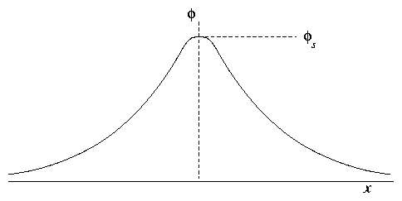
Debye shielding (cont.)
Solution to previous is
As r => 0, potential is that of a free charge in free space, but for r >> λ_{D} potential
falls exponentially.
Coloumb force is long range in free space, but only extends to Debye length in plasma.
For positive test charge, shielding cloud contains excess of electrons.
Recall
size of shielding cloud increases as electron temperature becomes high which electrons can overcome Coulomb attraction. Also, λ_{D} is smaller for denser plasma because more electrons available to populate shielding cloud.

Slide 21
The plasma parameter
The typical number of particles in a Debye sphere is given by the plasma parameter:
If Λ<<1, the Debye sphere is sparsely populated, corresponding to a strongly coupled plasma.
Strongly coupled plasmas tend to be cold and dense, whereas weakly coupled plasmas tend to be diffuse and hot.
Strongly coupled plasma: White dwarf, Neutron star atmosphere
Weakly coupled plasma: space plasma, Magnetic fusion

Slide 22
Collisions
Neutral particles have quite small collision cross sections. As Coulomb force is long range, charged particles are more frequent.
A collisional plasma is λ_{mfp} << L,
where L is the observational length scale and λ_{mfp} = 1/σn is the mean free path.
The effective Coulomb cross-section is σ = πr_{c}²
An electron will be affected by a neighboring ion if the Coulomb potential is of the order of the electron thermal energy
At T = 10⁶ K, σ ~ 10⁻²² m², which is much larger than the geometric nuclear cross section of 10⁻³³ m².

Slide 23
Collisions (cont.)
In terms of the plasma parameter, the collision frequency ( ) is
Where ln(Λ) is the Coulomb logarithm. Used as Λ is large, but 10 < ln(Λ) < 30.
In a weakly coupled plasma, ν << ω_{p} => collisions do not effect plasma oscillations
More rigorously, it can be shown that
Thus, diffuse, high temperature plasmas tend to be collisionless.
(Plasma frequency: ω_{p}~ n^{1/2} )

Slide 24
Mean free path
Using Debye number, mean free path is
The condition N_{D} >> 1 is equivalent to λ_{mfp} >> λ_{D}
If N_{D} >>1, electrons are moving around almost free from the collision (important for long-range collective effects)
A single electron cannot effectively screen the ion’s potential
= collision is not very effective when an electron approaches the ion at the distance λ_{D}.
N_{D} >> 1 is generally satisfied in many astrophysical objects.
If N_{D} ~ 1, the individual particles cannot be treated as a smooth continuum (short range correlation also important).

Slide 25
Plasma state
Accretion disk
Inter stellar medium

Slide 26
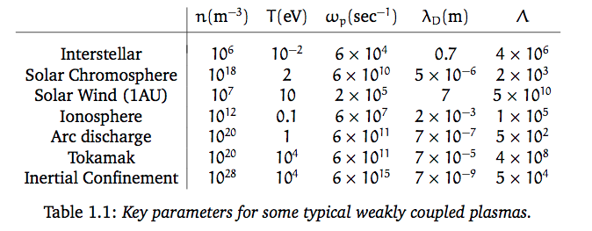
Example of plasma key parameter

Slide 27
Summery
A plasma is a quasi-neural ionized gas consisting of positive and negative charged particles
Plasma oscillations are result of plasma trying to maintain charge neutrality.
Plasma criteria #1: the collision time is longer than the oscillation period.
The charge neutrality holds only for the average over the scale that is greater than Debye (shielding) length
Plasma criteria #2: length scale of system is larger than Debye Length
The condition Debye number N_{D} >> 1 is equivalent to mean-free path λ_{mfp} >> λ_{D}
In many astrophysical plasma, collective effects dominate over collisions

