Slide 1
Plasma Astrophysics Chapter 10: Magnetic Reconnection
Yosuke Mizuno
Institute of Astronomy
National Tsing-Hua University

Slide 2
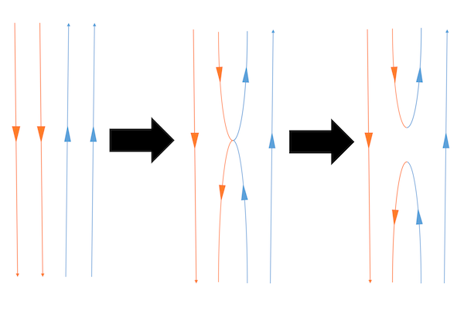
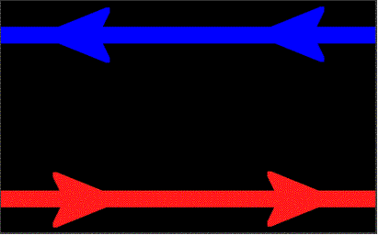
Magnetic reconnection
Ideal MHD gives frozen in magnetic fields.
Resistive MHD allows diffusion of fields.
Magnetic reconnection occurs through diffusion.
Magnetic reconnection is the process of a rapid rearrangement of magnetic field topology.

Slide 3
Magnetic reconnection (cont.)
Magnetic reconnection is transient phenomena (flaring event).
This process leads rapid and violent release of stored magnetic energy (to thermal and kinetic energies, particle acceleration).
In the universe,
interplanetary magnetic field => aurora in planet (earth etc.)
Sun (flare, CME)
Pulsar wind, Pulsar wind nebula and Pulsar jets (flare)
Magnetar flare
Relativistic jets (flare, time variability)
Gamma-ray bursts (time variability)
Magnetic reconnection is observed in laboratory plasma experiment. Therefore, magnetic reconnection is real physical phenomena.

Slide 4
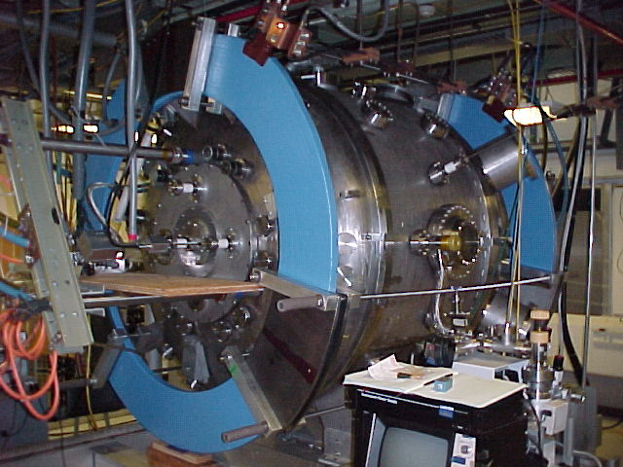
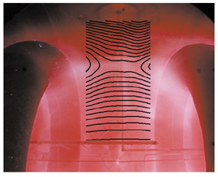
Magnetic reconnection in Laboratory
Laboratory Plasma Experiment
Magnetic Reconnection Experiment (MRX)
Magnetic reconnection seen in MRX

Slide 5
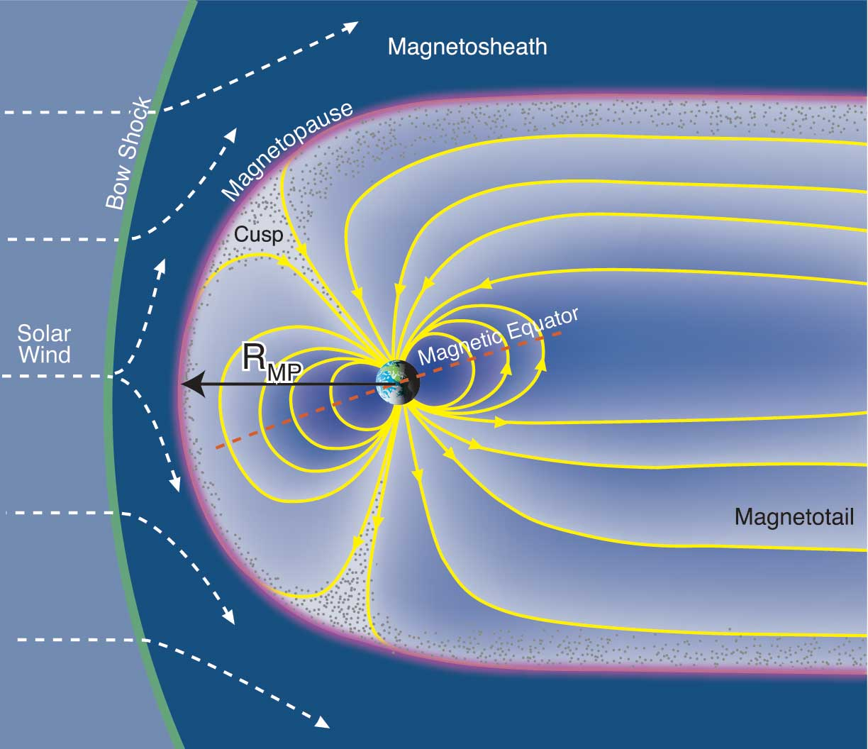
Magnetic reconnection in Planetary magnetosphere
Planetary (Earth) magnetosphere, aurora (substorm)
Movie here

Slide 6
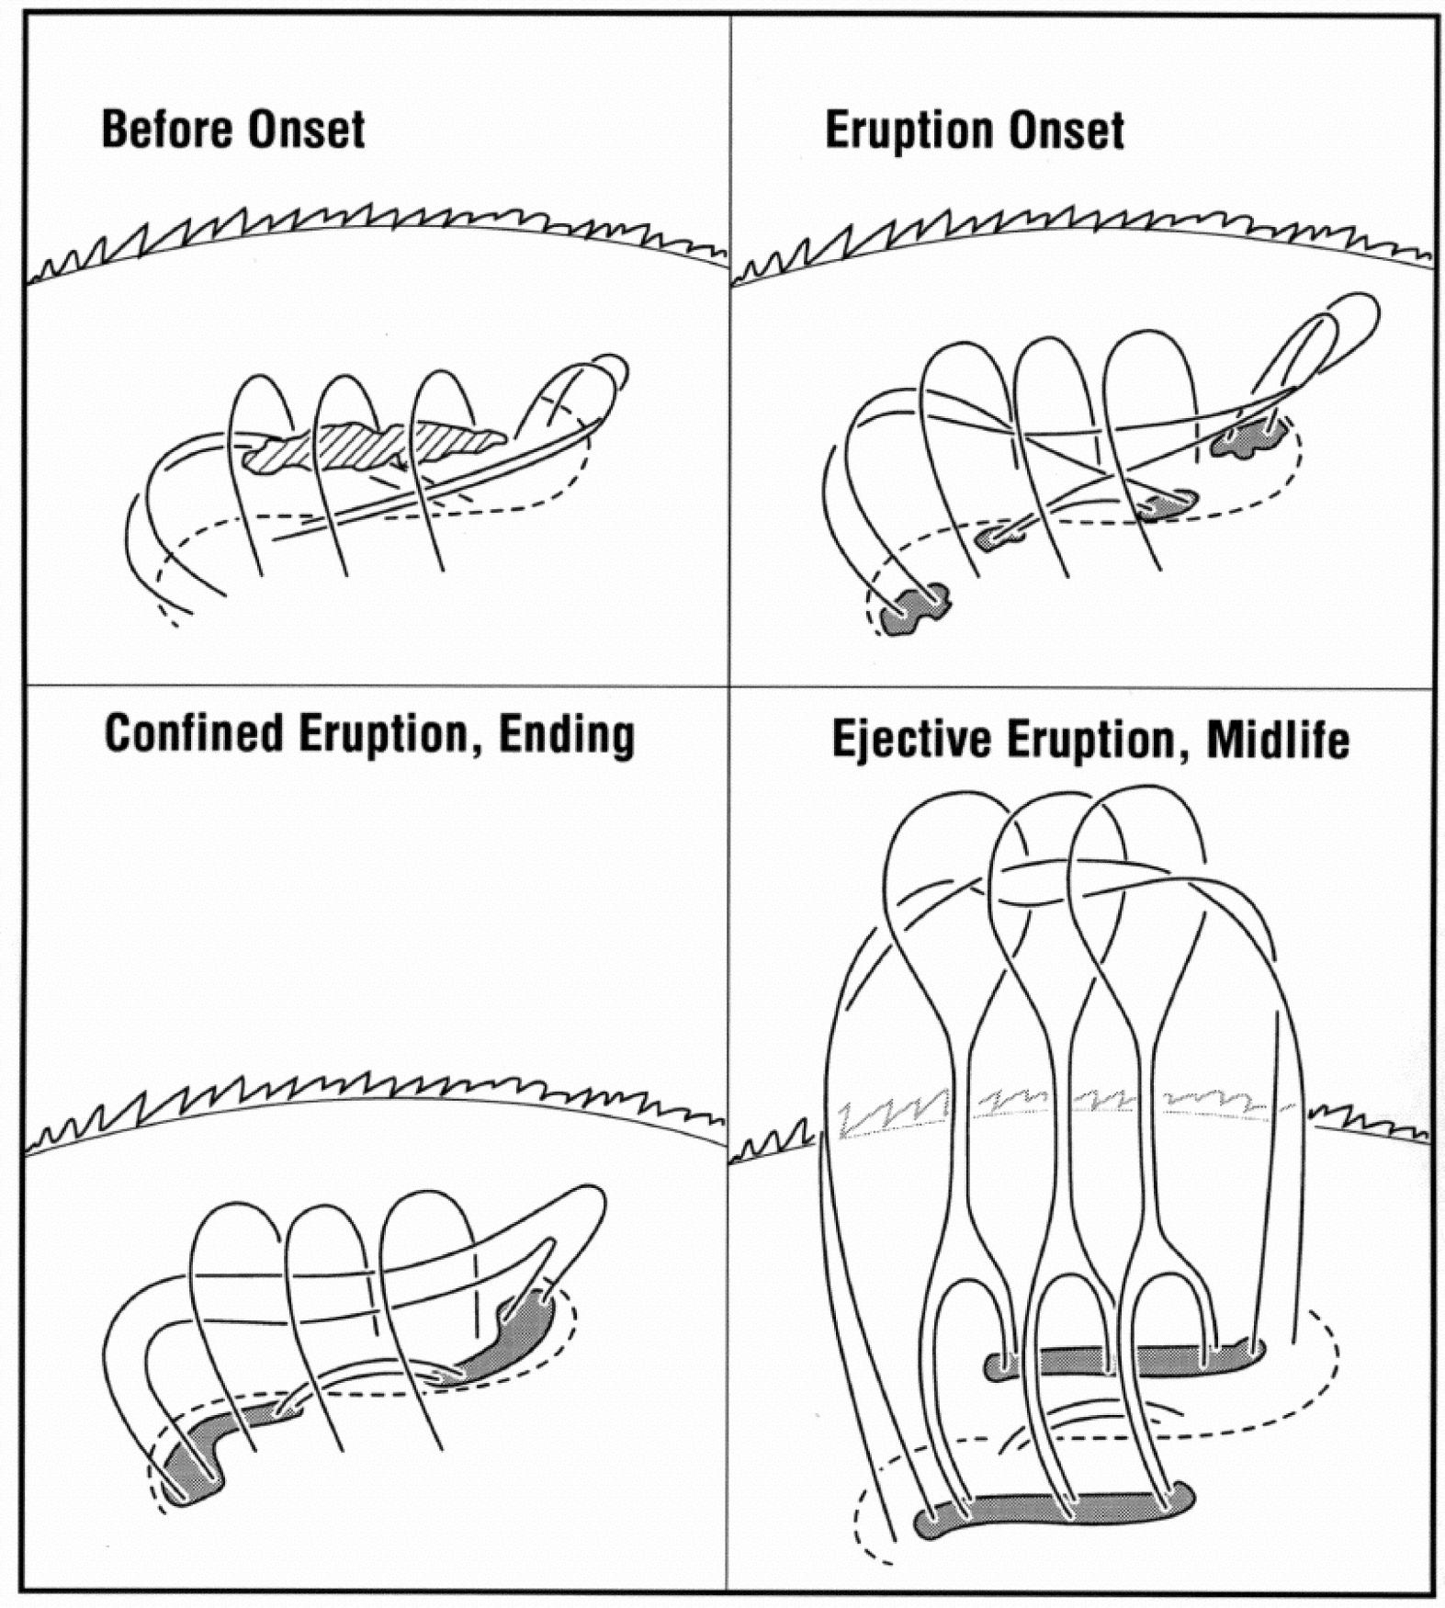
Magnetic reconnection in the Sun
Two ribbon flare (top of view of solar flare)
Movie here

Slide 7
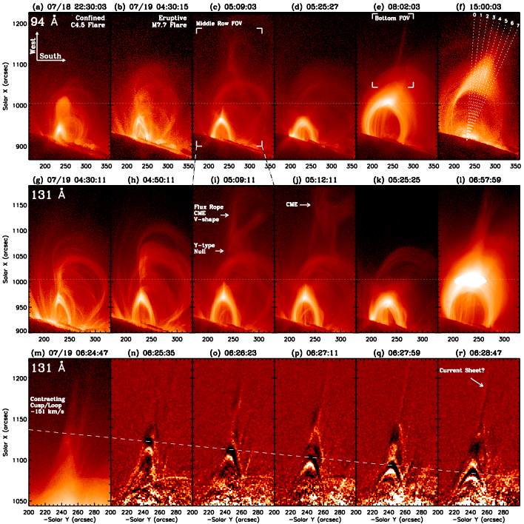
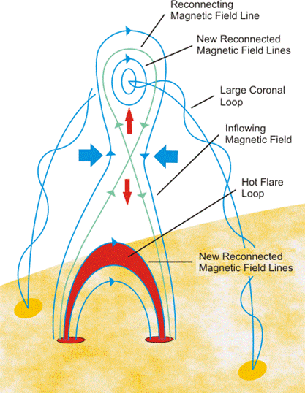
Magnetic reconnection in the Sun (cont.)
Cusp flare (side view of Solar Flare}

Slide 8
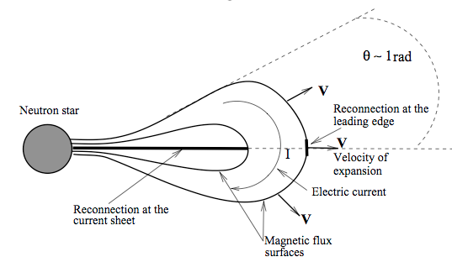
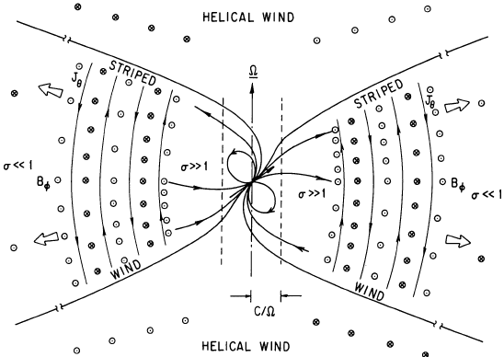
Magnetic Reconnection in Relativistic Astrophysical Objects
Pulsar Magnetosphere & Striped pulsar wind
obliquely rotating magnetosphere forms stripes of opposite magnetic polarity in equatorial belt
magnetic dissipation via magnetic reconnection would be main energy conversion mechanism
Magnetar Flares
May be triggered by magnetic reconnection at equatorial current sheet
Spitkovsky (2006)
Movie here

Slide 9
Magnetic diffusion
Consider the simplest case in which magnetic field (or current) dissipates only by resistivity (= diffusivity)
In this case, diffusion time for solar flare case becomes
Where L is typical size of solar flare, η is magnetic diffusivity (= c²/4πσ) and becomes
for coulomb collision. This is called classical resistivity or Spitzer resistivity.
The diffusion time becomes 10¹⁴ sec ~ 3 million year. It is difficult to explain solar flare time scale (10-100 sec ~ 10-100 τ_{A}).

Slide 10
Spitzer resistivity
Classical model of electrical resistivity based on electron ion collisions
Collision term: (see ch 3.5)
Collisions are Coulomb collisions, P_{ei} is proportional to Coulomb force (e²) and densities, so we can write
(see ch 4, here q = e)
So collision frequency is written as
Collision cross section: ( see ch 1, here mv² ~ 3/2 k_{B}T)
Collision frequency:
Resistivity is (mv² ~ 3/2 k_{B}T)

Slide 11
Spitzer resistivity (cont.)
This resistivity is considered large-angle collision alone. Therefore we also need to consider small-angle collision
Spitzer is shown as
Λ is plasma parameter (see ch.1)
Spitzer resistivity

Slide 12
Magnetic diffusion (cont.)
Dynamical time scale is defined as the Alfven transit time, τ_{Α}
The magnetic Reynolds number (Lundquist number) R_{m} (S) is defined by
(see ch 4) (Lundquist number)
Explosive magnetic energy release occurs even though S (~R_{m}) >> 1 in every kind of hot plasma. This puzzle is considered to be one of the most difficult and fundamental problem in nature.
(10.1)

Slide 13
Magnetic Reynolds / Lundquist number
The magnetic Reynolds number:
Lundquist number:
If the typical velocity of motion is Alfven speed, v=v_{A}, magnetic Reynolds number = Lundquist number
The magnetic reconnection is treated the dynamics of magnetic field. So the typical velocity of motion is Alfven speed.
Therefore in the study of magnetic reconnection

Slide 14
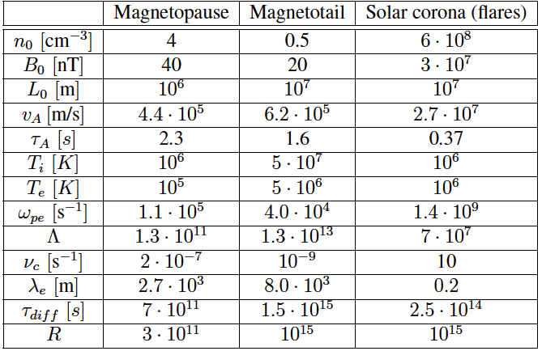
Magnetic diffusion (cont.)
Collision frequency
Lundquist number

Slide 15
Sweet-Parker Model
Sweet (1958) and Parker (1957) have developed a simple theory of steadily driven reconnection, taking into account the effect of plasma flow (2D model).
Consider current sheet (or diffusion region) has a total length of 2L and total thickness of 2δ (aspect ratio of the diffusion region is fixed).
At the inflow region, a magnetic field B₀ that is strongly tangential to the inflow boundary. The inflow velocity is approximately constant with v_{in}.
At the outflow boundary the magnetic field is B_{out} and the outflow velocity is v_{out}
The the region inside the diffusion region is assumed to be dominated by diffusion and the outside region is assumed to be ideal.

Slide 16
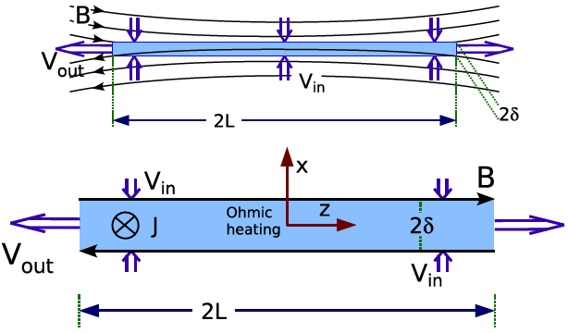
Sweet-Parker Model (cont.)
v_{y}, B_{x}
v_{x}, B_{y}
y
x
y
x
Diffusion region (current sheet)

Slide 17
Sweet-Parker Model (cont.)
First we estimate the inflow velocity to diffusion region.
From the assumption, there is no current in inflow region. Therefore, from Ohm’s law,
At the center (diffusion region), there is no magnetic field. Hence from induction equation
From Ampere’s law, The current at the center is roughly estimated as
From them, the inflow velocity is
(10.2)

Slide 18
Sweet-Parker Model (cont.)
From mass conservation, inflowing mass and outflowing mass is conserved:
This gives velocity ratio:
The same relation is hold for magnetic field
(10.3)
(10.4)

Slide 19
Sweet-Parker Model (cont.)
We calculate the outflow velocity. Consider the equation of motion (assuming steady and ignore pressure) in x-direction (parallel to outflow),
Along center of diffusion region,
Therefore the equation of motion is
This gives the result:
(10.5)

Slide 20
Sweet-Parker Model (cont.)
We put the relation (10.4) into this equation,
This gives
That is, the outflow velocity (reconnection jet(outflow)) is of the order of the Alfven speed in inflow region.
(10.6)

Slide 21
Sweet-Parker Model (cont.)
We calculate the reconnection rate. Using eq(10.2) and (10.3), the inflow velocity is written as
The resulting reconnection rate for the Sweet-Parker model is
Thus the reconnection rate normalized to the typical electric field E = B_{in}v_{A,in} is
(10.7)
Normalized reconnection rate

Slide 22
Sweet-Parker Model (cont.)
Since Lundquist (magnetic Reynolds) number is typically very large number, the resulting reconnection rate is very small.
This implies also a very large aspect ratio L/δ (see normalized reconnection rate).
In solar flare case, the time scale of Sweet-Parker reconnection is
This is not fast enough to explain the solar flare (10-100 sec).
Sweet-Parker reconnection is slow reconnection
Using classical resistivity, the thickness of diffusion region for solar flare is

Slide 23
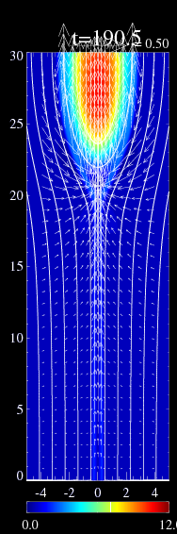
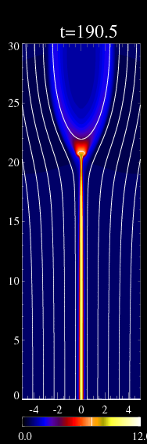
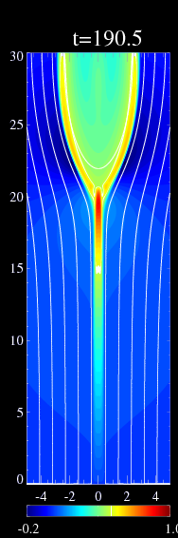
Sweet-Parker Model (cont.)
density
density
temp.
Vy
Movie here

Slide 24
Petschek Model
The large aspect ratio limits the possible reconnection rate in the Sweet-Parker model
Petschek (1964) realized that a much larger reconnection rate would be possible if the diffusion region were much shorter.
The main point in Petschek’s model is that the length of the diffusion region should be much shorter L_{p} << L in order to realize a higher reconnection rate.
A much shorter diffusion region also implies a thinner diffusion region, i.e., δ_{p} << δ, because faster reconnection implies a larger electric field and a higher current density at the x-line.
The fast transport out of this diffusion region over the scale from L_{p} to L occurs through a flow layer which is bounded by slow shocks.

Slide 25
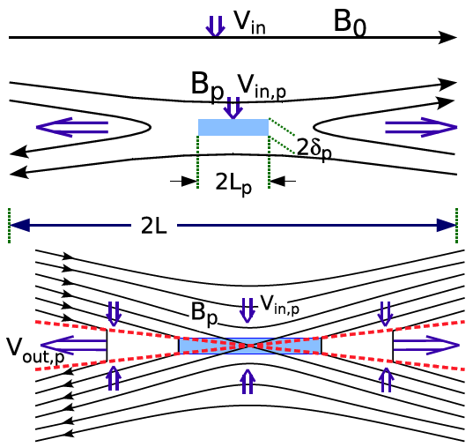
Petschek Model (cont.)
y
x

Slide 26
Petschek Model (cont.)
First look at the scaling in the vicinity of diffusion region.
The magnetic field in the inflow of the Petschek region is denoted B_{in,p} which is smaller than B_{in}
However, from magnetic flux conservation v_{in}B_{in}=v_{in,p} B_{in,p} (and assuming constant mass density)
using
the inflow Alfven Mach number is ( )
(10.8)

Slide 27
Petschek Model (cont.)
Using
and the relation
for length scale we obtain
Using (from eq(10.8)) , we obtain
or
(10.9)
(10.10)
(10.11)

Slide 28
Petschek Model (cont.)
Thus, once we have determined B_{in,p}/ B_{in}, we can obtain the ratio of the inflow Mach numbers as well as the scale of the Petschek diffusion region.
This is just a re-scaling of the diffusion region in size and is applicable to any smaller scale diffusion region.
Note that similar to the Sweet-Parker model, Petschek reconnection model also does not treat the diffusion region self-consistently.
The main insight from Petschek model is that the the transport from L_{p} to L does not require the thin outflow layer.
Petschek suggested that the outflow region is bounded by two slow switch-off shocks.
This is strictly only true if the shocks are horizontal, i.e., aligned with the x-direction.
But, since the shocks are only very slightly inclined, the error in the assumption of switch-off shocks is small

Slide 29
Petschek Model (cont.)
From the discussion of switch-off slow shocks, away from diffusion region, to satisfy the switch-off shock condition, the plasma in outflow region is jetting with at the speed of
Noted that the actual normal velocity in the downstream (outflow) region is 0.
This means that the slow shock is moving with a velocity
toward the upstream (inflow) region.
(10.12)

Slide 30
Petschek Model (cont.)
The prior discussion assumes that the density is constant, which is incorrect for a slow shock.
We can compute the outflow density from the switch-off shock properties.
To do so, one has to determine the angle of the upstream magnetic field with the shock normal.
The tangential and normal components are B_{in,p} and B_{n}
Magnetic flux conservation implies
The angle the upstream magnetic field is
where r_{p} is the reconnection rate for the Petschek diffusion region
(10.12)

Slide 31
Petschek Model (cont.)
This indicates that .
In this case, inflow velocity is

Slide 32
Petschek Model (cont.)
Determine the magnetic field at the diffusion region B_{in,p}
This field is modified because the field in the vicinity of the diffusion region is curved and different from the field B_{in} at large distance from the diffusion region
From long calculations, the magnetic field at the diffusion region is obtained as
(10.13)

Slide 33
Petschek Model (cont.)
For , eq(10.13) implies roughly such that (modification is small)
From eq (10.10), the relations for the diffusion region scales become
Petschek suggested that the process becomes inefficient if B_{in,p} becomes too small

Slide 34
Petschek Model (cont.)
Assuming that a reasonable value for the minimum B_{in,p} is B_{in,p}~B_{in}/2 yields for the approximate maximum inflow Mach number (or reconnection rate)
This reconnection rate is much larger than the Sweet-Parker rate (fast reconnection).
For instance, the case of R_{m}=10⁸,
the Petschek reconnection rate is r_{p} ~ 2 x 10⁻²
The Sweet-Parker reconnection rate is r_{sp} ~ 10⁴

Slide 35
Petschek Model (cont.)
The reason is that the aspect ratio δ_{p}/L_{p} is much larger than δ/L for the Sweet-Parker diffusion region.
This is accomplished by a much smaller length of the diffusion region
However, the thickness of diffusion region is also much smaller
In solar corona case, using classical resistivity (S~10¹⁴), the diffusion length of Petscheck reconnection becomes smaller than ion gyro-radius (~10 cm) (MHD is acceptable?).
Although Petscheck model is a very attractive idea, the question arises whether the single Petscheck reconnection controls the entire flare process or not (large scale difference).

Slide 36
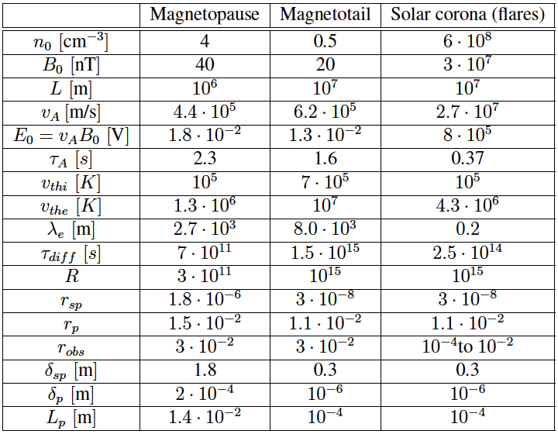
Sweet-Parker vs Petschek
Lundquist number
Reconnection rate
Thickness of diffusion region

Slide 37
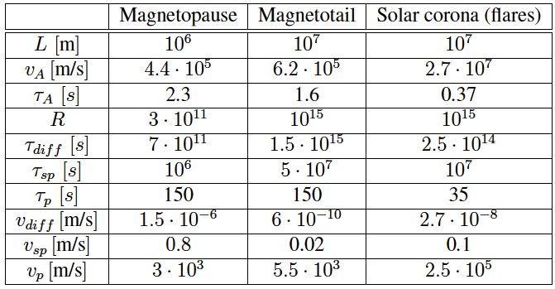
Sweet-Parker vs Petschek (cont.)
Reconnection time
Outflow velocity

Slide 38
Petschek Model (cont.)
The numerical simulations show that the Petschek model for fast reconnection does not arise under uniform resistivity in the limit of large S. (Biskamp 1986)
In order to develop Petschek-type reconnection, we need to use non-uniform resistivity (spatially-localized resistivity), so-called anomalous resistivity
What is the anomalous resistivity?
Until now, it is still unknown. But it may be related microscopic (kinetic) process.

Slide 39
Petschek Model (cont.)
Movie here

Slide 40
Tearing instability
Sweet-Parker model is slow reconnection process. It can not be explained solar flare.
Petschek model is fast reconnection process. It may be explained solar flare time scale but physically not-perfect.
Here we again focus on Sweet-Parker model.
The problem for slow reconnection is the large aspect ratio.
Question is can we make small aspect ratio?
In the evolution of Sweet-Parker reconnection, the diffusion region (current-sheet) is expanded.
Such long current-sheet is unstable against tearing instability

Slide 41
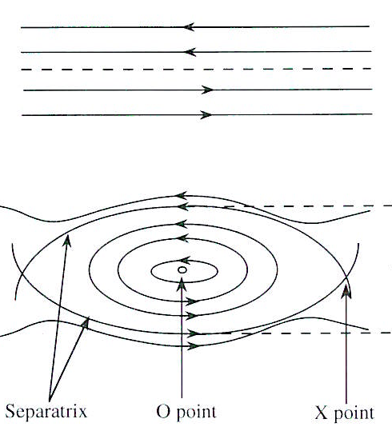
Tearing instability
a
Tearing mode is resistive instability that occurs in presence of current sheet
The tearing mode forms magnetic islands
The magnetic island grow unsteadily.
We follow Furth, Killeen & Rosenblth (1963) (FKR) study
λ

Slide 42
Tearing instability (cont.)
According to their analysis, the growth rate of the tearing instability is of the order of
For large S* and long wavelength λ > 2πa in parallel to current sheet, where
a is the thickness of current sheet and k is transverse wavenumber of the tearing mode

Slide 43
Tearing instability (cont.)
From FKR, the instability only exists for
Using the fastest growing mode, the maximum growth rate is
From numerical analysis of the linear tearing instability without using the so-called constant ψ approximation (Steinolfson & van Hoven 1984), the maximum growth rate is
This growth rate is faster than that found by FKR.

Slide 44
Tearing instability (cont.)
Let us now apply to solar corona, If we assume a =10⁴ km (typical length of solar flare), the Lundquist (magnetic Reynolds) number becomes S*~10¹⁴. Then we find
Hence the (most unstable) tearing mode cannot be applied to the solar corona.
But if we assume a =1km (10³ times larger thickness estimated from SP model), we have S* = 10¹⁰, and
And the growth time becomes
So in this case, the tearing instability can occur in the solar corona and will form multiple magnetic islands with a size 2 x 10³ km in the coronal current sheet

Slide 45
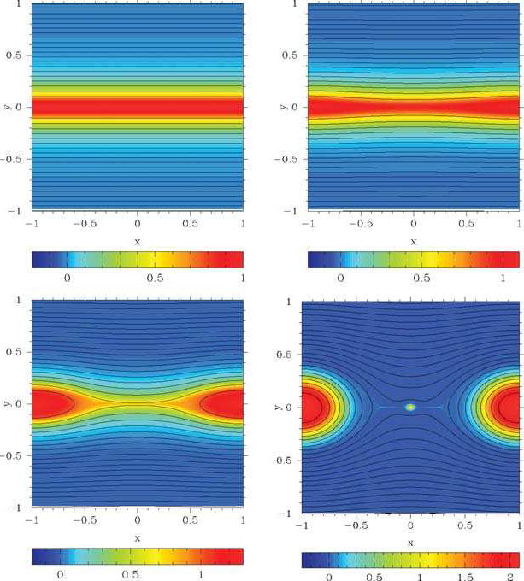
Tearing instability (cont.)
Current density
Force-free simulation

Slide 46
Tearing instability (cont.)
Movie here

Slide 47
Current trend of magnetic reconnection
Instability (turbulence) in collisional reconnection
Trigger of fast reconnection from Sweet-Parker type condition
Time-dependent, non-stationary reconnection in very large systems (Sweet-Parker type situation) show the development of multiple magnetic islands via tearing instability
Growing instability leads to turbulence in reconnection.
Turbulence makes small aspect ratio of diffusion region and leads to fast reconnection.
Now we consider interaction between two fundamental plasma processes: reconnection and turbulence
Collisional reconnection to collision-less reconnection.
Development of Physically correct Petschek type reconnection
Spatially-localized anomalous resistivity due to plasma micro-instabilities
Hall-term effect (two fluid effect) enables Petschek-like structure (v_{rec} < 0.1 v_{A})

Slide 48
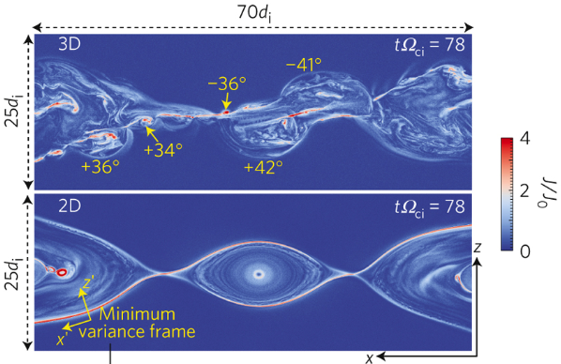
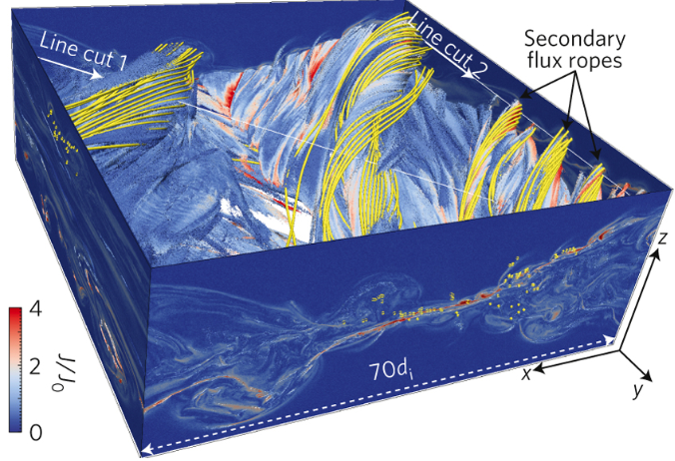
3D Magnetic reconnection
Movie here

Slide 49
Summary
Magnetic reconnection is the process of a rapid rearrangement of magnetic field topology which leads to rapidly and violent release of magnetic energy.
Flaring event (rapid energy release) in the universe may be related magnetic reconnection process.
In basic theory of magnetic reconnection, there are two physical models, Sweet-Parker model and Petscheck model.
Both models have some advantage and disadvantage.
Until now, we have not developed perfect magnetic reconnection theory
Magnetic reconnection is one of the most important fundamental questions in physics.

