Slide 1
Plasma Astrophysics
Chapter 4: Single-Fluid Theory of Plasma - Magnetohydrodynamics
Yosuke Mizuno
Institute of Astronomy
National Tsing-Hua University

Slide 2
Exercise 1
Plasma frequency:
Debye length:
Plasma number:
Mean free path:

Slide 3
Exercise 1 (cont.)
Gyro frequency:
Larmor radius:
Electron volts is energy units = particle’s kinetic energy
For Larmor radius, we need to get perpendicular components of velocity.

Slide 4
Single-Fluid Theory: MHD
Under certain circumstances, appropriate to consider entire plasma as a single fluid.
Do not have any difference between ions and electrons.
Approach is called magnetohydrodynamics (MHD).
General method for modeling highly conductive fluids, including low-density astrophysical plasmas.
Single-fluid approach appropriate when dealing with slowly varying conditions.
MHD is useful when plasma is highly ionized and electrons and ions are forced to act in unison, either because of frequent collisions or by the action of a strong external magnetic field.

Slide 5
Single-fluid equations for fully ionized plasma
Can combine multiple-fluid equations into a set of equations for a single fluid.
Assuming two-specials plasma of electrons and ions (j = e or i):
For a fully ionized two-species plasma, total momentum must be conserved:
As m_{i} >> m_{e} the time-scales in continuity and momentum equations for ions and electrons are very different. The characteristic frequencies of a plasma, such as plasma frequency or cyclotron frequency are much larger for electrons.
(4.1a)
(4.1b)

Slide 6
Single-fluid equations for fully ionized plasma (cont.)
When plasma phenomena are large-scale (L >> λ_{D}) and have relatively low frequencies (ω << ω_{plasma} and ω << ω_{cyclotron}), on average plasma is electrically neutral (n_{i} ~ n_{e}). Independent motion of electrons and ions can then be neglected.
Can therefore treat plasma as single conducting fluid, whose inertia is provided by mass of ions.
Governing equations are obtained by combining eqn (4.1)
First, define macroscopic parameters of plasma fluid:
Mass density
Charge density
Electric current
Center of Mass Velocity
Total pressure tensor

Slide 7
MHD mass and charge conservation
Using eq (4.1a):
Multiply by q_{i} and q_{e} and add continuity equations to get:
where J is the electric current density: and the electric charge:
Multiply eq (4.1a) by m_{i} and m_{e},
where is the single-fluid mass density and v is the fluid mass velocity
Charge conservation
Mass conservation / continuity equation

Slide 8
MHD equation of motion
Equation of motion for bulk plasma can be obtained by adding individual momentum transport equations for ions and electrons.
LHS of eq(4.1b):
Difficulty is that convective term is non-linear.
But note that since m_{e} << m_{i} contribution of electron momentum is much less than that from ion. So we ignore it in equation
Approximation: Center of mass velocity is ion velocity:
LHS:

Slide 9
MHD equation of motion (cont.)
RHS of eq(4.1b) :
In general, second term (Electric body force) is much smaller than J x B term. So we ignored.
Therefore, LHS+RHS:
For an isotropic plasma, where total pressure is p = p_{e} + p_{i} and
Equation of motion
Equation of motion

Slide 10
MHD equation of motion (cont.)
ρ_{e}E term is generally much smaller than J x B term. To see this take order of magnitudes.
from Maxwell’s equations:
Therefore,
This is generally very small number.
Example: small cold plasma, T_{e}=1eV, L=1cm, this ratio is about 10⁻⁸

Slide 11
Generalized Ohm’s law
The final single-fluid MHD equation describes the variation of current density J.
Consider the momentum equations for electron and ions (eq.4.1b):
Multiple electron equation by q_{e}/m_{e} and ion equation by q_{i}/m_{i} and add:
(We ignore second term of LHS as we dealing with small perturbation)

Slide 12
Generalized Ohm’s law (cont.)
In forth term of RHS:

Slide 13
Generalized Ohm’s law (cont.)
For an electrically neutral plasma and using
and , We can write
As and . In thermal equilibrium, kinetic pressures of electrons is similar to ion pressure (P_{e} ~ P_{i})
(4.2)

Slide 14
Generalized Ohm’s law (cont.)
The collisional term can be written:
where η is the specific resistivity, q² relates to fact that collisions result from Coulomb force between ions (q_{i}) and electrons (q_{e}) and total momentum transferred to electrons in an elastic collision with an ion is v_{i} – v_{e} .
Now q_{i}= - q_{e} and n_{e} = n_{i} and J=n_{e}q_{e}(v_{e}-v_{i}), =>
Eq. (4.2) can be written as
Where η is a tensor. This is generalized Ohm’s law
(4.3)

Slide 15
Generalized Ohm’s law (cont.)
For a steady current in a uniform E, and B = 0 so that
In general form, the electric field E can be found from Eq (4.3):
Consider right hand side of this equation:
  First term: E associated with plasma motion
  Second term: Hall effect
  Third term: Ambipolar diffusion from E-field generated by pressure gradients
  Fourth term: Ohmic losses/Joule heating by resistivity
  Fifth term: Electron inertia

Slide 16
One fluid MHD Ohm’s law
Generalized Ohm’s law
Now assume plasma is isotropic, so that
Also we neglect Hall effect and Ambipolar diffusion in generalized Ohm’s law since not important in one-fluid MHD.
For slow variations, J = constant, so can write generalized Ohm’s law as:
Rearranging gives,
Where σ = 1/η is electrical conductivity
One-fluid MHD Ohm’s law

Slide 17
Simplified MHD equations
A set of simplified MHD equations can be written:
Fluid equations must be solved with reduced Maxwell equations
Here we have assumed that there is no accumulation of charge (i.e., ρ_{e} = 0)
Complete set of equations only when equation of state for relationship between p and n (ρ) is specified.
(displacement current term is ignored for low frequency phenomena)

Slide 18
Plasma β
The MHD equation of motion contains J x B term, which can given rise to effects that are similar to those of the pressure term.
Current is given by
Taking cross product with the magnetic field,
Inserting into MHD equation of motion
In second term of RHS, the first term acted on by gradient is plasma pressure and the second term is magnetic pressure.
The dimensionless parameter, plasma β :
β <<1: dominated by magnetization effects
β>>1: behaves more like a fluid
Plasma beta

Slide 19
The induction equation
Taking the curl of one-fluid MHD Ohm’s law:
Assuming σ=const. Substituting for from Ampere’s law and using the law of induction equations (Faraday’s law):
The double curl can be expanding from vector identity
The second term in R.H.S. is zero by Gauss’s law ( ). So
MHD induction equation

Slide 20
The induction equation (cont.)
The MHD induction equation, together with fluid mass, momentum, and energy equations (EoS), a close set of equations for MHD state variables (ρ_{m}, v, p, B)
Here,

Slide 21
Ideal MHD
In the case where the conductivity is very high ( ), the electric field is E= -v x B (motional electric field only). It is known as ideal Magnetohydrodynamics.
A set of equations:
This is the most simplest assumption for MHD. But this is commonly used in Astrophysics.

Slide 22
The pressure equations
The above formulation of the ideal MHD equations exploits ρ, v, p, B as the basic variables
Equation of states is often replaced by pressure evolution equation.
It is also work out the evolution equation for the other thermodynamical variables, such as
  e: internal energy per unit mass (which is equivalent to T)
  s: entropy per unit mass
Neglect thermal conduction and heat flow, i.e., considering adiabatic processes, the entropy convected by the fluid is constant:
C_{v}: specific heat capacity

Slide 23
The pressure equations (cont.)
Apply change rule
Expand D/Dt
But
Pressure evolution equation

Slide 24
The internal energy equation
From pressure evolution equations, using equations of state
we can write the internal energy equations
Internal energy equation

Slide 25
Magnetic field behavior in MHD
MHD induction equation:
Dominant: convection
  Infinite conductivity limit: ideal MHD.
  Flow and field are intimately connected. Field lines convect with the flow.
  (flux fleezing)
  The flow response to the field motion via J x B force
Dominant: Diffusion
  Induction equation takes the form of a diffusion equation.
  Field lines diffuse through the plasma down any field gradient
  No coupling between magnetic field and fluid flow
  Characteristic Diffusion time:
Ratio of the convection term to the diffusion term:
Here using
Magnetic Reynold’s number

Slide 26
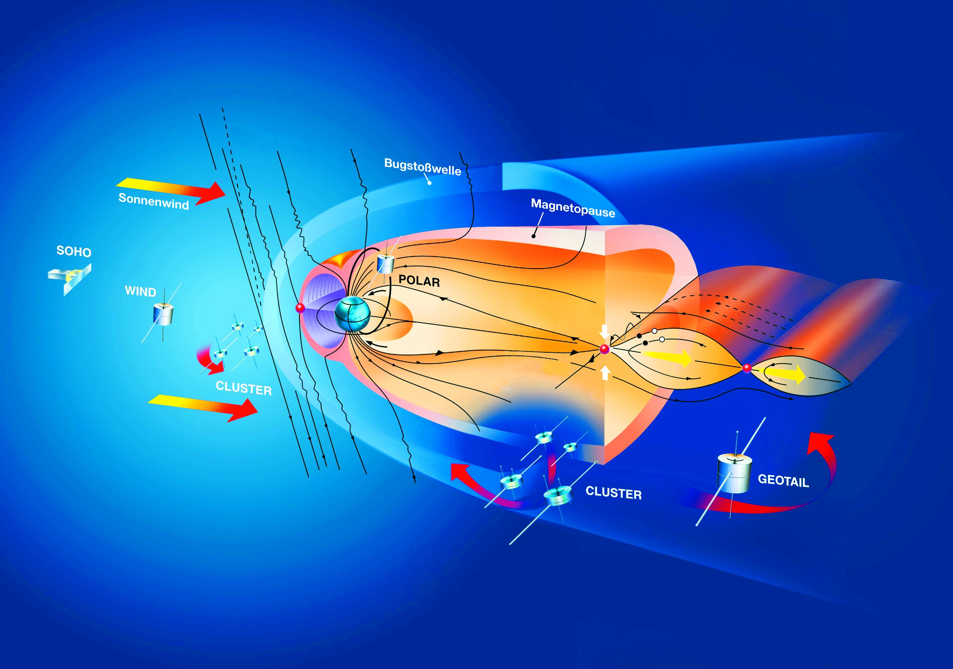
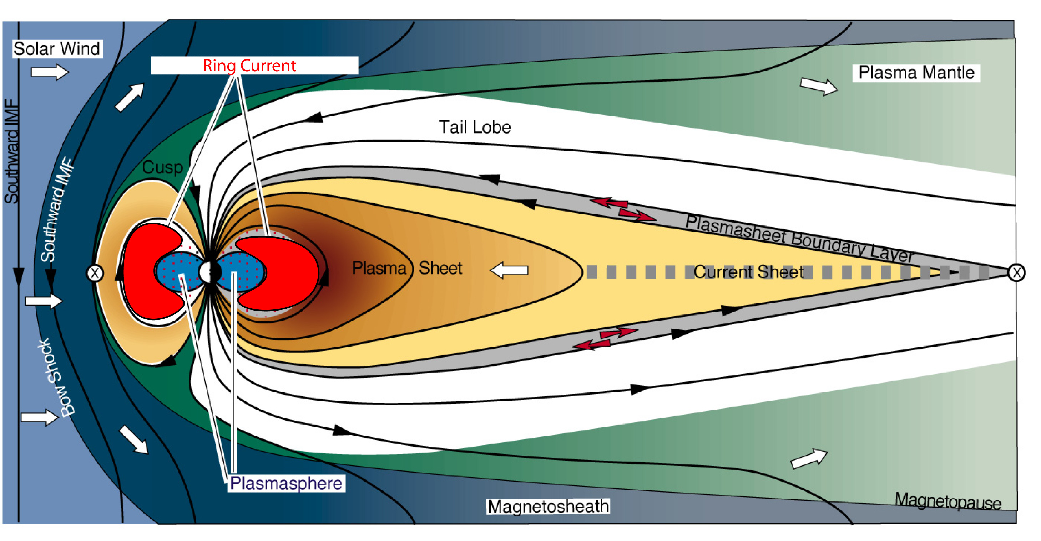
Magnetic field behavior in MHD (cont.)
Magnetic Reynold’s number
If R_{m} is large, convection dominates, magnetic field frozen into the plasma.
Else if R_{m} is small, diffusion dominates.
In astrophysics generally, R_{m} is very large.
  Solar flare: 10⁸,
  planetary magnetosphere: 10¹¹
But, not large everywhere
  Thin boundary layers form where R_{m}~1 and ideal MHD breaks down
Earth’s magetosphere

Slide 27
Magnetic field behavior in MHD (cont.)
Rewrite continuity equation:
  first term describes compression (fluid contracts or expansion)
  Second term describes advection
The induction equation (ideal MHD) can be written as, using standard vector identities:
Equation is similar to continuity equation.
  First term: compression
  Second term: advection
  Third term: new term describes stretching. It is related magnetic field amplification

Slide 28
Flux freezing
Alfven’s theorem (1947): “field is frozen into the fluid”
This is extremely important concept in MHD, since it allows us to study the evolution of the field by finding out about the plasma flow
MHD induction equation:
The magnetic flux though a closed loop l :
Where dS is the area element of any surfaces which has l as a perimeter. The quantity Φ_{B} is independent of the specific surface chosen, as can be proven from .
So the flux freezing law is expressed as:
where use total derivative d/dt to indicate that the time derivative is calculated with respect to fluid elements moving with the flow

Slide 29
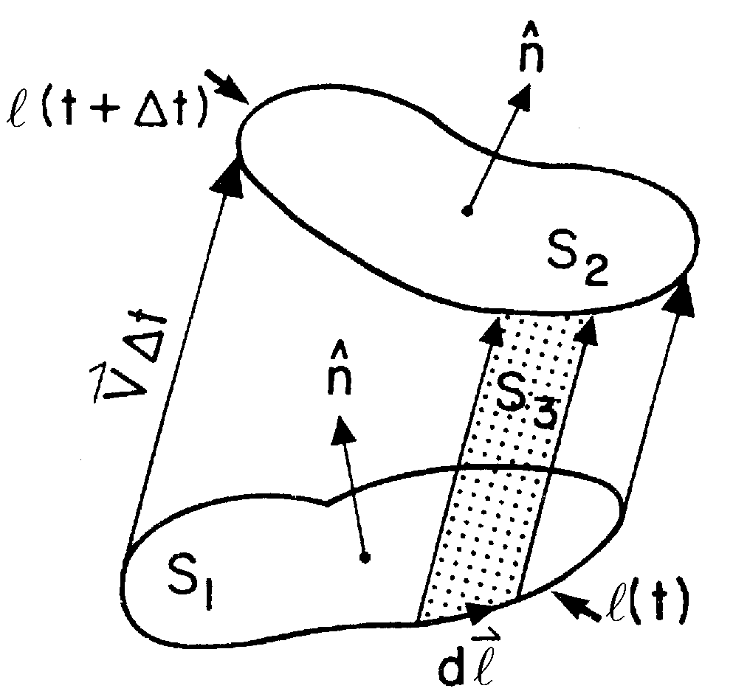
Flux freezing (cont.)
The quantity Φ_{B} is not locally defined.
So explicit calculation for its time derivative
Consider a loop of fluid elements l at two
instants in time, t and t+Δt
Two surfaces S₁ and S₂ have l(t) and l(t+Δt)
“cylinder” S₃ generated by the fluid motion between the two instants of the elements making up l.
Let Φ_{B} be the flux enclosed by l and Φ_{B1} be the flux through surface S₁ (similarity for S₂ and S₃)
Then

Slide 30
Flux freezing (cont.)
From the net flux through the surfaces at any time is zero
(Note that negative sign indicated as inward into the volume)
We can eliminate Φ_{B2}(t+Δt) and use definition of flux in expressing Φ_{B1} & Φ_{B3}
The first term in RHS in eq (4.4):
(4.4)

Slide 31
Flux freezing (cont.)
The area element for S₃ can be written , where dl is a line element of the loop of fluid elements.
The second term in RHS of eq (4.4):
By using Stokes theorem to convert the line integral to a surface integral
So finally putting these results into eq(4.4) :

Slide 32
Magnetic pressure and curvature force
Lorentz force:
First term: magnetic curvature force, which relates to rate of change of B along the direction of B.
Second term: magnetic pressure
To show the role of magnetic curvature force, we consider
,where B is the local intensity of B and is unit vector
The Lorentz force then becomes

Slide 33
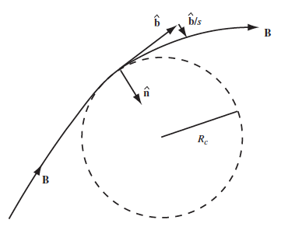
Magnetic pressure and curvature force (cont.)
Combine first two term:
Where is the projection of the gradient operator on a plane perpendicular to B
Second term contains the effects of field line curvature.
Its magnitude is
where is radius of curvature of path
( is the derivative along a field line )
The curvature force is directed toward a center of curvature ( ). It is often referred as hoop stress

Slide 34
Magnetic pressure and curvature force (cont.)
Example of magnetic curvature force
Consider an pure toroidal (azimuthal) magnetic field, in cylindrical coordinates (R, φ, z)
The strength of B is function of R and z only.
The unit vector in toroidal (azimuthal) direction has the property
so that
The curvature force is directed inward, toward the center of curvature.

Slide 35
Magnetic stress tensor
The most useful alternative form of Lorentz force is in terms of magnetic stress tensor
Writing a vector operators in terms of permutation (Levi-Civita) symbol ε, one has
where the summing convention over repeated indices and have been used. Define the magnetic stress tensor M by its components:
The Lorentz force is written as:
Levi-Civita symbol is related to Kronecker delta
(4.5)

Slide 36
Magnetic stress tensor (cont.)
If V is a volume bounded by a closed surface S, eq (4.5) yields by the divergence theorem
Where n is the outward normal to the surface S.
This shows how the net Lorentz force acting on a volume V of fluid can be written as an integral of a magnetic stress vector acting on its surface S
The force F_{S} exerted by the volume on its surroundings
Where is the component of B along the outward normal n to the surface of the volume.

Slide 37
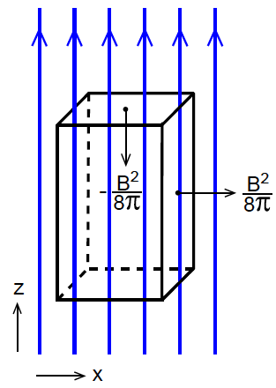
Magnetic stress tensor (cont.)
To get the behavior of magnetic stresses,
consider simple case of a uniform magnetic
field, B=B_{z}
The force F_{S} in right side of the box is
. The components are
The magnetic field exerts a force in the positive x-direction, away from the volume.
The force F_{S} in top of the box is
The magnetic field exerts a force in the negative z-direction, inward to the volume

Slide 38
Magnetic stress tensor (cont.)
The magnetic pressure makes the volume of magnetic field expand in the perpendicular directions, x and y. But in the direction along a magnetic field line the volume would contract.
Along the field lines the magnetic stress thus acts like a negative pressure, as in a stretched elastic wire
This negative stress is referred to as the tension along the magnetic field lines.
The stress tensor plays a role analogous like the gas pressure, but unlike gas pressure is extremely anisotropic.

Slide 39
Momentum equation
From equation of motion and continuity equations
Using definition of magnetic stress tensor, the momentum equation is ( for SI unit)
I is three-dimensional identity tensor
Momentum density
Stress tensor

Slide 40
Conservation form of ideal MHD equations
Mass conservation
Momentum conservation
Energy conservation
Magnetic flux conservation
Ideal equation of state
Neglecting gravity force.
This form is often used in numerical simulation.
( for SI unit)

Slide 41
Poynting flux
From energy conservation equation, energy flux is
This compose hydrodynamic part and magnetic part.
The magnetic part can be transformed:
This is called Poynting flux (Poynting vector), which represents the flow of electromagnetic energy

Slide 42
Entropy conservation equation
The best representation of the conservation form of MHD equation is in terms of the variables, ρ, v, e and B.
A peculiar additional variable is the specific entropy s
For adiabatic process of ideal gas, conservation of entropy is
But this is not in conservation form (but expresses the conservation of specific entropy co-moving with the fluid)
A genuine conservation form is obtained by variable ρ_{m}S, the entropy per unit volume
Entropy conservation equation

Slide 43
Summary
Single fluid approach is called magnetohydrodynamics (MHD).
In the case where the conductivity is very high, the electric field is E= -v x B. It is known as ideal MHD.
In ideal MHD, magnetic field is frozen into the fluid
Lorentz force divides two different forces: magnetic pressure & curvature force
The induction equation in ideal MHD shows evolution of magnetic field. It is including compression, advection and stretching
The induction equation in resistive MHD includes diffusion of magnetic field.
From energy conservation equation, energy flux composes hydrodynamic part and magnetic part. Magnetic part is called Poynting flux.

Slide 44
Hydro vs MHD
MHD equation is shown the coupling of hydrodynamics with magnetic field
MHD equation is recovered hydrodynamic equations when B=0.

Slide 45
Hydro vs MHD (cont.)
Conservation form of hydrodynamic equations

Slide 47
Exercise 2-1
Derivation of conservation form of total energy
From equation of motion:
=>
=>
Using continuity equation
=>
(1)

Slide 48
Exercise 2-1 (cont.)
From pressure equation:
Using ideal EoS and continuity equation,
=>
=>
Using continuity equation,
=>
(2)

Slide 49
Exercise 2-1 (cont.)
From induction equation:
=>
Using D6 =>
Using D1 & D2=>
(3)

Slide 50
Exercise 2-1 (cont.)
(1) + (2) + (3) =0

