Slide 1
Plasma Astrophysics
Chapter 6: Shocks and Discontinuities
Yosuke Mizuno
Institute of Astronomy
National Tsing-Hua University

Slide 2

Formation of shock
When the amplitude is so small that linear theory applies, that a disturbance propagates as a sound wave.
The wave profile maintains a fixed shape, since each part of wave moves with the same speed
But, when the wave have a finite amplitude, so that nonlinear terms becomes important, the crest of the sound wave moves faster than its leading and trailing edge.
This causes a progressive steepening of the front portion of wave as the crest catches up
Ultimately, the gradients of pressure, density, temperature and velocity becomes so large that dissipative processes (viscosity) are no longer negligible
Then a steady wave-shape is attained, called a shock wave, with a balance between the steepening effect of nonlinear convective terms and broadening effect of dissipation.

Slide 3
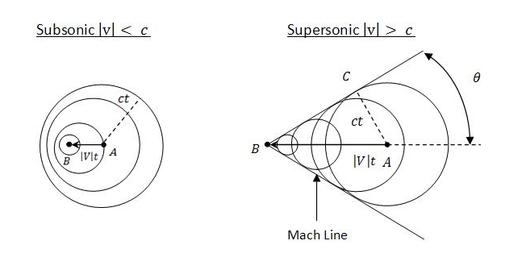
Shock wave
The shock wave moves at a speed in excess of the sound speed
So information cannot be propagated ahead to signal its imminent arrival.
Since such information would travel at only c_{s}, relative to the undisturbed medium ahead of the shock.

Slide 4
Shock wave (cont.)
gas
For example, suppose a long tube contains gas initially at rest and that a piston at one end of tube is accelerated into uniform motion
If the piston is being withdrawn from the tube, an rarefaction (expansion) wave travels into a gas (pressure is decreased)
If the piston is pushed into the tube, a compression wave is generated (pressure is increased) and this eventually steepens into a shock wave.

Slide 5
Shock frame
Models shock front by a plane discontinuity and the two states
subscripts 1 for unshocked gas (ahead of shock, upstream, pre-shock), 2 for shocked gas (behind of shock, downstream, post-shock)
In rest frame, shock speed is u, while speed of shocked gas is u₂ (< u)
More convenient to use a frame of reference moving with shock wave.
So unshocked gas enters the front of shock with speed, v₁=u
While the shocked gas leaves the back of shock with speed, v₂=u-u₂
Since u₂ is positive. So v₂ < v₁
When v₂=v₁, there is no shock
Rest frame
Shocked gas (downstream)
unshocked gas (upstream)
u₂
u
Shock frame
Shocked gas (downstream)
unshocked gas (upstream)
v₂
v₁(=u)

Slide 6
Thickness of shock
A detailed determination of the thickness of the shock and its internal structure is very complicated.
However, if the dominant dissipation mechanism is known, an order-of-magnitude estimate of the shock width (δx) may be obtained.
In the case of viscous dissipation, the amount of energy (δE) dissipated during a small time (δt) is give by
Where ν is the kinetic viscosity
δt ~ δx/v₁ as the time for the shock front to move a distance δx and putting δv ~ v₁-v₂

Slide 7
Thickness of shock (cont.)
For strong shock, , so that
In other words, the Reynolds number ( ) is order of unity.
Reynolds number (Re) = inertial force / viscous force = vL/ν

Slide 8
Hydrodynamic shocks
Consider a plane shock wave propagating
steadily with constant speed into a stationary
gas with density ρ₁ and pressure p₁
In a frame of reference moving with the shock,
the speed of shocked gas, v₂, its density ρ₂ and
pressure p₂
Jump relation (condition) between the shock surface is given us a set of conservation equations
(Q: conserved quantities, F: flux)
If shock is steady ( ) and 1D ( ),
Which is implies that
Shocked gas (2)
unshocked gas (1)
v₂
v₁(=u)
ρ₂, p₂
ρ₁, p₁

Slide 9
Hydrodynamic shocks (cont.)
Conservation form of hydrodynamic equations

Slide 10
Hydrodynamic shocks (cont.)
From conservation of mass, momentum and energy between the shock surface
These equations are referred to as the Rankine-Hugoniot (jump) relations
(6.1)
(6.2)
(6.3)

Slide 11
Hydrodynamic shocks (cont.)
Where (for perfect gas) the internal energy per unit mass is
So eq (6.3) reduces to
Let us define specific volume, V₁=1/ρ₁, V₂=1/ρ₂ and mass flux j=ρ₁v₁=ρ₂v₂. From eq (6.1) & (6.2),
(6.4)

Slide 12
Hydrodynamic shocks (cont.)
In principle this equation allows for two solutions,
  The post-shock medium has a higher pressure than the pre-shock medium (p₂ > p₁),
  The post-shock medium has a lower pressure than the pre-shock medium (p₂ < p₁).
The latter will turn out to be an unphysical solution. But such a solution will quickly smear out into a rarefaction (expansion) wave
We focus here on the case p₂ > p₁ (shock wave case)
Here we define
Where M₁ is shock Mach number, c_{s} is sound speed

Slide 13
Hydrodynamic shocks (cont.)
Eq (6.2) =>
Eq (6.4) (using eq (6.5)) =>
=>
The nontrivial solution can be written
(6.5)
(6.6)

Slide 14
Properties of hydrodynamic shocks
From eq (6.6), when M₁=1, density, pressure and velocity do not make any jump. So the shock is developed when M₁>1
Shock speed (v₁) must exceed the sound speed (c_{s1}) ahead of shock
In the shock frame, flow is supersonic in front of shock but subsonic behind it ( )
Shock must be compressive with
, shock wave slows the gas down but heat it up (convert flow kinetic energy into thermal energy in the process).
In (strong shock),
When γ=5/3 (mono-atomic gas), x=ρ₂ /ρ₁=4. So in strong shock, the density jump at the shock (shock compression ratio) is only 4.

Slide 15
Hydrodynamic discontinuity
Contact discontinuity: v₁=v₂=0, Density jump arbitrary, but other quantities (pressure for hydro) are continuous (temperature is also change)
Rarefaction (expansion) wave: a simple wave or progressive disturbance (not shock). density and pressure decrease on crossing the wave

Slide 16
MHD shock
Consider simple case of a 1D steady shock
We will work in a frame where shock
is stationary (shock fame)
x-axis will be a aligned with the shock
normal, so plane of shock is parallel to yz-plane
The jump across the any quantities of X can
be expressed using following notation:
MHD jump relation is given us a set of
conservation equations
(Q: conserved quantities, F: flux)
If shock is steady ( ) and 1D ( ),
Which is implies that =>
Shock frame
Shocked gas (downstream)
unshocked gas (upstream)
B₂
B₁
ρ₂, p₂
ρ₁, p₁
v₂
v₁

Slide 17
Conservation form of ideal MHD equations
(6.7)
Mass conservation
Momentum conservation
(6.8)
Energy conservation
(6.9)
(6.10)
Magnetic flux conservation
(6.11)
Ideal equation of state

Slide 18
MHD shock jump relation
For MHD, from mass conservation (continuity) equation (eq 6.7),
Which leads jump condition for shock:
From momentum conservation equation (eq 6.8), we consider two jump condition.
Firstly, the conservation of momentum normal to shock surface
Transverse momentum also has to balance,
Where the t subscript indicates transverse component to the shock. This reflects tangential stresses related to bend or kink of B-field

Slide 19
MHD shock jump relation (cont.)
The shock jump condition from energy conservation (eq.6.9) is
From , the normal component of magnetic field is continuous (B_{x}=const)
From magnetic flux conservation (eq 6.11),

Slide 20
MHD Rankine-Hugoniot (jump) relation
(6.12)

Slide 21
Possible type of MHD shock
Shock wave, : Flow crosses surface of discontinuity accompanied by compression and dissipation
Parallel shock |  |  | Magnetic field unchanged by shock (hydrodynamic shock)
Perpendicular shock |  |  | Plasma pressure and field strength increases at shock
Oblique shocks
Fast shock |  | Plasma pressure and field strength increases at shock, magnetic field bend away from normal.
Slow shock |  | Plasma pressure increases and field strength decreases at shock, magnetic field bend towards normal
Intermediate shock |  | Only shock-like in anisotropic plasma (magnetic field rotate of 180^{O} in plane of shock, density jump)

Slide 22
Possible type of MHD discontinuity
Discontinuity
Contact discontinuity |  | Density jump arbitrary, but other quantities are continuous
Tangential discontinuity |  | Plasma pressure and field change maintaining static pressure balance (total pressure is constant)
Rotational discontinuity |  | Form of intermediate shock in isotropic plasma, field and flow change direction but not magnitude

Slide 23
Perpendicular shock
Shock frame
Post-shock (downstream)
Pre-shock (upstream)
Consider perpendicular shock (B_{n}=0).
In this case, the velocities of both the
shock and plasma are perpendicular to
the magnetic field
The jump relation (eq 6.12) is
Here we define
ρ₂, p₂, v₂, B₂
ρ₁, p₁, v₁, B₁
(6.13)
(6.14)
(6.15)
(6.16)

Slide 24
Perpendicular shock (cont.)
From eq (6.14),
From eq (6.15),
Combine both eq (6.14) and eq(6.15)
X=1 does not make a shock (not our solution). So
(6.17)
(6.18)

Slide 25
Perpendicular shock (cont.)
We need to find the positive solution of f(x)
The fact that 1 < γ < 2 implies that this equation have just one positive root (a quadratic function with a single minimum)
The solution reduces to the hydrodynamic value (eq 6.6) in the limit of large β₁
The effect of magnetic field is to reduce X below its hydrodynamic value, since the flow kinetic energy can be converted into magnetic energy as well as heat
If X=1, f(1) < 0 => When X >1, we get a solution of f(X) = 0

Slide 26
Perpendicular shock (cont.)
In terms of sound and Alfven speeds,
The shock speed (v₁) must exceed the fast magnetosonic speed
ahead of the shock
Strong shock limit (M₁ >> 1),
For γ=5/3 case,

Slide 27
Oblique shock
In this case, the magnetic field contains
components both parallel and normal to
the shock front
Assume the velocity and magnetic field
vectors lie in the xy plane.
Shock frame
Shocked gas (downstream)
unshocked gas (upstream)
B₂
θ
ρ₂, p₂
ρ₁, p₁
B₁
v₂
v₁

Slide 28
Oblique shock (cont.)
The jump relation (from eq 6.12) is
(6.17)
(6.18)
(6.19)
(6.20)
(6.21)
(6.22)

Slide 29
Oblique shock (cont.)
An analysis of the jump relations can be considerably simplified by choosing axis moving along the y-axis parallel to the shock front at such a speed that
In this frame of reference both side of eq (6.22) vanish, and plasma velocity becomes parallel to the magnetic field on both side of the shock front (v || B) (v x B =0).
Using eq (6.17), (6.21), (6.23), we define as
(6.23)
(6.24)

Slide 30
Oblique shock (cont.)
From eq (6.19) and (6.23),
Here we consider the frame which plasma velocity becomes parallel to the magnetic field. So
From eq (6.24) and (6.25),
From eq (6.20), (6.23) and (6.24),
(6.25)
(6.26)
(6.27)

Slide 31
Oblique shock (cont.)
Using eq (6.24) and (6.26),
Where θ is inclination of upstream magnetic field to the shock normal such that v_{1x} = v₁ cosθ
Based on eq (6.27), we can drive the equation related X (need long calculation)
(6.28)

Slide 32
Oblique shock (cont.)
B₂
B₁
B₂
B₁
B₂
B₁
Slow shock
Intermediate shock
fast shock
Three solutions of eq (6.28), slow shock, intermediate (Alfven) shock and fast shock
In the limit as X => 1 (no compression), reduce to three waves
  for Alfven wave
  for the propagation speeds of slow and fast magnetosonic waves

Slide 33
Slow and Fast shocks
Consider first, the slow and fast shocks.
They are compressive, with X > 1, which implies that p₂ > p₁
From X >1,
When , this equation implies that B_{2y}/B_{1y} < 1, called a slow shock.
Magnetic field is refracted towards the shock normal and its strength decreases as the shock front passes by
When , this equation implies that B_{2y}/B_{1y} > 1, called a fast shock.
Magnetic field is refracted away from the shock normal and its strength increases as the shock front passes by

Slide 34
Slow and Fast shocks (cont.)
Evolutionary condition: shock speed (v_{1x}) relative to unshocked plasma must exceed the characteristic wave speed (slow magnetosonic wave speed in the case of slow shock, fast magnetosonic wave speed in the case of fast shock)
The effect of shock is to slow down the flow in x-direction (v_{2x} < v_{1x})
The flow in y-direction is slowed down for a slow shock (v_{2y} < v_{1y})
but speeded up for a fast shock (v_{2y} > v_{1y})
In the limit B_{x} => 0, field becomes purely tangential, fast shock becomes a perpendicular shock.
Slow shock reduces to a tangential discontinuity, for which both flow velocity and B-field are tangential to plane of discontinuity since v_{1x}=v_{2x}=B_{1x}=B_{2x}=0.

Slide 35
Slow and Fast shocks (cont.)
The tangential discontinuity (v_{1x}=v_{2x}=B_{1x}=B_{2x}=0) is a boundary between two distinct plasmas, at which the jumps in the tangential components of velocity (v_{y}) and B-field (B_{y}) are arbitrary.
Subject only to the condition,
That total pressure is continuous
Consider the case:
Magnetic field lines cross the boundary but there is no flow across it
One trivial solution: velocity, magnetic field and pressure is continuous but density (temperature) may be discontinuous (p₂=p₁).
This is known as a contact (entropy) discontinuity

Slide 36
Switch-off shock
θ
Two special cases of slow and fast shocks
are of particular interest, so-called
switch-off shock and switch-on shock.
They occur in the limit when v₁=v_{A1} and
From eq (6.25),
Even B_{1y} is non-zero, The tangential magnetic field component behind the shock (B_{2y}) can be vanished (slow shock).
Such the case, we called switch-off shock
Since v₁ and B₁ are parallel, a switch-off shock propagates at a Alfven speed based on the normal B-field component
B₂
B₁
Switch-off shock

Slide 37
Switch-off shock (cont.)
Using v₁=v_{A1} and , eq (6.28) reduces to
Where
The solution f(X) = 0 is
When θ => 0,
When θ => π/2,
(6.29)
(6.30)

Slide 38
Switch-off shock (cont.)
The behavior of solution is different with the value of A > 1,
or 0 < A < 1 ( )
When A > 1, one of the solution for θ=0 case is reduced as
It is not appropriate solution for shock (because X < 1).
So A > 1 case, the solution for X increases as the angle of incidence θ increase
When 1/2 < A < 1, the solution for X increases
as
When 0 < A < 1/2, the solution for X decreases
as

Slide 39
Switch-on shock
Consider a shock propagating along the magnetic field
(so that B_{1y} =0, θ=0)
The eq (6.28) reduces to
corresponding to a switch-on shock
Since X > 1, this occur only when the shock speed exceeds the Alfven speed (v₁ > v_{A1})
B₂
B₁
(6.31)
Switch-on shock
Hydrodynamic shock
fast shock

Slide 40
Switch-on shock (cont.)
A shock propagating along magnetic field. So from eq (6.21),
B_{2x}=B₁=B_{1x} (B_{1y}=0)
Elimination of p₂ from eq(6.18) and (6.20) yields,
Since the right-hand side must be positive, the density ratio X is
The upper limit is (γ+1)/(γ-1) when v_{A1} >> c_{s1}
The switch-on shock can exist only when the Alfven speed exceeds the sound speed in the unshocked plasma

Slide 41
Switch-on shock (cont.)
As X increases from 1, the deflection of field line ( )
increases from 0 to a maximum value of
at
Then it decreases to 0 at

Slide 42
Intermediate shock
When the wave-front propagates at the Alfven speed in the unshocked plasma, v₁=v_{A1}, one solution of eq (6.28) is X=1 (another solution is fast & slow shocks).
From eq (6.22) and (6.23),
From eq (6.18) and (6.20),
Thus, in addition to the trivial solution B₂=B₁, we have
for an intermediate (or transverse) wave (or rotational discontinuity for no density change)

Slide 43
Intermediate shock (cont.)
The tangential magnetic field component is reversed by the wave, and within the wave front magnetic field simply rotates out of the plane maintaining a constant magnitude
This is just a finite-amplitude Alfven wave
No change in pressure => not shock

Slide 44
Summery
Shock wave, : Flow crosses surface of discontinuity accompanied by compression and dissipation
Parallel shock |  |  | Magnetic field unchanged by shock (hydrodynamic shock)
Perpendicular shock |  |  | Plasma pressure and field strength increases at shock
Oblique shocks
Fast shock |  | Plasma pressure and field strength increases at shock, magnetic field bend away from normal.
Slow shock |  | Plasma pressure increases and field strength decreases at shock, magnetic field bend towards normal
Intermediate shock |  | Only shock-like in anisotropic plasma (magnetic field rotate of 180^{O} in plane of shock, density jump)

Slide 45
Summary (cont.)
Discontinuity
Contact discontinuity |  | Density jump arbitrary, but other quantities are continuous
Tangential discontinuity |  | Plasma pressure and field change maintaining static pressure balance (total pressure is constant)
Rotational discontinuity |  | Form of intermediate shock in isotropic plasma, field and flow change direction but not magnitude

Slide 46
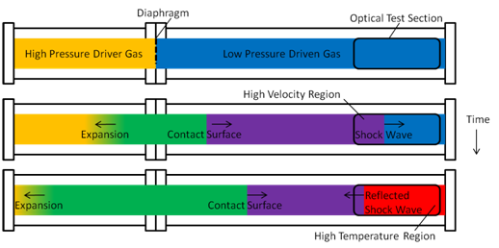
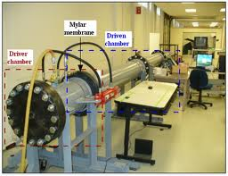
Shock tube problem
A common test for the accuracy of computational (magneto-)fluid code and laboratory experiments
The test consist separated two different states of gas initially
In time evolution, two different states make propagations of shocks or discontinuities
We can calculate analytical solutions therefore can test the validity of numerical codes.

Slide 47
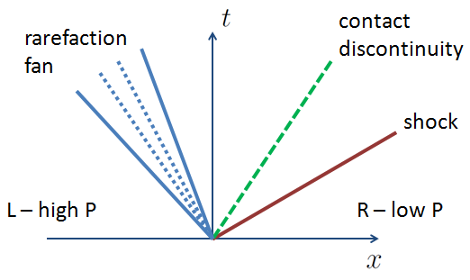
Shock tube problem (cont.)
Sod’s shock tube test (the most famous test)
Initial condition
  ρ_{L}=1, p_{L}=1, v_{L}=0
  ρ_{R}=0.125, p_{R}=0.1, v_{R}=0, with γ=1.4
Results
  Three Characteristic velocities
  v \pm c_{s} (shock/rafefaction to
  right/left)
  v (entropy waves)

Slide 48
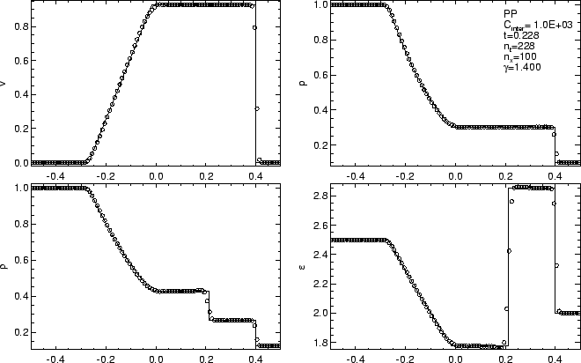
Shock tube problem (cont.)
Left-going
Raferaction wave
velocity
pressure
right-going
shock
right-going
Contact discontinuity
density
energy
Movie

Slide 49
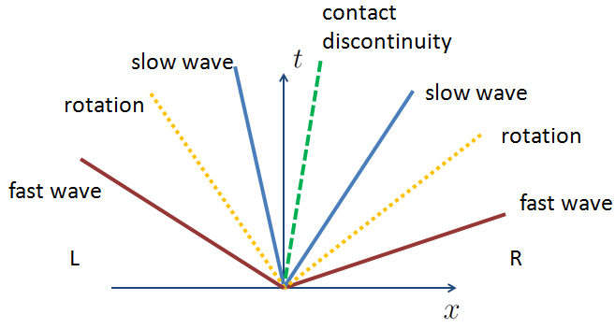
MHD shock tube problem
Brio & Wu MHD shock tube test (1D)
Presence of magnetic field, shock structure becomes much complicated
Initial condition
  ρ_{L}=1, p_{L}=1, v_{L}=0, B_{yL}=-1, B_{zL}=0
  ρ_{R}=0.125, p_{R}=0.1, v_{R}=0, B_{yR}=1, B_{zR}=0 with B_{x}=0.75 and γ=2
Results
  7 characteristic velocities
  v \pm v_{f} (fast shock/rarefaction)
  v \pm v_{A} (rot discont.)
  v \pm c_{s} (slow shock/rarefaction)
  v (entropy wave)
(Alfven)
(Alfven)

Slide 50
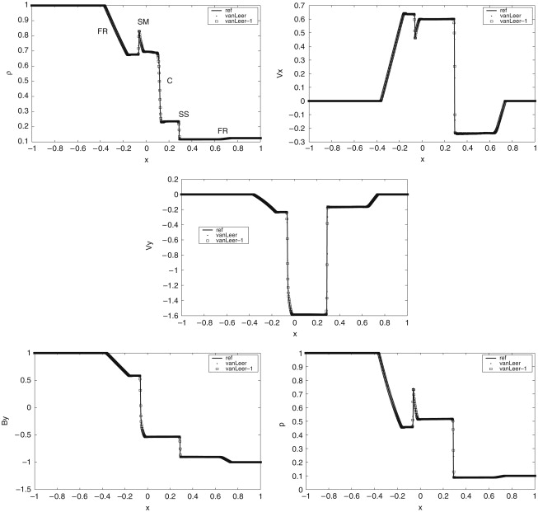
SR
density
v_{x}
IS
Regular solution: SS
Non-regular solution: IS + SR
(Takahashi & Yamada 2013)
v_{y}
movie
pressure
B_{y}

Slide 51
Astrophysical shocks
Shock waves are common in astrophysical environments
  Bow (termination shock) shock of solar system (interaction between solar wind and interstellar medium)
  Supernova remnants (blast wave)
  Shock traveling through a massive star as it explodes in core collapse supernova
  Shock in insterstellar medium, caused by the collision between molecular clouds or by a gravitational collapse of clouds
  Accretion shock in cluster of galaxies
  Gamma-ray bursts (relativistic blast wave)
  Shocks in astronomical jets
  Termination shock in pulsar wind nebulae
Shock is related particle accelerations (Fermi acceleration)

