Slide 1
Plasma Astrophysics
Chapter 7-2: Instabilities II
Yosuke Mizuno
Institute of Astronomy
National Tsing-Hua University

Slide 2
Table of contents
(last week)
What is the instability? (How to analyze the instability)
Rayleigh-Taylor instability
Kelvin-Helmholtz instability
(today)
Parker instability
Magneto-rotational instability
Jeans instability
Current-driven instability

Slide 3
Magnetic buoyancy
Convective motion in fluid is driven by thermal buoyancy
In compressible plasma, we have another important buoyancy, i.e., magnetic buoyancy
Consider isolated flux tube (density ρ_{i}, gas pressure p_{i} and magnetic pressure p_{m}) embedded in nonmagnetized plasma (density ρ_{e}, gas pressure p_{e} ) under uniform gravity g
Assume: isothermal, i.e., the temperature T_{i} = T_{e}= T
Assume: tube is thin, i.e., the radius of flux tube is much smaller than local pressure scale height

Slide 4
Magnetic buoyancy (cont.)
Equilibrium configuration of magnetic flux tube is determined by the balance of total pressure
Then, from EoS of p = ρRT, the density inside the tube (ρ_{i}) becomes smaller than the density outside the tube (ρ_{e})
Therefore
Hence the tube suffers the buoyancy force
This is called magnetic buoyancy
This is fundamental force to raise the flux tube to the surface of the Sun, stars and accretion disk (galactic gas disk)

Slide 5
Magnetic buoyancy (cont.)
A horizontal isothermal, isolated flux tube cannot be in equilibrium.
On the other hand, a 2D isothermal flux sheet can be in equilibrium
Even in this case, the sheet often becomes unstable because of magnetic buoyancy
There are two kinds of magnetic buoyancy instability
Interchange mode :
  Necessary condition:
  wavelength: arbitrary λ
  Flute instability, magnetic RT instability (Kruskal-Schwarzschild instability)
Undular mode:
  Necessary condition:
  Wavelength: λ > λ_{c} ~ 10H
  Ballooning instability, Parker instability

Slide 6
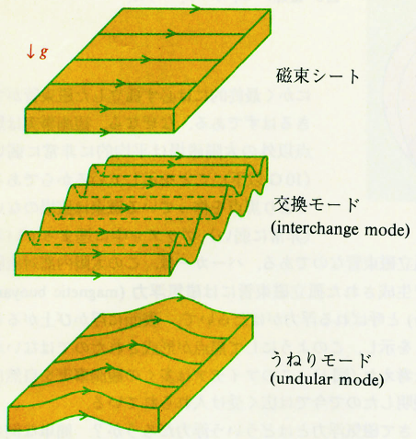
Magnetic buoyancy (cont.)
flux sheet
Interchange mode
k \perp B
Undular mode
k || B

Slide 7
Parker instability
Parker (1966) emphasized an importance of magnetic buoyancy instability (undular mode) in the Galactic disk (including cosmic-ray pressure effect) and explain the formation of interstellar cloud complexes.
Hence, in astrophysics, magnetic buoyancy instability (undular mode) is usually called Parker instability

Slide 8
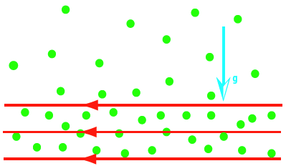
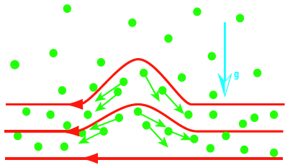
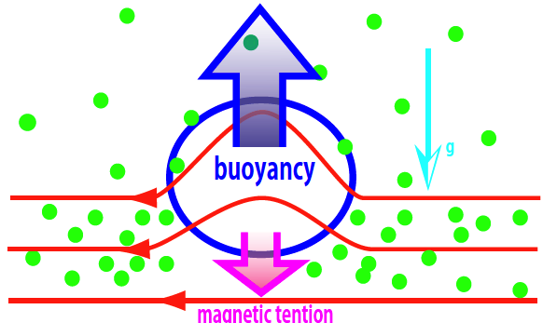
Parker instability (cont.)
g
B
Magnetic field lift-up from equilibrium state
Plasma falls down along bending magnetic field lines
Top region becomes more lighter. Then buoyancy force is working more (magnetic field lift-up more)
= growth of instability

Slide 9
Parker instability (cont.)
Here, drive instability condition
Consider : a horizontal flux sheet in magneto-static equilibrium with gravity ( and )
Assume: isothermal and plasma beta β= 2μ₀p /B² = constant
From isothermal condition (assume γ=1),

Slide 10
Parker instability (cont.)
From pressure balance (to gravity) in z-direction,
When there is no magnetic field (β=0),
: hydrostatic equilibrium
where H is scale height:
When the magnetic field is exist,
Where
In the magnetic field supported disk, the plasma is located higher region than hydrostatic disk case.

Slide 11
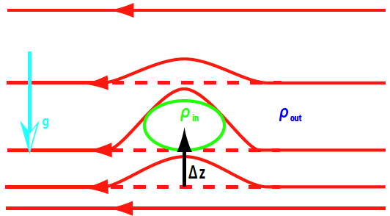
Parker instability (cont.)
g
From equilibrium state, magnetic field lifts up Δz (<< 1).
Plasma lift-up time-scale is much longer than sound crossing time scale. So maintains pressure balance everywhere.
After lift-up, plasma inside the bent magnetic field can move along field lines. Therefore magnetic pressure inside bent magnetic field does not change.

Slide 12
Parker instability (cont.)
Calculate density variance between the inside and outside of the bent magnetic field
It shows that inside the bent magnetic field becomes lighter
Plasma inside the bent magnetic field has buoyancy force (+z direction)
On the other hand, due to bent magnetic field, there is magnetic tension force in –z direction
(7.43)

Slide 13
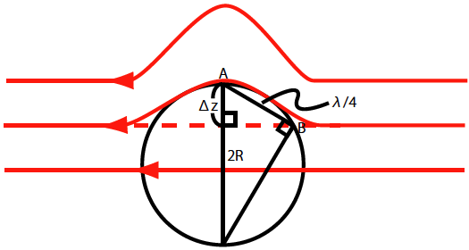
Parker instability (cont.)
Here curvature radius is R, the magnetic tension is estimated as
Consider triangle in the circle R, the relation between R and Δz is
Here λ is perturbed wavelength (distance AB ~ λ/4)
(7.44)
(7.45)

Slide 14
Parker instability (cont.)
If F_{buoyancy} > F_{tension}, plasma inside the bent magnetic field continuously lift-up. It means that it is unstable
From eq (7.43), (7.44), (7.45), critical wavelength is
Therefore if the magnetic field is perturbed the wavelength enough longer than scale-height, the buoyancy overcomes magnetic tension and gravity then inside plasma continuously lift-up (unstable).
This is so-called Parker instability
Growth rate is roughly estimated by

Slide 15
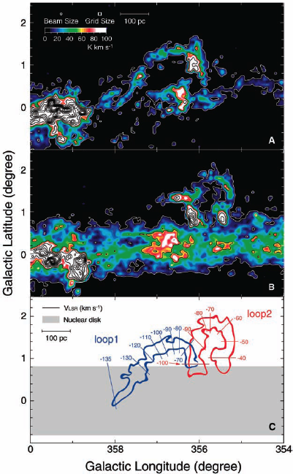
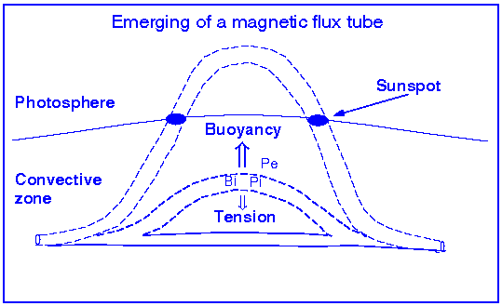
Parker instability (cont.)
Molecular Loops in the Galactic Center (radio CO obs)
Movie here
Solar coronal loop （Three year obs., by SDO）

Slide 16
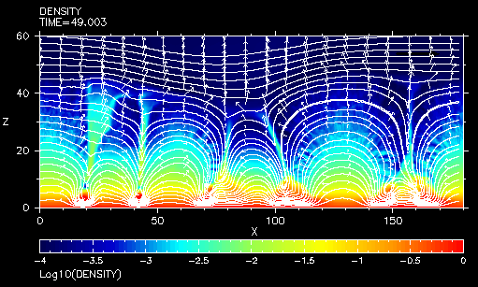
Parker instability (cont.)
Movie
2D MHD simulations of Parker Instability

Slide 17
Magneto-rotational instability
Important for angular momentum transport in accretion disk
In the standard theory of accretion disks (Shakura & Sunyaev 1973), the α-prescription of viscosity is adopted for radial angular momentum transport
What phenomenological viscosity parameter α?
From observation of dwarf novae, α=0.02 (quiescent) - 0.1 (bursting phase)
Molecular viscosity: NO (too small)
Hydrodynamic shear flow instability makes convective turbulence in accretion disk (turbulent viscosity).
  But in geometrically thin Keplerian disk, α=O(10⁻³)
In MHD model: magnetic stress enhanced turbulent viscosity incurred by fluctuating magnetic field <= generated by Magnetorotational instability (MRI) (Balbus & Hawley 1991)

Slide 18
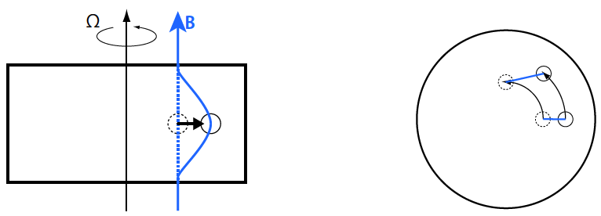
Magneto-rotational instability (cont.)
Side view
top view
r
r +Δr
Understanding of MRI through Lagrangian point of view
Consider differentially rotating plasma disk with vertical magnetic field (penetrate disk) in some gravitational field (stationary)
Put small radial perturbation in rotating plasma at radius r from rotation axis (angular momentum is conserved) and moves to r+Δr
The angular velocity in r+Δr is slower than that in r. Thus magnetic field is deformed more and magnetic tension is happened.

Slide 19
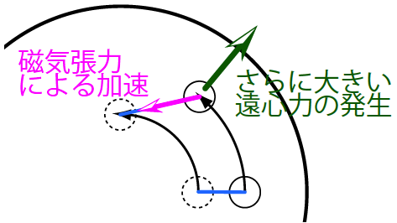
Magneto-rotational instability (cont.)
acceleration
Magnetic tension
Stronger centrifugal force
Due to the magnetic tension, plasma is accelerated to rotational direction.
The plasma in r+Δr tries to rotate with angular velocity at r.
This faster angular velocity makes stronger centrifugal force which is larger than gravitational force.
Then the plasma is push outward more. Again magnetic field is stretched more and make larger magnetic tension.
This process is so-called Magneto-rotational instability (MRI).

Slide 20
Magneto-rotational instability (cont.)
Rough estimate the instability condition
Assume Keplerian rotating plasma disk with vertical magnetic field (penetrate disk) in some gravitational field (stationary)
Put small radial perturbation in rotating plasma at radius r from rotation axis (angular momentum is conserved) and moves to r+Δr
Consider radial force balance at r+Δr
  Gravity:
  Centrifugal force:
Where, the effect of acceleration by magnetic tension in rotational direction is included in centrifugal force

Slide 21
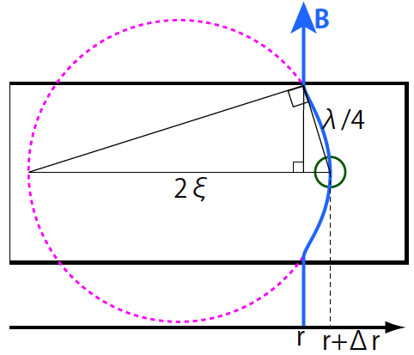
Magneto-rotational instability (cont.)
From Keplerian rotation,
Radial force including gravity
and centrifugal force is
Next calculate radial force by magnetic tension.
As shown in figure, the deformation of magnetic field is approximate as a circle with radius ξ
Magnetic tension is

Slide 22
Magneto-rotational instability (cont.)
From similarity relation
Using this value, magnetic tension is
The system is unstable when
(gravity + centrifugal force) > (magnetic tension in radial direction)
Therefore, the condition for growing instability is
=>

Slide 23
Magneto-rotational instability (cont.)
From instability condition, the instability occurs longer than the critical wavelength.
This feature is similar to that of Parker instability, i.e., stabilized by magnetic tension force.
If magnetic field is strong, this instability is stabilized because the critical wavelength λ_{c} exceeds the disk thickness H.
In this case, the critical field strength for stability is
For growth of MRI, weak magnetic field in the accretion disk is important

Slide 24
Magneto-rotational instability (cont.)
Next, we derive dispersion relation of MRI,
Linearized equations

Slide 25
Magneto-rotational instability (cont.)
Consider the frame of rotating around z-axis with angular velocity Ω(r) in cylindrical coordinates (r, φ, z) i.e.,
In equilibrium state, gravity and centrifugal force is balanced
Uniform magnetic field,
Perturbation: , wavenumber
In detail of calculation, need to use from local analysis
After some manipulations, we get following dispersion relation (for simply use B_{0φ}=0),

Slide 26
Magneto-rotational instability (cont.)
Rigid rotation case
  From , the dispersion relation is
  There is no solution with ω² < 0, therefore rigid rotation disk is stable against MRI
Keplerian rotation case
  From this, the dispersion relation is
  When , ω²< 0. Therefore Keplerian disk is unstable against MRI. And maximum growth rate is

Slide 27
Magneto-rotational instability (cont.)
In Keplerian disk, growth rate is comparable with Ω, i.e., this instability is fairly fast instability occurring at the rotation time scale of disk
This instability occurs even if the magnetic field is very weak
People often neglected the effect of magnetic field in accretion disk simply because magnetic field is very weak in the disk
But from properties of MRI, we cannot neglect magnetic field any more.

Slide 28
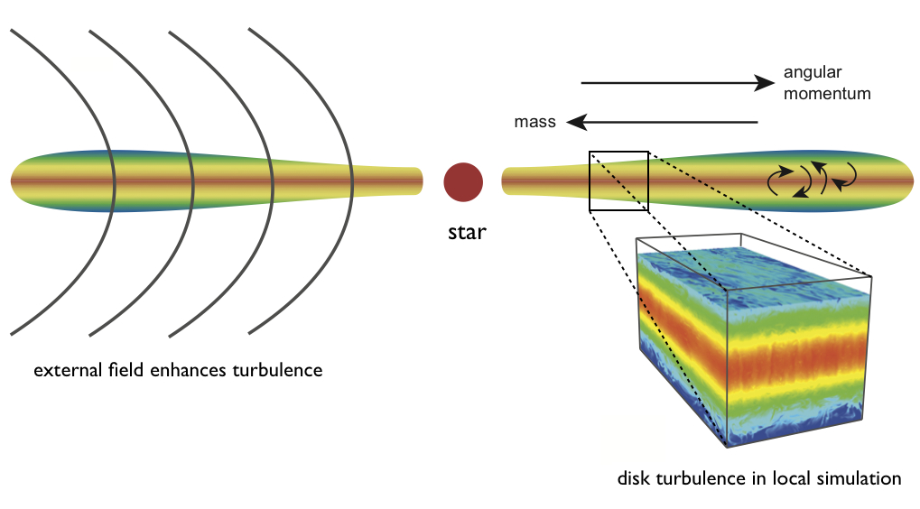
Magneto-rotational instability (cont.)
3D MHD in global accretion disk
3D MHD Simulation in local shearing box
Movie here
Movie here
Movie here

Slide 29
Jeans instability
In many astrophysical phenomena, gravitational field plays an important role.
In particular, self-gravity and the associated instability are essential when we consider the formation of various objects (e.g., stars, galaxies, and the clusters of galaxies) due to density fluctuations
Consider an infinite homogeneous medium at rest
ρ =ρ₀=uniform, p=p₀=uniform, v=v₀=0, Φ=Φ₀
Here we consider self-gravity of medium but neglect magnetic field and assume adiabatic, p=Kρ^{γ}

Slide 30
Jeans instability (cont.)
Linearized equations
From these equations, we obtain
If G=0, this equation expresses the propagation of sound wave in a homogeneous medium.
In other word, this equation shows that how the propagation of sound wave is modified in self-gravity field

Slide 31
Jeans instability (cont.)
If we consider a plane wave and put
we obtain the dispersion relation
ω² becomes negative when
where λ_{J} is so-called Jeans wavelength (radius).
In the perturbation with longer wavelength, attracting force from self-gravity overcomes increase of gas pressure then gravitational collapse is occurred (unstable)
This is so-called Jeans instability.

Slide 32
Jeans instability (cont.)
Compute the mass contained within the Jeans radius (consider as a sphere)
Here M_{J} is so-called Jeans Mass. From this instability, the object with M > M_{J} is formed.
Jeans mass is small if temperature is low and density is high.
Therefore because of the density increase by the cloud contracts, the Jeans wavelength becomes shorter and shorter.
It means that the Jeans instability is takes place at smaller and smaller scales as the cloud contracts, leading to a fragmentation into many small pieces.

Slide 33
Jeans instability (cont.)
In this lecture, we consider the simple model, an infinite homogeneous medium at rest
If we consider the rotating disk, the Coriolis force is protected to contraction of gas => instability condition is changing (Toomre 1964)

Slide 34
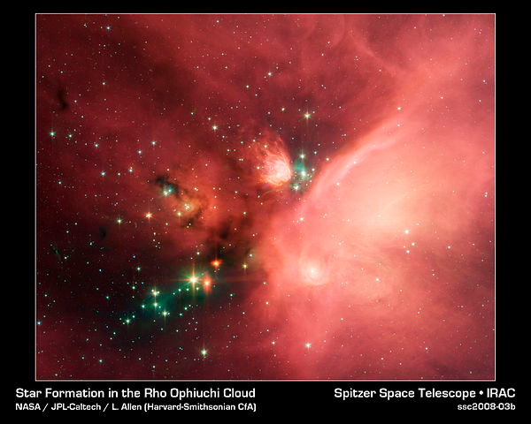
Jeans instability (cont.)
Movie here
Star formation in molecular cloud
3D SPH simulations of star formation from gas cloud

Slide 35
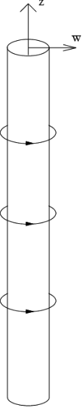
Current driven (kink) instability
J
r
A linear pinched discharge in the laboratory is a cylindrical plasma column (radius a) that is confined (or pinched) by toroidal magnetic field due to current ( ) flowing along its surface or through its interior
This configuration is similar to magnetic flux tubes present in the solar atmosphere and astrophysical jets formed from compact rotator.
So summaries its stability properties here
B_{φ}
a

Slide 36

Current driven (kink) instability (cont.)
The radially inwards J x B force (magnetic pressure B²/2μ₀ and magnetic tension B²/2μ₀r) is balanced by outwards pressure gradient.
When plasma (at pressure p₀ & density ρ₀) contains no magnetic field (interior), the pinch is unstable to the interchange mode (k \perp B), since the confining field is concave to plasma
The place where it pinched, toroidal field is increases and radius is deceases. Therefore magnetic pressure and tension increase => inward force is no longer balances with gas pressure => perturbation grows
The place where it bulges out, toroidal field is decreases and radius is increases. Therefore magnetic pressure and tension decrease => perturbation grows
B_{φ}

Slide 37
Current driven (kink) instability (cont.)
This instability is so-called sausage instability (m=0 mode of current-driven instability, sausage mode).
This instability is unstable in all wavelength (for cylindrical plasma column with toroidal field)
The growth rate of this instability with the wavenumber
The cylindrical plasma column can be stabilized against the sausage mode by the presence of a large enough axial field (B_{0z})
The value of toroidal field at the interface is B_{φ}, the force balance on the interface gives

Slide 38
Current driven (kink) instability (cont.)
The effect of Alfven wave propagating along the axis with speed
is to modify the dispersion relation to
This force balance gives stability (ω² > 0) when

Slide 39
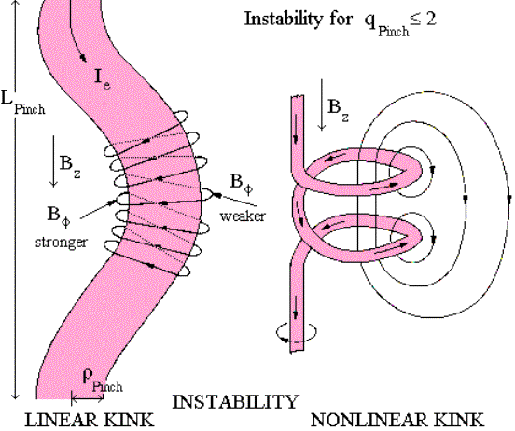
Current driven (kink) instability (cont.)
Consider the perturbation of kink to cylindrical plasma column
Inside kinked plasma column, magnetic pressure becomes strong, while outside of the kinked plasma column, magnetic pressure becomes weak => perturbation grows (unstable).
This instability is so-called kink instability (m=1 mode of current-driven instability, sausage mode)
The axial field in cylindrical plasma column also affects the stabilize of this instability (kink-mode)
a

Slide 40
Current driven (kink) instability (cont.)
The condition of stability for kink mode is
If the perturbed wavelength is long enough, the plasma column with helical magnetic field is unstable against kink instability.
Kruskal-Shafranov criterion

Slide 41
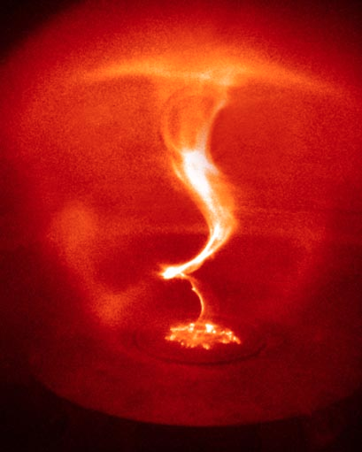
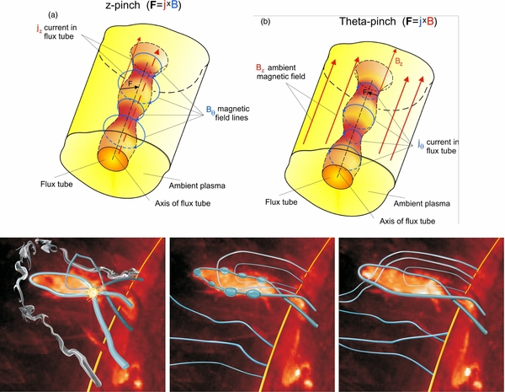
Current driven (kink) instability (cont.)
Kink instability in laboratory experiment
Sausage pinch instability in solar corona (Obs by SDO)
MHD simulation of kink instability
Movie here

Slide 42
Summary
There are many potentially growing instabilities in the universe.
These instabilities are strongly related the dynamics in the universe.
Important:
  what system is stable/unstable against instabilities (condition for stable/unstable of instability)
  What is the time scale of growing instabilities (growth rate). Does it affects the dynamics of system?
Here not covered…but may be important
  Thermal instability, radiation (pressure)-driven instability, Richitmeyer-Meshkov instability, Corrugation instability, Tearing instability …

